Slide 1
MOTORSPORT SOUTH AFRICA
COMPANY INFORMATION AND STRUCTURES

Slide 2
ORGANISATIONAL STRUCTURE – MSA AUTHORITY
FIM
FEDERATION INTERNATIONALE DE MOTOCYCLISME
WADA
WORLD ANTI DOPING AGENCY
FIA
FEDERATION INTERNATIONALE
DE I’ AUTOMOBILE
SPORT AND RECREATION SOUTH AFRICA (SRSA)
SOUTH AFRICAN INSTITUTE FOR DRUG FREE SPORT (SAIDS)
SOUTH AFRICAN SPORTS CONFEDERATION AND OLYMPIC COMMITTEE (SASCOC)
MOTORSPORT SOUTH AFRICA

Slide 3
MSA STRUCTURE
NATIONAL COURT OF APPEAL (NCA)
BOARD OF DIRECTORS
CHIEF EXECUTIVE OFFICER
MANAGEMENT COMMITTEE (MANCOM)
COMMISSIONS/PANELS
WORKING GROUPS/STEERING COMMITTEES
REGIONAL COMMITTEES
MSA MEMBERS
COMPETITORS

Slide 4
MSA INTERNAL STRUCTURES
BOARD OF DIRECTORS
CHIEF EXECUTIVE OFFICER
MANAGEMENT COMMITTEE
SPORTING SERVICES MANAGER
OPERATIONS MANAGER
Public Relations and Communications Coordinator
Medical and Insurance Coordinator
Customer Services
Regional Secretary
Sport Coordinators
Senior Sporting & Operations
Co Ordinator
Accountant

Slide 5
MSA FUNCTIONS
Formulates, Compiles / Distributes:
Sporting Policy
Technical Rules and Regulations
Annual Motorsport Calendar
National and Regional Championships Scoring
Issues / Publishes:
Competitor Licences
Official Licences
National and Regional Circulars
Quarterly Bulletins
Media Releases
Court Findings
Informative and updated website
Ensures:
Conformity of South African motorsport regulations with FIA, CIK and FIM International Sporting Codes
Conformity and compliance with WADA Anti-Doping Regulations
Compliance with Ministry of Sport and SASCOC laws, statutes and requirements
Qualification of licensed officials
Safety of competitors, officials and spectators at all events
Attendance of qualified medical personnel at events
Transparent and clean administration of the sport and all financial matters
Transformation within motorsport – both from a competitor as well as official/administration viewpoint
Awareness and protection of environment
Negotiates and Arranges:
Competitor and Official Insurance at unbeatable premiums for best cover
Public Liability Insurance (claims by third parties)
Democratic and fair Courts to deal with Protests, Appeals and Enquiries to ensure effective, fair and equal treatment for all competitors, officials, organisers and sponsors
The awarding of National Colours to all competitors who meet the requirements of Sport & Recreation S.A. and SASCOC
Controls:
Commercial Rights for all categories of motorsport
Awarding of South African and Regional Championship titles
Promotes:
The interests of South African motorsport
Equality in motorsport
Implements:
Special projects whenever deemed necessary
Development programmes on behalf of Sport & Recreation and National Lottery Board

Slide 6
MSA COMMISSIONS AND WORKING GROUPS
Commissions represent associations, clubs and competitors regarding the sporting affairs of the various categories:
SPORTING COMMISSIONS:
Car Circuit Racing Commission
Circuit Motorcycle Commission
Historic Commission
Karting Commission
Motocross Commission
Cross Country Commission (Bikes & Cars)
Drag Racing Commission
Oval Commission
Spinning & Drifting Commission
SPECIALIST PANELS:
Environmental Panel
Medical Panel
Women in Motorsport Panel
STEERING COMMITTEE:
Enduro Steering Committee
4 X 4 XTrack Committee
Rally Steering Committee
Shelby Can Am Steering Committee

Slide 7
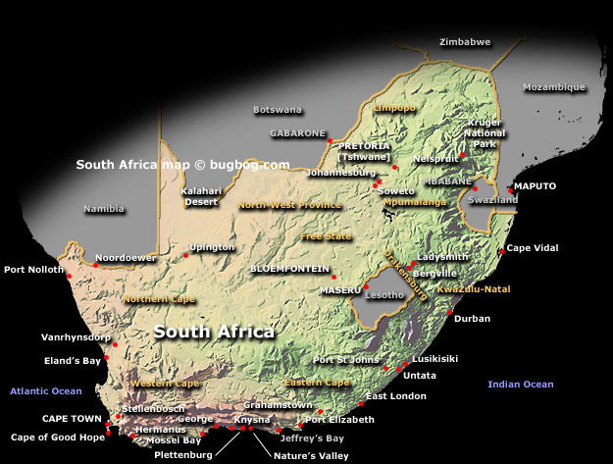
MSA REGIONAL MOTORSPORT COMMITTEES
6 Regional Committees ensure the efficient administration of motorsport at regional level
Border Regional Motorsport Committee
Eastern Province Regional Motorsport Committee
Free State/Northern Cape Regional Motorsport Committee
Kwazulu Natal Regional Motorsport Committee
Northern Regions Regional Motorsport Committee
Western Cape Regional Motorsport Committee

Slide 8
MSA SWOT ANALYSIS
Strengths:
Sound Structure
International and Local stakeholder recognition of MSA
Democratic Election Process
Financially sound
Commercial Rights holder
Excellent relationship with all International Governing Bodies
Compliance with International Sporting Regulations
All seasons sport
Caters for all ages
Independent governing body
Volunteer Officials
No discrimination
Motorsport seen as dynamic and professional
Weaknesses:
MSA role not clearly defined/understood
No premier categories
Reliance on volunteers
Limited pool of volunteers
Lack of communication within MSA infrastructure
Concentrated pool of main sponsors
Simultaneous withdrawal of sponsors could create financial problem
Not a sport which entertains/interests the whole family
Insufficient training of Officials
Difficult to speed up transformation
Insufficient Communication/Exposure at Grass Roots Level
Lack of venues for training purposes
Threats:
Considered as white elitist sport
Competitive environment (other sports)
Cost of participation
Withdrawal of current major sponsors
Broadcasters’ lack of support/interest
Poor TV programme content (boring) and slot times
Broadcast/Slot costs
General lack of interest in motorsport
Possible Loss of appeal to youth
Declining spectators – distance, other entertainment, cost
Motorsport seen by many as an extremely dangerous sport
Considered as a male dominated sport
Civil Action threats
Loss of land for non-circuit motorsport (environmental)
Opportunities:
Clean image of Motorsport in South Africa
Revenue from sale of Commercial Rights
Revenue from sale of International Broadcast rights
Revenue from contingency/individual sponsorship
Grass roots level approach
Dedicated Motorsport Channel
Create, promote and grow awareness and involvement of women in motorsport
Speed up transformation within motorsport – all levels
Growth in popularity, big sponsorships, promising competitors
Sponsorship twice more relevant to youth than advertising
Motorsport can be more exciting and interesting
Other entertainment at circuits and events
Other media coverage
Optimal TV coverage to maximize stakeholder ROI
Merchandise to build Corporate awareness

