Slide 1
GRAP e-learning
CIGFARO workshop
20 July 2017
Presented by: Rodney Petersen
Director: Technical Support Services
Office of the Accountant General

Slide 2
The need for a GRAP e-Learning platform
Requests for training on GRAP increasing.
On-line GRAP practical guide and training resource mechanism to increase ease of access to guidance and training for practitioners.
Audit results identified lack of knowledge and skills in relation to GRAP.
Consultants too often used to prepare AFS.

Slide 3
Project Initiation and Process
Approved donor funding – 30 September 2015
Kick start project – 2 November 2015
Content conversion and review into e-learning format – 31 Standards by 31 May 2016
User Acceptance Testing – 8 and 9 June 2016
Project handover – 30 June 2016
Project closeout – 31 July 2016

Slide 4
Where are we now?
Deploy onto NSG’s learning platform and live testing.
Draft memo’s/circulars regarding GRAP e-learning to all GRAP- based entities.

Slide 5
Who should participate in the course?
OAG identified course benefit to all practitioners involved in municipal GRAP financial accounting and reporting.
Responsibility to identify specific participants would rest with the Municipal Manager or Municipal Chief Financial Officer.
Course is available to various participants per municipality depending on capacity.

Slide 6
The GRAP e-Learning Platform
A quick walkthrough

Slide 7
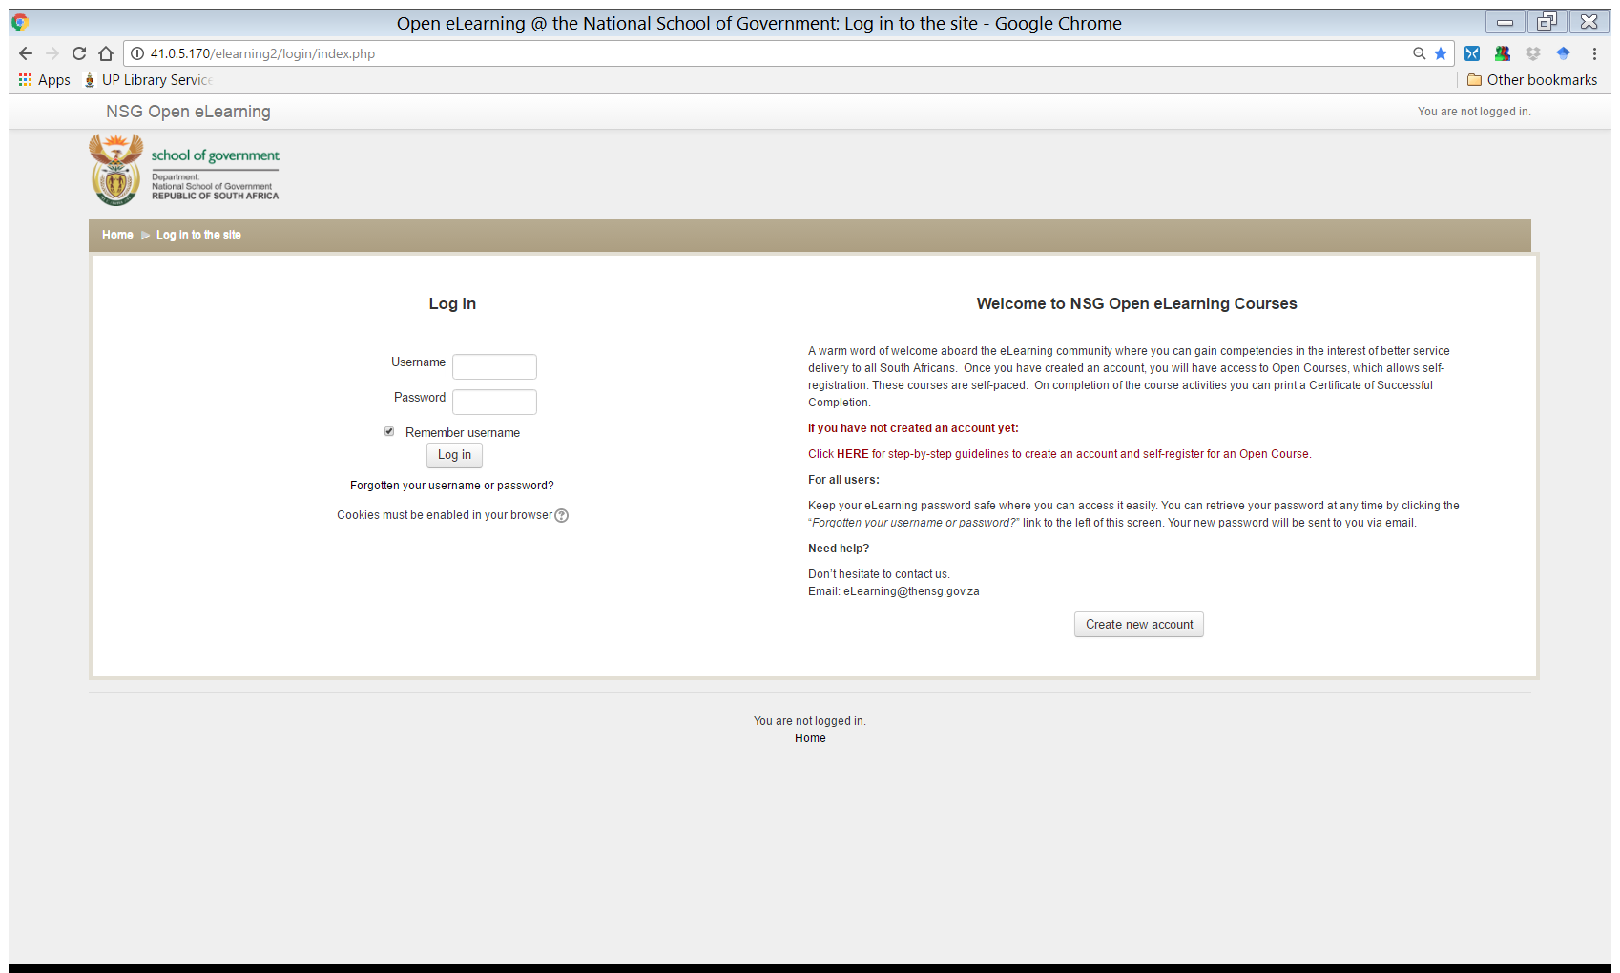
User login screen

Slide 8
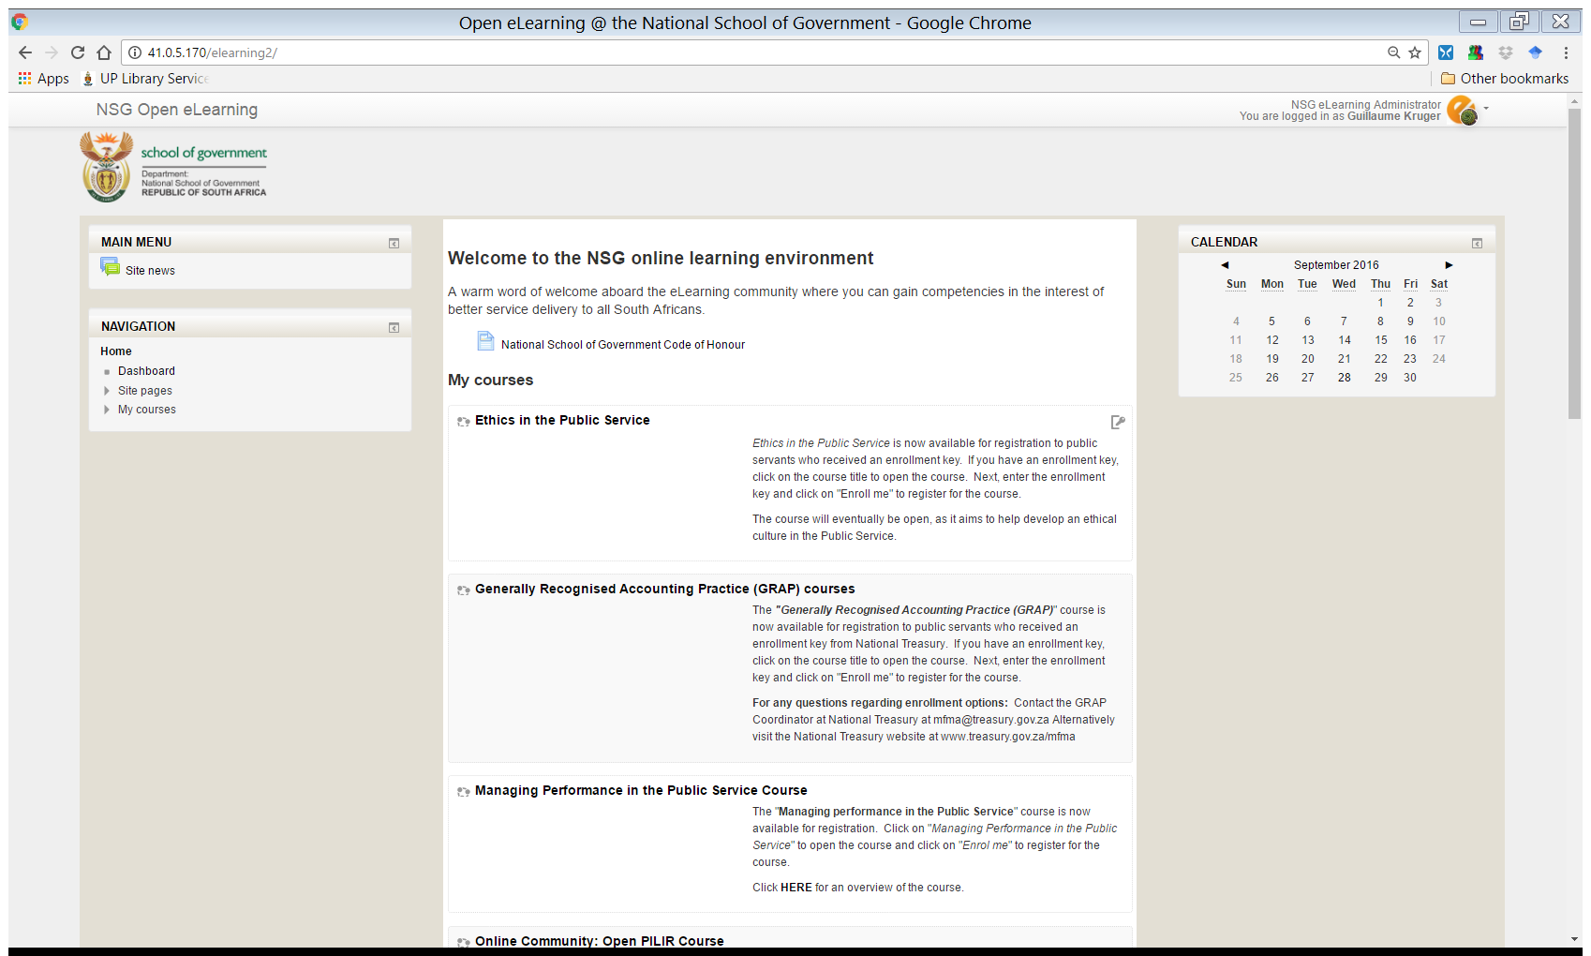
Homepage
GRAP standards are grouped in one Moodle course

Slide 9
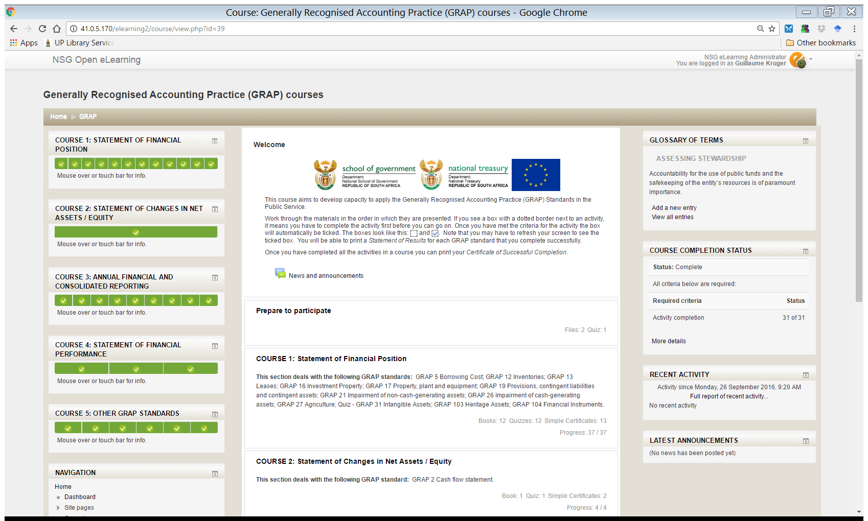
Progress reports
Visual representation of the user’s progress in each course.
Navigating the GRAP Standards
Users are able to search for a GRAP Standard and choose a particular standard by selecting the relevant course heading.

Slide 10
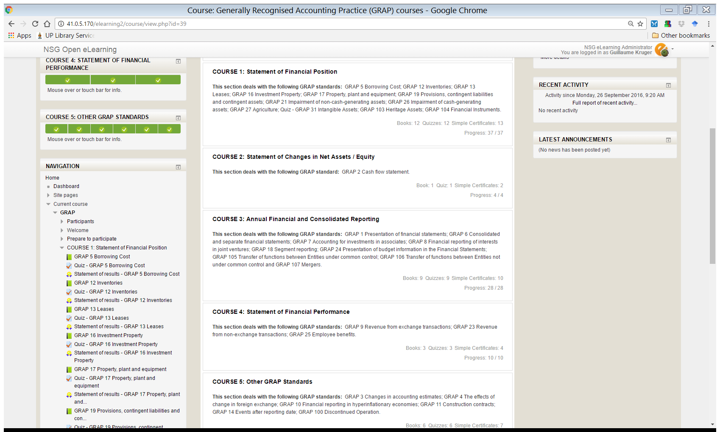
Navigating the GRAP Standards
Users are able to search for a GRAP Standard, and choose a particular standard by selecting the relevant course heading.

Slide 11
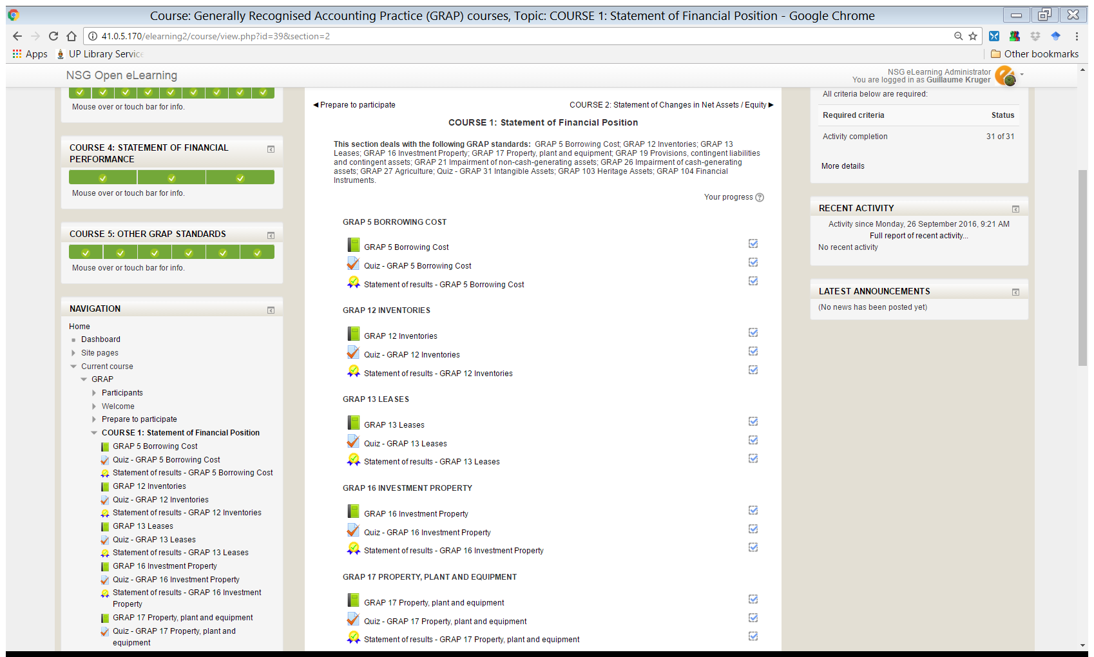
Navigating the GRAP Standards
Upon selecting a particular standard the user will be able to work through the
content after which the can attempt the assessment.

Slide 12
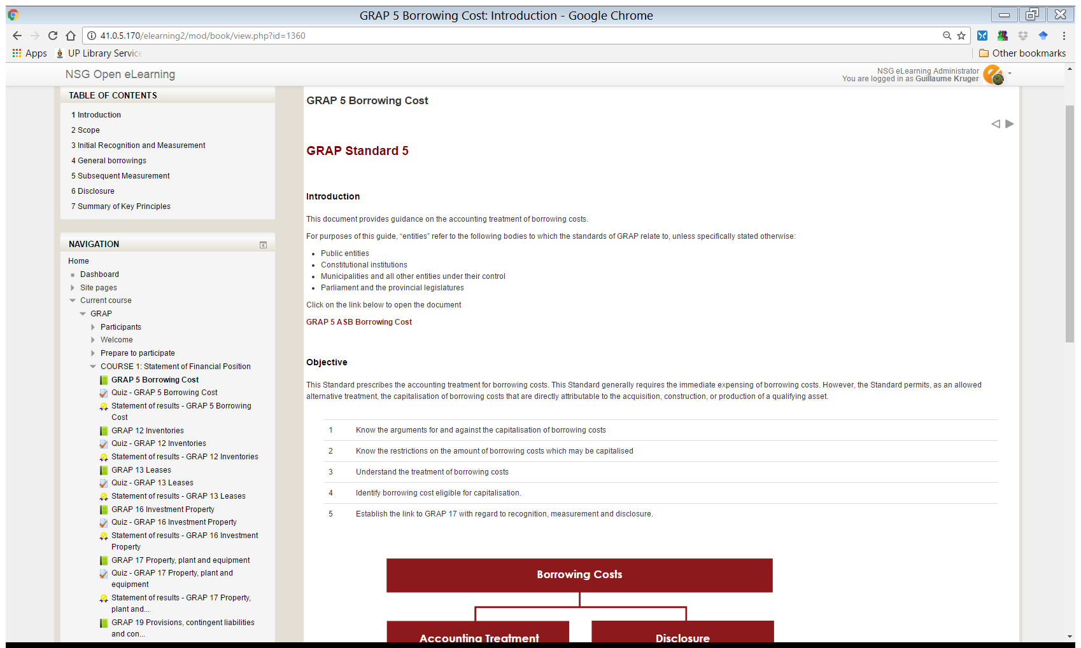
Users navigate by either selecting the
‘’next’’ button or navigating through the
table of contents to a specific section of
the standard.
Content contains links to relevant PDF
documents that users may need to
Reference.
Learning objectives are defined for each GRAP standard.

Slide 13
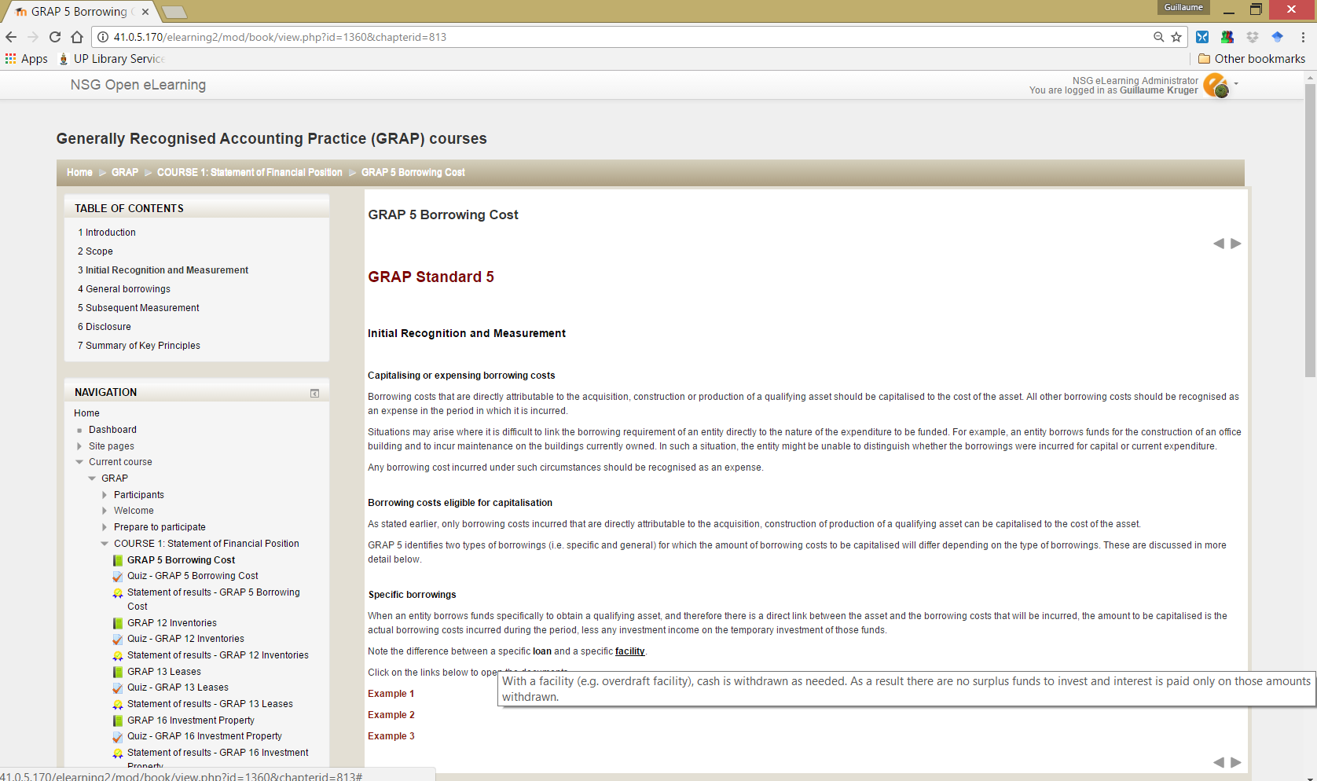
Interactive links to reduce text heaviness of the content:
Mouse-over definitions
Links to examples
Pop-up links for extended definitions.

Slide 14
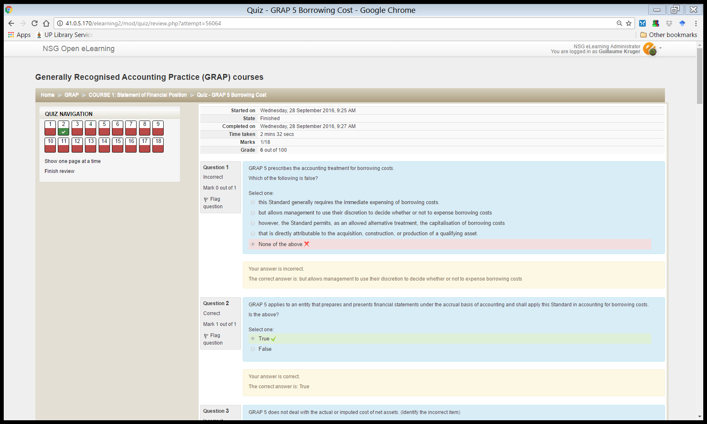
Assessments/Quizzes
Quiz navigation indicates the status of questions as the user completes the assessment (red indicating questions answered incorrect, green for correct).
Corrective feedback is provided for all answers.

Slide 15
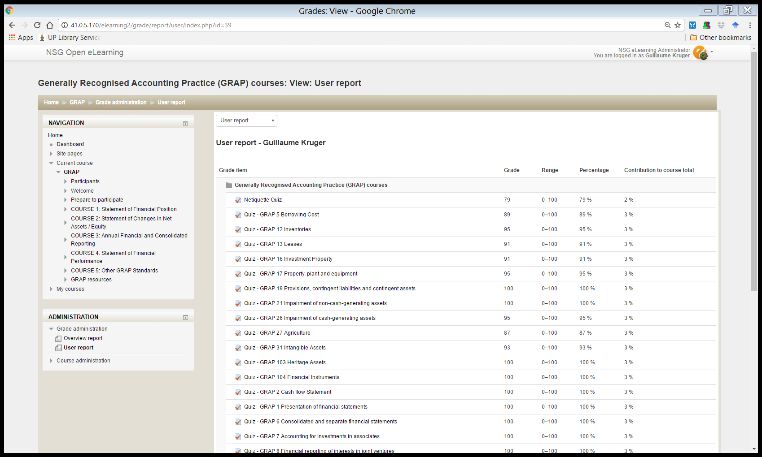
Gradebook
Record of user’s quiz attempts and marks.

Slide 16
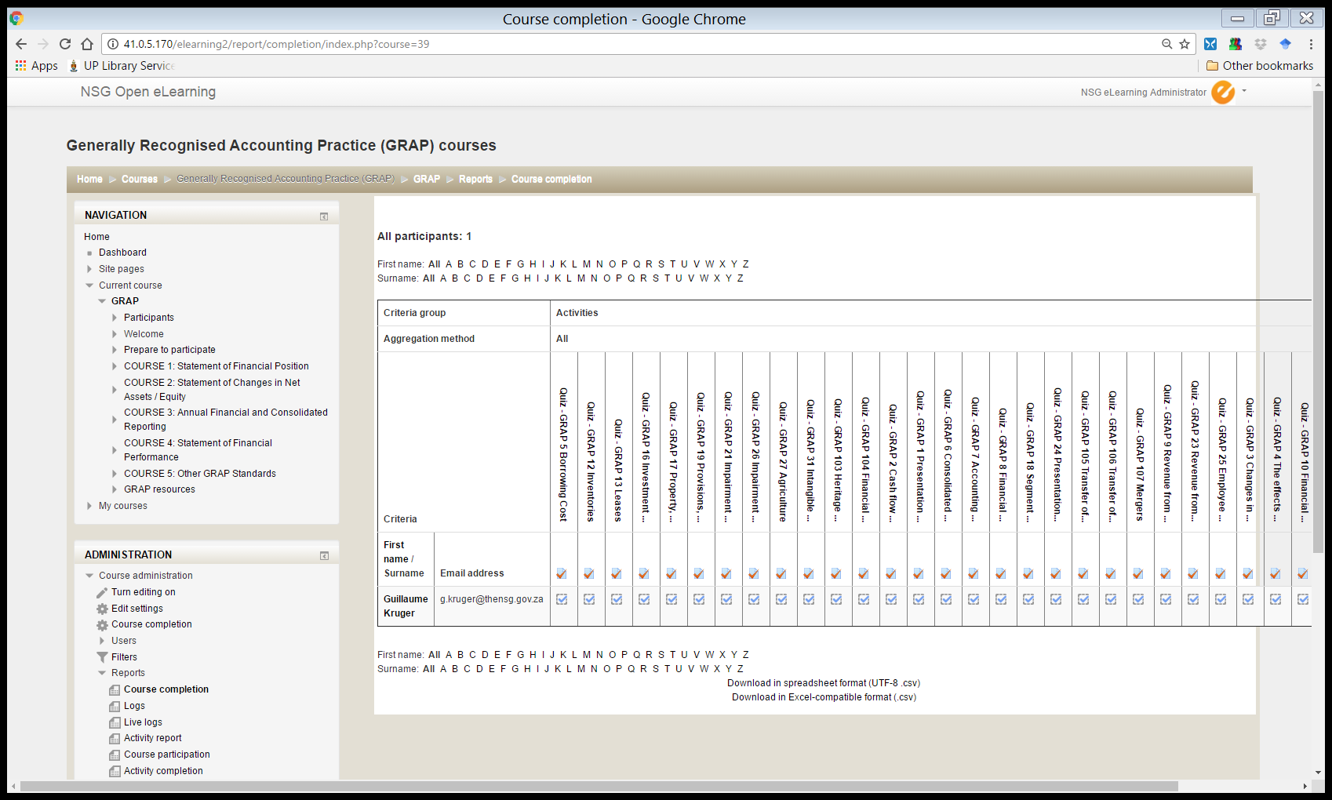
User completion report Downloadable in XLS format for reporting purposes.

Slide 17
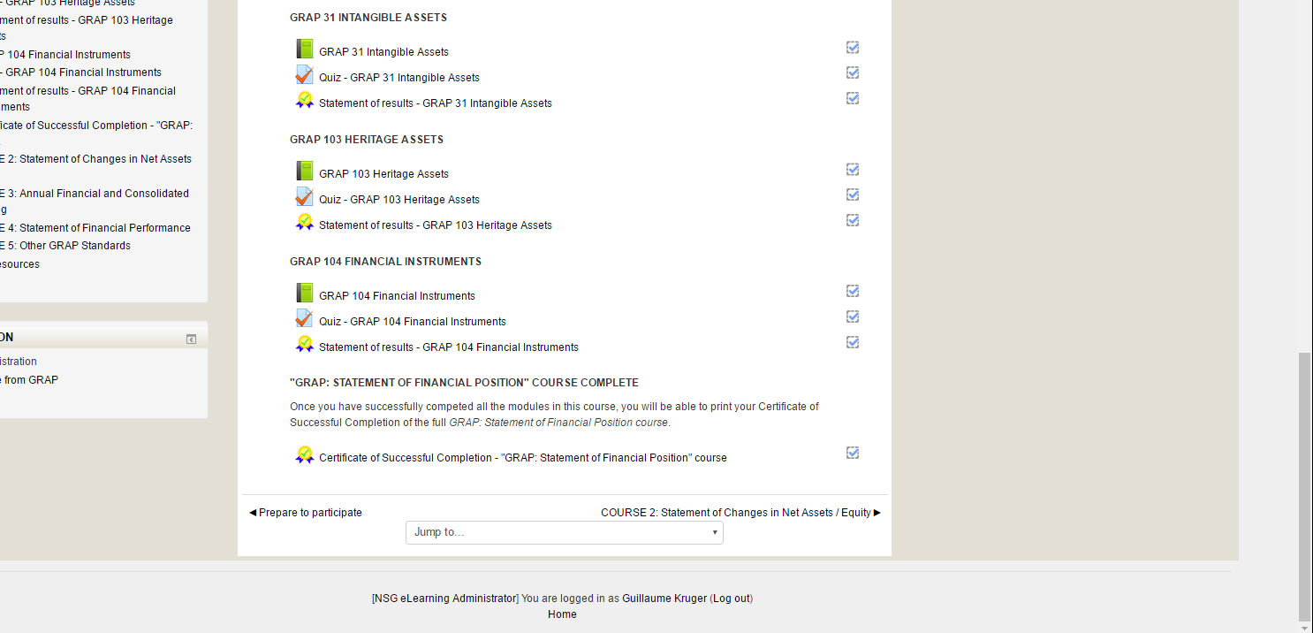
Certificate per GRAP Standard
Once a user achieves 80% for the quiz, the user can print out a certificate for that specific GRAP standard..
User’s name and surname
User’s ID number
Unique certificate number

Slide 18
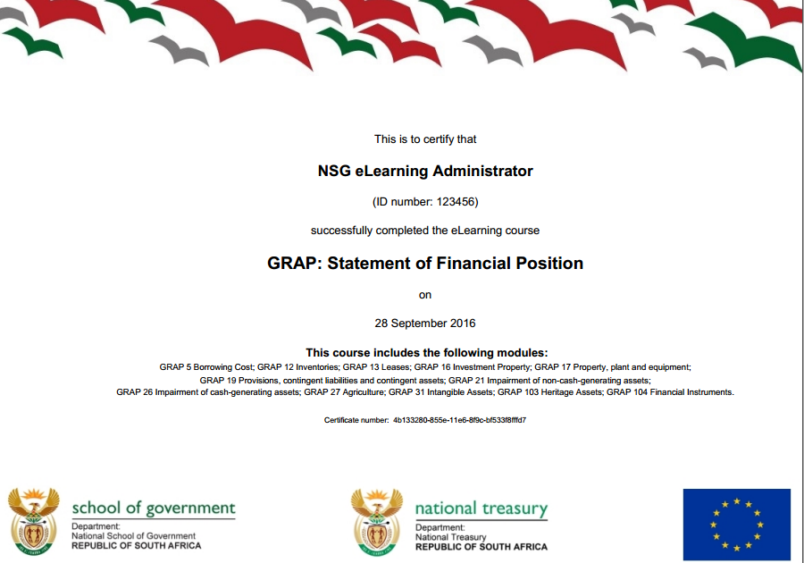
Certificate of Successful Completion
Once a user achieves 80% for all quizzes in a course, the user can print out a certificate of successful completion for that GRAP course.
User’s name and surname
User’s ID number
GRAP course and individual GRAP modules completed
Unique certificate number

Slide 19
Benefits
Increased ease of access to GRAP guidance and training for practitioners
Improved GRAP knowledge and skills for practitioners
Reduced reliance on consultants
Enabling compliance with MFMA financial accounting and reporting requirements
Improved accountability through better recording, control and better informed decision making.

Slide 20
Thank You

