Slide 1
CIGFARO:
“ENABLE Sustainable LOCAL GOVERNMENT”
Goudini Spa
S Mayekiso

Slide 2

OVERVIEW
  Sustainable Procurement???
  Situational analysis
  Provincial Government philosophy “sustainable Local Government”
  Technology
  Strategic procurement
  Approach

Slide 3
Sustainable procurement….
Notes:
Commenced in 2012
First published in 2013
At the time and still is the only one of its kind published by any administration in South Africa

Slide 4

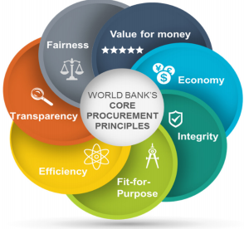
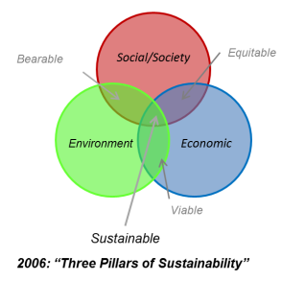
Sustainable Procurement – World Bank

Slide 5
Sustainable Procurement – Localised
  Sustainable procurement is an enabling link which allows institutions to stimulate economic growth;
  Allows the achievement of the Physical end product and soft issues (employment);
  Guides institutions to develop organizational wide strategies and targets focusing on:
Environmental impact (Green Procurement)
Efficiency
Economic use
Economic impact

Slide 6
Situational Analysis ….
Notes:
Commenced in 2012
First published in 2013
At the time and still is the only one of its kind published by any administration in South Africa

Slide 7
Situational Analysis – SCM Reforms
Wave 1
1995-2002
10 Point Plan on Procurement, 1995
Western Cape Preferential Procurement Policy
Wave 2
2003-2010
Wave 3
2011 and 2017
New Preferential Procurement Regulations, 2011
Green Paper on procurement reform, 1997
Preferential Procurement Policy Framework Act and Regulations, 2000/2001
NTR’s 2003 and 2005
Various SCM practice notes
BBBEE codes in 2007
CIDB policies and practice notes
BBBEE Act, 2003
Local Procurement Accord, 2011
Local Content instruction notes, 2011 onwards
SCM Instruction Notes
Amended BBBEE codes, 2013/15
Establishment of Office of the Chief Procurement Officer, 2013
SCM capacity building initiatives by NT, 2014
E-portal for procurement , 2015
Central Supplier Database, 2015
Draft Preferential Procurement Regulations, 2015
SCM DURING THIS PERIOD DETERIORATED
Envisaged Public Procurement Bill 2016/17
WCG disband WC Provincial Tender Board
SCM devolved to Accounting Officers as from 1 Jan 2004
PT issued first SCM blueprint

Slide 8
Situational Analysis….. (cont.)
2018 and beyond
G-COMMERCE
WAVE 4:
DIGITAL REVOLUTION
CSD/ePortal
IFMS
E-Procurement

Slide 9
Provincial Treasury Philosophy ….
Notes:
Commenced in 2012
First published in 2013
At the time and still is the only one of its kind published by any administration in South Africa

Slide 10
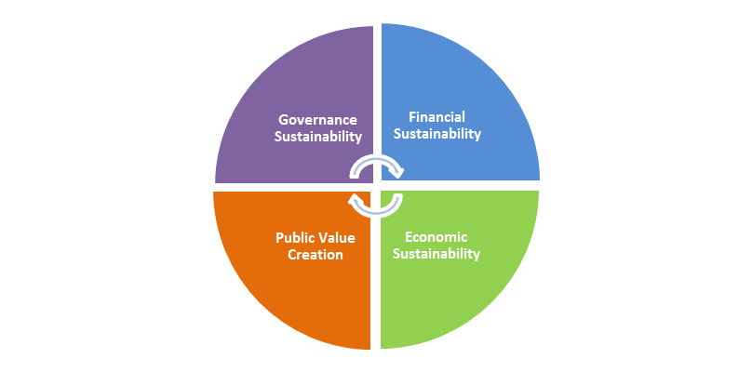
PT Focus Areas on Sustainable Local Government
Public Finance & Fiscal Policy
Revenue Management
Expenditure Management
Cash Management

Slide 11
BIG PICTURE
As a province we are spending:
R 52 billion
We have households above?
6.1 Million

Slide 12

Reality
Sport & Culture
Health
Poverty/Armoede/
Indlala
Housing
DEA & DP
Education
Infrastructure
LED
Economic Growth
Social Services
Agriculture
Safety
Notes:
Bele in Onderwys
Gesondheid
DEA & Dp
INFRASTRUKTUUR
Sport & kultuur
Veiligheid
Behuising
LED
Sosiaal Maatskaplik
Landbou

Slide 13
SCM Governance
(Policy and Control)
SCM Capacitation and Training
(Organisational Structure Capacity and Skill)
Development of SOP’s for the Municipal SCM System
Contractor Development Initiatives
Assessment of SCM and AM Structures
Training and capacitation strategy and programme
Internal and external client service (helpdesks, risk based municipal interventions.)
FAIRNESS
EQUITY TRANSPARENCY
COMPETITIVENESS
COST EFFECTIVENESS
SYSTEMS
INTERNAL CONTROL
RISK MANAGEMENT
SYSTEMS
INTERNAL CONTROL
RISK MANAGEMENT
SYSTEMS
INTERNAL CONTROL
RISK MANAGEMENT
SYSTEMS
INTERNAL CONTROL
RISK MANAGEMENT
Compliance to policy, prescripts and alignment to legislative framework.
Development of System of Delegations
Development of a framework for risk based assessments
SCM bespoke training interventions
Supplier Development Initiatives in collaboration with Municipal SCM and LED units
PERFORMANCE
CONFORMANCE
Strategic Procurement
SCM Technology
(Reporting, Data Integrity)
Reporting that is credible consistent and provides for integrity of data and ensure councils oversight role is effectively implemented
Procurement Planning / Demand Planning
Procurement Strategy aligned to SDBIP and IDP
Economies of Scale
Vendor Management: Database and Administration efficiencies
Value for money (Cost vs. quality vs. opportunity vs level of service )
Research market intelligence and technical expertise to redress and improve municipal procurement strategies and planning
Assessment of the MERO/PERO link to municipal Procurement Strategies
Integration of financial and non-financial systems
Development of a Information Management System link to vendor performance/contract management
Development of Enterprise Content Management System
Research, Development and Implementation of a fully fledged E-Procurement Compliance System
Effective utilisation of resources
MGRO (CONFORMANCE AND PERFORMANCE)

Slide 14
Sustainable Procurement: Collective Approach “District empowerment”
District Approach:
Empowering the district municipalities to undertake strategic functions:
Arranging transversal contracts (economies of scale)
District procurement analysis;
Developing district wide economic and procurement strategies;
Establishment of one forum for all financial discipline (issues of common interest)
Economies of scale;
Improved Contract Management;
Improved planning (demand and Procurement planning)

Slide 15
Technology ….
Notes:
Commenced in 2012
First published in 2013
At the time and still is the only one of its kind published by any administration in South Africa

Slide 16
Sustainable Procurement: Using technology as a lever
SCM Technology:
Start extracting data from financial system;
Analysis of data: high value transactions, volume of transactions,
TOP suppliers,
Location of suppliers,
repeat use of supplies.
Data Collection and analysis (Spend Analysis);
Procurement Plan collection and analysis;
ERP system and CSD (e-procurement)
District Spending Patterns

Slide 17
Strategic Procurement ….
Notes:
Commenced in 2012
First published in 2013
At the time and still is the only one of its kind published by any administration in South Africa

Slide 18
Sustainable Procurement: Procurement as economic enabler
Strategic Procurement:
Out of the stats and data analysis:
Determine the best procurement strategies to deploy (local labour, procuring materials locally);
Analysis of economic value chain.
Capacity assessments
LED, IDP and SCM
Framework agreements:
Advanced procurement;
Targeting local suppliers on major projects and routine projects
Mainstream small local (regional) suppliers into economic hub.
Procurement strategies (LED/IDP)initiative
Framework agreements

Slide 19
Constitution: Section 217 Vs Section 152 & Section 153
Section 217
Section 152&153
Encouragement of Local Community participation
Competitive
Protection against unfair discrimination
Provision of a democratic and accountable local government
Safe & healthy Environment
Fair
Social & economic Development
Equitable
Cost-effective &Value for money
Promotion of financial sustainability
Provision of Sustainable Basic service
Transparent
Provision for Categories of preference
Decreasing Unemployment
Uplifting Poor communities

Slide 20
Approach….
Notes:
Commenced in 2012
First published in 2013
At the time and still is the only one of its kind published by any administration in South Africa

Slide 21
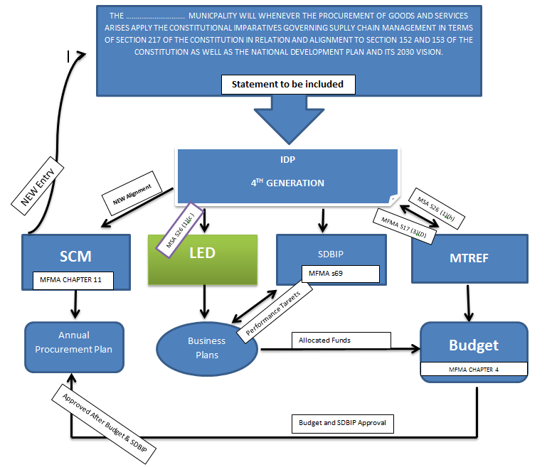
Municipality Strategic Planning Framework Alignment
Notes:
This diagram represent the current legislation framework that allows municipalities to institute the alignment between IDP, LED and SCM.

Slide 22


GREATEST 21st CENTURY ENTREPENEUR/INVENTOR
What things would have the great impact on the future of humanity’s destiny? - Elon Musk (TESLA & SPACEX)

