Slide 1
Budgeting for a SURPLUS 11 October 2017
Presented by National Treasury:
Chief Director: Local Government Budget Analysis
Eduard le Roux

Slide 2
Contents
Background
Local Government Utilisation of Equitable Share
Adequate Provision for Repairs and Maintenance
Loss Management
Cost Reflective Tariffs
Maintaining Reasonable Collection Levels
Funded Budgets

Slide 3
Background

Slide 4
Purpose of the Budget
Budget provides details of
Available sources of revenue
Expenditure requirements
Operational surplus/deficit
Tool for implementation of Council policies
A basis for control of revenue and expenditure
Informs tariff calculation – cost of rendering the service; to be recovered from tariffs charged
“Budget is telling
where the money is coming from and where to go”

Slide 5
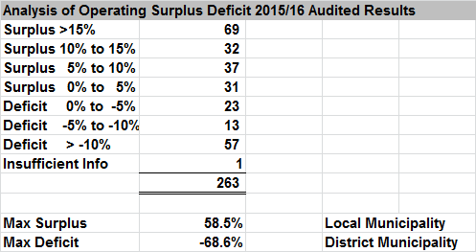
Budgeting for Surpluses - 2015/16 Audited Outcomes
263 Municipalities out of 278 submitted audited results to the National Treasury LG Data Base
65 Municipalities budgeted for a deficit in the 2015/16 adjustment budget process (24.7 per cent)
93 Municipalities recorded a deficit for 2015/16 audited results (35.4 percent: 1 Metro; 80 LMs; 12 Districts)
100 Municipalities recorded an operating surplus of between 0% and 15% (38 percent)
Variance from maximum surplus to maximum deficit was 58.5% surplus (LM) to 68.6% deficit (District)

Slide 6
Achieving a Balance for Sustainable Service Delivery
Realistic revenue projections to achieve operational surpluses
Completeness of revenue
Optimising the municipalities’ revenue generation potential across all sources
Collect all monies due
Priority spending – adequate provision for operational expenditure, R&M, non-cash items, allocation of secondary costs so that tariffs are cost reflective
Eliminate operational inefficiencies – contain distribution losses
Service Delivery

Slide 7
The LG Equitable Share Allocation The ES formula is informed by data from the 2011 Census. This will be updated with data from the 2016 Community Survey over the 2017 MTEF period. This smooth transition will be facilitated by a three year phased in update over the three years of the MTREF

Slide 8
The Equitable Share transfer
The Equitable Share provides for:
Cost of free basic services for households classified as “indigent” (Basic Services Component)
Municipalities with limited resources to afford basic administrative and governance capacity, and perform core municipal functions ito three components, namely,
Institutional, provides a subsidy for basic municipal administrative costs;
Community services, provides for other core municipal services not included within basic services; and
Revenue adjustment factor for municipalities with limited potential to raise their own revenue. Municipalities that are least able to fund these costs from their own revenues should receive the most funding
Predictability and stability through the correction and stabilisation factor, which ensures that all of the formula’s guarantees can be met

Slide 9
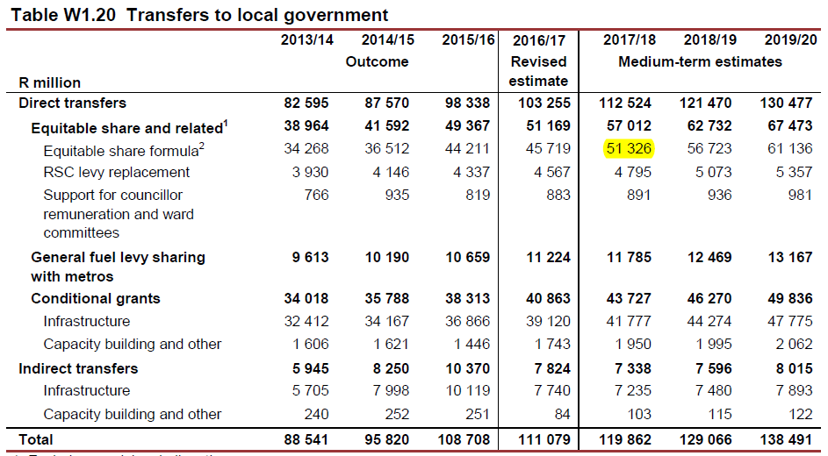
The LG Equitable Share

Slide 10
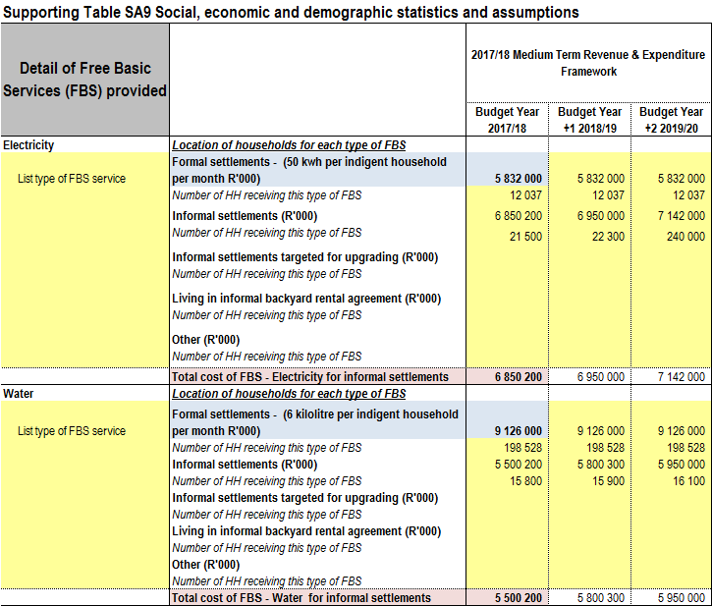
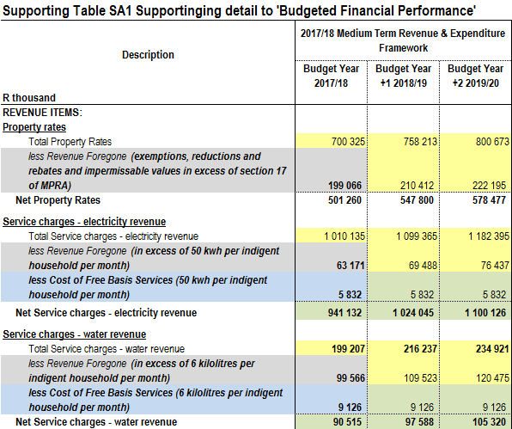
The LG Equitable Share

Slide 11
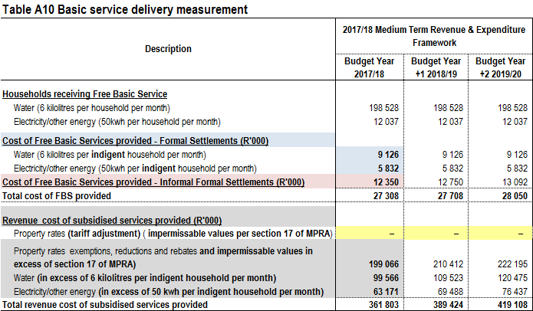
The LG Equitable Share

Slide 12
The LG Equitable Share
Municipalities are required to disclose use of ES towards defraying the “Cost of FBS” on table SA9
FBS in formal areas
FBS in informal areas
This information is transferred to Table SA1 & A10 “Cost of FBS” (formula driven)
Includes cost of 6 kl water, 50kwh electricity, a sanitation and refuse removal service
Cost should be comparable to the “Basic Services” component of the ES
Property rates rebates and subsidisation of services in excess of the above norms:
Not FBS as per DoRA – subsidised services by way of a council resolution
Cannot be funded from “Basic Services” component of the ES
Funded from rates and tariffs
Adopted budgets for 2017/18 MTREF
Only 127 municipalities out of 257 budgeted for FBS on Table A10
Total amount budgeted by 127 Municipalities = R13.697 billion compared to R41.147 billion allocated to municipalities
Difference R27.45 billion
Increasing importance of Table SA9, SA1 & A10
Disclosing “Cost of FBS” and “Revenue Cost of Subsidised Services” separately
Aligning the “Cost of FBS” to the “Basic Services” component of the ES

Slide 13
Adequate Provision for Repairs & Maintenance

Slide 14
Adequate Provision for R&M

Slide 15
Providing for Repairs and Maintenance
Table A9 above represents the aggregate asset management position for all municipalities for the 2017/18 MTREF:
2017/18-2019/20 MTREF
R&M increased at a slower rate than total expenditure in 5 of the 6 years (refer red text in table above)
R&M increased by 2% – average of 0.66% per annum
Total expenditure increased by 19% – average of 6.34% per annum
The difference in the percentage increases may be indicative that R&M are not properly prioritised
Carrying value of PPE increased by 10.9% – average of 3.65% per annum
This does not take into account asset life cycles as well as assets fully depreciated
Decrease in R&M as percentage of PPE compared to increase in Carrying value of PPE – Red flag in need of carefull analysis by municipalities
Important asset management ratios
Percentage of capital expenditure allocated to renewal of assets - increased from 41.2% to 57.0% (norm 60%)
Renewal of Existing Assets as % of depreciation - increased from 77.5% to 78.9% (norm 100%)
R&M as a % of PPE – reduced from 3.9% to 3.6% (norm 8%)
The combined effect of the under performance of these 3 ratios – imminent infrastructure failure
R&M Table SA1 - Total Repairs and Maintenance Expenditure should reconcile to Table A9 - Repairs and Maintenance by Asset Class [formula linked to SA34(c)]

Slide 16
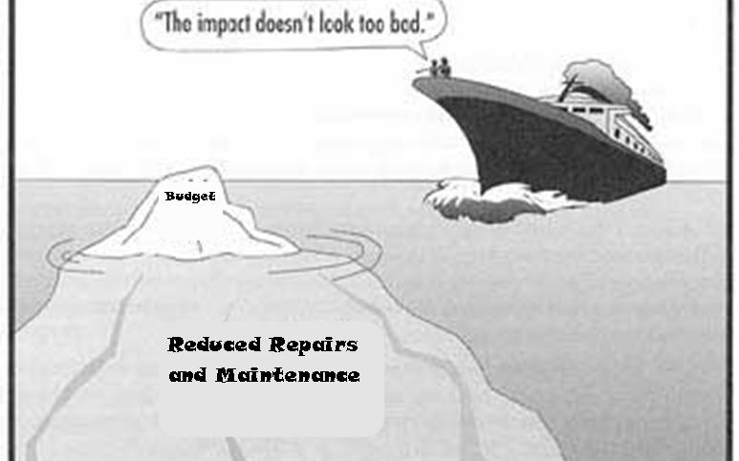
Adequate Provision for R&M
The impact of infrastructure failure due to insufficient R&M is often not immediate but always inevitable
hence
“the impact does not look so bad” ??? …………For Now !!!

Slide 17
Loss Management
Distribution losses should be disclosed on Table SA8 of the A1 Budget Schedule
Municipalities reported as follows on Budget A1 Schedule:
2013/14 - 23 municipalities (electricity) - 22 municipalities (water)
2014/15 - 24 municipalities (electricity) - 22 municipalities (water)
2015/16 - 25 municipalities (electricity) - 21 municipalities (water)
2017/18 - 41 municipalities (electricity – budgeted R5.141 billion) - 40 municipalities (water – budgeted R3.572 billion)
Information on water & electricity distribution losses on the LG Data Base not reliable
AG’s Consolidated Report on 2015/16 Audit Outcomes - Main findings on distribution losses were:
Over half of the municipalities responsible for providing water did not have the basic policies and plans in place to ensure that maintenance of water infrastructure took place
34%, of municipalities did not complete conditional assessments of the infrastructure to inform maintenance plans and budgets,
24% of municipalities did not budgeting anything for maintenance
41% of municipalities experienced water losses above the norm of 30% in 2015/16 – the average water losses for these municipalities were 52%
9% of municipalities did not even disclose their water losses
AG did not report in detail on electricity losses – possible similar position than water
Budgeting for surpluses with this level of inefficiencies in the system is not achievable

Slide 18
Cost Reflective Tariffs

Slide 19
Full Cost Recovery – Cost of Providing the Service
Service Charges
All other internal revenue streams from fees, charges, penalties and fines
mSCOA
mSCOA
Revenue required for full cost recovery
Transfers
Direct (primary) cost
mSCOA
Full cost of Service Level/Standard
Indirect (secondary) costs – Costing Section
Departmental Charges
Internal Billings
Activity based Recoveries
Chosen Level/Standard of Service

Slide 20
Full Cost Recovery – Cost of Providing the Service – mSCOA Segments
Expense - mSCOA chart
Contra Accounts
Contracted Services
Default
Depreciation and Amortisation
Discontinued Operations
Employee Related Cost
Income Tax
Interest, Dividends & Rent on Land
Expense - mSCOA chart
Operational Cost
Remuneration of Councillors
Share of Deficit attributable to Associate
Share of Deficit attributable to Joint Venture
Share of Deficit attributable to Minorities
Statutory Payments other than Income Taxes
Transfers and Subsidies
Inventory Consumed
Operating Leases
Bulk Purchases
Bad Debts Written Off

Slide 21
Full Cost Recovery – Cost of Providing the Service – mSCOA Segments
Costing Segment
Costing Segment
Charges to receiving departments
Recoveries made by sending departments
Part of cost/management accounting
Zero sum exercise Charges (dt) = Recoveries (cr)
Indirect (secondary) cost is initially recorded as direct (primary) cost within the Item Segment and funded according to the Fund Segment.
Provides for the classification of indirect (secondary) costs that do not directly attribute to the output
Distinction is made between
Extracting information from multiple segments within SCOA would thus provide “full cost” information for the defined core municipal functions
Full cost forms the basis for tariff setting
Municipality needs to decide on the cost allocation model to be used
Activity based recoveries
Internal service charges (internal billings)
Departmental charges
Included in mSCOA to provide for the recording of “full cost reflection” for at least the four core municipal functions

Slide 22
Full Cost Recovery – Cost of Providing the Service – mSCOA Segments
Internal Billing
Internal Billing –Departmental use of internal services such as
electricity
In illustrating - the electricity consumed during water purification
waste management
waste water management
water
Activity Based Recoveries
Allocation of resources utilised by trading & economic services & various departments
Examples
Allocation of labour costs are based on time sheets
Allocation of vehicles and plant equipment cost are based on log sheets
This usually requires use of a costing module of the financial application
Requires weekly time & log sheet processing
Initially lack of information will complicate budget preparation
Departmental Charges
Department Charges (Support Services) - Allocation of overheads to cost centres:
Information technology used by multiple functions
Pro rata allocation based on the number of service points or users such as the electricity department

Slide 23
Full Cost Recovery – Cost of Providing the Service – Cost Allocation Model
mSCOA – Cost Allocation Model
mSCOA – Cost Allocation Model
Complexity of the design of a system depends on:
Municipality needs to decide on the cost allocation model to be used
Not necessary the case, cost allocation models can range in complexity from a simple Excel spreadsheet to something more complex such a full costing module
The size of the municipality
Cost of maintaining the system
Age of the infrastructure, and
Reporting structure within departments
Complexity and diversity of cost objects
Frequency at which cost are required
What level of information is required
The staff capacity
Two common methods of estimating the indirect costs:
A usage or benefit approach
A pro rata approach
Perception that the development and maintenance of costing models require significant resources

Slide 24
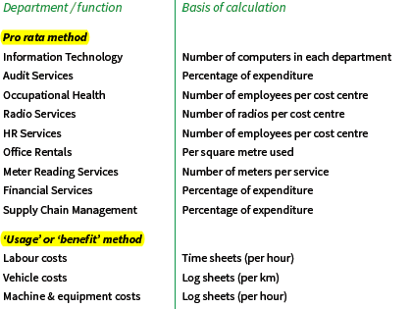
Full Cost Recovery – Cost of Providing the Service – Cost Allocation Model
Typical departments/cost centres that render internal services to the tariff departments (four core services) and possible basis of calculation for costing these services.

Slide 25
Improving municipal tariff setting
1. Annual Budget - The main purpose of preparing a budget could be summarised as follows:
Provides detail of
Revenue sources available
Expenditure requirements
Tool for implementation of Council policies
Forms the basis for control over revenue and expenditure
Forms the basis for tariff calculation – Cost of rendering the service
2. Type of Services and Tariff Setting
Trading services (Full cost recovery plus a budgeted operating surplus)
Economic Services (Budgeted to break even – full cost recovery)
Subsidised services (Not full recovery of cost to provide the service – some tariffs)
Community services (No tariffs – funded from assessment rates and surpluses from trading services)

Slide 26
Improving municipal tariff setting
3. Tariff Policy
The tariff policy is the key to transparent tariff setting that outlines how tariffs are determined, monitored and reviewed to assure its citizens that tariffs are set on a rational basis
Objective of the tariff policy is to ensure that:
Tariffs of the Municipality conform to acceptable policy principles
Municipal services are financially sustainable
There is certainty in the Council and community of how the tariffs will be determined
Tariffs of the Municipality comply with the applicable legislation

Slide 27
Improving municipal tariff setting
3. Tariff Policy
Need for a tariff policy
Revenue adequacy and certainty - the Municipality must:
Fully exploit the available sources of revenue to meet its developmental objectives and be reasonably certain of its revenue to allow for realistic planning
Sustainability - Financial sustainability requires that the Municipality must ensure that:
Its budget is properly funded, services are provided at affordable levels It is able to recover the costs of service delivery
Effective and efficient usage of resources
Resources are scarce and must be used in the best possible way to ensure the maximum benefit for the community

Slide 28
Requirements for Proper Tariff Setting
Need for a tariff policy (Continued)
Accountability, transparency and good governance - The Municipality must be accountable to the community for the use of its resources
Equity (fairness) - The Municipality must treat members of the community equitably with regard to the provision of and payment for services in proportion to the costs that are incurred in providing the service
Development and investment - Meeting basic needs in the context of existing services and backlogs, will require increased investment in municipal infrastructure

Slide 29
Requirements for improving tariff setting
4. Demand and Service levels
Important step in setting a tariff for the main trading and economical services is to understand the demand for the services. Identify the following:
Number and type of consumers - four basic categories of consumer:
Domestic - households who use services to meet their own requirements
Commercial - businesses that provide services and use municipal services to meet the consumption requirements of their staff and customers
Industrial - Industrial consumers are businesses that are involved in the manufacture of products and use municipal services in their manufacturing processes
Institutional - Institutional consumers are organisations dedicated to providing services that are of benefit to the community, and include schools, hospitals, places of worship, orphanages and so on.

Slide 30
Requirements for improving Tariff Setting
4. Demand and Service levels (continued)
Levels of service to which they have access –
Mainly three service levels:
Basic (Low) Level of Service
Medium Level of Service
High Level of Service
Service level available determines:
Type of infrastructure that is installed
Affects the consumption of that service
Affects the cost of providing the service - different tariffs are levied for different levels of service

Slide 31
Requirements for improving Tariff Setting
4. Demand and Service levels (continued)
Current levels of consumption of services
Where consumption can be measured
Tariffs levied based on the level of consumption of a service
Determination of levels of consumption is crucial factor in tariff setting
Measuring consumption differs for different services:
Electricity and water – measured in units consumed (kwh & kl)
Waste management – measured in mass or volume removed as well as frequency of the service or number of collection points
Waste Water management – measurement – various scenarios:
Can be estimated based on levels of water cons (66%-70%)
Can be estimated based on property value
Can be estimated based on number of toilets
No measurement – tariff based on a flat rate
Other non-trading services consumption refer to numbers of times that the service is used (example, number of library books borrowed)

Slide 32
Requirements for improving Tariff Setting
5. Determine “full costs” to provide a service
Full cost of providing a service includes:
Direct (primary) costs: Day-to-day costs incurred in running the service
Costs incurred exclusively in providing a particular service.
Direct costs include:
Employee related costs: all expenditure related to the personnel required to provide the service. This includes normal salaries and wages, any bonuses paid, overtime costs, allowances, fringe benefits and social contributions.
Bulk purchases: the cost of purchasing bulk water and electricity from an external provider, where relevant.
Repairs and maintenance: the cost of any materials or equipment used to repair and maintain fixed assets.
Contracted services: the cost of any services that have been contracted out to external providers.
Other costs: all expenditure not grouped under one of the other categories.

Slide 33
Requirements for Improving Tariff Setting
5. Determine “full costs” to provide a service (continued)
Full cost of providing a service includes:
Indirect (secondary) cost: Overhead costs of running the municipality as a whole
Costs that are not directly attributable to a service but are incurred in running the municipality as a whole
Overheads must be apportioned between services in a clear, structured way
Capital financing costs: costs to expand and manage infrastructure
Costs associated with financing infrastructure expansion and with rehabilitating and/or replacing existing infrastructure as it ages
Adequate provision for capital financing costs is vital to ensure that service provision is sustainable in the long term

Slide 34
Requirements for Improving Tariff Setting
5. Determine “full costs” to provide a service (continued)
Capital financing costs include:
External interest associated with financing capital expenditure using external loans.
Depreciation - cost of ‘consuming’ assets in service delivery
Proper depreciation accounting results in a cash surplus on the operating account which can be transferred to reserve used to finance asset replacement
Cash funding of depreciation is a challenge due to impact on tariffs
Provisions to capital reserves: a cost item used to create a cash surplus on the operating account which can be transferred to a reserve used to finance asset expansions

Slide 35
Maintaining Reasonable Collection Levels & Funded Budgets

Slide 36
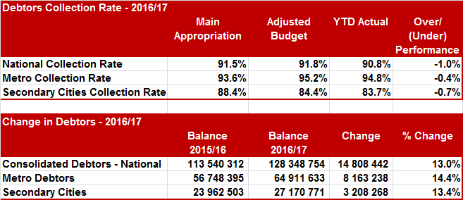
Maintaining Reasonable Collection Levels & Funded Budgets
Collection Rate - Norm 95% - actual performance below norm
Rate of growth in gross debtors ??
Provision for Debt Impairment 2015/16
Original Budget R14.851 billion
Adjusted Budget R16.514 billion
Audited Outcome R21.312 billion

Slide 37
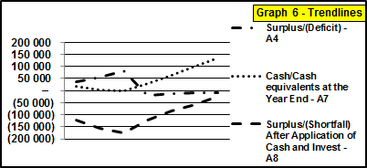
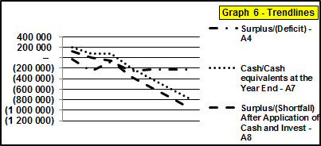
Maintaining Reasonable Collection Levels & Funded Budgets
Small Rural Town - Collection Rate 47.8% Large Town - Collection Rate 63.9%
Small Rural Town
Table A4
Collection rate just below 50%
Relative small operating deficit (less than non-cash)
Depreciation almost cash backed
Table A5
Small internally generated CAPEX
Table A7
Improved cash position
Table A8
Not funded but improving over MTREF
Large Town
Table A4
Collection rate just below 64%
Large operating deficit (R200m more than non-cash)
Depreciation not cash backed
Table A5
Small amount internally generated CAPEX
Table A7
Drastically deteriorating cash position
Table A8
Not funded drastically deteriorating over MTREF

Slide 38
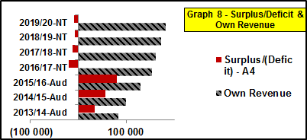
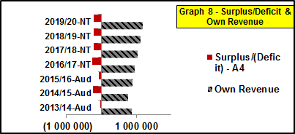
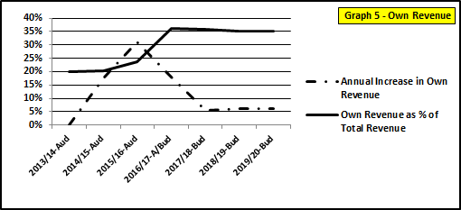
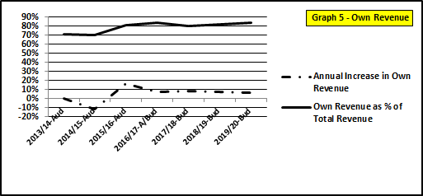
Maintaining Reasonable Collection Levels & Funded Budgets
Small Rural Town - Collection Rate 47.8% Large Town - Collection Rate 63.9%

Slide 39
Maintaining Reasonable Collection Levels & Funded Budgets
Small Rural Town
Low collection rate –
Adequate provision for debt impairment on table A4
Expenditure was adjusted downward in line with realistically expected revenue projections after provision for debt impairment
Small operating deficit – much lower than the non-cash component
Depreciation almost fully cash backed – utilisation towards future asset replacement once budget is fully funded
Need to budget for a surplus to generate cash backed reserves for new internally generated capex
Very small contribution to internally generated CAPEX on Table A5 – not funded and should be removed
Improved cash - positive cash and improving over the MTREF
Funding -
Still unfunded drastically improving over the MTREF
Medium to longer term budget will become funded with cash backed reserves to fund new/renewal assets

Slide 40
Maintaining Reasonable Collection Levels & Funded Budgets
Large Town
Higher collection rate –
Adequate provision for debt impairment on Table A4
Expenditure was not adjusted downward in line with realistically expected revenue projections after provision for debt impairment
Huge operating deficit far exceeding the non-cash component
Depreciation not cash backed
Need to budget for a surplus to generate cash backed reserves for new internally generated capex
Very small contribution to internally generated CAPEX on Table A5 – not funded and should be removed
Decreasing cash - negative cash position and deteriorating over the MTREF
Funding -
Unfunded and drastically deteriorating over the MTREF
Medium to longer term budget will become further un-funded with inability to meet current liabilities

Slide 41
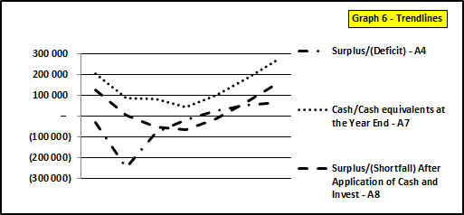
Maintaining Reasonable Collection Levels & Funded Budgets
Large Town - Collection Rate 63.9% Large Town - Collection Rate 90.0% - No Payment of Creditors
Large Town
Table A4 - Collection rate improved from 63.9% to 90%
Large operating deficit changed into operating surplus
Depreciation fully cash backed in outer years of MTREF
Operating Surplus to fund future internally generated CAPEX
Table A5
Potential to increase internally generated Capex due to funded budget position in outer years of MTREF
Large Town
Table A7
Positive cash position in outer years of MTREF
No additional payment towards arrear creditors
Table A8
Budget funded and improving over the MTREF
Potential to increase internally generated Capex due to funded budget position in outer years of MTREF

Slide 42
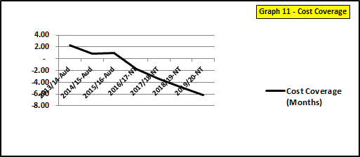
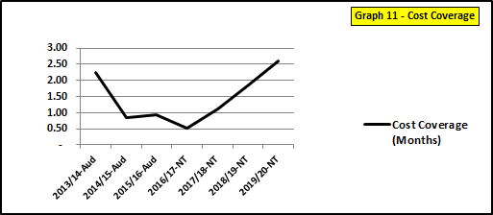
Maintaining Reasonable Collection Levels & Funded Budgets
Large Town - Collection Rate 63.9% Large Town - Collection Rate 90.0% - No Payment of Creditors
Large Town
Cost coverage
Improved from a negative position to just above 2.5 months due to improved cash position
Important to note that improvement is overstated due to no additional payments towards arrear creditors

Slide 43
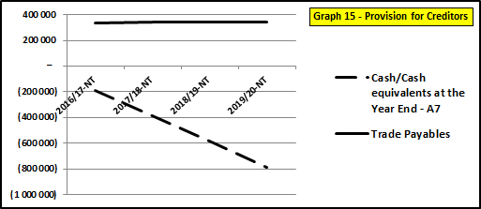
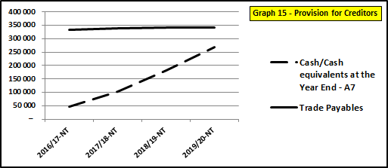
Maintaining Reasonable Collection Levels & Funded Budgets
Large Town - Collection Rate 63.9% Large Town - Collection Rate 90.0% - No Payment of Creditors
Large Town
Ability to Pay Creditors
This measures the ability to pay creditors from available cash & cash equivalents
Not all creditors covered - Ability to pay creditors drastically improves due to improved cash position

Slide 44
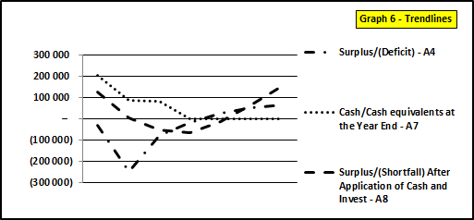
Maintaining Reasonable Collection Levels & Funded Budgets
Large Town - Collection Rate 90% - No Payment of Creditors Large Town - Collection Rate 90.0% - Add Payment to Creditors
Large Town
Table A4
Surplus position on Table A4 not affected by payment of creditors – Table A6 Financial Position
Table A7
Cash and cash equivalents now depleted – available cash was utilised to pay arrear creditors
Table A8
Funding position on Table A8 not affected by payment of arrear creditors – Reduction in asset (cash) and reduction in liability (trade payables)

Slide 45
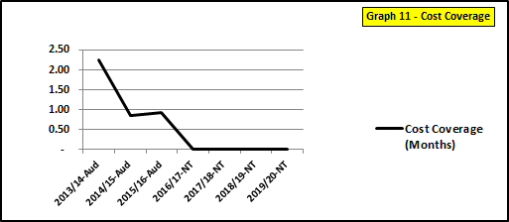
Maintaining Reasonable Collection Levels & Funded Budgets
Large Town - Collection Rate 90% - No Payment of Creditors Large Town - Collection Rate 90.0% - Add Payment to Creditors
Large Town
Cost coverage
Reduced to zero months due to all available cash at each year end utilised to pay arrear creditors
Possibly too drastic - should seek balance between maintaining some level of cost coverage and payment of arrear creditors as the cash position improves

Slide 46
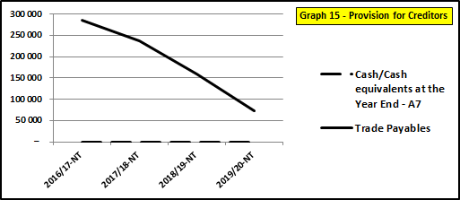
Maintaining Reasonable Collection Levels & Funded Budgets
Large Town - Collection Rate 90% - No Payment of Creditor Large Town - Collection Rate 90.0% - Add Payment to Creditors
Large Town
Ability to Pay Creditors
Due to surplus cash utilised to pay creditors the liability reduced drastically
Achieved by compromising the cost coverage – balance required whilst mindful to settle arrear creditors as quickly as possible

Slide 47
Conclusion
Budgeting for surpluses essential for sustainable service delivery – Requires a fine tuned balance of:
Realistic revenue projections to achieve operational surpluses
Completeness of revenue
Optimising the municipalities’ revenue generation potential across all sources
Collect all monies due
Priority spending – adequate provision for operational expenditure, R&M, non-cash items, allocation of secondary costs so that tariffs are cost reflective
Eliminate operational inefficiencies – contain distribution losses
We need to assess to what extent nationally and individually municipalities meets the above-mention criteria and to what extent we are budgeting for surpluses ??

Slide 48
Thank You EC le Roux Cell: 083 287 4905 email: eduard.leroux@treasury.gov.za

