Slide 1
mSCOA Reporting and
Data Strings
GRAP, mSCOA and SCM Workshop
CEO (CCGS) : Walter Muwandi
CA

Slide 2
Presentation Overview
mSCOA Reporting and Data Strings
What – What - What?
When should they be submitted.
Validations to be passed?
How – Method
Preventive Measures
Early Detection

Slide 3
Presentation Overview
mSCOA Reporting and Data Strings
What – What - What?
When
How

Slide 4
What - What - What
mSCOA Reporting and Data Strings
What needs to be submitted
What format should it be in
What validations should it meet

Slide 5
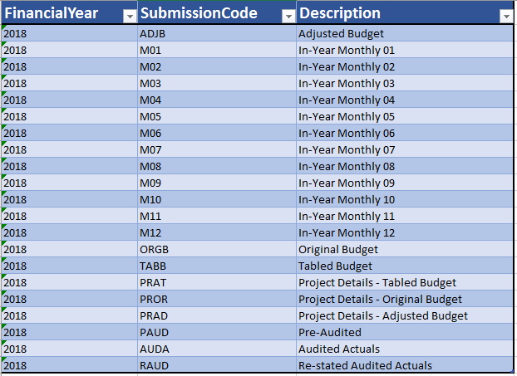
What Needs to be Submitted
mSCOA Reporting and Data Strings

Slide 6
What Needs to be Submitted
mSCOA Reporting and Data Strings
OSB – Statement of Financial performance (operating budget)
Muncde_OSB_ccyy_Y.xls
CA – Capital acquisition budget
Muncde_CA_ccyy_Y.xls
CFB – Cash flow budget
Muncde_CFB_ccyy_Y.xls
GSR – Grants and subsidies received
Muncde_GSR_ccyy_Y.xls
GSG – Grants and subsidies given
Muncde_GSG_ccyy_Y.xls
BS – Statement of financial position (balance sheet)
Muncde_BS_ccyy_Y.xls
SP – Strategic plan (IDP to budget)
Muncde_SP_ccyy_Y.xls
AM – Asset Management return
Muncde_AM_ccyy_Y.xls

Slide 7
What Needs to be Submitted
mSCOA Reporting and Data Strings
CAAA – capital acquisition audit
Muncde_CAAA_ccyy_Y.xls
OSAA – operating audited
Muncde_OSAA_ccyy_Y.xls
BSA – balance sheet audited
Muncde_BSA_ccyy_Y.xls
CFAA – cash flow audited
Muncde_CFAA_ccyy_Y.xls
ACA – audited creditor analysis
Muncde_ACA_ccyy_Y.xls
ADA – audited debtor analysis
Muncde_ADA_ccyy_Y.xls
AMA – asset management audited
Muncde_AMA_ccyy_Y.xls

Slide 8
What format should it be in?
mSCOA Reporting and Data Strings
Below is an explanation of the matrix on the previous slide:
Code Name Code Name Description and Content
TABB Tabled Budget:
The data file should include transactions for categories: TABB, ITY1]
(Indicative Tabled Yr. 1), ITY2 (Indicative Tabled Yr. 2), and TM01 to
TM12 (Projected tabled months 1 to 12)
ORGB Original Budget:
The data file should include transactions for categories: ORGB
ORGB, IBY1 (Indicative Budget Yr. 1), IBY2 (Indicative Budget Yr. 2) and PM01 to PM12 (Projected original months 1 to 12)
ADJB Adjusted Budget:
The data file should include transactions for categories: ADJB, AM01
to AM12 (Projected adjusted months 1 to 12)

Slide 9
What format should it be in?
mSCOA Reporting and Data Strings
The format of the data extraction file transaction records,(data strings):
Before the mSCOA data files can be moved from the LG Upload portal to the reporting tables, the data has to meet the following requirements:
The data extraction file must be pipe delimited (|)
No headings or column headings are allowed
The 6 segments, i.e. Project, Function, Item, Fund, Costing and Region may be
either in the form of the “GUID” or the “Long code”
The detail line(row) must comprise of the following elements/data fields and must be in the following sequence:
i. Demarcation code (This leading code identifies the transacting municipality)
ii. Financial Year (The year, in which the financial period ends, for example,
2016/17 will be 2017)
Transaction Category(Type of transaction provide for the distinction of financial transactions within periods in a particular financial year)

Slide 10
What format should it be in?
mSCOA Reporting and Data Strings
Project segment (GUID or long code)
Function segment (GUID or long code)
Item segment (GUID or long code)
Fund segment (GUID or long code)
Costing segment (GUID or long code)
Region segment (GUID or long code)
Amount
(Amount provides the monetary value of the transaction.
Due to the closing balance requirements on control accounts, the
amount should be informed by the net movement and will only
balance to zero as per general ledger if closing balances are omitted.
No cents are allowed in the amounts field, amounts should be rounded
Credit amounts must have a preceding “-“ sign).

Slide 11
What format should it be in?
mSCOA Reporting and Data Strings

Slide 12
What validations should it meet?
Validation 1
Both Capital and Operational projects must be used

Slide 13
What validations should it meet?
Validation 2
Capital Projects can only have Item Non-Current Assets

Slide 14
What validations should it meet?
Validation 3
Operational projects not valid against acquisitions or additions
(PO not valid against IA002 level acquisitions or additions)

Slide 15
What validations should it meet?
Validation 4
Oper Proj: Cost of Free Basic Services and Revenue Cost of Free Services and Property Rebates can only have Item Revenue or certain Item Assets

Slide 16
What validations should it meet?
Validation 5
Capital Projects can only have Item Non-Current Assets

Slide 17
What validations should it meet?
Validation 6
Remuneration of Councillors not against Mayor and Council
(IE008 not against FX004)

Slide 18
What validations should it meet?
Validation 7
Bulk purchase electricity not against Electricity
IE002001 not against FX002001001 or FX002002001)

Slide 19
What validations should it meet?
Validation 8
Bulk purchases water not against Water
(IE002002 not against FX016001002 or FX016002002)

Slide 20
What validations should it meet?
Validation 9
Inventory consumed:Water not against Water
(IE007004 not against FX016001002 or FX016002002)

Slide 21
What validations should it meet?
Validation 10
Default not valid
(RX001 not valid)

Slide 22
What validations should it meet?
Validation 11
Sum of Charges and Recoveries
(CO001 + CO002)

Slide 23
What validations should it meet?
Validation 12
Charges and Recoveries must balance
(CO001 and CO002 must balance)

Slide 24
What validations should it meet?
Validation 13
Default Costing and default Expenditure not valid
(CO003 and IE018 not valid)

Slide 25
What validations should it meet?
Validation 14
Default Costing and default Revenue not valid
(CO003 and IR004 not valid)

Slide 26
What validations should it meet?
Validation 15
Small Differences Tolerances must be zero
(IE010053 must be zero)

Slide 27
What validations should it meet?
Other Validations
Funding Check – Source and Type
Virements within Vote and %
Detailed IDP Project Changes
Month End – Reporting Variances manual vs data string

Slide 28
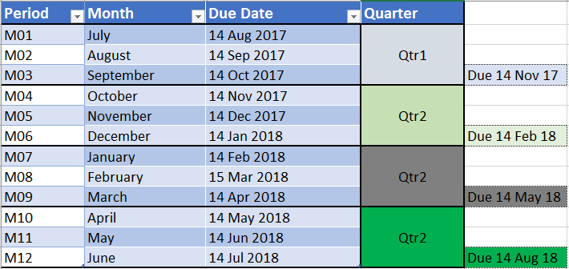
When should they be submitted?
mSCOA Reporting and Data Strings

Slide 29
How - Method
mSCOA Reporting and Data Strings
Zero Based Budgeting from IDP – Budget – SDBIP = mSCOA Budget per Vote
Compliant Budget through the use of Budgeting Tools with validations and checks
Preventative measures
File format Checks
Balance Checks
System Checks, Exceptions and Validations
System is configured and customized to extract the data in required format.
Report/Data Analysis Reviews on time (Month-end procedures with automatic period closure)

Slide 30
Early Detection
mSCOA Reporting and Data Strings
Systems Checks and Validations
Exception Reporting, Dashboards and Analysis

Slide 31
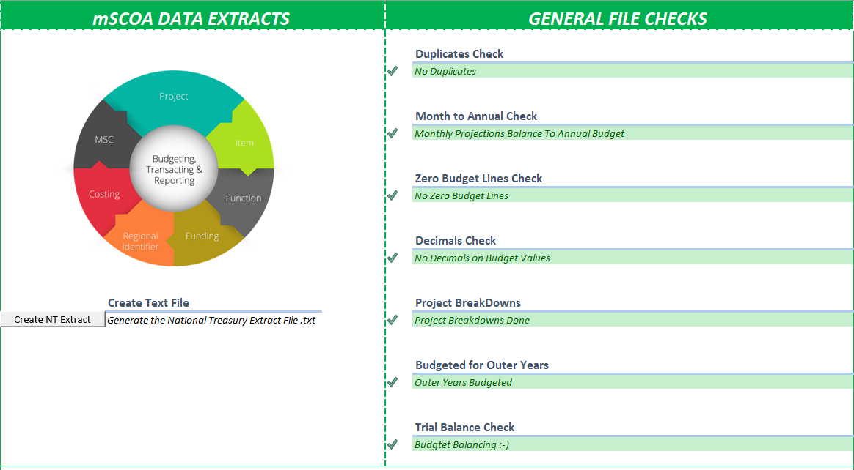
Early Detection
Dashboards - Sample

Slide 32
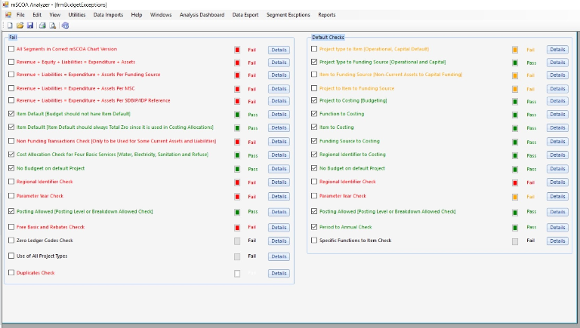
Early Detection
Dashboards - Sample

Slide 33
After Submission
Its not Over until its Over
Please double check and confirm that files successfully uploaded and validated on the LG Upload Portal
Ensure that when submitting you select the correct submission type, financial year, period and mSCOA guid/long code so that you do not affect file format checks

Slide 34
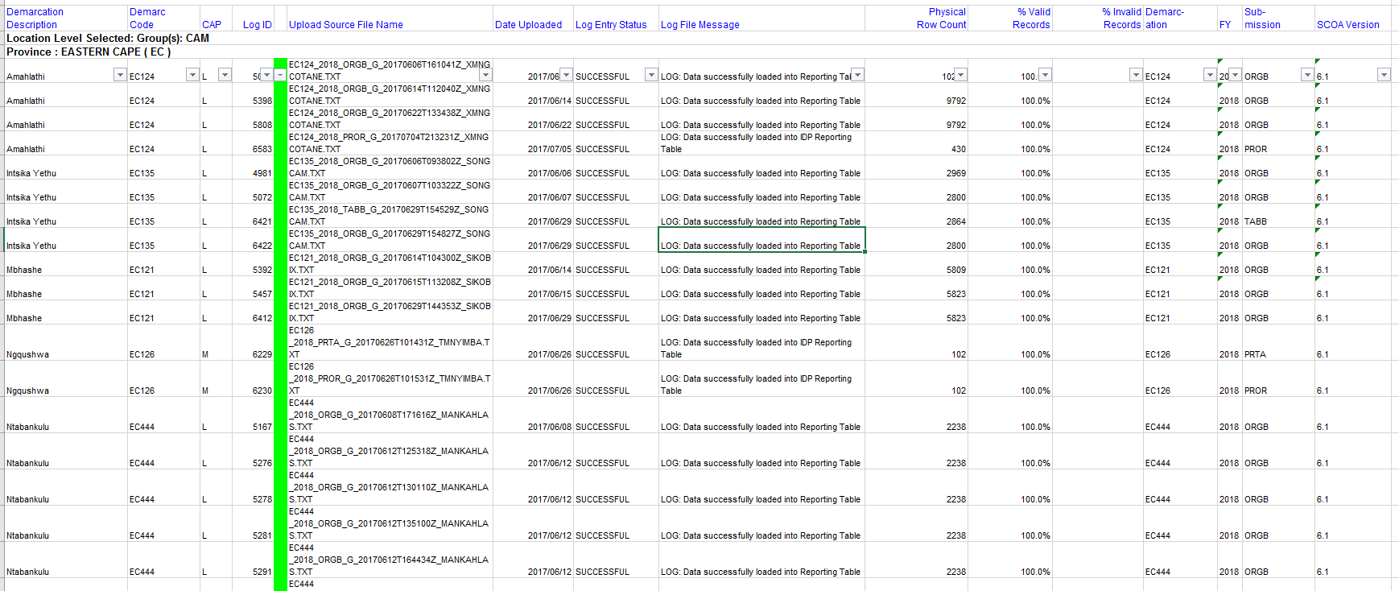
After Submission
Its not Over until its Over

Slide 35
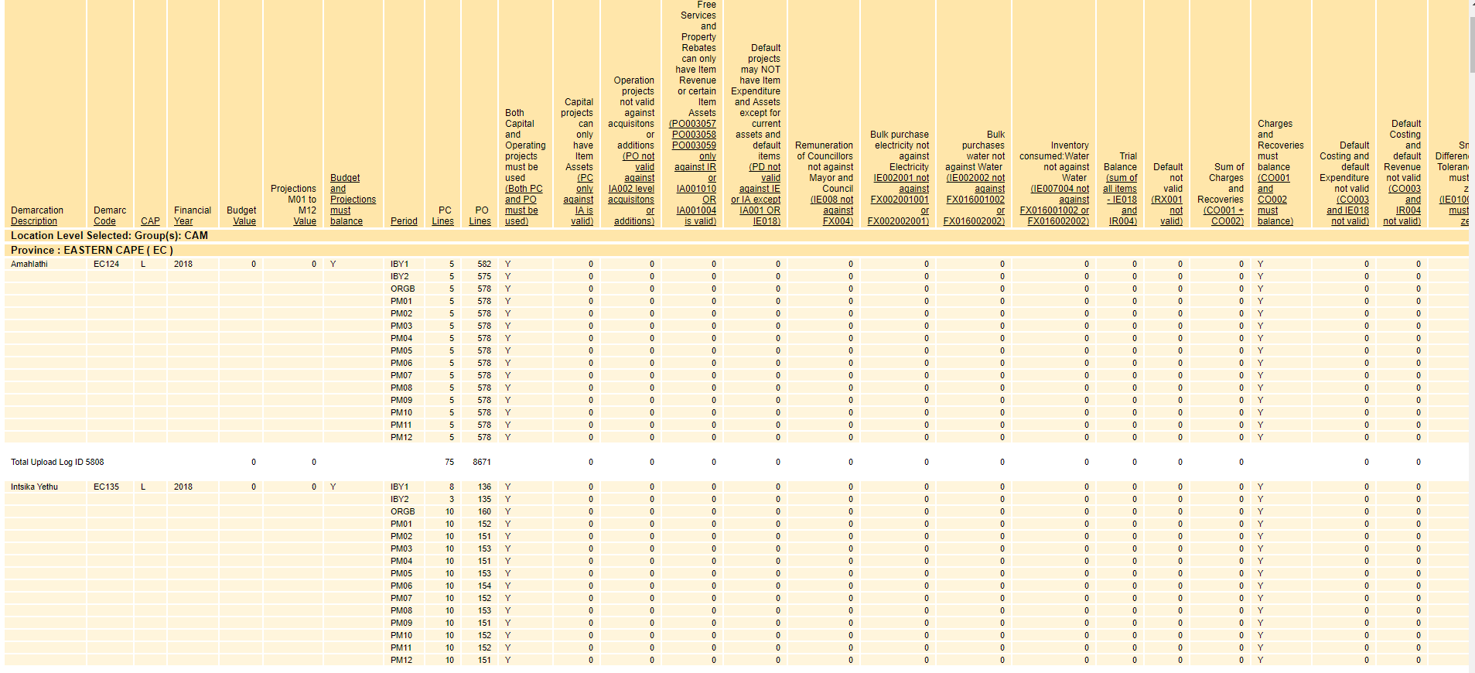
After Submission
How it looks when all is well ☺ ☺ ☺

Slide 36
THE END

