Slide 1
DOING BUSINESS 2016
South Africa
Global Indicators Group
DEVELOPMENT ECONOMICS

Slide 2
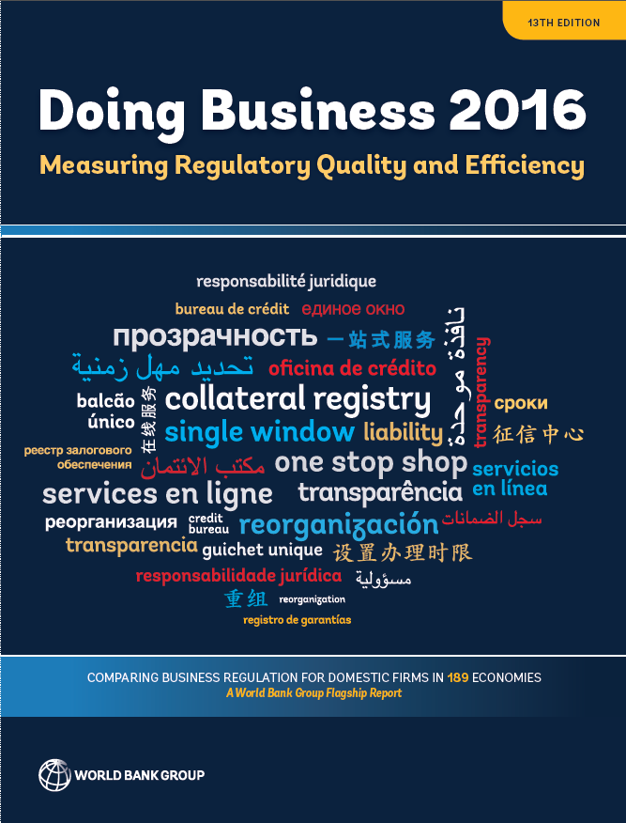
What does Doing Business measure?
Doing Business indicators:
Focus on regulations relevant to the life cycle of a small to medium-size domestic business.
Are built on standardized case scenarios.
Are measured for the most populous city in each country, and the second largest business city in countries with more than 100 million inhabitants.
Are focused on the formal sector.
Doing Business DOES NOT measure all aspects of the business environment such as security, macro-economic stability, prevalence of bribery and corruption, level of training and skills of the labor force, proximity to markets, regulations specific to foreign investment or the state of the financial system.

Slide 3
The 11 areas of business regulation measured by Doing Business affect firms throughout their life cycle
At start-up
Starting a business
Labor market regulation
When things go wrong
Enforcing contracts
Resolving insolvency
In daily operations
Paying taxes
Trading across borders
In getting a location
Dealing with construction permits
Getting electricity
Registering property
In getting financing
Getting credit
Protecting minority investors
Notes:
While measuring aspects of the quality of regulation is not new for Doing Business, the two-year process of introducing improvements that was launched in last year’s report represents a systematic effort to include measures of quality in most of the indicator sets. This year’s report introduces new measures of regulatory quality in four indicator sets: dealing with construction permits, getting electricity, registering property and enforcing contracts. Last year’s report added a measure of regulatory quality to the indicator set for resolving insolvency and expanded those in the indicator sets for getting credit and protecting minority investors.
Doing Business measures the quality of regulation by analyzing whether the regulatory infrastructure needed for a transaction to be successfully completed is in place. Doing Business does not measure the quality of the outcome related to that regulation. For example, Doing Business measures the quality of building regulations and controls by assessing whether building plans are approved by staff with the right qualifications and whether the necessary inspections take place. It does not assess whether the warehouse that gets constructed in the end is of good quality. The following discussion looks at the relationship between efficiency and quality through the lens of Doing Business data. Doing Business focuses on specific case studies and measures particular aspects of business regulation. The results should be interpreted with that framework in mind.

Slide 4
South Africa on the Ease of Doing Business index
Indicator | South Africa’s ranking | World’s top ranked | Sub-Saharan Africa’s top ranked
Starting a business | 120 | New Zealand | Burundi (19)
Dealing with construction permits | 90 | Singapore | Mozambique (31)
Getting electricity | 168 | Korea, Rep. | Mauritius (41)
Registering property | 101 | New Zealand | Rwanda (12)
Getting credit | 59 | New Zealand | Rwanda (2)
Protecting Minority investors | 14 | Hong Kong SAR China, New Zealand, Singapore | South Africa (14)
Paying taxes | 20 | United Arab Emirates, Qatar | Mauritius (13)
Trading across borders | 130 | EU economies trading within the EU | Swaziland (30)
Enforcing contracts | 119 | Singapore | Mauritius (39)
Resolving insolvency | 41 | Singapore | Mauritius (32)

Slide 5
Sub-National Doing Business 2015
South Africa

Slide 9
Measures administration of services and regulations that are important throughout the life cycle of SMEs
START-UP
1. Starting a business
- Employing workers
GETTING A LOCATION
2. Dealing with construction permits
3. Getting electricity
4. Registering property
GETTING FINANCING
- Getting credit
- Protecting investors
WHEN THINGS GO WRONG
5. Enforcing contracts
- Resolving insolvency
DAILY OPERATIONS
Paying taxes
6.Trading across borders

Slide 11
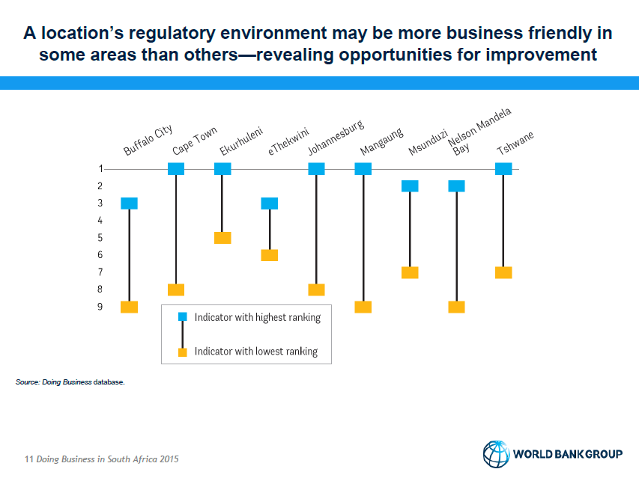

Slide 15
Registering property
Sub National doing business 2015

Slide 16
Why does Registering Property matter?
Real estate typically accounts for 50-75% of national wealth
Unregistered property is dead capital
Registered property enables increased financing and growth
Lenders will not risk lending
Secure property rights lead to increased investment
Real estate holders will not risk investing on the property
Government loses out on tax income
Greater credit potential and less costly to obtain finance
Government: revenue increases & greater planning capacity
In developing economies, only 30% of land is subject to a form of land registration
Just 10% of land in Sub-Saharan Africa is registered

Slide 17
Locations around SA have similar procedural requirements for transferring property
Pre-registration
Conveyance performs due diligence on building and companies
Municipality issues rates clearance certificate(s)*
Municipality issues building compliance certificate (s)*
Conveyancer drafts sales deed
Conveyancer pays transfer duty to SARS
Buyer and seller sign the sales deed
Registration
Conveyancer lodges the transfer deed at the deeds registry & registrar approves the transfer
Simultaneous procedures
Procedures for which requirements/ or time varies across locations*

Slide 18
SA Cities Ranking on Registering property
- Entomologist or ‘beetle’ certificate in coastal cities - Cape Town, eThekwini, Nelson Mandela Bay & Buffalo City
- Plumbing certificate in Cape Town

Slide 19
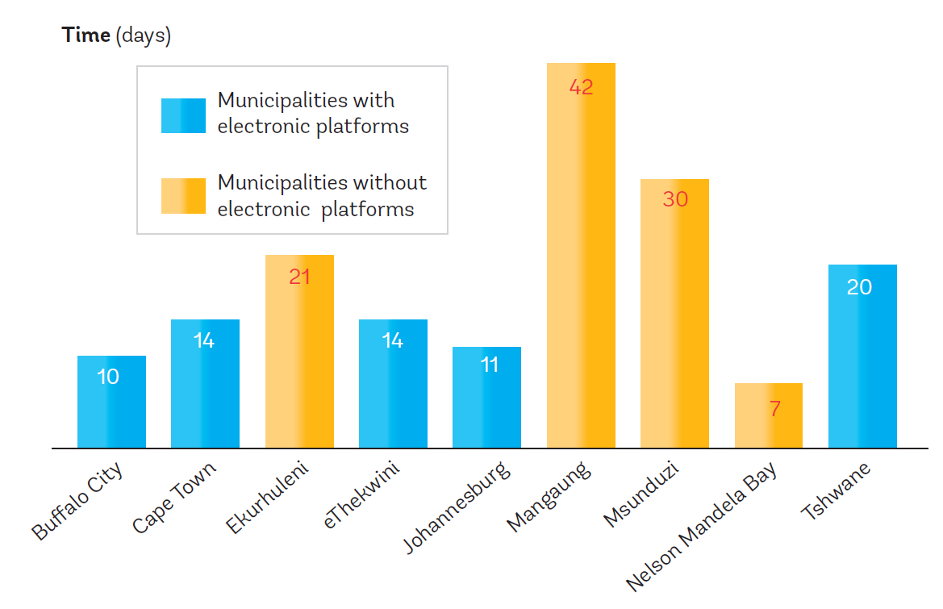
On average, municipalities using electronic platforms issue property rates clearances faster
Note: The percentages of cost are calculated as the average of the 9 benchmarked cities.
Source: Doing Business database.

Slide 20
Registering property in South Africa – DB2016 (Johannesburg)
No | Procedure | Time to complete | Associated cost
1 | Obtain a rates clearance certificate from the local authority | 1 to 2 weeks (simultaneous with procedures 2,3, 4 and 5) | ZAR 178
2 | The conveyancer prepares and collects all the required documentation | 10 days (simultaneous with Procedures1,3,4 and 5) | Included in Procedure 6
3 | Obtain an electrical compliance certificate | 1 week (simultaneous with 1, 2, 4, and 5) | ZAR 1000- 1500
4 | The conveyancer obtains an ownership certificate | less than a day (online procedure and simultaneous with procedure 1, 2, 3 and 5) | No cost (included in procedure 6)
5 | Obtain a transfer duty receipt from the South African Revenue Services | less than a day online procedure(simultaneous with Procedures 1,2, 3 and 4) | Value of property (Rand): Rate 0 – 600,000: 0% 600,001 – 1.000,000: 3% of the value above R600,000, but less than R1.000,000 1.000,001 – 1.500,000: R12,000 + 5% of the value above R1.000,000 but less than R1.500,000 1.500,001 and above: R37,000 + 8% of the value exceeding R1.500,000
6 | Parties sign all the documentation at the conveyancer’s office | 1 day | ZAR 27,310
7 | The conveyancer lodges the deed at the Deeds Registry | 6-14 days | Cost last year: As of 2 May 2013, the Deeds Office fees have increased, as set out in the Government Gazette of 2 April 2013 (No.9938 Notice No. 241).

