Slide 1
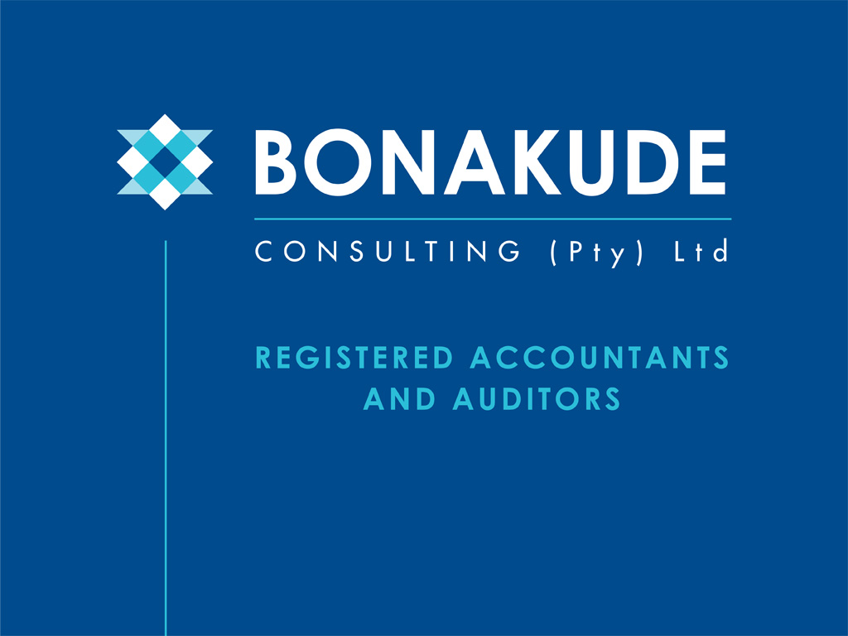
ASSET MANAGEMENT
The third dimension

Slide 2





Our Vision
To be a preferred provider of Accounting,
Auditing and Consulting services
^{in South Africa.}

Slide 3


Our Values
Our core values are underpinned by the following:
^{Professionalism}
We take pride in presenting work that is of high quality, is accurate in a timely manner.
^{Integrity}
We have honest and ethical intentions at all times.
^{Accountability}
We take ownership and show leadership, irrespective of our position.
^{Transparency and objectivity}
We are upfront in our dealings and maintain neutrality at client.
^{Investment in our people}
We ensure that our staff are competent and always motivated
^{Courtesy and decency}
We show self-respect and respect for others

Slide 4



Our Mission
^{To achieve our Vision by:}
By developing strategic partnerships with clients and key role players in the Public and Private Sectors.
By going the extra mile through our availability, strong work ethic and reliability, thus leaving a lasting impact.
By ensuring that our staff are competent and motivated to deploy our diverse skills on client projects.

Slide 5
About our Firm
We are a black owned and black managed professional consulting and auditing firm. We are specialists in public sector accounting and internal auditing with vast experience in local government finance, public entities and provincial departments.
We have a team of highly motivated professionals who are registered accountants, registered auditors, tax practitioners, registered internal auditors, professional accountants and BEE approved auditors. ’Our senior management are accredited by CIGFARO and National Treasury as MSCOA Trainers.
Our staff are affiliated with professional bodies such as:
South African Institute of Chartered Accountants (SAICA)
Independent Regulatory Board of Auditors (IRBA)
Institute of Internal Auditors (IIA)
South African Institute of Professional Accountants (SAIPA)
Chartered Institute of Government Finance, Audit & Risk Officers(CIGFARO)
South African Institute of Government Auditors (SAIGA)
A number of our staff, including the Chief Executive Officer, are products of the Auditor-General South Africa (AGSA) trainee programme

Slide 6
Our Services
Business Consulting
^{Municipal Support}
GRAP Compliant Fixed Asset Management
GRAP Compliant Financial Statement Assistance / Preparation or Review
^{VAT Compliance and Recovery}
Annual Reports and Performance Reporting
Research and Technical Services
^{Training}
Municipal Demarcation Support and Change Management
^{MSCOA Training and Support}
Internal Audit
Internal Audit Policies and Framework Development/Reviews and Updates
^{Risk Management}
^{Combined Assurance Frameworks}
^{Out-and Co-sourcing}
^{Financial Reviews}
Audit of Predetermined Objectives and Performance Information
^{Compliance Audits}
^{Performance Audits}
Forensic Audits and Special Investigations
^{IT Audits}
^{Mentoring and Training}

Slide 7
Our Services
Accounting Service
Assurance
External Audit
Due Diligence Reviews
^{Accounting}
^{Payroll Outsourcing}
^{Bookkeeping}
^{Tax Returns}
Company Registration Annual Returns
^{Tax Clearances}
^{Provisional Tax Submissions}
^{VAT Registrations}
^{VAT 201 Returns}
EMP201 Returns Employees Tax Reconciliations

Slide 8

Resolution to Sustained Quality Improvement
To ensure that we produce quality work and quality services to our clients, our engagements are constantly supervised by dedicated, skilled project supervisors who are on site during the execution of the fieldwork. Their mandate is to ensure that work is executed at the appropriate standards; work is supported, changes
and challenges to the projects are identified on a timely basis and appropriate action agreed with directors and the client. The timelines for the project are adhered to or deviations approved, efficiencies and quality are improved..

Slide 9
Content
^{INTRODUCTION}
^{2. LEGISLATIVE REQUIREMENT}
4. INTERNAL CONTROL AND ASSET MANAGEMENT
^{3. ISO STANDARDS} ^{ON ASSET MANAGEMENT}

Slide 10
Introduction
Internal Control Environment and ISO standards in relation to asset management . ISO AND INTERNAL CONTROLS , same whats app group
Best Practice = ISO not compulsory
First world countries (municipalities) have voluntarily adopted ISO to improve asset management practice
Objective of ISO is to Enable organization to achieve its objectives through effective & efficient management assets . INTERNAL CONTROL

Slide 11
Introduction
Internal controls in relation to assets management can be alleviated to two distinct risks.
The primary risk is physical in nature and relates to the asset getting lost, stolen or damaged thereby affecting the value as reported on the AFS.
The second risk on value is financial in nature, related to errors in determining cost basis, useful life, (including assessment thereof), impairment and depreciation.

Slide 12
Legislative requirements
The municipalities are required to structure and manage their administration processes to give priority to the basic needs of the community (The Constitution).
The Accounting officer must ensure that the municipality has and maintains a management, accounting and information system that accounts for all assets. (S63 of the MFMA)
Senior managers are responsible for taking reasonable steps to ensure that the assets and liabilities of the municipality are managed effectively and that assets are safeguarded and maintained to the extent necessary (S78 –MFMA).

Slide 13
Accounting framework
GRAP Standards applicable
Property plant and equipment (GRAP 17)
Land (GRAP 12, 16, 17 & 103)
Intangible Assets (GRAP 31 )
Heritage Assets (GRAP 103)
Investment Property (GRAP 16)
Non-current assets held for sale (GRAP 100)
Impairment- non-cash and cash generating (GRAP 21 & 26)
The above standards provide guidance on how the assets should be recognised, measured and disclosed in the financial statements and the information that should be in the accounting policies.

Slide 14
WHY ASSET MANAGEMENT?
An organization’s top management, employees and stakeholders should implement planning, control activities (e.g. policies, processes or monitoring actions) and monitoring activities, to exploit opportunities and to reduce risks to an acceptable level.
Asset management involves the balancing of costs, opportunities and risks against the desired performance of assets, to achieve the organizational objectives. The balancing might need to be considered over different timeframes.
Asset management enables an organization to examine the need for, and performance of assets and asset systems at different levels. Additionally, it enables the application of analytical approaches towards managing an asset over the different stages of its life cycle (which can start with the conception of the need for the asset, through to its disposal, and includes the managing of any potential post disposal liabilities).

Slide 15
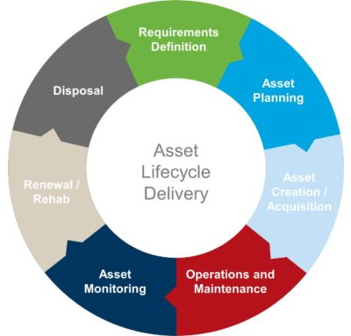
Asset management life cycle

Slide 16
WHAT ARE THE BENEFITS OF ASSET MANAGEMENT
improved financial performance: improving the return on investments and reducing costs can be achieved, while preserving asset value and without sacrificing the short or long-term realization of organizational objectives;
informed asset investment decisions: enabling the organization to improve its decision making and effectively balance costs, risks, opportunities and performance;
managed risk: reducing financial losses, improving health and safety, good will and reputation, minimizing environmental and social impact, can result in reduced liabilities such as insurance premiums, fines and penalties;
improved services and outputs: assuring the performance of assets can lead to improved services or products that consistently meet or exceed the expectations of customers and stakeholders;
demonstrated social responsibility: improving the organization’s ability to, for example, reduce emissions, conserve resources and adapt to climate change, enables it to demonstrate socially responsible and ethical business practices and stewardship;

Slide 17
WHAT ARE THE BENEFITS OF ASSET MANAGEMENT
demonstrated compliance: transparently conforming with legal, statutory and regulatory requirements, as well as adhering to asset management standards, policies and processes, can enable demonstration of compliance;
enhanced reputation: through improved customer satisfaction, stakeholder awareness and confidence;
improved organizational sustainability: effectively managing short and long-term effects, expenditures and performance, can improve the sustainability of operations and the organization;
improved efficiency and effectiveness: reviewing and improving processes, procedures and asset performance can improve efficiency and effectiveness, and the achievement of organizational objectives.

Slide 18
Asset management overview

Slide 19
Asset management in local government
To be effective, asset management in municipalities/entities should include the following:
Service level needs identified in the IDP process must drive asset management practices and decision-making;
Asset management plans must be integral part of the municipal planning process;
Asset acquisition decisions must be based upon the evaluation of alternatives, including demand management and non-asset solutions;
Asset acquisition proposals that include a full business case, including costs benefits and risks across each phase of an asset’s life cycle;
The must be a defined responsibility and accountability for performance, safe custody and use of asset.
Disposal decisions must be based on an analysis of disposal options, designed to achieve the best possible return for the municipality and made in accordance with the provisions of the MFMA;
Sound risk-based internal controls supporting all asset management
practices must be in place.

Slide 20
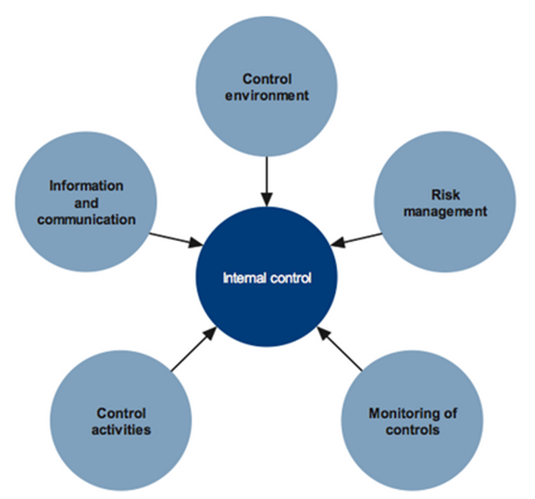

Slide 21
Why Internal controls are important?
Internal controls are there to ensure the following:
Only needed assets are acquired;
Assets are safeguarded/protected;
Assets records are maintained and accurate;
Promote operational efficiency of assets;
Assets achieve the organizational goals; and
There is compliance with policies, rules, regulations, and laws

Slide 22
Some of the key internal controls
Internal controls regarding asset management include some of the following:
Approval process for Capital Expenditures (Capex)
Determination whether planned expenditure is capitalized or expensed
If capitalized, appropriate useful life and residual value determined
Correct depreciation expense is calculated and applied each period
Assets are assessed for impairment indicators in line with GRAP
Asset are maintained in line with approved asset manteinance plans
Insurance coverage relates directly to asset exposure
Annual asset counts conducted to verify assets
Disposal of assets is done in line with assets disposal policy and procedure

Slide 23
ISO (International Organization for Standardization ) on Asset Management
ISO 55000 | Asset management (AM) – Overview , principles and terminology
ISO 55001 | AM - Management systems – Requirement
ISO 55002 | AM – Management systems – Guidelines for the applications of ISO 55001

Slide 24
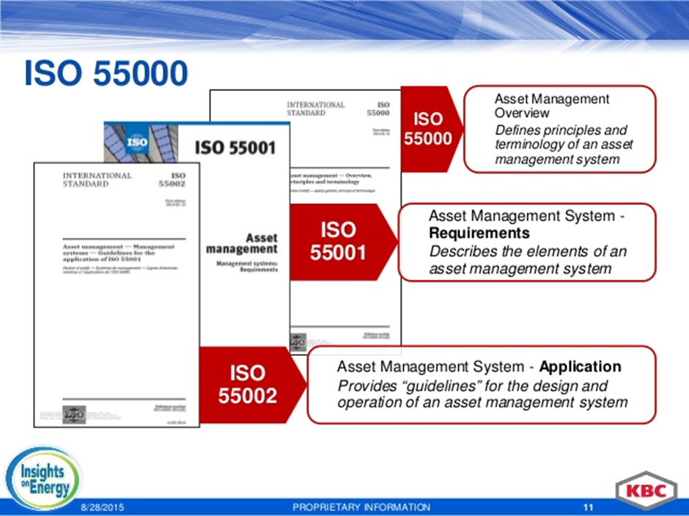

Slide 25
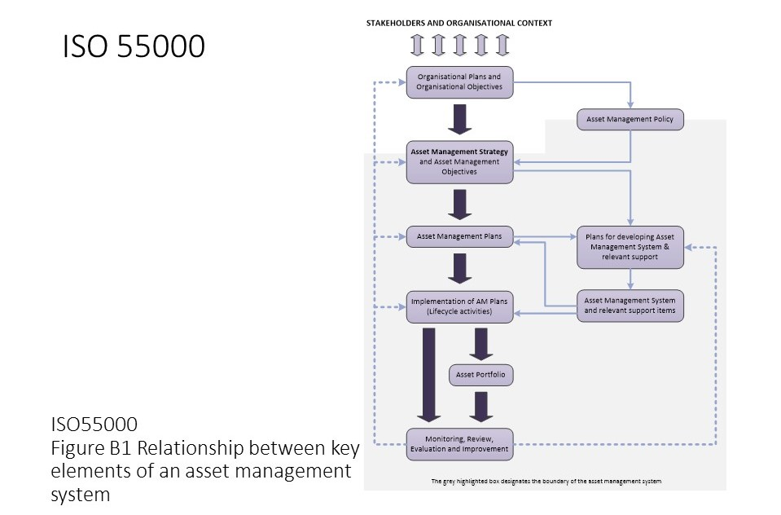
Relationship between key elements of an asset management system

Slide 26
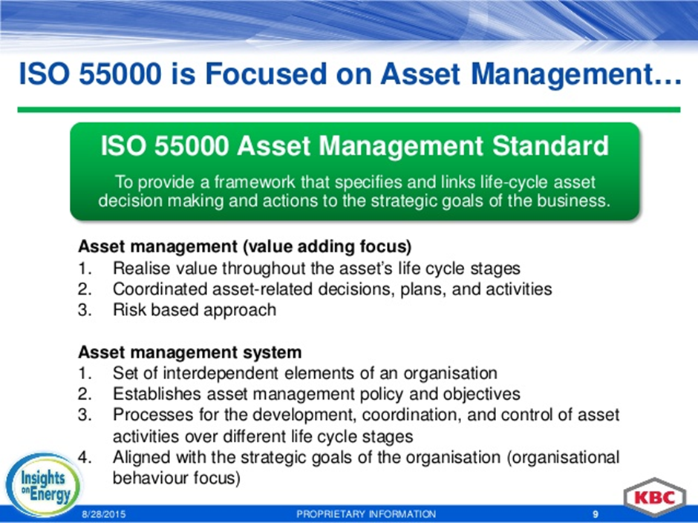

Slide 27
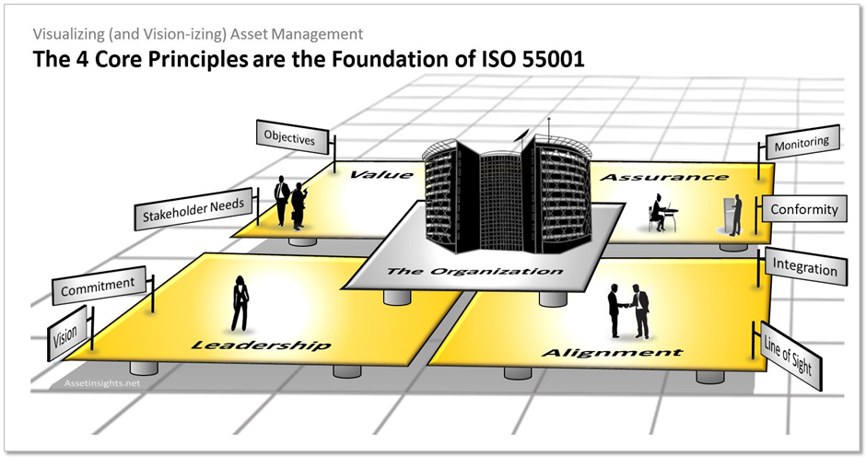

Slide 28

Thank You!

Slide 29

DURBAN OFFICE
84 Seventh Avenue, Morningside, Durban 4001
PO Box 50112, Musgrave, 4062
Tel: 031 201 1241/2 • Fax: 087 231 4072
Email: admin@bonakude.co.za
GAUTENG OFFICE
2nd Floor West Tower, Nelson Mandela Square
Maude Street, Sandton, Johannesburg 2196
PO Box 785553, Sandton, 2146
Tel: 011 881 5452 • Fax: 087 231 4072
Email: admin@bonakude.co.za
www.bonakude.co.za

