Slide 1
Artificial Intelligence : The Impact of Finance Professionals
By : Walter Muwandi
CIGFARO GRAP SEMINAR
2 July 2018
Emperors Palace : Ekurhuleni

Slide 2
THE PAST
THE PRESENT
THE FUTURE

Slide 3
First Lets Look at The Evolutional of Finance Professionals
The us/we Finance Professionals
The Millennial Finance Professionals
The Gen Z Finance Professionals
The Alpha Finance Professionals

Slide 4
THE PAST

Slide 5
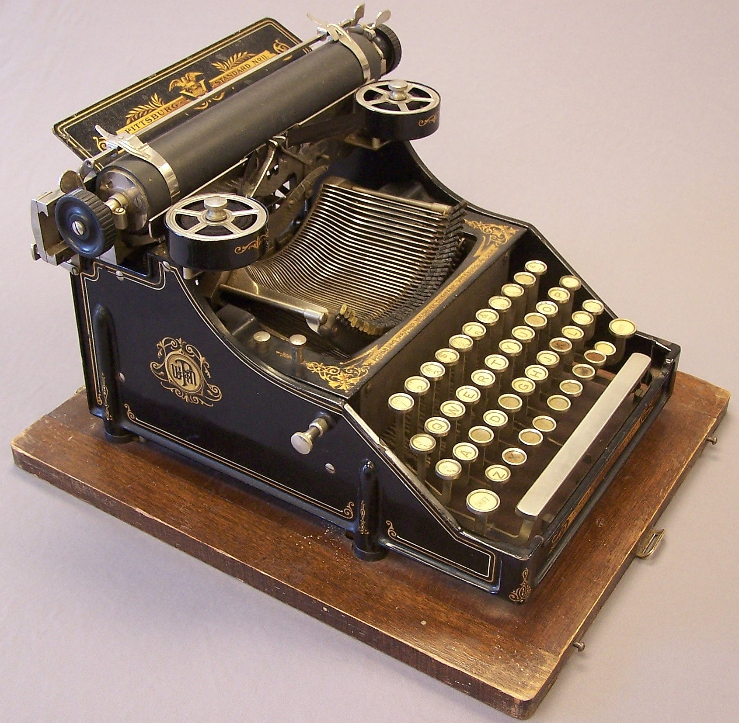
1. The Past

Slide 6
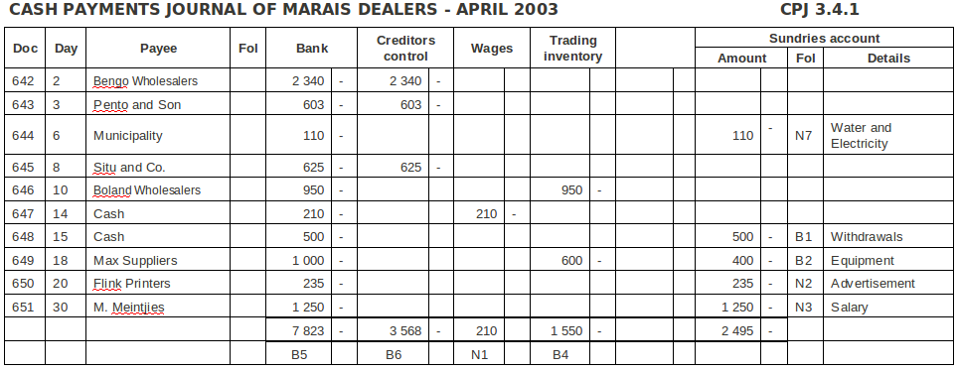
1. The Past Continued…..

Slide 7
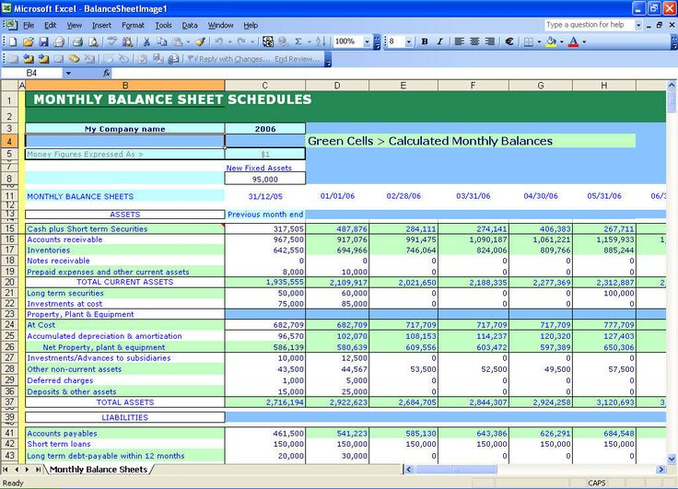
1. The Past Continued…….
Excel Financial Statements

Slide 8
2. THE PRESENT

Slide 9
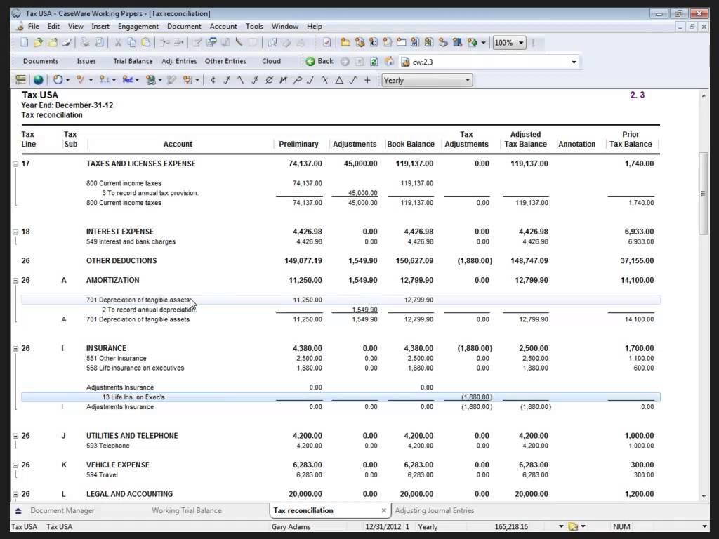
2.1 Use of AFS Preparation Software :

Slide 10
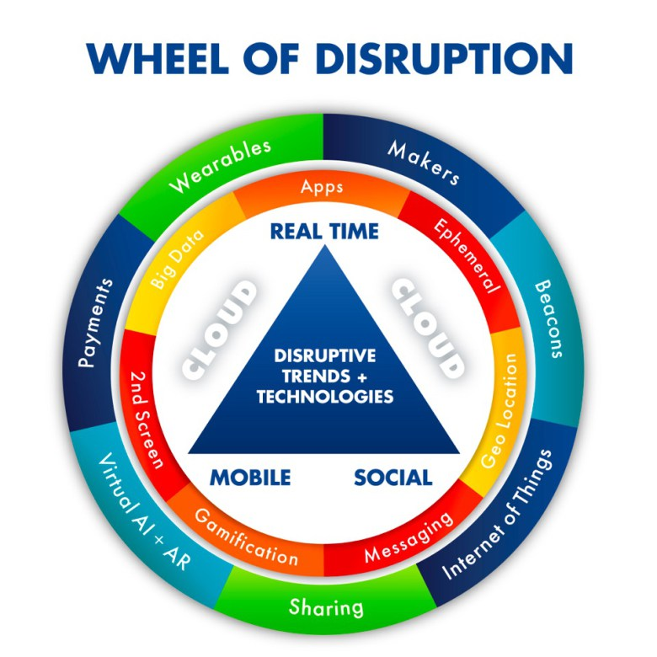
2.2 The Present Continued …..

Slide 11
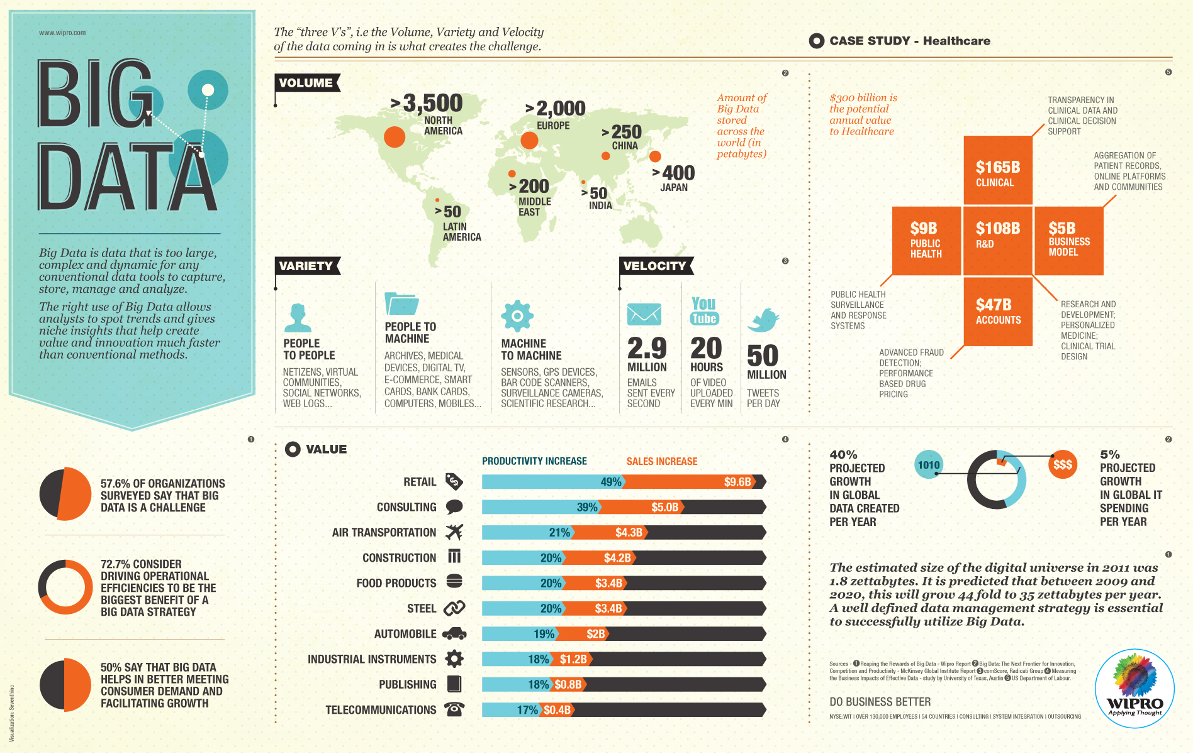
2.3 The Present Continued…..
2. THE PRESENT

Slide 12
2.4 The Present Continued …. Interactive Session on How we Transact :
When you Order Food via Uber Eats
Lets Ponder & Analyse :
Time Taken
Transactions/Parties/Legislation
How have these been Recorded?
How do we Collect Taxes?
How do we Audit them?
Will the Present methods of accounting work?
Continued…….
Continued…….

Slide 13
3. THE FUTURE

Slide 14
3.1 GRAP [#]
Crypto Currencies?
Crypto Assets?
Big Data Accounting?

Slide 15
3.2 ARTIFICIAL INTELLIGENCE
CIGFARO GRAP Seminar
BY-SA

Slide 16
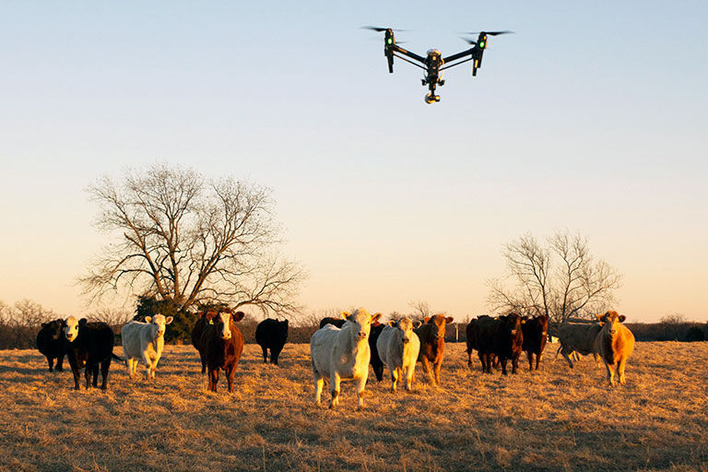
3.3 Intelligent Drones for inventory/Assets

Slide 17
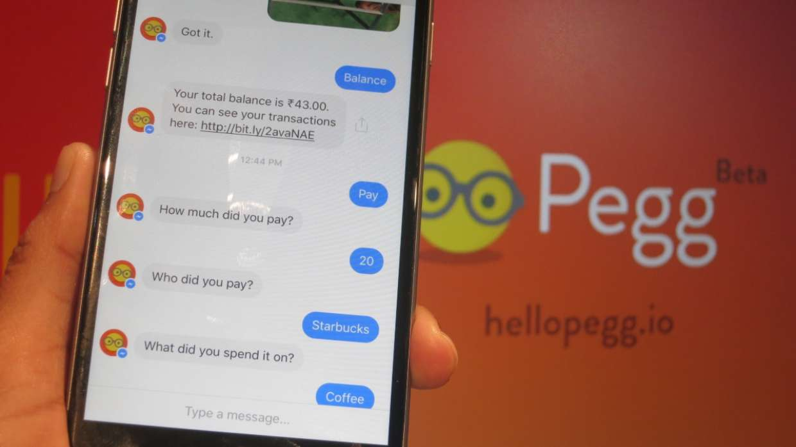
3.4 Chat Bots, OCR, Accounting at Source
THE FUTURE

Slide 18
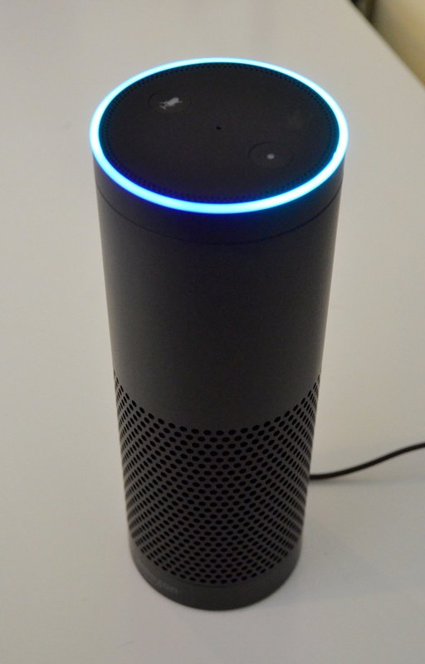
3. 5 The Future Continued….
Smart Accounting :
Machine Learning, Voice Interaction, Augmented Reality;
ERP Integration CRM, Hr, Payroll, etc eg Alexa & Sage One , Alexa and Web Hr

Slide 19
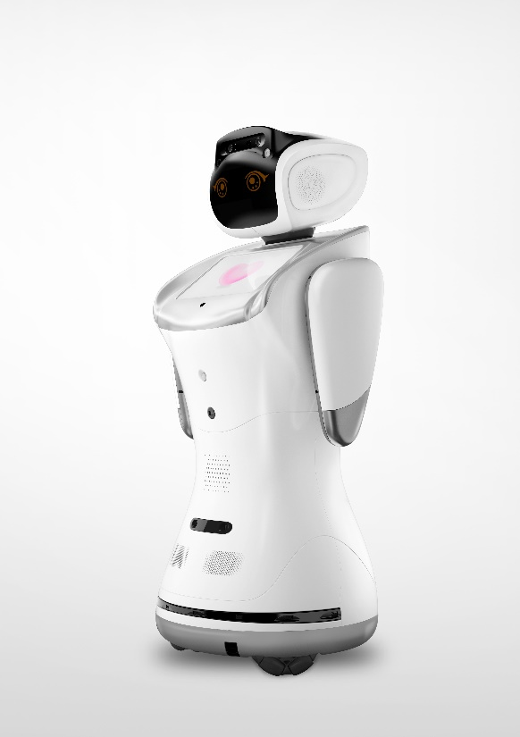
3.6 Humanoids, Robots
Presentations, Point of Sale, Dashboards, Learning and Development, Stocktakes, Data Analytics
CIGFARO GRAP Seminar
CIGFARO GRAP Seminar

Slide 20
What Next For the Finance professional
When data Processing is Redundant
When Reporting is Automated
When Knowledge of Standards is Embedded
When Presentations is Automated

Slide 21
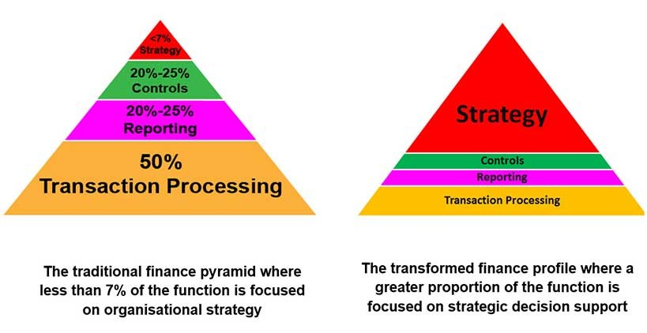
The Changing Role :

Slide 22
Contacts :
Walter Muwandi (FCCA)
Email : Walter@ccgsystems.co.za
Tel +27 83 8707020
Office +27 11 805 1027

