Slide 1
Bridging the gap between skills capacity and performance
Research Paper by Graham K Reid and Carl W Stroud (3 July 2018)

Slide 2
Abstract
Many authors have investigated why skills transfer is not optimally successful in the Local Government environment and other sectors. It is evident from most of these studies that a key area that inhibits the transfer of skills and the requisite performance attached to that is the individual’s capacity to learn. An extremely pertinent word being the individual.
Yet no scientific and comprehensive assessment has been proposed and utilized to analyze the individual’s inherent capacity to learn.

Slide 3
Introduction
The performance of many Municipalities has been under scrutiny and as such it has been deemed imperative that the skills gaps of individuals be analyzed in order to identify relevant, efficient and effective means to eradicate these gaps and thereby enhance the performance of Municipalities within the South African context.

Slide 4
Introduction
This study will therefore identify the main constructs of learning and leadership, assess individuals against those constructs, identify gaps, deliver the findings and make recommendations that can close the gaps identified, thereby making a positive future impact on the performance of the Local Government sector as a whole.

Slide 5
Contextualisation
“From a South African Municipal context Mafunisa, Ramabulana, Hlaele and Nekwakwani (2014) have identified, amongst others, that skills transfer in the Municipal environment is influenced by the following criteria/ constructs:
Self-Efficacy
Knowing how to learn
Learning Ability and Trainability
Cognitive Ability
Management and Leadership Skills
Communication and accountability
Method of Learning vs Learning Style
They further contend that a skills audit prior to embarking on training is also essential.

Slide 6
Research Methodology
The study makes use of the Ad Astra Leadership Potential Assessment tool to assess the learning and leadership potential of 20 Municipal workers from various levels within their respective organizations. These individuals and the organizations they are from will remain anonymous from an ethics perspective.

Slide 7
Research Methodology
The Ad Astra Leadership Potential Assessment tool assesses and identifies gaps regarding the following dimensions:
Literacy
Numeracy
Trainability
Leadership Potential
Personality
Leadership Style
Decision Making Style
Self-Efficacy (Individuals belief in their ability to achieve their goals)
Creativity

Slide 8
Research Methodology
The Ad Astra Leadership Potential tool has been successfully used by the Macsteel Group amongst other organizations in order to: identify skills gaps; enhance career path planning; motivate staff; re-organize divisions; enhance Employment Equity efforts; identify talent; better engage employees; improve success rates of learnerships; effectively balance teams; enhance decision-making; amongst others.

Slide 9
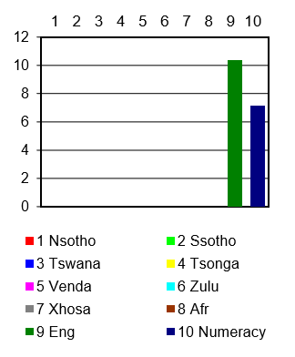
Findings
Languages and Numeracy (Level) Summary
Notes:
As can be seen from Figure 1 the average English Literacy level of the group is below ABET Level 5/ Grade 10/ NQF2,
while the average Numeracy of the group is ABET Level 3/ Grade 7.

Slide 10
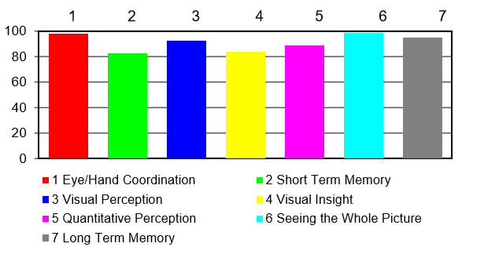
Findings
Trainability Summary
Notes:
As can be seen from Figure 2, the trainability of the group is on average at 91%. This result is above the benchmark of 90% as listed in Table 1 attached hereto, but as will be discussed in the analysis portion to follow Short Term and Long Term Memory are especially a cause for concern.

Slide 11
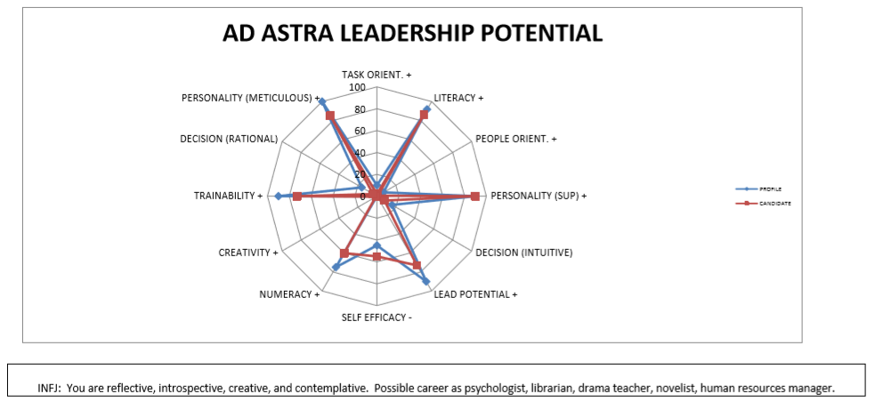
Findings
Ad Astra Leadership Potential of Respondent 15
Notes:
Figure 4 above depicts the profile of an individual that has gaps for most areas assessed in comparison to the benchmark.

Slide 12
Findings
Notes:
LP: 85% of Respondents fell below the benchmark of 90% for Leadership potential, which indicates a potentially lower ability to acquire and transfer knowledge to their team and the likelihood of a loss in credibility amongst their team members.
LS: PO: 60% of the Respondents fell short of the benchmark score of 7 indicating that they might be too Task Oriented and therefore ignore the needs of individual members and also not show enough focus on group interactions.

Slide 13
Findings
Notes:
LS: TO: 20% of the Respondents fell short of the benchmark score of 15 indicating that the majority of Respondents are sufficiently Task Oriented to get their job done. The 20% of Respondents that fell short will however need intervention in this area as a good Leader should achieve a score of higher than the benchmark in both areas of Leadership Style.
DM: R: 10% of the Respondents fell short of the benchmark score of 16 indicating that the majority of Respondents possess a satisfactory Decision Making (Rational) they however do not have the prerequisite balance between their two Decision Making Styles as indicated in Decision Making (Difference) below. The 10% of Respondents that fell short will however need intervention in this area as a good Leader should achieve a score of higher than the benchmark in both areas of Decision Making Style.

Slide 14
Findings
Notes:
DM: I: 65% of the Respondents fell short of the benchmark score of 16 indicating that the majority of Respondents do not possess a satisfactory Decision Making (Intuitive) and they therefore do not have the prerequisite balance between their two Decision Making Styles as indicated in Decision Making (Difference) below. The 65% of Respondents that fell short will therefore need intervention in this area as a good Leader should achieve a score of higher than the benchmark in both areas of Decision Making Style.
DM: D: 90% of the Respondents fell short of the benchmark score of Zero (0) indicating that the majority of Respondents do not possess a satisfactory balance in their Decision Making Style. The 90% of Respondents that fell short will therefore need intervention in this area as a good Leader should achieve a balanced score in the two Decision Making Areas.

Slide 15
Findings
Notes:
S-E: 10% of the Respondents fell short of the benchmark score of 45 indicating that the majority of Respondents possess a satisfactory Self-Efficacy. 35% of the Respondents however scored just below the benchmark score of 45 and since the lower the score is the greater the person’s confidence it is clear that at least 45% of the Respondents will greatly benefit from interventions in this area.
Creativity: 5% of the Respondents fell short of the benchmark score of zero (0) indicating that the majority of Respondents possess a satisfactory level of Creativity.

Slide 16
Recommendations
It is deemed of utmost importance that each individual in an underperforming Municipality be assessed using the scientific methodology of this paper to identify individual skills gaps that when resolved will lead to increased and optimal performance of the individual and the relevant Municipality as a whole.

