Slide 1
Redefining the 21st century Asset Management
A Municipal Perspective by Emmanuel Ngcobo

Slide 2
POINT OF DISCUSSION
Overview
Traditional vs. Modern Times Techniques
Limitations on Infrastructure Assets
Modern Approaches
Conclusion

Slide 3
Overview
Driver:-
Constitution Sec 152.
Objects of local government –
(a) To provide democratic and accountable government for local communities;
(b) To ensure the provision of services to communities in a sustainable manner;
(c) To promote social and economic development;
(6) To promote a safe and healthy environment; and
(e) To encourage the involvement of communities and community organisations in
the matters of local government.

Slide 4
Overview
Driver:-
Municipal Finance Management Act (Section 96)
Safeguarding of Assets
Establishment of Systems
Proper & sound management of assets allows municipalities to provide an agreed and expected level of service in the most cost effective manner for present and future generations/communities.

Slide 5
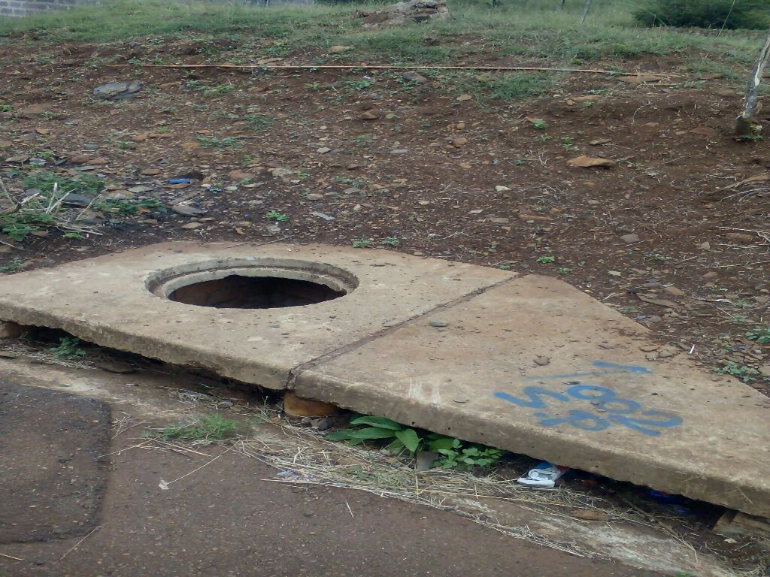
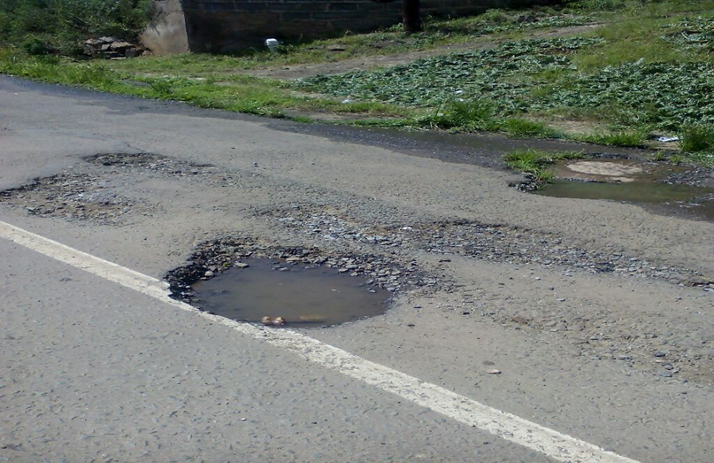
CURRENT STATUS

Slide 6
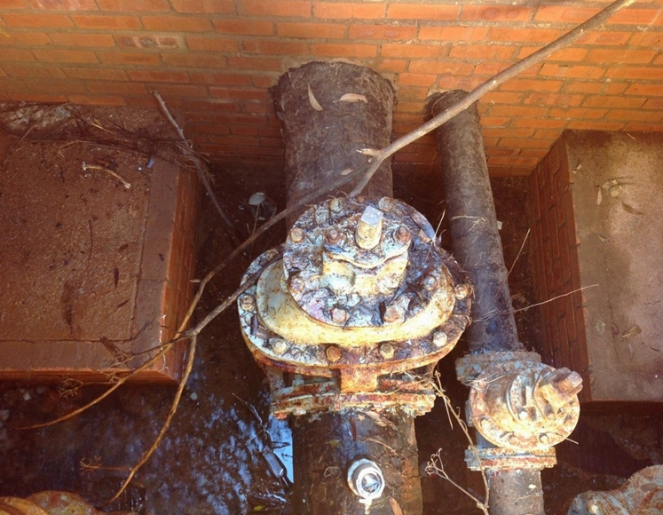
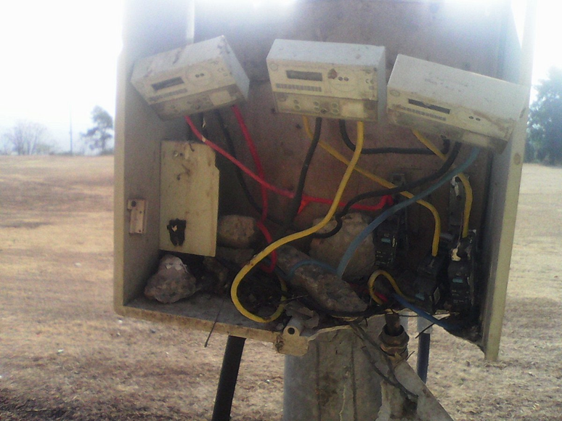
CURRENT STATUS

Slide 7
TRADITIONAL VS. MODERN TIMES
Audit Outcomes Approach
Preparation of Annual Financial Statements
CFO Office Driven
Movables vs Infrastructure ‘Management’ time spent
AMP ‘in place’ adopted by Councils
Conditional Assessment performed….mostly each year

Slide 8
LIMITATIONS
Human Capacity (Subject Matter)
Inadequate Budgets (0.5% vs 8% of PPE); O & M; Replacements
Depreciated Values – Not set aside
Political > Socio-economic *
Impact of Climate Change
“aging of roads caused by climate change will require increased maintenance and more frequent rehabilitation”
Urbanisation

Slide 9
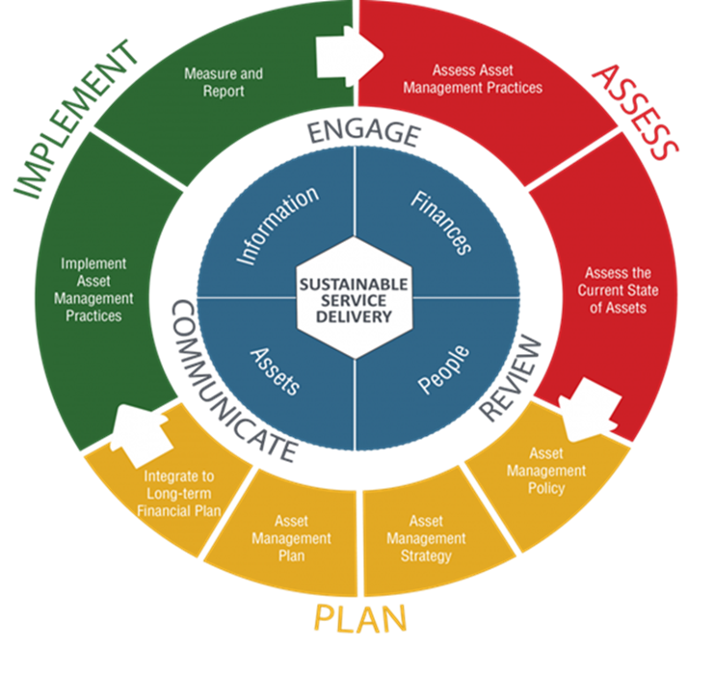
…MODERN TIMES

Slide 10
…MODERN TIMES
Holistic Approach – Organisationally
Level of Service Understanding – Optimum Cost Effective Use
Data Analytics/Management – Uses
Alternative Funding Models
Human Resource Development
Collaborations *

Slide 11
THANK YOU

