Slide 1
XaaS – Anything as a Service in the Municipal Environment
Willy Govender
CEO : Evaluations
9 October 2018

Slide 2
Change – we have to Embrace it
Status Quo
Buy Licenses
Purchase Hardware
Capitalize and Depreciate
Buy more than required
AMC costs around 20% of original spend
Crossing over
Internet now more than mature
Broadband – high speed and more reliable
Computing power – more and more required
Notes:
With the convergence of technology and infrastructure platforms, the Internet has paved the way of several disruptions to traditional business models. By combining the Internet, high speed broadband networks, and data centers with powerful computing power, in technology, XAAS provides a platform for organisations to dramatically reduce its capital costs, scale on demand and pay only for what is used. This session will examine what XAAS is, the benefits and how it applies to local government.

Slide 3
Xaas Explained
Outsource non-core components to vendor to manage
Pay as you go, depending on use
Typically delivered over the internet to onsite at client
SaaS
PaaS
IaaS
software applications, such as Google Apps, Microsoft Office 365 and Salesforce, to users.
preconfigured virtual machines (VMs) and other resources for application development and testing. offerings, such as Amazon Web Services (AWS) Google App Engine, SAP HANA
deploy and configure virtual machines hosted in a data center and manage those VMs remotely such as Microsoft Azure, Amazon Cloud

Slide 4
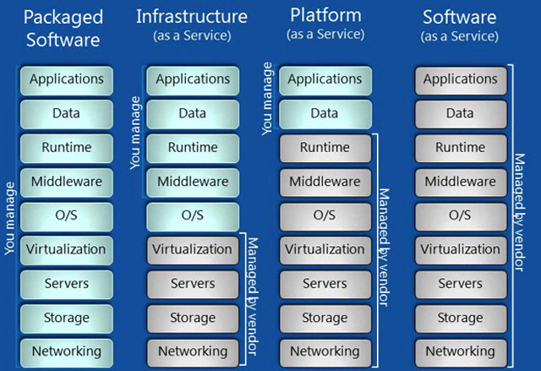
Technology based Service offerings

Slide 5
Meal as a Service
On Premise
IaaS
PaaS
SaaS
Table/Chairs
Table/Chairs
Table/Chairs
Table/Chairs
Drinks
Drinks
Drinks
Drinks
Energy
Energy
Energy
Energy
Equipment
Equipment
Equipment
Equipment
Ingredients
Ingredients
Ingredients
Ingredients
Cook At Home
Ready Made
Take Out
Eat out

Slide 6
traditional onsite to subscription based
Transportation as a Service
UBER
Accommodation as a Service
Airbnb
Payment as a Service
Zapper
Malware as a Service
Anti-virus and security
Entertainment as a Service
Netflix
TAXIFY
LYFT
Tripping.com
Google Pay
Samsumg Pay
Snapscan
vmware Appdefense
Spotify
Apple Music
Amazon Prime
Google (youtube)

Slide 7
Benefits
Lower cost
No outright purchase or upfront costs
Cost is divided over contract term
Capex to Opex
Scalability/Flexibility
Upgrade or downgrade depending on user requirements and demand
New versions and updates at no additional cost
Respond faster to business changes, improvements and innovations
Maintenance
Vendor does all maintenance at no additional cost to customer
Backups
Simplicity
IT services, infrastructure, skills reduced
No real estate overhead costs, reduced energy costs etc
Independence
Device – use multiple modes to access
Location – access from anywhere

Slide 8
Be aware of
Security/Risk
Internet/cloud based
Data privacy
Resilience
Broadband dependency
Multi-vendor strategy
Continuity
Vendor reliance/ESCROW
SLA Management

Slide 9
The business of Municipalities
Management
Functions
Finance
Human Capital
Planning
Accountability
Community Services
Maintenance
Information Technology
Supply Chain
Planning and Building Regulations
Utilities (Water, Electricity, Cleansing, Street Lighting)
Health Services
Transport
Business (Trading, Markets, Licensing)
Safety (Traffic, Police)
Housing

Slide 10
Customer Care, Credit Control and Debt Collection
Municipal Budgeting, Planning and Financial Modelling
Financial Accounting
Costing and Reporting
Project Accounting
Treasury and Cash Management
Grant Management
Underpinned with a Standard Chart of Accounts
Customer Care
Financials
Revenue
Management
Corporate
Governance
Revenue Cycle: Meter Reading, Billing, Accounts Receivable and Revenue Management and Receipting
Supply Chain
Management
Procurement Cycle: Supply Chain Management, Expenditure Management, Contract Management and Accounts Payable
Human Resource
Management
Municipal Reporting Framework
Real Estate
Management
Asset
Management
Human Resource and Payroll Management
Full Asset Life Cycle Management including Maintenance Management
Land use and Building control Management
Valuation Roll Management

Slide 11
Billing as a Service (BaaS)
CRM
Customer Management
Service Requests
Customer Care
Self Service
Correspondence
Service Delivery
Provisioning
Maintenance
Fault Management
Measurement
Disconnections
Billing
Tariff Management
Bill Generation
Delivery of Bill
Bill Trapping
E-Services
Collections
Receipting
Reconciliations
Allocations
Debt Management
Reporting

Slide 12
How it Works
BaaS
Readings sent to Vendor
Vendor Generates Account
Vendor sends Bill to Customer
Customer Pays
Benefits to Municipality
No billing system required
No IT equipment/services
Administration reduced
Pay per bill generated
Customer requests services
Municipality provides and maintains the Service
Service is measured
Account is Generated
Bill/Statement Sent to Customer
Customer Pays
Revenue Allocation
Debt Management where Customer does not pay

Slide 13
Land as a Service (LaaS)
Property
Registrations/Titling
New Property Creation
Cadastre Mapping
Rates Clearances
MSCOA
Land Use Management
Building Plans
Land Use/Zoning
Town Planning
GIS Mapping
SPLUMA
Valuation Roll
Ownership
Sales
Valuations
Supplementary Rolls
MPRA

Slide 14
Land Administration Model
Vendor
Maintains all property transactions
Deeds Office/Surveyor General Liaison
Provides SaaS for GIS, data administration, business processes
Services related to cadaster maintenance, gis mapping
Provides view/query services to stakeholders
Municipality
Provides base data (aerial imagery, admin GIS data etc)
Undertakes functions (planning, valuations, rates clearances)
Integration to billing systems
Commercials
Per monthly property basis
turnkey SaaS, management and maintenance

Slide 15
Valuation as a Service
Valuation Roll Production
MPRA Compliance
GV every 2 years for Tier 1/2, and 3 years Tier 3/4
Turnkey Services
Property Management
Land Audit
Register Management
GIS/Deeds updates
Systems
Property Register
Valuation Roll
Cloud based
Web publishing
Integration to Billing
Services
Aerial Imagery
Data Management
Valuations
Publishing
Objections and Appeals
Maintenance/Supplementary
Rates Tariff Modelling
Rates Clearances
Optional
LUMS
Billing
Collections

Slide 16
VaaS – How it works
Customer contracts with Implementation Date specified, and a fixed contract term, 5-6 years
Vendor undertakes the full Function to comply with MPRA and meet the timeframes for publishing in year of implementation
This includes the preparation of the register, land audit, monthly deeds updates, imagery acquisition as required, valuations, online publishing, maintenance, objections and attendance to VAB hearings.
A minimum of 2 GVs produced, and annual supplementary valuations
Customer only pays when roll is implemented, in monthly instalments based on the rates amount generated.

Slide 17
VaaS
Exclusions
VAB Costs
Postage cost of notices (S49, S78, S52)
Integration costs to Billing Systems
Advantages
Frequency of Rolls
Fair and equitable
No upfront costs
Legislative Compliance

Slide 18
XaaS in the Smart City
Smart Grid
Smart Connect
Smart Lighting
Smart Water
Smart Waste
E-services
Fines
Security

Slide 19
Where to for Municipalities
XaaS is here …. and expanding
Decide on what is core and XaaS the rest
Build strong contract/SLA management capability to manage vendor contracts and monitor service quality
Revise procurement challenges/issues/policies
Work with vendors that have financial backing, track record, accreditation and willing to share risk and reward
Ensure local economic development is supported by vendor

Slide 20
Contact
Willy Govender
Email : willy@sdh.za.com
Cell : +27 (83) 7795441

