Slide 1

Headline Verdana Bold
Unpacking Carbon Tax
In Conversation with Deloitte Africa Tax & Legal
23 May 2019

Slide 2

Carbon Tax Briefing
Global Investment and Innovation Incentives (Gi³)

Slide 3
Overview of briefing
 | Environmental accountability – the New Normal
 | The South African view – response mechanisms
 | Carbon Tax – getting ready and short term approach
 | The New Normal – strategic response required

Slide 4
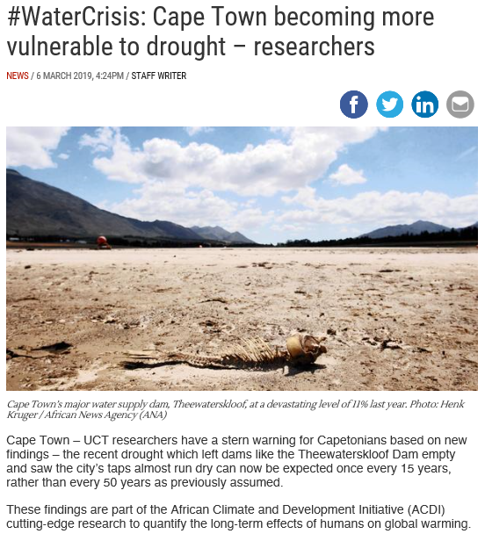

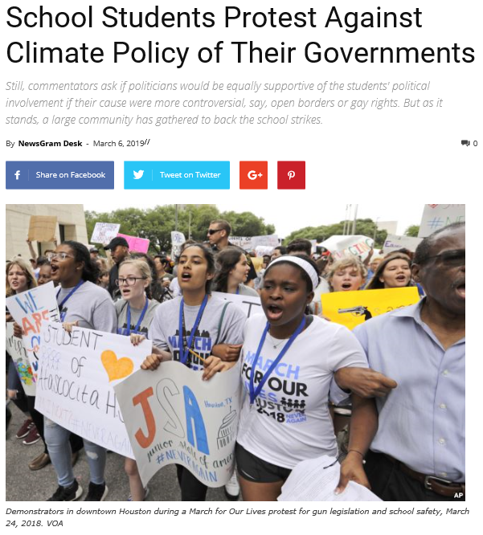
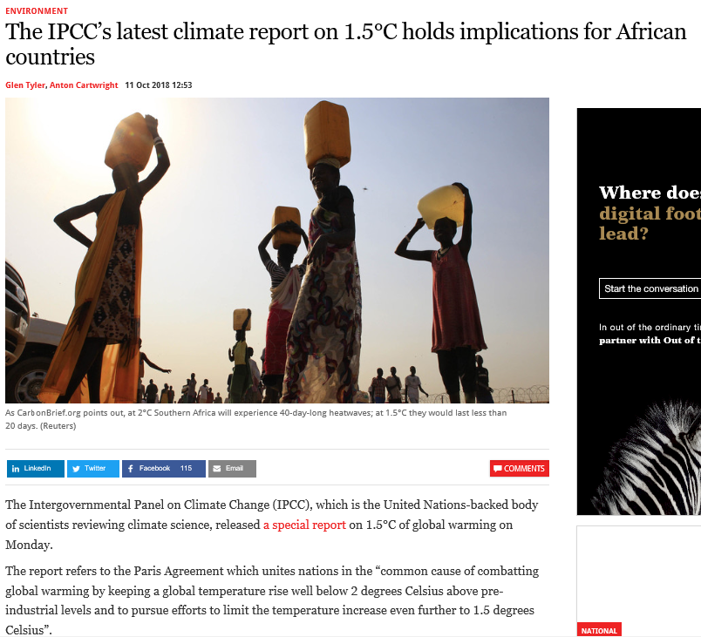


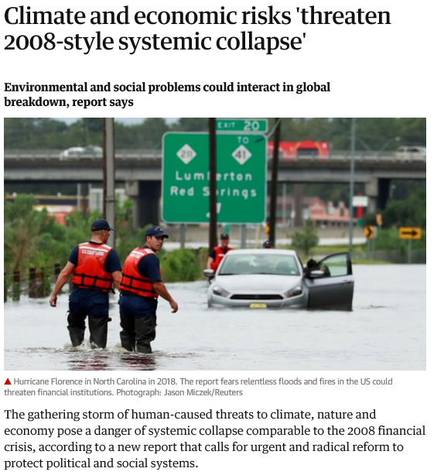
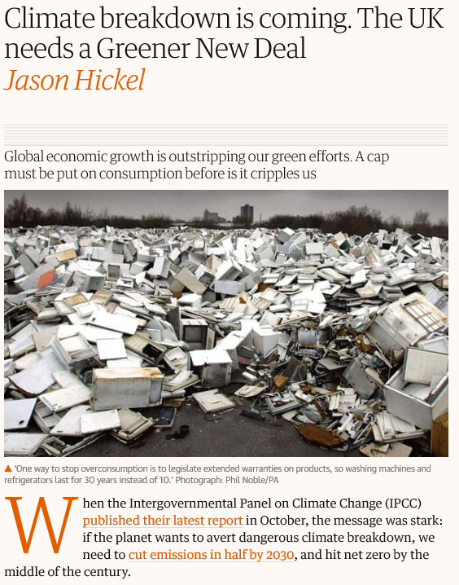
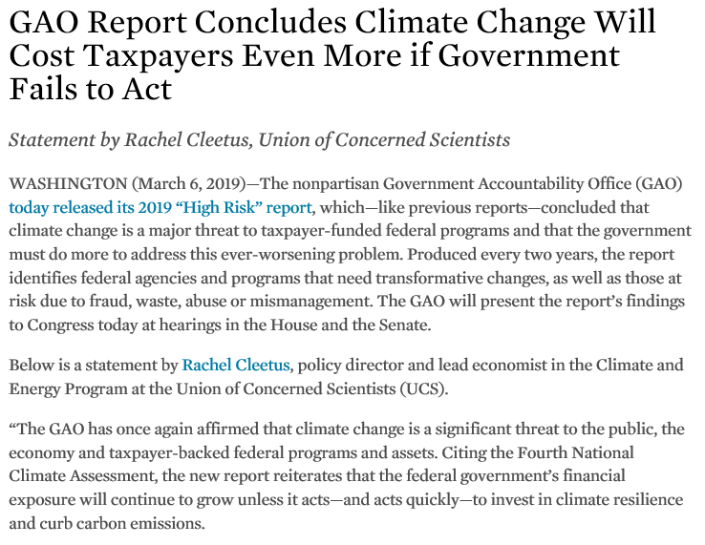

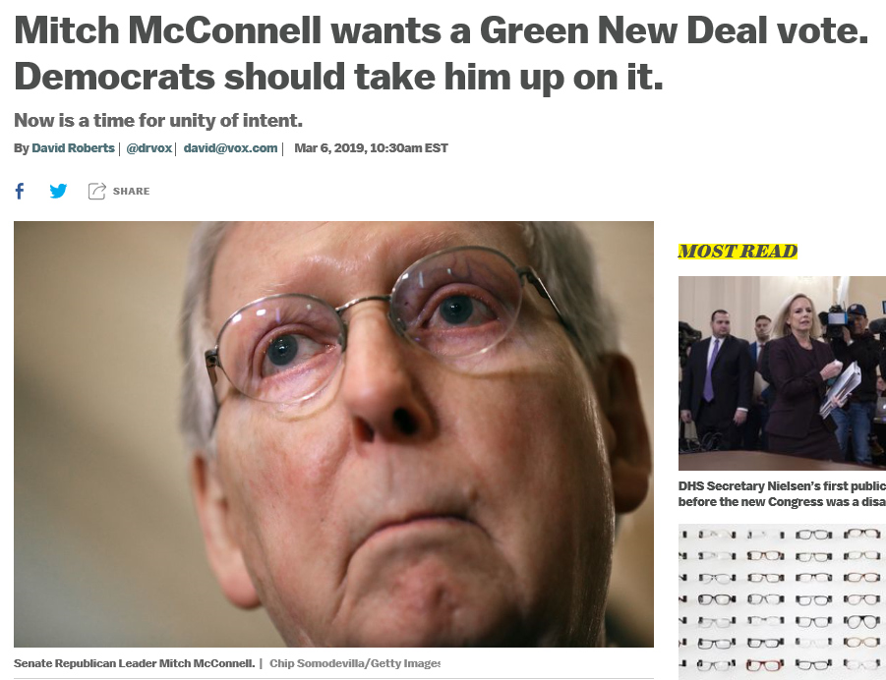
Social | Science
Political | Economical
This is dummy text it is not here to be read it is here to show how this document will look.
Notes:
1950 – Carbon dioxide level exceed 300ppm – for the first time 400,000 years
1988 – Establish the Intergovernmental Panel on Climate Change
1992 – United Nations Framework Convention on Climate Change
1997 – Kyoto Protocol
2016 – COP21 Paris Agreement

Slide 5
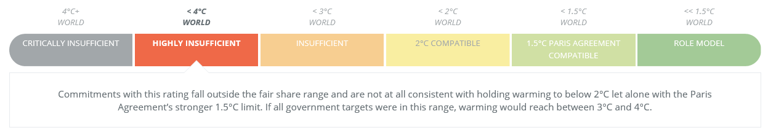
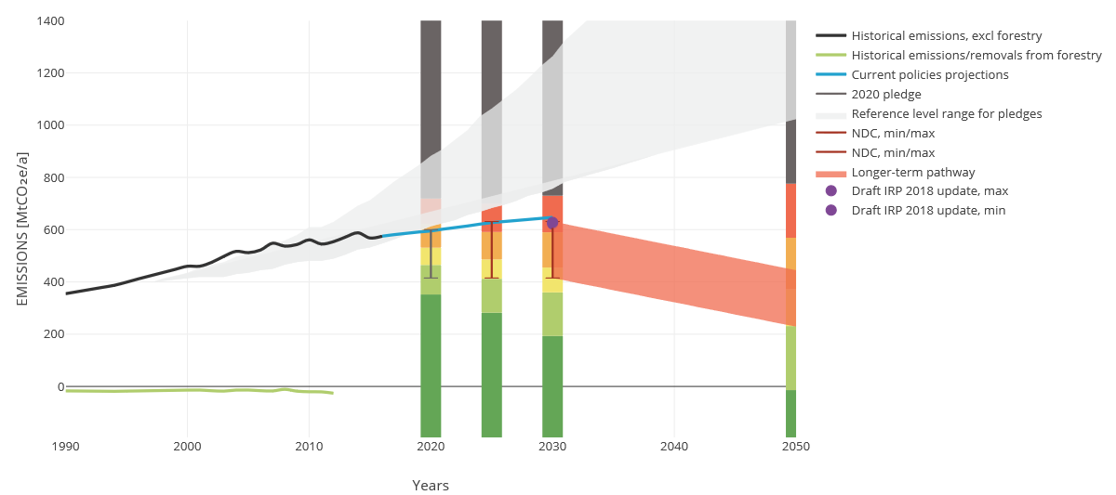
Environmental Accountability – The “New Normal”
South Africa’s commitments and emissions trajectory

Slide 6
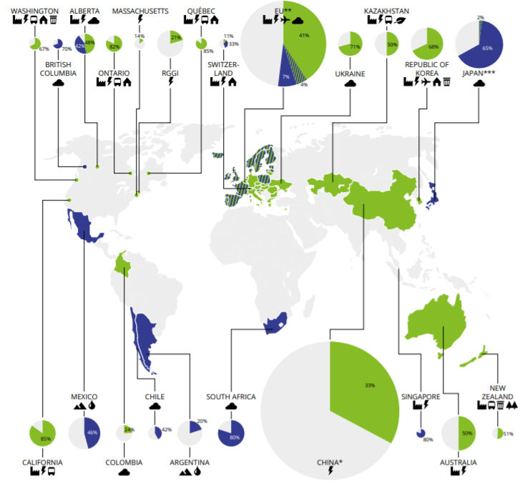
Environmental Accountability – The “New Normal”
International Carbon Pricing trends
Emission trading schemes implemented or scheduled for implementation
Carbon Tax implemented or scheduled for implementation

Slide 7
The Carbon Tax
Getting ready and short term implications

Slide 8
The Carbon Tax
The basic process
Determine
emissions
Submit
GHG report
Apply
allowances
Make
payment
Qualify
01
02
03
04
05
Determine if you exceed the threshold for any activity by summing capacity of all owned and operated facilities.
Use activity data in conjunction with reporting guidelines to determine emissions.
Submit GHG report to the DEA annually by 31 March.
Determine allowances that qualify by reviewing regulations.
Submit annual Carbon Tax payment – expected to be July each year.

Slide 9


The Carbon Tax
Greenhouse Gas emissions reported to the DEA will form the basis of the Carbon Tax
  Legislature overview
    Data providers include:
      Holding companies, corporations or legal entities
      All subsidiaries and legally held operations (including JVs)
      All facilities with operational control not covered by another data provider
    Boundaries potentially different from Carbon Tax
    Covers combustion, fugitive and process emissions
    Reporting thresholds per activity throughout an entire entity –
    generally 10 MW thermal net heat input
Tier 1, 2 or 3 methodology
Report for each listed GHG separately
Calculation example
Emissions (kgCO2) = combusted coal (TJ/tonne) × emission factor (kgCO2/TJ)
Calculation example
Emissions = tonnes combusted coal × emission factor

Slide 10
The Carbon Tax
Code | Name | Shall report when total installed capacity for this activity is over the threshold | Category A Threshold
1A3a | Civil Aviation | Tier 2 or 3 | 100 000 litres/year
1A3b | Road Transportation | NA | NA
1A3c | Railways | Tier 2 or 3 | 100 000 litres/year
1A3d | Water-borne Navigation | Tier 2 or 3 | 100 000 litres/year
1A3e | Other Transportation | NA | NA
1A4 | Other Sectors
1A4a | Commercial/Institutional | Tier 2 or 3 | 10 MW (th)
1A4b | Residential | Tier 2 or 3 | 10 MW (th)
1A4c | Agriculture/Forestry/Fishing/Fish Farms | Tier 2 or 3 | 10 MW (th)
1A5 | Non-Specified
1A5a | Stationary | Tier 2 or 3 | 10 MW (th)
1A5b | Mobile | NA | NA
1A5c | Multilateral Operations | NA | NA
1B | Fugitive Emissions from Fuels
1B1 | Solid Fuels
1B1a | Coal Mining and Handling | Tier 2 or 3 | None
1B1b | Uncontrolled Combustion and Burning Coal Dumps | NA | NA
1B1c | Solid Fuel Transformation | Tier 2 or 3 | None
1B2 | Oil and Natural Gas
1B2a | Oil | Tier 2 or 3 | None
Reporting thresholds
Reportable activities
Combustion emissions (1Axx)
Fugitive emissions (1Bxx & 1Cxx)
Industrial process and product use emissions
(2Axx, 2Bxx, & 2Cxx)
Forestry (3B1x)
Waste (4Axx & 4Cxx)
Threshold type
Capacity (e.g. 10 MW thermal input)
None
N/A
Specific thresholds

Slide 11
The Carbon Tax
GHGe reporting example
Things Holdings
Cement (Pty) Ltd
Paper (Pty) Ltd
Ceramics (Pty) Ltd
Cement Plant 1
Cement Plant 2
Paper Plant 1
Paper Plant 2
Tile Plant
Fuel combustion (1A2f)
150 MW (th)
Process emissions from clinker (2A1)
Fuel combustion (1A2f)
1 MW (th)
Fuel combustion (1A2d)
60 MW (th)
Fuel combustion (1A2d)
10 MW (th)
Fuel combustion (1A2f)
4 MW (th)
Fuel combustion (1A1a)
35 MW (th)
Process emissions (2A2)
GHG reporting
Sum of activities at holding company level.
Activities:
1A2f
  Threshold 10 MW (th)
  Capacity = 155 MW
1A2d
  Threshold 10 MW (th)
  Capacity = 70 MW
1A1a
  Threshold 10 MW (th)
  Capacity = 35 MW
2A1 and 2A2
  No threshold, automatically in
Notes:
Things Holdings
Cement (Pty) Ltd
Cement Plant 1 – integrated cement plant including coal fired kiln and cement grinding
Cement Plant 2 – Cement grinding mill only with heating for grinding mill
Paper (Pty) Ltd
Paper Plant 1 – integrated pulp and paper mill including coal and biomass boilers and natural gas turbine for electricity
Paper Plant 2 – paper mill including coal boiler
Ceramics (Pty) Ltd
Tile Plant – Clay tile plant including gas fired kiln

Slide 12
The Carbon Tax
The basic process
Determine
emissions
Submit
GHG report
Apply
allowances
Make
payment
Qualify
01
02
03
04
05
Determine if you exceed the threshold for any activity by summing capacity of all owned and operated facilities.
Use activity data in conjunction with reporting guidelines to determine emissions.
Submit GHG report to the DEA annually by 31 March.
Determine allowances that qualify by reviewing regulations.
Submit annual Carbon Tax payment – expected to be July each year.

Slide 13
The Carbon Tax
Determine GHG emissions

Slide 14



The Carbon Tax
Verified data will be critical to ensure compliance
GHG report
Carbon Tax
Carbon Budget and PPP
Verified data source
Annual report
CDP report
DoE report

Slide 15
Carbon Tax administration
will bring together very precise
and very imprecise accounting mechanisms

Slide 16
The Carbon Tax
The basic process
Determine
emissions
Submit
GHG report
Apply
allowances
Make
payment
Qualify
01
02
03
04
05
Determine if you exceed the threshold for any activity by summing capacity of all owned and operated facilities.
Use activity data in conjunction with reporting guidelines to determine emissions.
Submit GHG report to the DEA annually by 31 March.
Determine allowances that qualify by reviewing regulations.
Submit annual Carbon Tax payment – expected to be July each year.

Slide 17
The Carbon Tax
Breaking down the Carbon Tax formula
Carbon Tax payable
X
Carbon Tax rate, R120 per tonne CO₂e increased by CPI +2% annually
R
 | Combustion |  | Process |  | Fugitive
X = < | {[(E - S) x (1 - C)]-[D x (1-M)]} | + | {P x (1 - J)} | + | {F x (1 - K)} | > x R
E | S | C | D |  | P | J |  | F | K
Fuel combustion emissions | Sequestered emissions | Sum of fuel combustion emission allowances | Emissions from diesel and petrol (will be included in fuel levy) |  | Process emissions | Sum of process emission allowances |  | Fugitive emissions | Sum of fugitive emission allowances

Slide 18
The Carbon Tax
As amended during SCoF process
Example of Carbon Tax Allowances for Combustion Emissions
    An environmental levy, not a tax
    Tax on total combustion, process and fugitive emissions
    Tax rate of R120 per tonne of CO₂e
Taxpayers can reduce their effective Carbon Tax rate to R12 tCO₂e through allowances (or R6 tCO₂e for fugitive and process emissions)
Allowances
Basic tax free threshold | 60% or 70%
Trade exposure | 0%, 5% or 10%
Performance | 0% to 5%
Carbon budget | 5%
Carbon Offsets | 0% to 10%
Maximum of | 90% or 95% set

Slide 19
The Carbon Tax
Allowances for different emission types
Emission source | Fuel combustion | Transport (other than road) | Fugitive emissions | Process emissions
Basic allowance for combustion emissions | 60% | 75% | 0% | 0%
Basic allowance for process emissions | 0% | 0% | 0% | 70%
Fugitive emissions allowance | 0% | 0% | 10% | 0%
Trade exposure allowance | 10% | 0% | 10% | 10%
Performance allowance | 5% | 0% / 5% | 5% | 5%
Carbon budget allowance | 5% | 5% | 5% | 5%
Offsets allowance | 10% | 10% | 5% | 5%
Maximum total allowances | 90% | 90% / 95% | 35% | 95%

Slide 20

The Carbon Tax
Trade Exposure allowance has recently been reworked between business and Treasury
Second Draft Carbon Tax Bill approach:
$$\text{Trade} \text{exposure} \text{allowance} \text{∝} \frac{\text{Value} \text{of} \text{imports} \text{+} \text{Value} \text{of} \text{exports}}{\text{Local} \text{production}}$$
Exact method to be determined by regulation.
This methodology may be supplemented by the use of a qualitative assessment based on the specific competitive characteristics of a sector.
Indication that allowance will be 0% (<10%), 5% (<35%) or 10% (>35%), and not pro rata.
253 | Mining and quarrying other non-metallic minerals
301 | Meat, fish, fruit etc.
302 | Dairy products
303 | Grain mill products
304 | Other food products
305 | Beverages
306 | Manufacture of tobacco products

Slide 21
The Carbon Tax
Performance allowance requires submission of benchmarks for approval
Ecofys, with support from the World Bank’s Partnership for Market Readiness, originally developed benchmarks for select number of sectors, and recommended further engagement with industry
Benchmark development is complex in sectors with a highly diverse set of products (e.g. consumer products)
Deadline for submissions passed, awaiting regulations
“It can be challenging for sectors where multiple products are produced simultaneously without a clear basic production process and in cases where there is a large variety of product specifications within the same product group and where these product specifications influences the emissions intensity of production of this product.”
As a next step, it is for this sector very important to discuss possible benchmark approaches with the sector in more detail by looking at similarities and differences in production processes and products produced. International experience is of little help in this respect as hardly any international benchmark methodologies could be found for this sector.

Slide 22
The Carbon Tax
Voluntary participation in Carbon Budget programme requires engagement with DEA
Carbon budget participation invitations initially extended to entities in sectors where at least one entity emits more than 100 000 tCO₂e per year
Potential for opting in by engaging with DEA:
    Develop estimate of emissions for five year period looking forward
    Indicate what emission reduction measures will be put in place
    Non-binding commitment to emissions cap
System expected to become mandatory in 2021

Slide 23
The Carbon Tax
Sequestration
[(E - S) x (1 – C)]
Allows for the deduction of sequestered emissions from fossil fuel emissions.
Requires a certificate from the DEA verifying the sequestered emissions.
Methodologies for determining sequestration presently being developed by DEA with relevant sectors.
Afforestation –
more carbon stored in forest = sequestration

Slide 24
The Carbon Tax
Carbon offsets involve specific projects that reduce, avoid or sequester emissions
Process
1 offset reduces Carbon Tax liability by R120
Expected trade price of offsets R±80
Presently over the counter market – expected to become exchange in future (with potential for international buyers)
Limitations and requirements:
    South African offsets only
    Activity not subject to Carbon Tax
    CDM, VCS or Gold Standard projects
    No concurrent benefits (Section 12L, government funding, REIPPPP)
    Project must be additional
Section 12K provides for exemption of income derived from selling Certified Emission Reduction credits (until December 2020).
Select/develop methodology
Validate project (VVB)
Implement project
Annual verification (VVB)
Sell offsets on open market

Slide 25
The Carbon Tax
Carbon offset revenue from a 1 MWp solar rooftop PV system
1 MWp = 1,600 MWh pa
CERs = 1,504 pa
Year 1 = R160,000
Value of offset = -15%
Tax Rate = CPI + 2%

Slide 26
The Carbon Tax
The basic process
Determine
emissions
Submit
GHG report
Apply
allowances
Make
payment
Qualify
01
02
03
04
05
Determine if you exceed the threshold for any activity by summing capacity of all owned and operated facilities.
Use activity data in conjunction with reporting guidelines to determine emissions.
Submit GHG report to the DEA annually by 31 March.
Determine allowances that qualify by reviewing regulations.
Submit annual Carbon Tax payment – expected to be July each year.

Slide 27
The Carbon Tax
Carbon Tax reporting example
Things Holdings
Cement (Pty) Ltd
Paper (Pty) Ltd
Ceramics (Pty) Ltd
Cement Plant 1
Cement Plant 2
Paper Plant 1
Paper Plant 2
Tile Plant
Fuel combustion (1A2f)
150 MW (th)
Process emissions from clinker (2A1)
Fuel combustion (1A2f)
1 MW (th)
Fuel combustion (1A2d)
60 MW (th)
Fuel combustion (1A2d)
10 MW (th)
Fuel combustion (1A2f)
4 MW (th)
Fuel combustion (1A1a)
35 MW (th)
Process emissions (2A2)
Carbon Tax
Sum of activities at legal entity level.
Tile plant is not in Carbon Tax net
Installed capacity of Ceramics (Pty) Ltd for activity 1A2f is 4 MW (th)
Below 10 MW (th) threshold

Slide 28
The Carbon Tax
Payments will be administered through customs & excise mechanisms
Draft SARS rules published for public comment May 2019
Rules require licensing of activities above threshold
Registration required for operators below threshold
Account submission form not yet published
Submission will likely require the following:
    Confirmation of emissions per activity from DEA (later via NAEIS)
    Confirmation of sequestration from DEA
    Confirmation of retired offsets from DoE
    Proof of qualifying for Z-factor and trade exposure allowances
tbd
End
March
End May
July
July
End of
FY
License facilities
Submit GHG report
DEA completes 60 day review period
Determine liability after allowances
Submit account details and pay Carbon Tax
Deduct from Income Tax (end of FY)

Slide 29
The Carbon Tax
Example of licensing
Holding company
Cement (Pty) Ltd
Paper (Pty) Ltd
Integrated cement plant
Grinding plant
Paper plant 1
Paper plant 2
Combustion emissions (1A2f)
Process emissions (2A1)
Combustion emissions (1A2f)
Combustion emissions (1A2d)
Process emissions (2A2)
Combustion emissions (1A1a)
Combustion emissions (1A2d)
Each IPCC code within a legal entity will be licensed individually.
Cement (Pty) Ltd
1A2f license
Paper (Pty) Ltd
1A1a license
2A1 license
1A2d license
2A2 license

Slide 30
The Carbon Tax
The basic process
Determine
emissions
Submit
GHG report
Apply
allowances
Make
payment
Qualify
01
02
03
04
05
Determine if you exceed the threshold for any activity by summing capacity of all owned and operated facilities.
Use activity data in conjunction with reporting guidelines to determine emissions.
Submit GHG report to the DEA annually by 31 March.
Determine allowances that qualify by reviewing regulations.
Submit annual Carbon Tax payment – expected to be July each year.

Slide 31
The Carbon Tax
Impact on electricity prices
Intention for the impact on electricity prices to be neutral for the first phase
Existing Environmental Levy payments subtracted from Carbon Tax paid by electricity producers
Renewable energy premium also subtracted
However, fuel supplier cost inflation might be seen – coal production is diesel intensive
Potential impact post 2022 remains to be seen

Slide 32
The Carbon Tax
The fuel levy component
Carbon Tax on petrol and diesel a separate mechanism from the Carbon Tax bill
Carbon Tax on petrol and diesel will be applied with fuel levy at source
Starting 5 June 2019
Impact will be immediate, as opposed to Carbon Tax payment which is delayed until next year
Presently unclear if 9/10 cents per litre indicated includes pass through and other associated costs
Based on 75% allowance
CO₂ tax on new vehicles will remain

Slide 33
The New Normal
Strategic Response Required

Slide 34
The New Normal
South Africa’s National GHG emissions profile
Majority of emissions from electricity production – calculations have shown that SA will not exceed NDC until 2025 due to reduced electricity sales

Slide 35
The New Normal
South Africa plans for an absolute decrease in net emissions

Slide 36
The New Normal
Not all sectors are self determinant, and others can’t reduce

Slide 37
The New Normal
Carbon Tax impact relatively stable for first phase, but many changes are likely during 2021 to 2023 period
2019
2023
60% Basic Allowance phase out begins
Carbon Budget allowance discarded when Carbon Budgets become mandatory
Electricity price impact neutrality ends
Tier 2 or 3 emission factors become mandatory
CPI+2% increase until 2022

Slide 38
The New Normal
The Carbon Tax could become a stealth tax, with many rate increases already being considered in policy
Scenario for entity with 190 000 tCO₂e emissions and 130 GWh electricity consumption annually

Slide 39
Environmental accounting
will become the “new normal” of any sustainable business

Slide 40
The New Normal
A strategic approach will be needed to manage all the aspects surrounding the Carbon Tax
Greenhouse Gas Emissions Report
Ensure correct methodology
Verify data completeness & correctness
Define optimal information workflow procedure
SANAS compliance tests
Mitigation Strategies
Financial feasibility of energy efficiency and renewable energy projects based on carbon price outlook
Optimization of grants and incentives i.e. Section 12L energy efficiency tax deduction
Tax Free Allowances
Test viability to pursue allowance initiatives
Develop activity benchmarks
Ensure correct custom codes for trade exposure
Carbon Budget
Lobby for sector carbon allocation
Assist with science based targets
Establish energy efficiency and renewable energy pipeline adequacy to meet budget
Carbon Tax Liability
Corporate Structure
Energy and carbon management as a service - outsource none-core business activities
Tax efficient structures
Carbon Offsets
Determine if proposed carbon offset project meets RSA criteria
Develop project based on existing international carbon standards. i.e. CDM, VCS & Gold Standard
Development and approval of local carbon offset standards
Carbon offset open market – connect supply and demand side
Administration under Customs & Excise Act
Licensing and registration of emission activities
Assistance with rebates and drawbacks
Assistance with SARS audits
Energy and Carbon Efficiency Management Processes
Real-time performance tracking and exception reporting on deviation from carbon budget
Blockchain solutions to ensure credibility of environmental data

Slide 41
Closing
Q&A

Slide 42
Deloitte refers to one or more of Deloitte Touche Tohmatsu Limited ("DTTL"), its global network of member firms and their related entities. DTTL (also referred to as "Deloitte Global") and each of its member firms are legally separate and independent entities. DTTL does not provide services to clients. Please see www.deloitte.com/aboutto learn more.
Deloitte is a leading global provider of audit and assurance, consulting, financial advisory, risk advisory, tax and related services. Our network of member firms in more than 150 countries and territories serves four out of five Fortune Global 500® companies. Learn how Deloitte’s approximately 286,000 people make an impact that matters at www.deloitte.com.
This communication contains general information only, and none of Deloitte Touche Tohmatsu Limited, its member firms or their related entities (collectively, the “Deloitte network”) is, by means of this communication, rendering professional advice or services. Before making any decision or taking any action that may affect your finances or your business, you should consult a qualified professional adviser. No entity in the Deloitte network shall be responsible for any loss whatsoever sustained by any person who relies on this communication.​
© 2019. For information, contact Deloitte Touche Tohmatsu Limited.

