Slide 1
CIGFARO AUDIT & RISK INDABA
The importance of Computer Audits and Controls against current Cyber Risk
Presenter:
Imre Nagy CA(SA) RA
Director: Inspections

Slide 2
Synopsis
Examples of recent Cyber attacks
Where can it happen?
Who is at risk?
Impact of cybercrime
Types of Cyber attacks
Perpetrators of cybercrime
Definition of Cyber security
Measures to prevent cybercrime
Mechanisms to implement
IT Controls in context
External Audit
Reporting Cybercrime

Slide 3
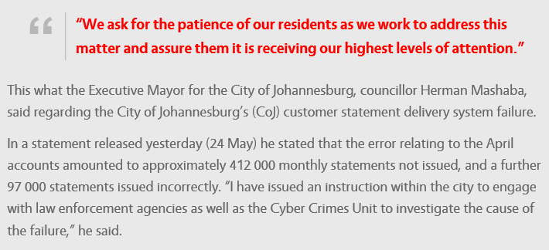
Example 1: CoJ billing system allegedly hacked
Source: www.roodepoortrecord.co.za: 25 May 2017

Slide 4
Example 2: Cyber attack takes 16 hospitals offline
"Hospitals in London, northwest England and elsewhere have all been knocked offline.
At least 16 hospitals are having to reject patients after their systems were taken offline.
A huge cyber attack has infected NHS trusts across the country and has led to all digital systems being pulled down.
The ransomware threatens hospitals that they will lose access to patient records and other files if they don't pay money to the hackers."
Source: www.independent.co.uk: 12 May 2017

Slide 5







Where can it happen?
Home
Office
Public

Slide 6
Who is at risk?
Any individual or organisation that is connected to the internet.
Organisations that are custodians of confidential information.
According to the recently released 2016 IBM X-Force cyber security intelligence index the 5 most cyber-attacked industries globally were:
  Healthcare
  Manufacturing
  Financial Services
  Government
  Transportation

Slide 7
Impact of cybercrime
Financial loss – losses can be direct through loss of electronic funds, or indirect through the costs of correcting the exposure.
Legal repercussions – lawsuits from individuals and other organisations due to the disclosure of confidential information.
Disclosure of confidential information – disclosure of sensitive or embarrassing information.
Reputational damage – loss of faith in the organisation by the public.
Inability to deliver critical services – a cyber attack could render a critical/essential service provider handicapped.

Slide 8
Types of Cyber attacks
Malware - various forms of harmful software, such as viruses and ransomware. Once malware is in your computer, it can wreak all sorts of havoc, from taking control of your machine, to monitoring your actions and keystrokes, to silently sending all sorts of confidential data from your computer or network to the attacker's home base.
Phishing - attacker may send you an email that appears to be from someone you trust, like your boss or a company you do business with. The email will seem legitimate, and it will have some urgency to it (e.g. fraudulent activity has been detected on your account). In the email, there will be an attachment to open or a link to click. Upon opening the malicious attachment, you’ll thereby install malware in your computer.

Slide 9
Types of Cyber attacks (Continued…)
Denial of Service (DoS) - where the perpetrator seeks to make a machine or network resource unavailable to its intended users by temporarily or indefinitely disrupting services of a host connected to the Internet.
Man-in-the-Middle Attacks - attack where the attacker secretly relays and possibly alters the communication between two parties who believe they are directly communicating with each other.
Social engineering - psychological manipulation of people into performing actions or divulging confidential information. A type of confidence trick for the purpose of information gathering, fraud, or system access

Slide 10
Perpetrators of cybercrime
Hackers – persons with the ability to explore the details of programmable systems and the knowledge to stretch or exploit their capabilities.
Employees – people affiliated with the organisation and given system access based on job responsibilities.
Information System personnel – these individuals have the easiest access to computerised information, since they are custodians of the information.
Former employees – people who have left on unfavourable terms who may still have access to information systems if not immediately removed.

Slide 11
Perpetrators of cybercrime (Continued…)
Interested outsiders – such as terrorists, organised criminals, hackers looking for a challenge, etc.
Part-time employees – part time employees who have access to computer systems and sensitive information.
Other third parties – such as vendors and consultants to gain access to the organisation’s information system.

Slide 12
Definition of Cyber security
“Preservation of confidentiality, integrity and availability of information in the Cyberspace.” source: ISO/IEC 27032 - Information technology — Security techniques — Guidelines for cybersecurity
Cyberspace is defined as “the complex environment resulting from the interaction of people, software and services on the Internet by means of technology devices and networks connected to it, which does not exist in any physical form” source: ISO/IEC 27032 - Information technology — Security techniques — Guidelines for cybersecurity
“The process of protecting information by preventing, detecting, and responding to attacks.” source: Framework for improving critical infrastructure cybersecurity – National Institute of Standards and Technology.
“Measures taken to protect a computer or computer system (as on the Internet) against unauthorized access or attack. ” source: Merriam-Webster dictionary

Slide 13
Measures to prevent cybercrime
Know what constitutes your enterprise data —understand the data that you own and what is at risk.
Policy and awareness investment.
Back up enterprise data—then back it up again. Create data backups regularly.
Restrict network access according to the principle of least privilege.
Network vulnerability scanning.

Slide 14
Measures to prevent cybercrime
(Continued…)
Employ the appropriate technical tools to mitigate intrusions—ensure the use of robust firewalls, intrusion detection systems, end-point protection and anti-virus technology.
Update software patches regularly—patch on a regular, organizationally defined basis.
Develop and exercise the enterprise incident response plan—create a plan and exercise it regularly across all departments to ensure effective communication and maintain basic continuity of operations.

Slide 15
Mechanisms to implement
3 Lines of Defence:
Management
Internal Audit
Risk Management

Slide 16
Mechanisms to implement
Three lines of defence - The audit and review universe is spread across three lines of defence, each of which contributes to the overall assurance of the cyber security program. These are:
  First line - Management
    Regular management review
    Attack/break penetration
    Functional/Technical training
  Second line - Risk Management
    Formal cyber security risk evaluation
    Business Impact Analysis (BIA)
    Emerging risks
  Third line – Internal Audit
    Internal controls testing
    Cyber security compliance
    Investigation/forensics

Slide 17
Mechanisms to implement
(Continued…)
Enhance existing frameworks and methodologies
  DPSA’s Corporate Governance of Information and Communication Technology Policy Framework (CGICTPF)
  Governance of Enterprise IT – COBIT 5
  National Institute of Standards and Technology (NIST) Framework for Improving Critical Infrastructure Cybersecurity -USA
  ISO/IEC 27001/27002.4 standards

Slide 18
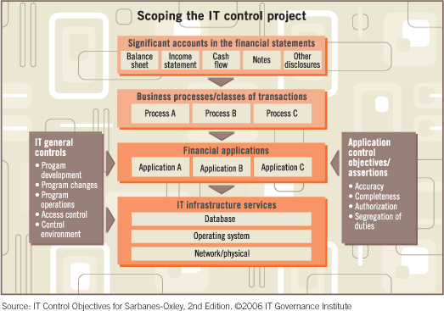
IT Controls in context

Slide 19
IT Risk & External Audit
IT Risks impact on the External Audit process
  Risk-based approach
  External auditors consider ITGC, Network vulnerability and Application Controls (IT Control Environment)
  Ultimate goal is to provide assurance on the fair presentation of financial statements
  Control reliance approach versus substantive approach
  IT related risks may increase audit risks (with a cost bearing)
  The higher the risk, the more audit work need to be performed by the auditor

Slide 20
Reporting Cybercrime
Chapter 13 of the Electronic Communications and Transactions Act 25 of 2002 (“the ECT Act”)
The ECT Act sets out criminal provisions relating to unlawful access to or interference with data
Report to SAPS

Slide 21
Thank you

