Slide 1
THE INTERNAL AUDITOR – TRUSTED ADVISOR
SJ Masite- Past President, CIA, CMIIA, QIAL,CFE,FIFMO

Slide 2
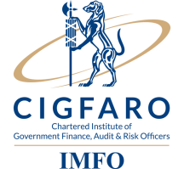
nda
INTRODUCTION
GENERAL ASSUMPTIONS
That the audience is aware of the role of internal auditors and the law governing IA.
That internal auditors can develop relationships with other clients and stakeholders.
That Councillors, Executive Authorities, Accounting Authorities, Accounting Officers, management and all other stakeholders understands their different responsibilities in supporting IA.

Slide 3
TOPICS TO BE COVERED
Trust
Responsibilities of IA per legislative requirements
Mandate of IA : IIA Standards
How to test this mandate
Enhancing its independence of IA without any compromise
Key success factor
Recommendations
Futuristic and Evolving Auditor
Conclusion
Progressive Institute

Slide 4
A TRUSTED ADVISOR
Trust - explained
Confidence (belief or state of being certain)
Dependable ( trustworthy)
Reliable (consistently good quality or performance)
Honest (truthful and sincere)
Integrity (having strong moral principle)
This is what trust entails. It is the foundation of any sound relationship.

Slide 5
RESPONSIBILITIES OF IA PER LEGISLATIVE REQUIREMENTS
The law promotes trust regarding the work of Internal
Audit to:
To give assurance to the accounting officer and report to audit committee on matters relating to, internal audit, internal control, accounting procedures and practices, risk and risk management, performance management, loss control and compliance with MFMA, DORA and any other applicable legislation. (eg Water Services Act, Electricity Regulation Act, Municipal Fiscal Powers and Functions, Disaster Management Act etc..)
Perform such other duties as may be assigned by the accounting officer as consulting services

Slide 6
nda
MANDATE OF INTERNAL AUDIT: IIA STANDARDS
Internal Auditing is an independent, objective assurance and consulting activity designed to add value and improve an organisation's operations. It helps an organisation accomplish its objectives by bringing a systematic, disciplined approach to evaluate and improve the effectiveness of risk management, control, and governance processes.
Assurance = peace of mind
Consulting = make a difference

Slide 8
PRINCIPLES OF IA CODE OF ETHICS
RULES OF CONDUCT
Integrity- Internal auditors shall perform work with honesty, diligence and responsibility.
Objectivity- Internal auditors not accept that may impair or be presumed to impair their professional judgement.
Confidentiality- IA shall be prudent in the use and protection of information acquired in the course their duties.
Competency- IA shall engage only in those services for which they have the necessary knowledge, skills and trust.
which is aligned to the Batho-pele principles if further unpacked.

Slide 9
HOW TO TEST THE MANDATE
“The true worth of internal audit is not measured in the weight of after-the-fact recommendations, but in the ability to provide just-in-time advice and influence positive change that adds value to the organization.”
Spencer Stuart, the Changing Face of Internal Audit: Views

Slide 10
KEY SUCCESS FACTORS
"
Effective Internal Audit
Tone at the Top
Good Communication and Training
Service Delivery improvement
Clean Administration
Governance Processes
Improvement
Control Environment
Improvement
Risk Management
Improvement

Slide 11
TIPS TO ENHANCE IA INDEPENDENCE without any …
IA must think and act like business
owners
Not hide behind independency and
objectivity
Agent of change

Slide 12
HOW CAN IA ENHANCE ITS INDEPENDENCE without any…… 1
Trusted Auditor
“help Accounting Officer/DG and audit committee to sleep at night.” by auditing and reporting the right things
Where the customer says, “There has not been an audit I would not gladly pay for.”
Where internal auditing is seen by management as a competitive advantage.

Slide 13
HOW CAN IA ENHANCE ITS INDEPENDENCE without any…… 2
The source of projects that are noticed, that will be told to the team’s grandchildren.
The internal consultants of choice.
At the exit interview, the manager says (sincerely) thank you.
A source of talent.
Passion, dedication and commitment

Slide 14
RESPONSIBILITY OF ACCOUNTING OFFICER
MFMA Sec.165-(1) “Each municipality must have
an internal audit and section 62(1)( c) (ii) The accounting officer is responsible for managing administration of municipality, and must:
for that take all reasonable steps to ensure-that the municipality has maintains effective, efficient and transparent systems of internal audit operating in accordance with prescribed norms and standards.
Read with section 173 of MFMA.
Progressive Institute

Slide 15
RECOMMENDATIONS
Accounting Officers
Complying with Systems Act and its regulations, MFMA
and PFMA and Treasury Regulations.
Appointing Head of IA at the level of Authority.
Implementing IA and AG recommendations Supporting the Performance Audit Committee and Audit Committees
Exercising their fiduciary responsibilities.
Progressive Institute

Slide 16
RECOMMENDATIONS …./2
Performance Audit Committee and Audit Committee
Proper evaluation and monitoring on the implementation of Performance Audit Committee/ Audit Committee charter.
Collaboration with Risk Management Committee and Oversight committees.
Oversee the role of the Trusted Advisor.
Reporting the right things to Council
Reporting timely to Council
Meet with the speaker and EM/Mayor to determine their expectations.
Progressive Institute

Slide 17
RECOMMENDATIONS …./3
Council and Accounting Authority
Appoints Audit Committees and Performance Audit
committees with relevant skills.
Enforces that recommendations of Internal and External
Auditors to be implemented. ( Trusted Advisors).
Progressive Institute

Slide 18
RECOMMENDATIONS …./4
MPAC
Enforces that recommendations of Internal and External Auditors are implemented by management.
Collaboration with Internal and External Auditor.

Slide 19
RECOMMENDATIONS……/5
COGTA
Proper co ordinations and consultations with other stakeholders eg IIA, Performance Audit Committees,
Risk Management Committees, AG, SALGA and CIGFARO to able to develop guiding frameworks .
Evaluation criteria- maturity levels for IA esp. performance internal auditors as are linked to Service delivery efforts.
Catalytic in terms of Clean Administration/ Audit Continuous communication with IA ( non compliance eg Annual Reports, Performance Mgt Systems, IDP and SDBIPs,
Non Compliance with Municipal Systems and Structures Acts including implementation of the Anti Fraud Strategy.
Ensure that CIGFARO is Statutory recognized by law.
Progressive Institute

Slide 20
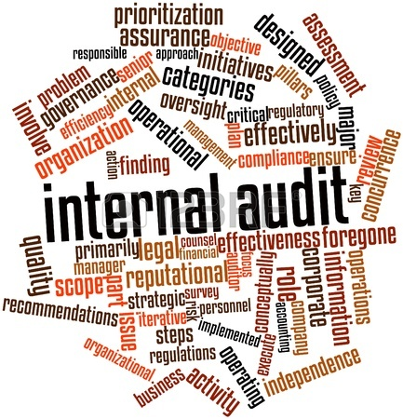
FUTURISTIC AND EVOLVING AUDITOR
MPAC
.
Progressive Institute

Slide 21
FUTURE AND EVOLVING IA …..2
1.Evolving role of internal auditors and expanding scope of audits:
IA properly structured internal audit function, impacting not just regulatory compliance but also operational excellence –
Infrastructure Audits
Environmental Audits
Engineering Background
2.Service delivery and quality assessments: Every stakeholder, management and the audit committee, relies heavily on internal audit for providing assurance and establishing trust in the organization.
Service Delivery Reports
3.Organizational structure for accountability and transparency: Today’s environment calls for greater collaboration and strong relationship between the auditor and the auditee at all levels. The trend therefore is moving towards developing a structure that facilitates healthy environment. Combined Assurance
4 Shift away from post factor assurance to more proactive approach: just on time audits; Balancing Assurance and Consulting service necessity.
5. Upgrading audit infrastructure and technological advancement: Large municipalities, specially with complex auditing requirements that span not just financial audits but also audits, assessments on infrastructure and IT

Slide 22
"The problem is never how to get new, innovative thoughts into your mind, but how to get the old ones out.”—
P

Slide 23
FUTURE AND EVOLVING IA …..3
Courage:
Brave
Daring
Pluck
Nerve
Resolute

Slide 24
IN CONCLUSION
T ogether
E veryone can
A chieve
M ore
work is the solution towards achieving the service delivery objectives thus improving the livelihood of our communities.

Slide 25
LESSON TO ALL
“TRUST TAKES YEARS
TO BE BUILD
SECONDS
TO BREAK
AND FOVEVER
TO REPAIR”

Slide 26
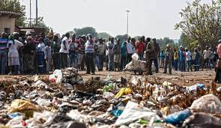
“ITS IN OUR HANDS TO AVOID SITUATION LIKE IN FUTURE ….”

Slide 27
Thank You!

Slide 28
QUESTIONS AND COMMENTS
"

