Slide 1
Without a qualification: Where are we now? How we got there? What we would do differently if we had a qualification?

Slide 2
Where are we now and how we got there?
Matric (grade 12), final exams, we pass, Jippie.
Now what?
Select a workplace. What about Government or Municipalities?
Am I equipped? No!!!!
Training, Training and more training.
Learn from peers and managers
Learn from mistakes
Clime the corporate leather according to the set criteria

Slide 3
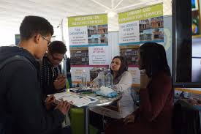
And then?
Applying for another post
Learn more, attend more training
After many years – apply for a management post
You not qualifying. You don’t have a relevant qualification
Demotivated, continue with the job but something is lacking
Should we now start studying or make piece with the circumstance?
Again, go for training, apply for another post, hopefully the boss will notice that I am competent and recognise my skills.
Hope, hope, hope

Slide 4
How would it look like if we had a qualification
Still applying for a job at a government department or Municipality
Still attend training but…..
Start applying your knowledge and skills in the workplace. You contribute positively in the workplace
Your Boss look good. He acknowledge your skills
New posts are available, you been headhunted by companies or other departments and municipalities
You get promotion.
This is not a dream. It is reality. That is what can happen after you successfully complete your qualification.

