Slide 1
INPUT ON THE PANEL DISCUSSION
PRESENTED BY:
THE HONOURABLE DEPUTY MAYOR OF THE CITY OF uMHLATHUZE CLLR SG MKHIZE

Slide 2
Why successful Mayors cannot employ female MM’s and the role of women in the Public Sector?
"A woman is like a tea bag—you never know how strong she is until she gets in hot water." —Eleanor Roosevelt

Slide 3
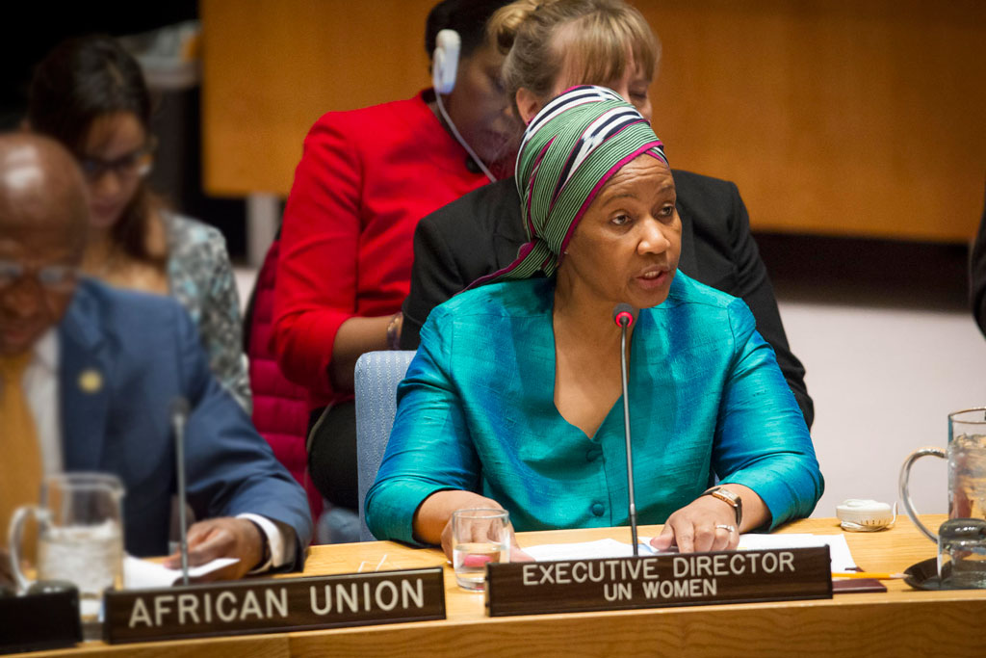
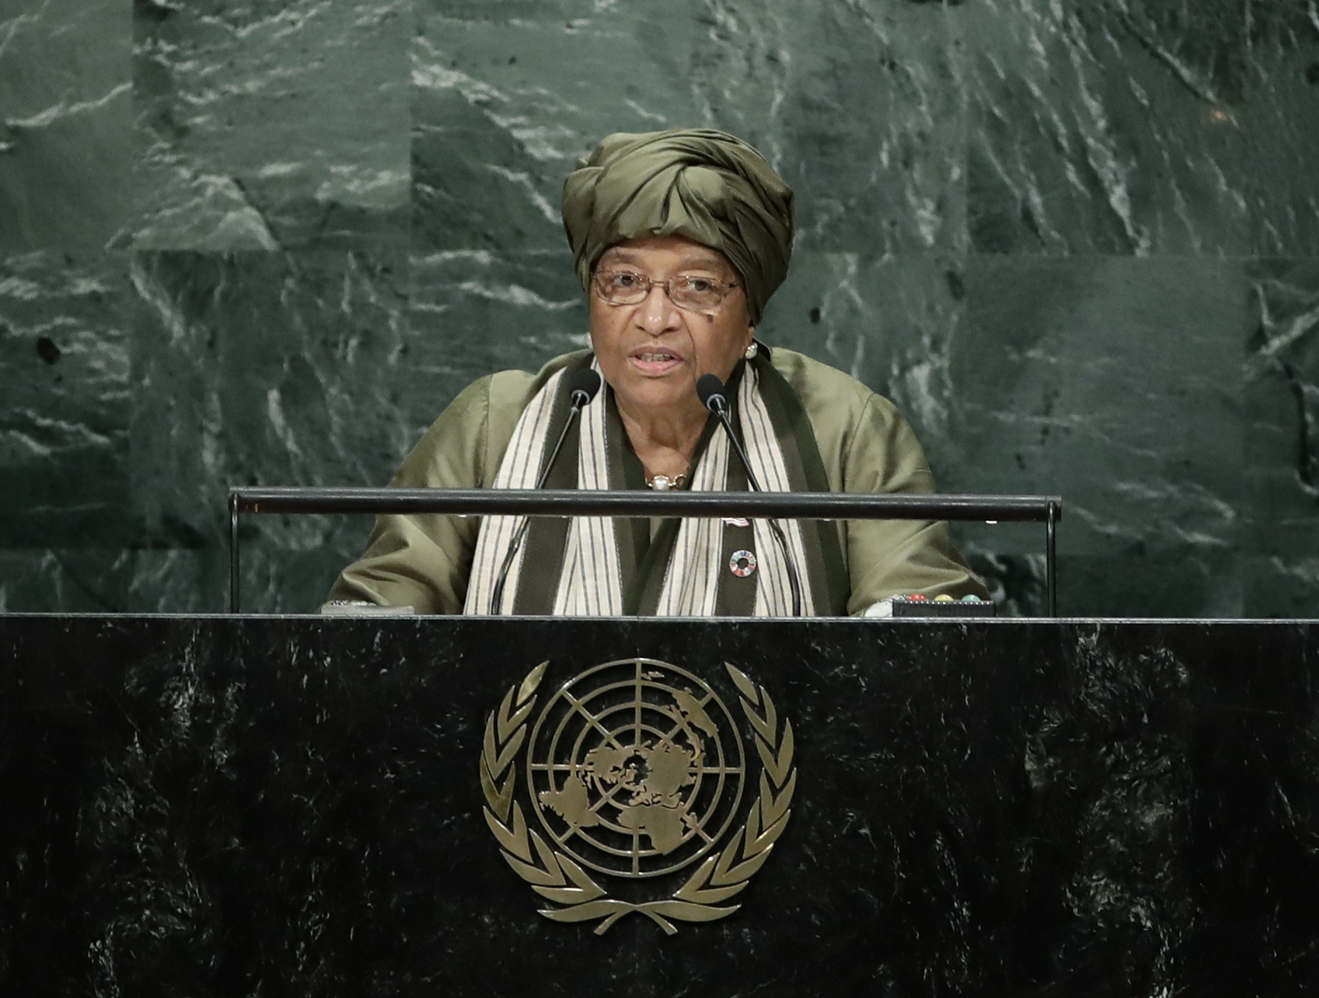
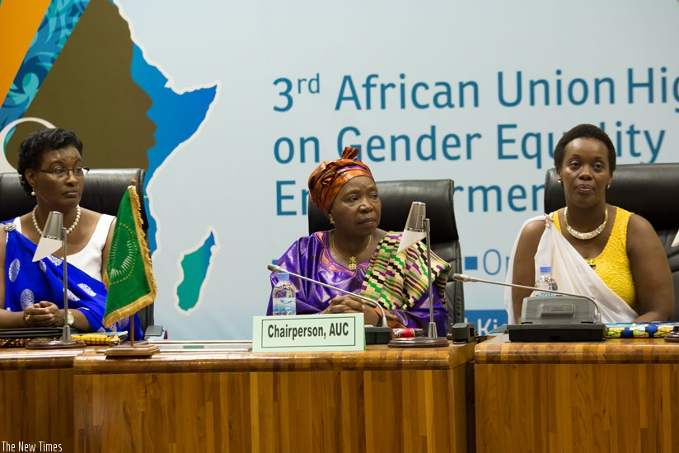
Why successful Mayors cannot employ female MM’s and the role of women in the Public Sector?
"There is no limit to what we, as women, can accomplish." —Michelle Obama

Slide 4
Management positions in all municipalities 2017

Slide 5
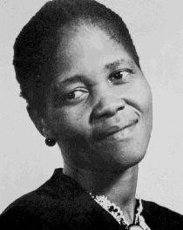
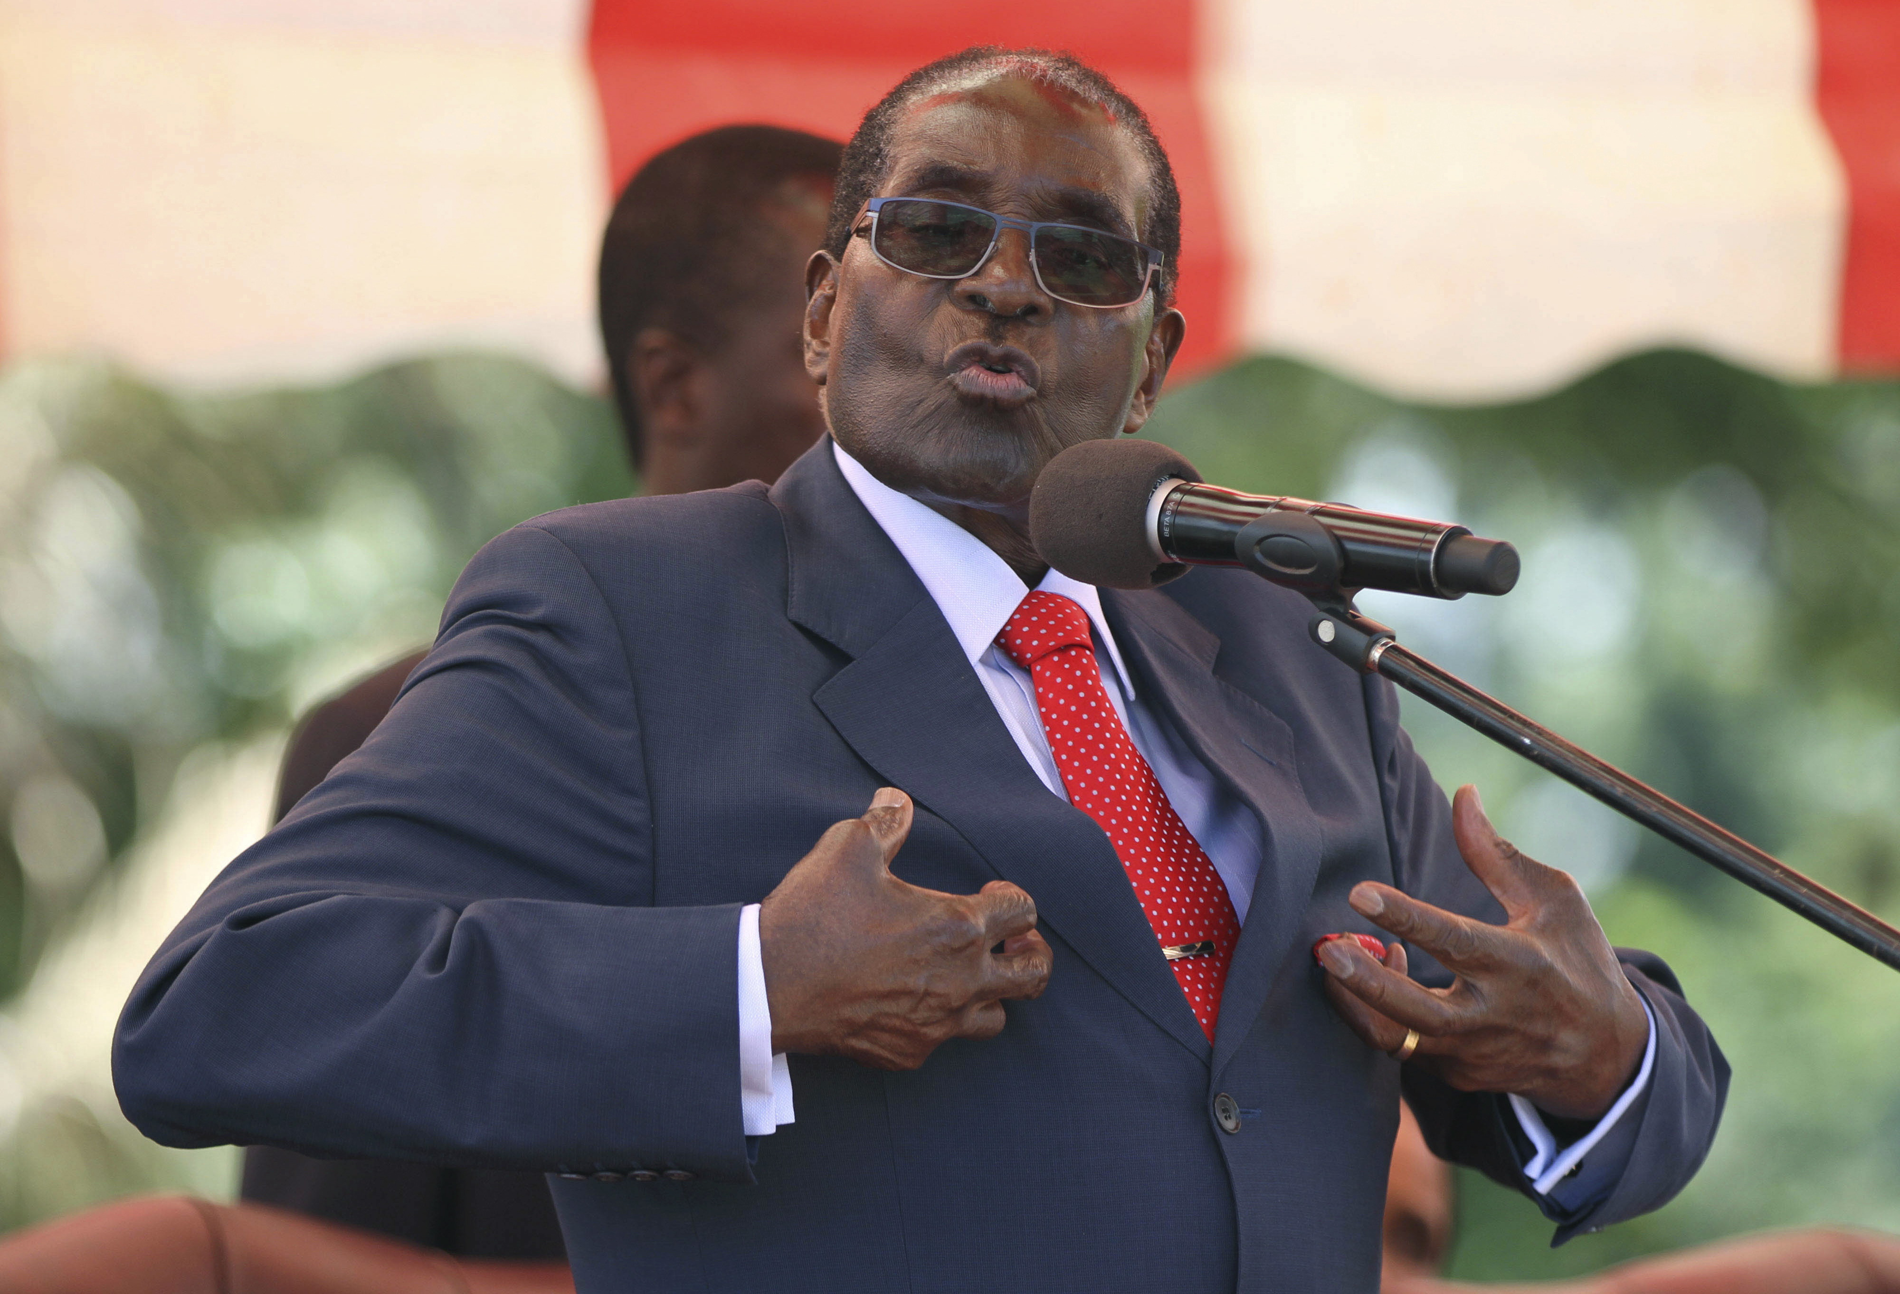
Leadership Styles
Transformational Leadership
Caring , empathy acting as a mother, nurturing, emotion, collaboration, empowerment, recognition, acknowledgment , leading by example and a good listener
Transactional Leadership
Achieving goals, foster compliance being directive, demand obedience

Slide 6
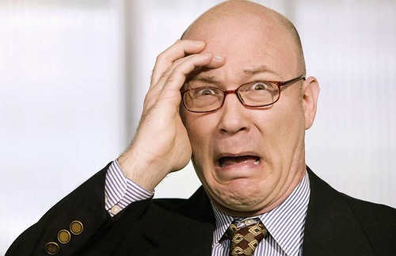
Consequences
Effects of gynophobia
Occurs in men having unresolved conflicts with their mothers
Hatred, ill will towards their own sisters, abandonment or physical abuse

Slide 7
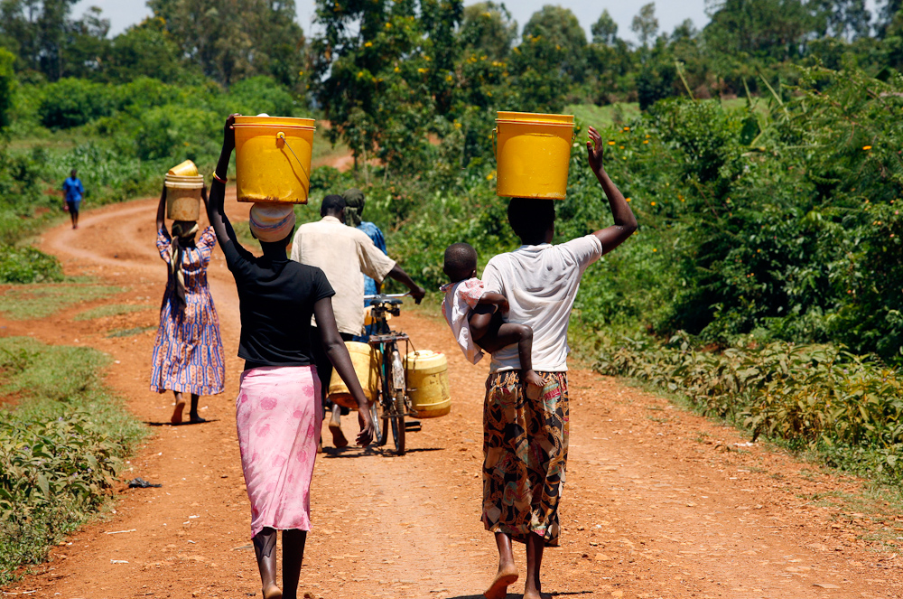
History and Culture
"Feminism isn't about making women strong. Women are already strong. It's about changing the way the world perceives that strength." —G.D. Anderson
"I am not free while any woman is unfree, even when her shackles are very different from my own." —Audre Lorde

Slide 8
Municipal Managers in KZN 2017

Slide 9
Mayors in KZN 2017

Slide 10
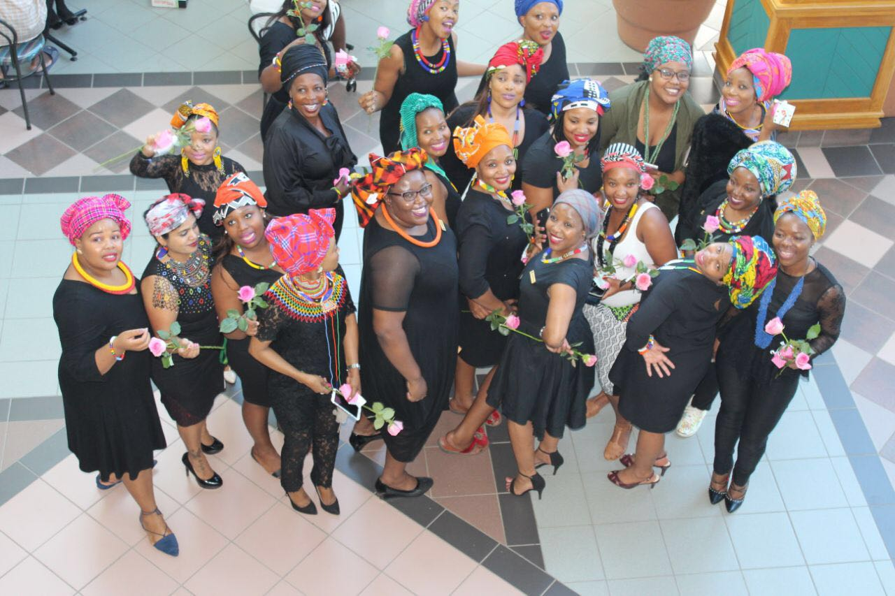
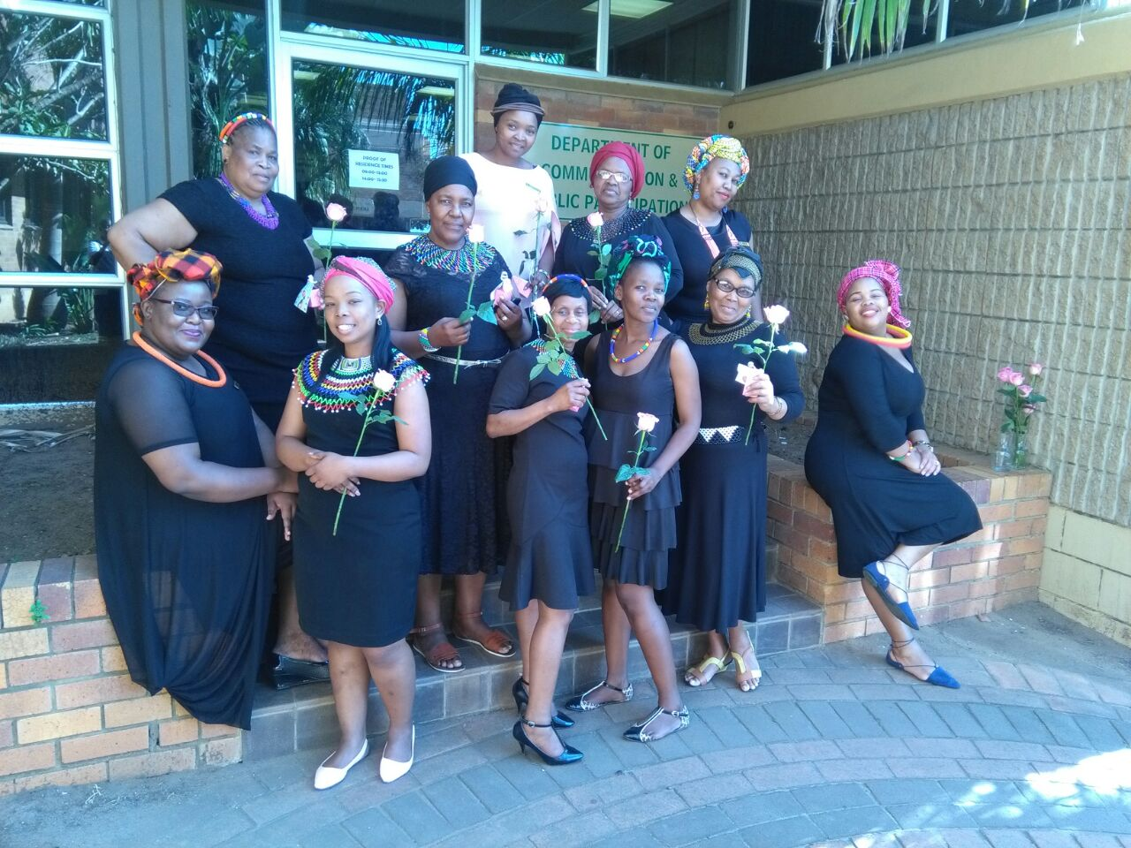
Flowers of uMhlathuze
"Women belong in all places where decisions are being made... It shouldn't be that women are the exception." —Ruth Bader Ginsburg

Slide 11
Representation of women in management positions
OCCUPATIONAL CATERGORY | TOTAL NO. OF WOMEN | TOTAL NO. OF MALES
TOP MANAGEMENT | 2 | 3
SENIOR MANAGEMENT | 9 | 24
MIDDLE MANAGEMENT | 21 | 41
"Women belong in all places where decisions are being made... It shouldn't be that women are the exception." —Ruth Bader Ginsburg

Slide 12
Where to from here? Recommendation
Culture
Building a gender –balanced organisation
Resistance to change
Empowerment
Gender differences
The question isn't who's going to let me; it's who's going to stop me." —Ayn Rand

Slide 13
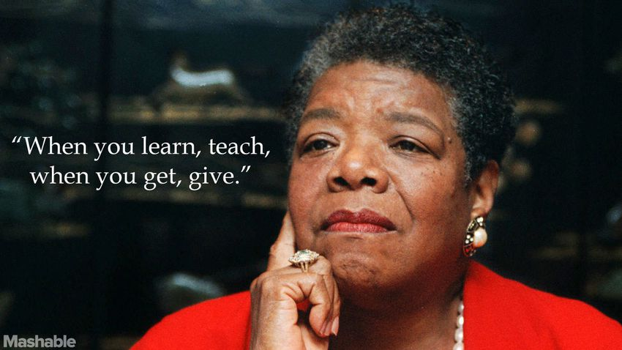
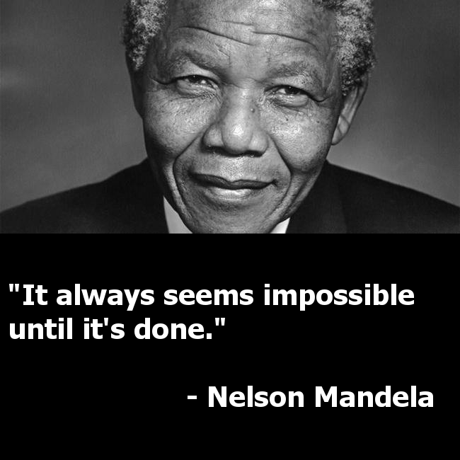
Towards the future

Slide 14
Siyabonga/
Thank you!

