Slide 1
CIGFARO
90TH ANNUAL CONFERENCE:
10TH – 11TH APRIL 2019
EAST LONDON ICC
“EFFECTIVE GOVERNANCE IN THE NEW DAWN”

Slide 2
TABLE OF CONTENTS
COMPLEXITY OF THE TOPIC
UNDERSTANDING THE COMPLEXITY AND UNIQUENESS OF OUR MODEL OF LOCAL GOVERNMENT IN SOUTH AFRICA
DEVELOPMENTAL LOCAL GOVERNMENT MATURITY MODEL AND ITS FAULT LINES?
REFLECTIONS ON STRIDES AND REVERSALS IN THE LOCAL GOVERNMENT SECTOR
CONTRIBUTION OF SALGA TO PROPEL THE LOCAL GOVERNMENT SECTOR FORWARD IN TERMS OF GOOD GOVERNANCE AND ACCOUNTABILITY
5.1 WORKING TOWARDS THE REQUIRED BALANCE BETWEEN THE SUPPLY SIDE AND THE DEMAND SIDE OF EFFECTIVE OVERSIGHT AND ACCOUNTABILITY
6. CONCLUSIONS

Slide 3
COMPLEXITY OF THE TOPIC
“RECLAIMING GOVERNANCE AND ACCOUNTABILITY IN PUBLIC SECTOR – A NEW DAWN FOR PUBLIC SERVICE”.
To RECLAIM presupposes a particular conclusion that is informed by what was which now is either lost or waning
The NEW DAWN also carries with it a value loaded meaning which invites one to opine on what must be contributing to a sense of renewed hope, reinvigorated sense of pride and therefore a qualitative departure from that which created conditions for the necessity of the new dawn.
I must say these are INDEED CAREER LIMITING CHALLENGING elements of the topic if one were to substantively venture into them.
Regardless, one is obliged to opine on:
  Our performance as people who have the honour to serve South Africans with respect to governance and accountability
  To what extent must we own – up to some of the challenges bedeviling our beautiful country
  What contribution can we made to deepen democracy and therefore enhance good governance and accountability

Slide 4


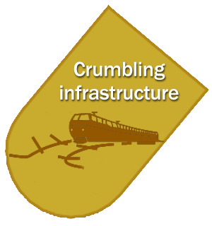
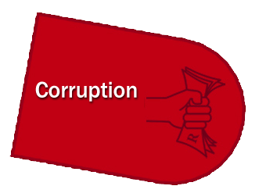






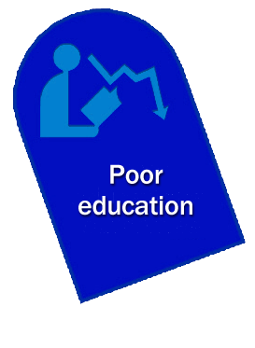

Slide 5
COMPLEXITY OF THE TOPIC
SO WHAT ARE POSSIBLE PILLARS OF THE NEW DAWN
The public discourse has indeed been dominated by inherently contradictory views from both protagonist and antagonist on the new dawn. For purposes of today's presentation the following speak to all of use particularly practitioners and professionals in the public sector:
  Clean Governance and Intensified Anti-Corruption Drive
    Promote clean administration and eliminate all forms of fraud, theft, corruption unethical conduct and inefficiencies (probity)
    Strengthening the capacity of the state and all relevant agencies
    Empowering SOE Boards to ensure effective oversight
  Rebuilding a Broken Economy
    It is our challenge as civil servants to ensure that brand SA’s reputation creates an investor friendly environment
    Building a broad coalition for reindustrialisation.
    Committing to reindustrialisation
    Confronting concentration and uncompetitive behaviour.
    Systematically consider creating an indigenously led manufacturing sector
    Addressing the structuring limits of our economy through deconstructing the apartheid geography
  Training and education
    Preparing our country for the fourth industrial revolution
    Addressing challenges in the education system including more investment in hard skills sector

Slide 6
COMPLEXITY OF THE TOPIC
SO WHAT ARE POSSIBLE PILLARS OF THE NEW DAWN
The public discourse has indeed been dominated by inherently contradictory views from both protagonist and antagonist on the new dawn. For purposes of today's presentation the following speak to all of use particularly practitioners and professionals in the public sector:
  Strengthening the capacity of the state through
    Address the key failings in the state which according to the NDP include the administrative – political interface, long term skills planning, strengthening accountability and improved coordination for implementation
    Accountability is critical at all levels,
    Strengthening oversight bodies including the legislative sector
    Addressing the mismatch between the vision for developmental local government and the current practices
    Strengthening the nation-wide monitoring and oversight
    Strengthening horizontal and vertical integration
  The clarion call for all to lend a hand (Thuma mina) liberation song and recorded song by Hugh Masekela_
    Social cohesion is necessary to transform the country while reducing poverty and enhancing opportunity for young people are critical to building social cohesion
    Despite diverging interests, success will depend on building partnerships across society
    Rallying people around the Constitution and its values
    Active citizenship through enhancing communication channels between government and society
    The renewed sense of inspiration

Slide 7
COMPLEXITY OF THE TOPIC
WHAT POSSIBLE DEMANDS FOR THE REQUIRED CALIBRE OF PUBLIC SERVANTS
OECD Skills for a High Performing Civil Service (2017)
# |  | PROFESSIONAL | STRATEGIC | INNOVATIVE
1 | NEEDS CIVIL SERVANTS WHO ARE: | Qualified Independent Values driven Ethical | Outcomes driven Evidence based Future oriented Proactive Networked | Iterative Data literate Citizen centred Curious Storytellers Insurgent
2 | IN A CIVIL SERVICE WHICH IS: | Merit based Capable of integrating soft skills, ethics, talent management (future potential vs. past performance) Able to structure the right balance of generalist and specialist professions and career paths | Agile Attractive to skilled job seekers Planned and managed to ensure the right skills and competencies are effectively allocated to areas of current and emerging need Future oriented and Responsive | Open and collaborative cultures, leadership and management Engaged Autonomous (e.g. work design) Mobile Diverse Learning oriented
3 | LED BY SENIOR CIVIL SERVANTS WHO ARE: | Trusted policy advisors and effective transactional managers | Transformational leaders, change managers | Collaborative leaders and adaptive managers

Slide 8
UNDERSTANDING THE COMPLEXITY AND UNIQUENESS OF OUR MODEL OF LOCAL GOVERNMENT IN SOUTH AFRICA
There can be no single debate on any matter on local government in South Africa. The provision for various categories of municipalities compel all of us to debate matters of local government with in mind this uniqueness and complexity.
  Unlike in Provinces where regardless of size in terms of socio economic context, size and rural or urban nature in local government we have these variables serving as important considerations to determine whether a municipality is a
    Category A Metropolitan Municipalities
    Category B Local Municipalities or whether there is a need for an umbrella
    Category C District Municipalities
    Even in each of these categories there are further complexities. For instance
      In category B a provision in law is made for
        Executive Mayoral type
        Collective executive
        Plenary system
The above on its own imposes a necessity to apply a different approach in looking on matters of each of these categories. How you look at a governance model of a METRO has to be different from how you look at a governance model of a Plenary Municipality, a Collective Executive and an Executive Mayoral governance model.

Slide 9
UNDERSTANDING THE COMPLEXITY AND UNIQUENESS OF OUR MODEL OF LOCAL GOVERNMENT IN SOUTH AFRICA
The third complexity which must be understood relates to the fact that in terms of section 151 (2) of the Constitution, both executive and legislative powers are vested in Council. This is contrary to sections 85 and 125 which gives the President and Premier Executive Powers respectively.
The fourth talks to a mixed electoral system, where there is direct democracy with citizens electing their representatives and Proportional Representatives drawn from organised formations, be it political parties or community organisations. This introduces another layer or accountability in the local government sector
The fifth one is the fact that a Municipality is defined in law. In terms of section (2) of the Municipal Systems Act a Municipality is defined as
  Council
  Administration
  Community the law expressly state that a community is an integral part of a municipality meaning that in both the manner in which a municipality’s governance model is articulated and associated structures, there must be a clear provision on how a community will participate in the affairs of the municipality as required in terms of section 152(1) where a municipality is required to encourage the involvement of communities and community organisations in the matters of local government.

Slide 10
STUBBORN CHALLENGES FACING LOCAL GOVERNMENT
DEVELOPMENTAL LOCAL GOVERNMENT MATURITY MODEL AND ITS FAULT LINES?
STUBBORN PROBLEMS FACING SA ECONOMY
South Africa still faces the triple challenges of rising unemployment (particularly the youth), stubbornly high degree of inequality and mixed success in reducing poverty rates
Unemployment
Inequality
Poverty
Financial management and revenue
Rural development and spatial transformation
Collaboration and intergovernmental cooperation
Accountability and consequences
Municipal Governance
Commitment to service delivery
Migration patterns
Lack of strong strategic planning
Ability to confront and effect change
Corruption and maladministration
Incoherent national monitoring, support and regulatory environment

Slide 11


Slide 12
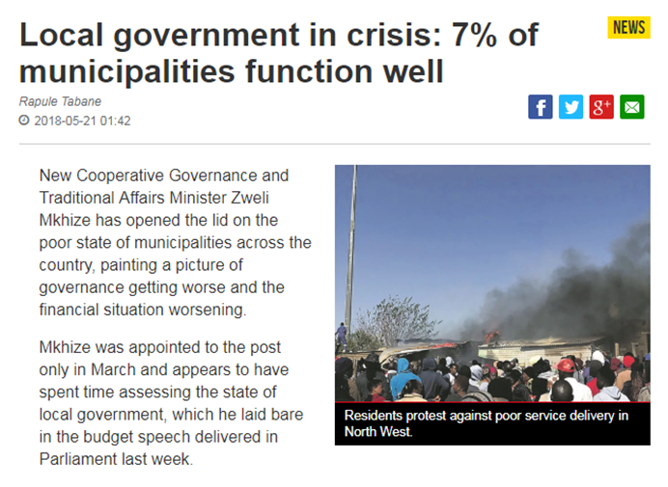
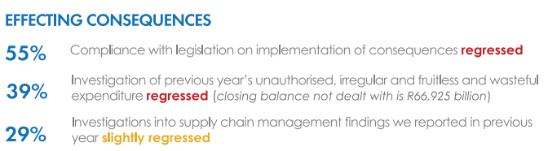
REFLECTIONS ON STRIDES AND REVERSALS IN THE LOCAL GOVERNMENT SECTOR
Municipal Governance
The Promise
Current reality
Restoring the promise
(White Paper on LG 1998)
SALGA is expected to play a leading supportive role in the wholesale transformation of local government to be developmentally oriented
SALGA has potential to make a strong contribution to the development of municipalities in the country, through e.g.:
Provision of specialised services to strengthen capacity of LG
Research and information dissemination;
Facilitate shared learning between municipalities;
Human resource development; and Cllr training [Leadership Development]
AG report 2017 states that most of South Africa’s 257 municipalities are in a disastrous financial position.
Only 33 (13%) are in full compliance with the relevant legal requirements, and produced quality financial statements and performance reports.
Provincial and national governments to support municipalities to perform their functions
Appropriate financial management capacity
Accountability across the board

Slide 13
THE WHITE PAPER ON LOCAL GOVERNMENT: THE ROLE OF DEVELOPMENTAL LOCAL GOVERNMENT
    Characteristics:
    Maximising social development and economic growth
    Integrating and coordinating
    Democratising development, empowering and redistributing
    Leading and learning
    Outcomes:
    Provision of household infrastructure and services.
    Creation of liveable, integrated cities, towns and rural areas.
      Local economic development.
      Community empowerment and redistribution
Developmental
Local government
    Tools and Approaches:
    Integrated development planning and budgeting.
    Performance management.
    Working together with local citizens and partners.
      A developmental role for local government offers substantive benefits to local residents, communities, provincial and national spheres of government, and the nation as a whole.

Slide 14
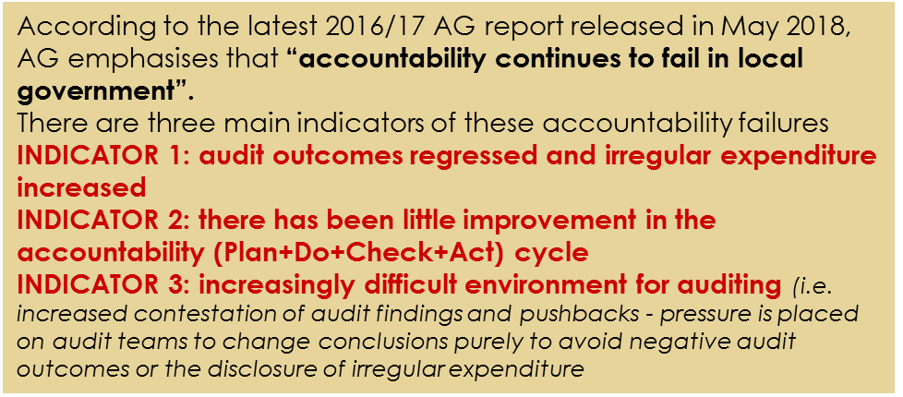
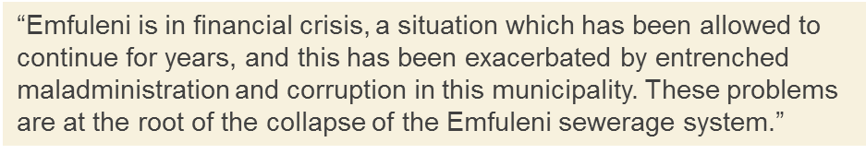
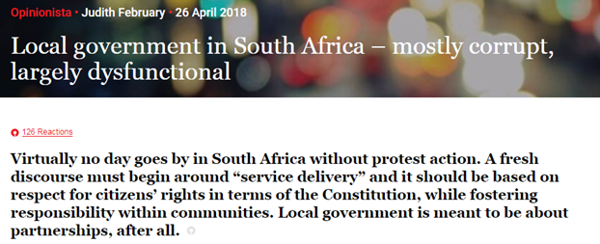
REFLECTIONS ON STRIDES AND REVERSALS IN THE LOCAL GOVERNMENT SECTOR
Accountability and consequences
Corruption and maladministration

Slide 15
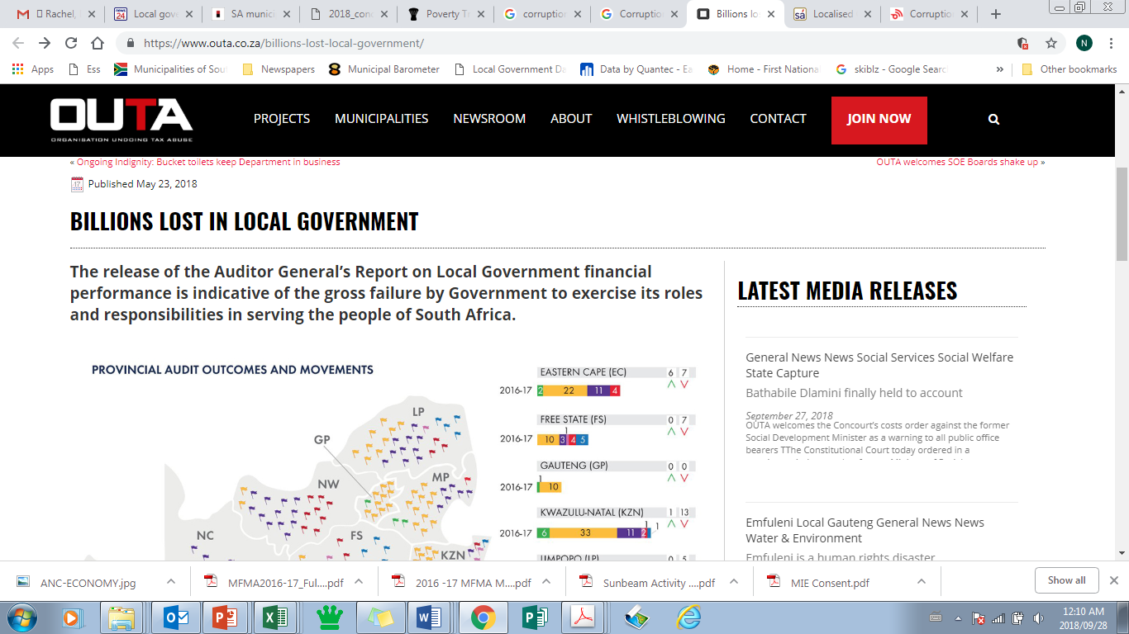
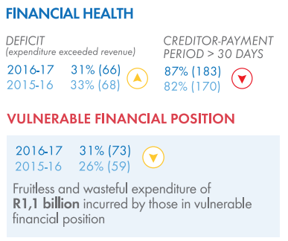
REFLECTIONS ON STRIDES AND REVERSALS IN THE LOCAL GOVERNMENT SECTOR
Financial management and revenue
The Promise
Current reality
In 2017/18
Capital expenditure amounts to R58.8 billion or 82.3 per cent of the adjusted capital budget of R71.4 billion.
Aggregated year-to-date total expenditure for metros amounts to R213.4 billion or 89.2 per cent of their adjusted budget expenditure of R239.2 billion. On average, this represents an annual retraction of 8.6 per cent when compared to the fourth quarter of 2016/17.
consumer debts amounted to R143.2 billion (compared to R139.2 billion reported in the third quarter) as at 30 June 2018.
(Municipal Finance Management Act, No. 56 of 2003)
Responsibility of the Accounting Officer to ensure financial administration of a municipality
(Municipal Systems Act, No. 32 of 200)
Establish a sound customer management system
Debt collection
Credit control procedures

Slide 16

REFLECTIONS ON STRIDES AND REVERSALS IN THE LOCAL GOVERNMENT SECTOR
Financial management and revenue
Restoring the promise
Recruitment
Should we introduce a Shared Recruitment system?
Provision for recognised Body – Municipal Executive Recruitment Commission (MERC)
Discipline - Labour Relations good practise
Knowledge Sharing of LG Best Practise Policies
Basic Financial Management
Some Benefits of Shared Services:
Cost Savings
Increase Process Efficiencies
Improve Knowledge
Increase Turnaround time
Reduce Consultants
Focus on Service Delivery

Slide 17
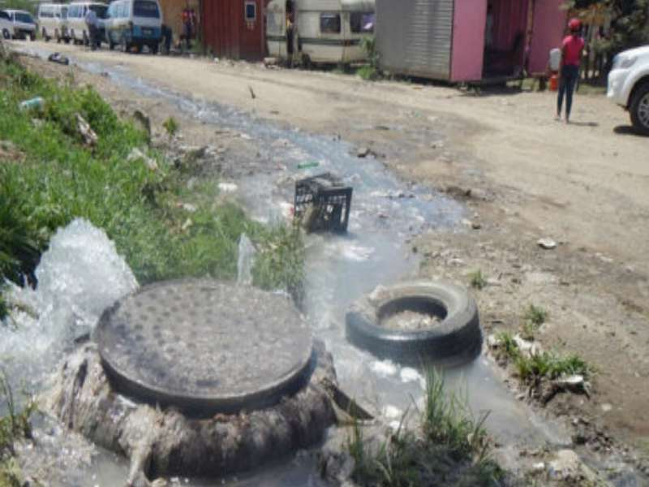
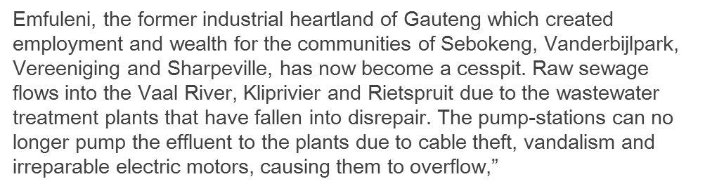
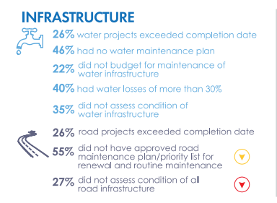
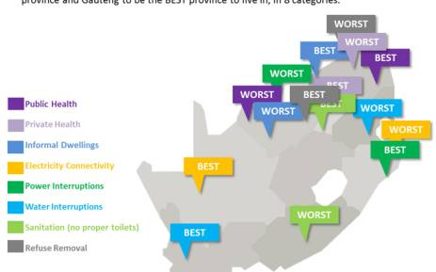
REFLECTIONS ON STRIDES AND REVERSALS IN THE LOCAL GOVERNMENT SECTOR
Commitment to service delivery
(AG REPORT 2016/17)

Slide 18
REFLECTIONS ON STRIDES AND REVERSALS IN THE LOCAL GOVERNMENT SECTOR
Access to Service Delivery
Water
Electricity
Sewerage
Solid Waste
Source: Stats SA 2017 Non Financial Census of Municipalities

Slide 19
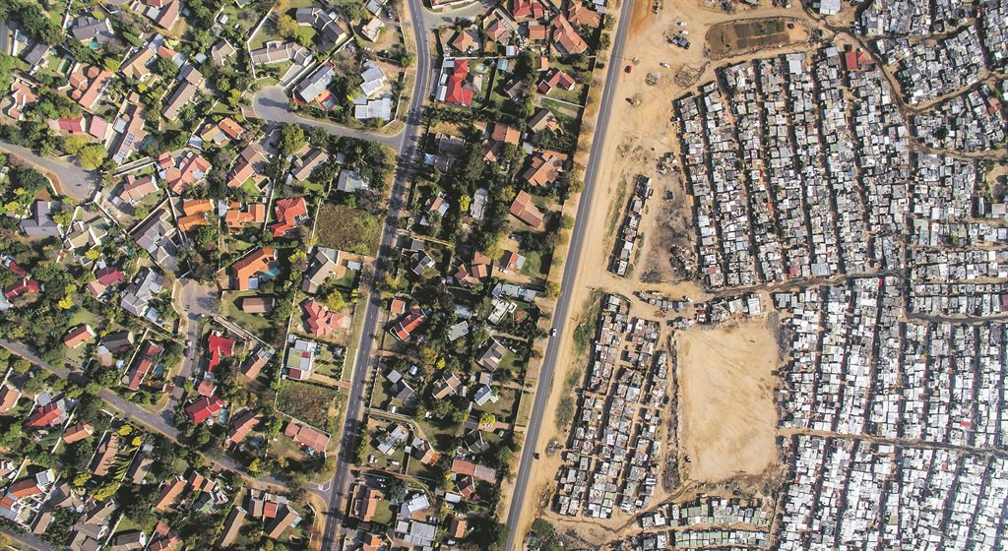
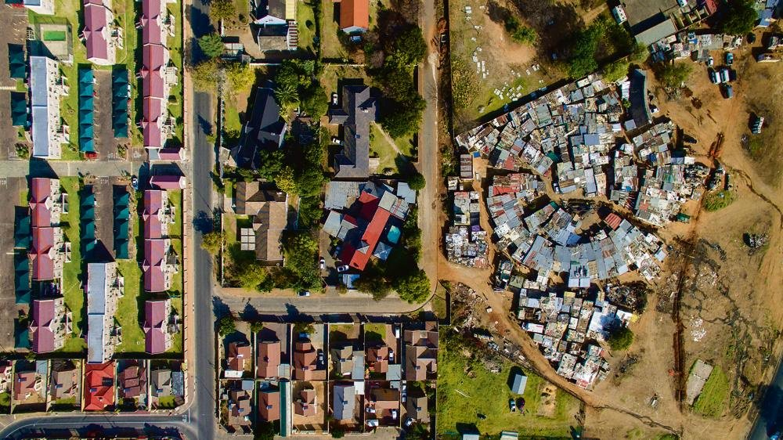
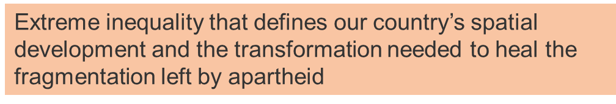
REFLECTIONS ON STRIDES AND REVERSALS IN THE LOCAL GOVERNMENT SECTOR
Rural development and spatial transformation
Kya Sands in Johannesburg. One street separates an informal settlement from the middle class suburb of Bloubosrand
Alexandra and Casey Park are so close yet so far apart in terms of their extreme disparities of living standards and opportunities
Eighteen years after the establishment of “Wall-to-Wall” democratic local government our municipal spaces remain "Two-worlds" municipalities and societies. This is despite sterling progress made by municipalities in providing access to basic services to those who were previously unserved

Slide 20
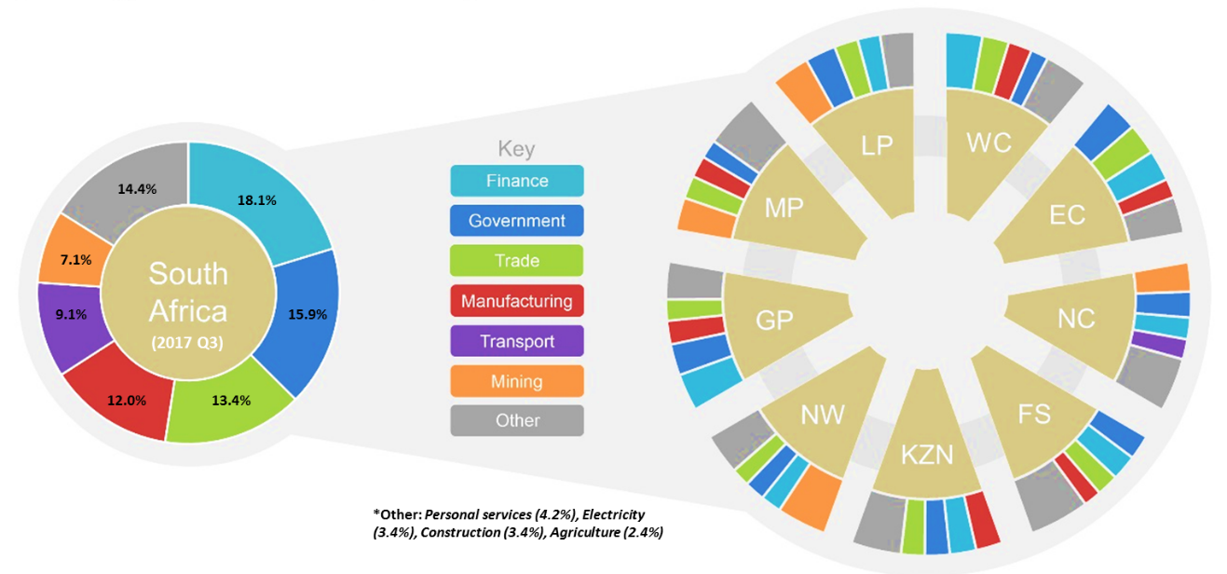

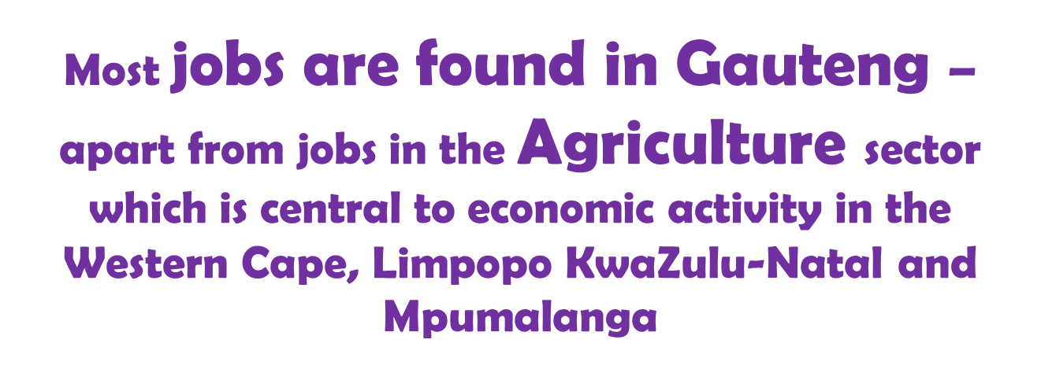

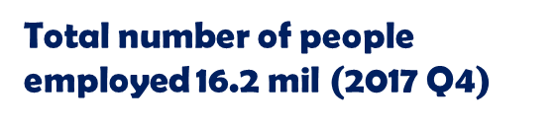
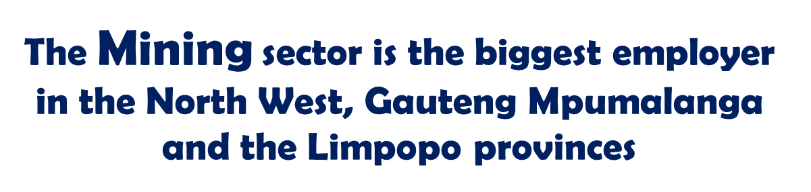
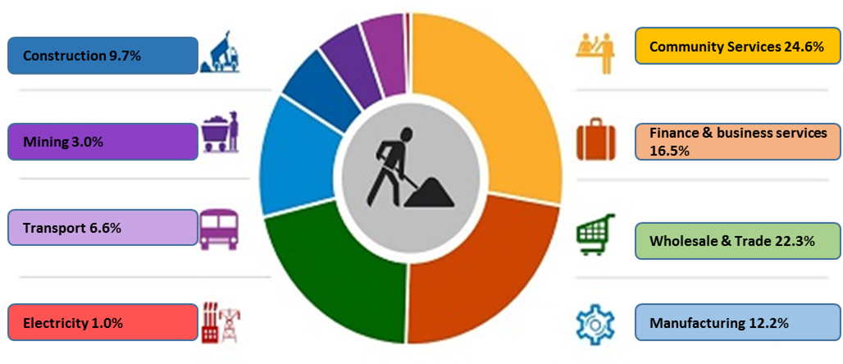
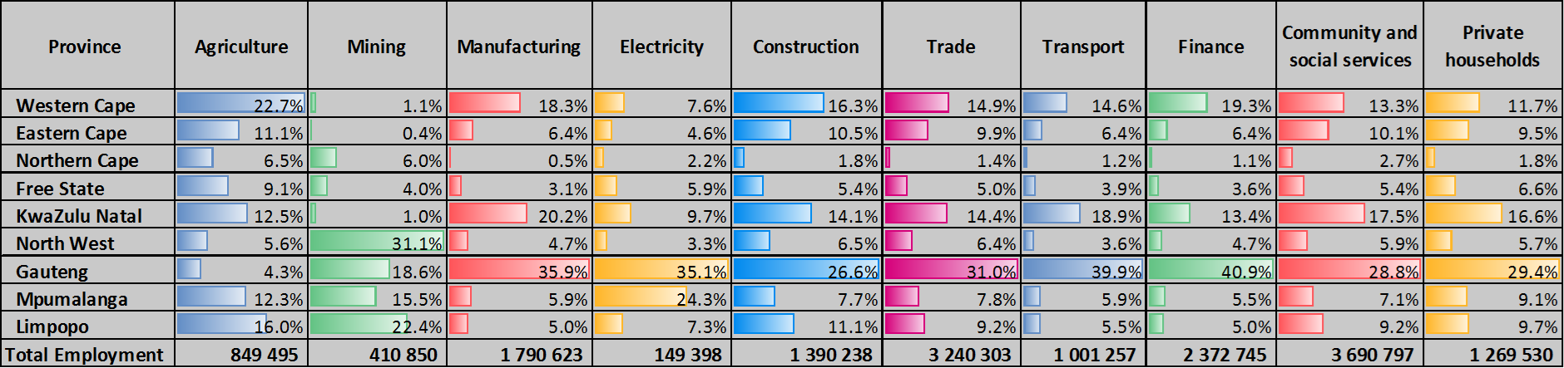
Economic Growth and Employment
REFLECTIONS ON STRIDES AND REVERSALS IN THE LOCAL GOVERNMENT SECTOR
The top four sectors driving economic activity as well as employment creation include, Financial services, Government services (incl community and social services), Trade & wholesale and Manufacturing services.
However some provinces require diversification as they are largely depended on one or two key sectors for their economic activity i.e Limpopo (mining), Western Cape (agriculture and finance).
A diversified economy is vital to ensure a province is not heavily affected by factors which would result in a market crash (i,e. the water crisis in the Western Cape and its impact into the agriculture sector).
There is a need for creating a sustainable cycle of economic activity where businesses continually feed off of one another and grow larger as the economy grows. As more and more businesses open their doors, it leads to the growth of supporting industries.

Slide 21
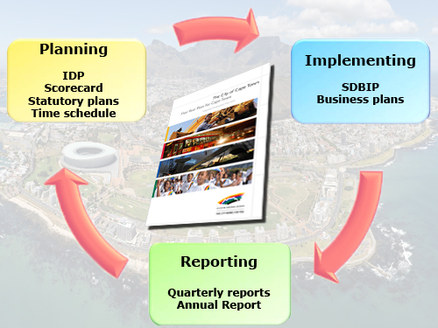
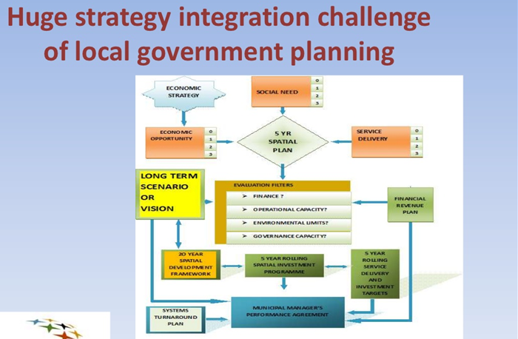
REFLECTIONS ON STRIDES AND REVERSALS IN THE LOCAL GOVERNMENT SECTOR
LACK OF STRONG STRATEGIC PLANNING
WHY ONLY LOCAL GOVERNMENT HAS A RESPONSIBILITY TO INTEGRATE?

Slide 22
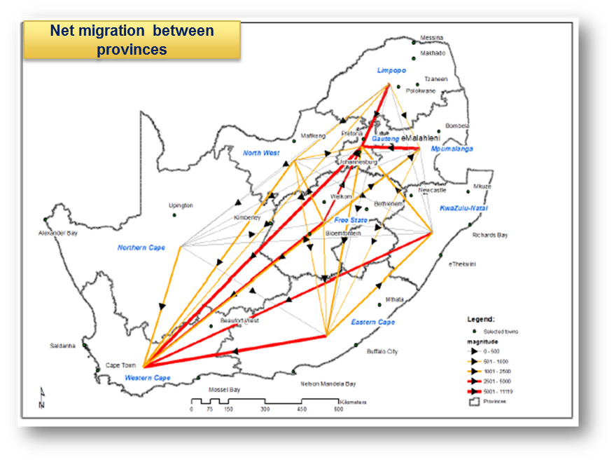
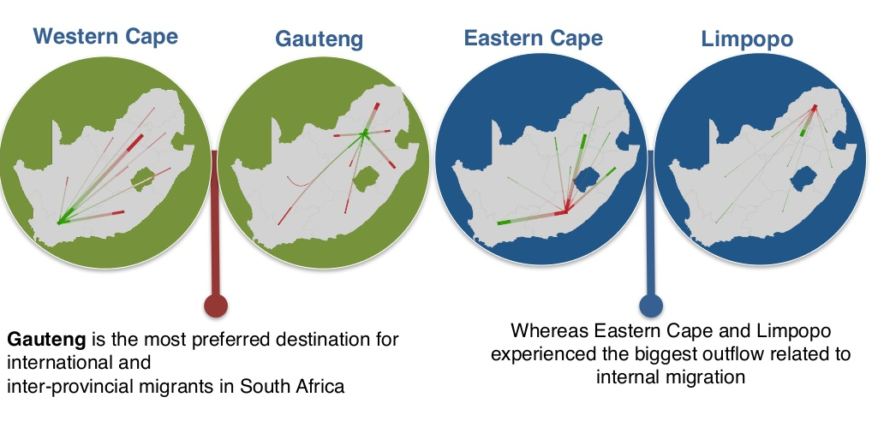
MIGRATION PATTERNS
REFLECTIONS ON STRIDES AND REVERSALS IN THE LOCAL GOVERNMENT SECTOR
The Western Cape is the province with the second highest number of net migrants after Gauteng. Over 159 thousand people moved out of the province while close to 260 thousand people moved in resulting in slightly about 292,372 thousand net migrants. Most of the migrants come from the Eastern Cape and Gauteng provinces.
The most common reasons for migrating to the Western Cape and Gauteng are the perception of a better quality of life, improved infrastructure and more employment opportunities. The consequences however include increased demand for housing and related infrastructure services.
GEOGRAPHY IS POLITICAL IN SOUTH AFRICA

Slide 23
“DEMOCRACY THAT EMPOWERS CANNOT BE IMPORTED
The democracy a nation chooses to develop depends on its history and circumstances- countries will necessarily be “differently democratic”. But in all countries democracy is about much more than a single decision or hastily organized election. It requires a deeper process of political development to embed democratic values and culture in all parts of society - a process never formally completed” UNDP, Human Development Report, 2002

Slide 24
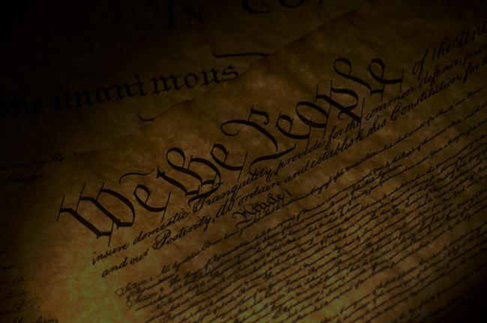
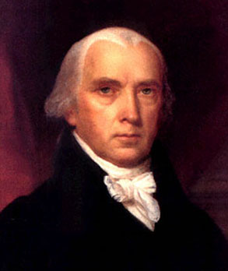
“If men were angels, no government would be necessary. If angels were to govern men, neither external nor internal controls on government would be necessary.
James Madison

Slide 25

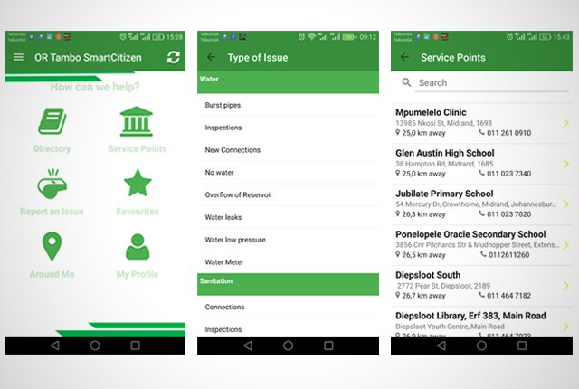
WORKING TOWARDS THE REQUIRED BALANCE BETWEEN THE SUPPLY SIDE AND THE DEMAND SIDE OF EFFECTIVE OVERSIGHT AND ACCOUNTABILITY
CITIZEN ENGAGEMENTS
Both the Constitution and all relevant local government legislation requires, amongst others, that municipalities develop mechanisms to ensure meaningful involvement of communities and community organisations in performing their functions and exercising their powers.
In order to promote active citizenry over and above structures and platforms, there has been a number of emerging innovative technological initiatives that seeks to deepen local democracy i.e Gov Chat, Vodacom SmartCitizen app (for OR Tambo District Municipality ) form a link between ward councillors, the community and the municipality.
Govchat allows citizens to WhatsApp councillors directly- providing complaint management system, rate and report public services and facilities (Uploading reports and photographs of issues ensure councillors can quickly and accurately address problems in the community they serve.
Vodacom SmartCitizen ( the new Thetha Nathi) – was showcased at the SALGA Municipal Innovative Infrastructure Conference, which took place at Emperor’s Palace from 13-15 June 2018.
App allows OR Tambo residents to:
Bypass the queues by reporting blocked drains, burst pipes, electricity outages, missing manhole covers, refuse issues, and other service delivery issues.
Track the progress of issues reported and receive notifications on progress.
Find and engage ward councillors.
Find local government facilities.

Slide 26


Slide 27
Municipal Integrity Management Framework
CONTRIBUTION OF SALGA TO PROPEL THE LOCAL GOVERNMENT SECTOR FORWARD
The LOCAL GOVERNMENT ANTI CORRUPTION STRATEG
MUNICIPAL INTEGRITY MANAGEMENT FRAMEWORK F
Cohere on key guiding objectives and principles and provides clarity in terms of roles and IGR requirements
Attempts to outline key national and provincial measures to support municipalities towards fight the scourge of fraud, theft and corruption
Sets out responsibilities of municipalities and outlines parameters of the framework
Critical success factors of the strategy
Sound cooperative governance
Clarity of roles and responsibilities
Emphasis on rallying all including private sector, professional bodies, civil society and citizenry at a national level
Tone at the top
Integration of all national and professional efforts
Critical success factors
Leadership commitment
Municipal institutional ethics management
Active and social conscious citizenry
Resilient municipal institutions and strong governance
  Prevention
  Detection
  Investigations
  Resolution
Quality reporting
Effective monitoring. Knowledge sharing. Peer review and learning. Hands on support. Differentiation. Resource allocation. Strategic and operational risk management. Records management. Shared indicators of good governance and effective consequences management

Slide 28
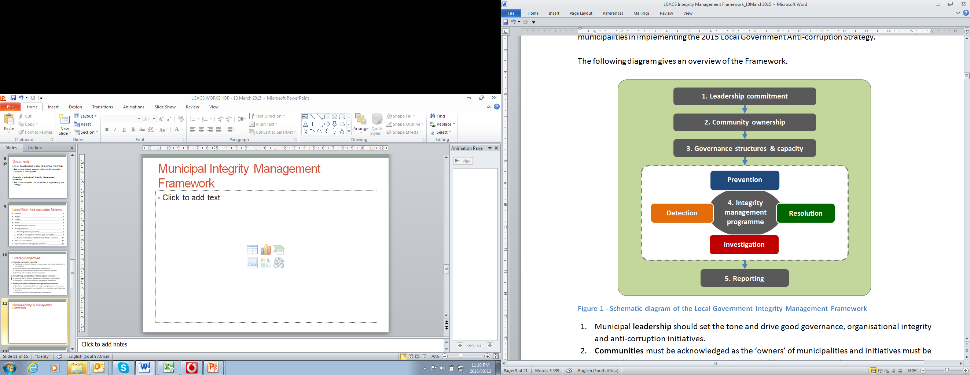
Municipal Integrity Management Framework
CONTRIBUTION OF SALGA TO PROPEL THE LOCAL GOVERNMENT SECTOR FORWARD

Slide 29
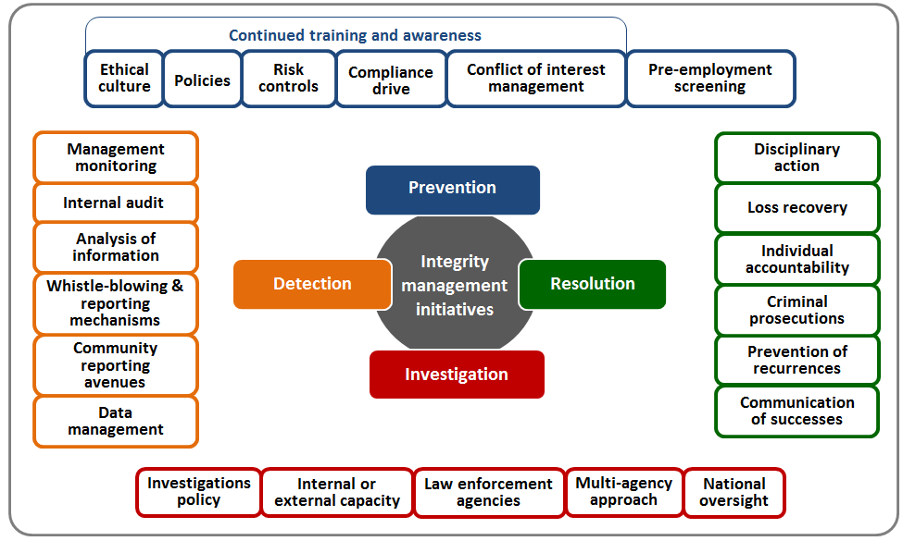
CONTRIBUTION OF SALGA TO PROPEL THE LOCAL GOVERNMENT SECTOR FORWARD

Slide 30
CONTRIBUTION OF SALGA TO PROPEL THE LOCAL GOVERNMENT SECTOR FORWARD
LOCAL GOVERNMENT ETHICS MANAGEMENT FRAMEWORK.
This would be a local government environment that:
Promotes good moral conduct, positive values and acceptable ethical behaviour by both councilors, officials, communities, NGOs and businesses/private sector;
Internalises values and ethics through education, awareness, training and advocating for these issues to be in the sector’s daily conversations;
Where leaders and functionaries recognize that ethics and ethical conduct are moral and social norms that requires action more than complying with the law;

Slide 31
CONTRIBUTION OF SALGA TO PROPEL THE LOCAL GOVERNMENT SECTOR FORWARD
LOCAL GOVERNMENT ETHICS MANAGEMENT FRAMEWORK.
CONCRETELY:
Establishment of an Ethics Committee of Council
Metros and Secondary Cities encouraged to establish Offices of Integrity Commissioner and City Ombudsman
Each Municipality to establish and resource an Ethics Management Unit
Appointment of Ethics Officers in the Administration
Implementation of internal and external awareness

Slide 32
CONTRIBUTION OF SALGA TO PROPEL THE LOCAL GOVERNMENT SECTOR FORWARD
PROMOTING OPERATIONALISATION OF THE EIGHT BATHO PELE PRINCIPLES TO FOSTER A CULTURE OF CITIZEN – CENTRIC SERVICE CULTURE
The proposed Batho Pele Operationalization Strategy represents a framework within which efforts to practically apply a social compact campaign to promote a meaningful transparent, accountable and inclusive governance could be structured into the following six pillars:
Re-engineering and improving the back-office operations of relevant municipal departments;
Re-engineering and improving the front-office operations of municipalities and their entities;
Internal communication; and municipal – wide institutional coherence
External communication. Each of these pillars is unpacked below.

Slide 33
STRENGTHENING OVERSIGHT THROUGH CONSEQUENCES MANAGEMENT & ACCOUNTABILITY FRAMEWORK
CONTRIBUTION OF SALGA TO PROPEL THE LOCAL GOVERNMENT SECTOR FORWARD
specific objectives of the framework:
To provide a concise guide on available options on which applicable consequences for which type or class of transgressions and non-performance and the attendant implications for failure to act by leadership at both political and administrative levels
To promote a culture of accountable, professional and ethic local public administration that places emphasis on good governance and effective service provision to municipal inhabitants
To clearly spell-out of the role of each integral group in local government
A FRAMEWORK OR A TOOLKIT

Slide 34
CONTRIBUTION OF SALGA TO PROPEL THE LOCAL GOVERNMENT SECTOR FORWARD
LOCAL GOVERNMENT PEER REVIEW MECHANISM
The peer review mechanism which will be piloted this financial year seeks to provides a platform for a friendly assessment by peers to highlight good practice and provide a peer to peer advice.
It is designed to be a voluntary exercise rather than a mandatory one.
Our role together with our strategic partners will be technical back-office support and documentation including validation and autonomous audit.
“This is not an inspection but a supportive approach undertaken by friends, albeit critical friends and its intention is to help a municipality identify its current strengths as well as its weaknesses” then Minister of Local and Provincial Government, Fholisani Mufamadi.

Slide 35
CONTRIBUTION OF SALGA TO PROPEL THE LOCAL GOVERNMENT SECTOR FORWARD
INTRODUCTION OF A PERIODIC NATIONAL LOCAL GOVERNMENT GOOD GOVERNANCE INDEX
  Openness
  Inclusive governance and participation
  Transparency
  Operational efficacy
    Administratio – politico interface (remember public administration is applied politics)
    Council
    Development and service delivery
  Effective oversight and accountability
  Predictability
  Integrity management and promotion of ethical organisational environment

Slide 36
CONTRIBUTION OF SALGA TO PROPEL THE LOCAL GOVERNMENT SECTOR FORWARD
A RENEWED EMPHASIS ON RECORDS MANAGEMENT
Without records there can be no rule of law and no accountability.
Records provide a reliable, legally verifiable source of evidence of decisions and actions and this includes precedencies which in terms of administrative law creates an obligation on management decision making.
It is records where we document compliance or non-compliance with laws, rules, and procedures.
Municipalities can no longer justify taking action with little or no reference to past performance or future goals. Nor can they justify parallel or duplicate services when they can combine services and reduce costs (popular toilet picture)
The decline, and in some cases total collapse, of record keeping systems makes it virtually impossible to determine responsibility for actions and to hold individuals accountable.
The loss of control of records has consequences for all citizens, especially for the poorest who are least able to defend themselves.
Relevant and accurate public records are essential to preserving the rule of law and demonstrating fair, equal, and consistent treatment of citizens.

Slide 37
CONTRIBUTION OF SALGA TO PROPEL THE LOCAL GOVERNMENT SECTOR FORWARD
On-ongoing support hands on support to all municipalities on governance and accountability
Supporting stabilisation of council and council structures mainly focusing on governance framework
  Rules of order
  Delegations frameworks
  Council structures delegations and terms of reference
Capacity building and leadership development
Technical and strategic advice

Slide 38
WORKING TOWARDS THE REQUIRED BALANCE BETWEEN THE SUPPLY SIDE AND THE DEMAND SIDE OF EFFECTIVE OVERSIGHT AND ACCOUNTABILITY
ESTABLISHING STRATEGIC PARTNERSHIPS WITH CIVIL SOCIETY FORMATIONS
  Moral Regeneration Movement
  Ethics Institute (currently finalising Public Sector Ethics Survey)
  South African Institute of Security Study and several other specialised civil society formations on social unrest and political violence
  Good governance learning network
  Human Science Research Council
  In discussions with the Association of Community Advice Centres
  Partnerships with Professional bodies

Slide 39

CONCLUSIONS OR REMINDER?
Stop the blame Culture!

