Slide 1
PROVINCIAL TREASURY
ASSET MANAGEMENT VS AFS REPORTING
24 May 2019

Slide 2
Content
Overall Objective- asset management
Directives and interpretations
GRAP Standards

Slide 3
Introduction
Asset management in a municipal environment
Guidance through legislative provisions

Slide 4
Assets
Assets
resources controlled by a municipality, (e.g. property, dams, power stations, trademarks);
as a result of past events (actions undertaken previously e.g. the order, purchase, payment for a resource);
from which future economic benefits (income generating assets);
or service potential (assets used for administration, indirectly generates income);
are expected to flow to the entity (the inflow of cash or cash equivalents).

Slide 5
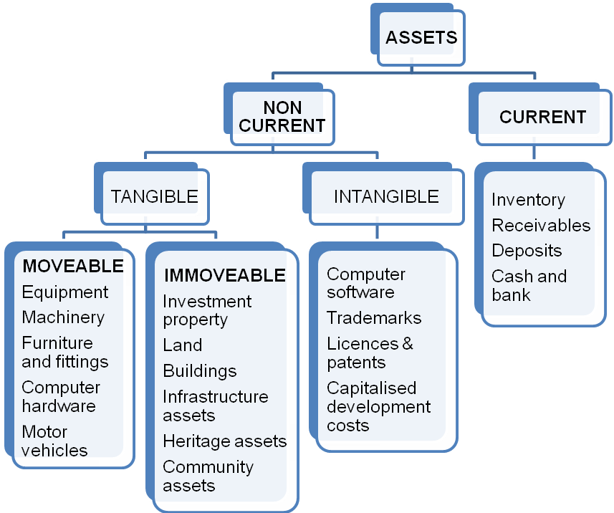

Slide 6
Asset Groups
GRAP allows entities to recognise assets which do not only generate future economic benefits in the form of cash flows but which an entity is required to hold in order to provide the services which it is mandated to do so, for example a clinic which is required to provide free medical services to a local community.
cash generating Assets
Non cash generating Assets

Slide 7
Asset life cycle
Planning
Acquisition
Asset Life Cycle
Disposal
Operations and maintenance

Slide 8
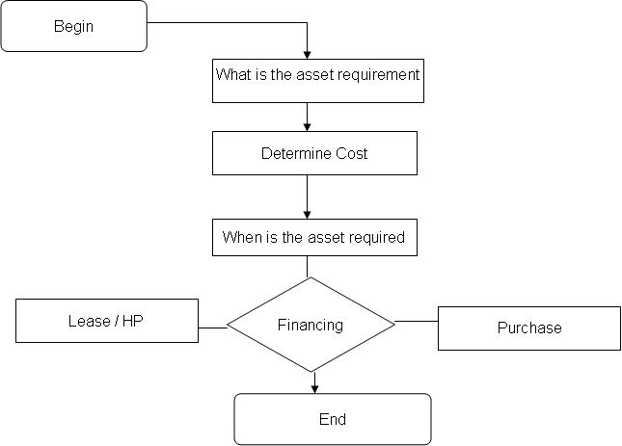
Procurement

Slide 9
Legislative provisions for asset
Management of assets and liabilities
Section 63 of the MFMA
Section 96, Disposals and transfers
Section 14 and 90 of the MFMA
Section 48 of the MFMA
Section 75(1) - Information to be placed on websites of municipalities
Other provisions of the MFMA
Section 78
Section 84
Section 94 (1)
Section 154
Section 168 – Treasury regulations and guidelines
Section 173

Slide 10
National Treasury Asset Management guide
National Treasury asset management framework include:
Measurement of assets
Legislative base for asset management
Classification of assets
Depreciation
Assets and financial statements
Asset life cycle of management

Slide 11
Key Definitions
Cash-generating assets -are assets used with the objective of generating a commercial return. Commercial return means that positive cash flows are expected to be significantly higher than the cost of the asset.
Non cash generating assets- used in providing as service where there no commercial return
An impairment -is a loss in the future economic benefits or service potential of an asset, over and above the systematic recognition of the loss of the asset’s future economic benefits or service potential through depreciation
An impairment loss of a non-cash-generating asset- is the amount by which the carrying amount of an asset exceeds its recoverable service amount
Residual Value –The amount the entity expects to receive at the end of the usefullife of an asset.
Fair value - the estimated price at which the an asset can be sold for in an orderly transaction to a third party or under market conditions

Slide 12
Asset management
Asset Management plans,
IDP, budgets and SDBIP
Demand Management plans including Acquisitions (New, replacement and upgrade of Assets)
Reporting requirements
Maintenance Plans
Asset Risk Management Plans
Disposal decisions

Slide 13
GRAP
GRAP standards are issued by ASB inline with section 89 of the PFMA
Applicable to Municipalities and Municipal entities
Board (ASB) issues Directives and Interpretations to deal with specific issues which entities may encounter when applying GRAP

Slide 14
Effective GRAP Standards -
Effective GRAP Standards applicable to accounting for assets are:
•GRAP 3 – Accounting Policies, Changes in Accounting Estimates and Errors
•GRAP 5 – Borrowing costs
•GRAP 11 – Construction Contracts
•GRAP 12 – Inventories
•GRAP 13 – Leases
•GRAP 16 – Investment Property
•GRAP 17 – Property, Plant and Equipment
•GRAP 21 – Impairment of Non-cash Generating Assets
•GRAP 26 – Impairment of Cash Generating Assets
•GRAP 27 – Agriculture
•GRAP 31 – Intangible assets
•GRAP 100 – Discontinued operations
•GRAP 103 – Heritage assets

Slide 15
Amendments to GRAP
Information to be presented on the face of the statement of financial position .79 In accordance with paragraph .38 As a minimum, the face of the statement of financial position shall include line items that present the following amounts:
(a) property, plant and equipment;
(b) investment property;
(c) intangible assets;
(d) heritage assets;
(e) financial assets (excluding amounts shown under
(f), (i), (j) and (k)); (f) investments accounted for using the equity method;
(g) inventories;
(h) biological assets that form part of an agricultural activity;
(i) receivables from non-exchange transactions (taxes and transfers);

Slide 16
Amendments to GRAP
Information to be presented on the face of the statement of financial position .79 In accordance with paragraph .38 As a minimum, the face of the statement of financial position shall include line items that present the following amounts:
(j) receivables from exchange transactions;
(k) cash and cash equivalents;
(l) taxes and transfers payable;
(m) payables from exchange transactions;
(n) provisions;
(o) liabilities and assets for current and deferred tax, where applicable (as defined in the International Accounting Standard® on Income Taxes);
(p) financial liabilities (excluding amounts shown under
(k), (l) and (m)); (q) non-controlling interest, presented within net assets; and

Slide 17
Directives
Effective Directives applicable to Assets are:
Directive 3 – Transitional Provisions for High Capacity Municipalities
Directive 4 – Transitional Provisions for Medium and Low Capacity Municipalities
Directive 5 – Determining the GRAP Reporting Framework
Directive 7 – Application of Deemed Cost
Directive 11 – Changes in measurement base

Slide 18
Interpretations on GRAP
Interpretations applicable to Assets are:
IGRAP 2 – Changes in existing decommissioning, restoration and similar liabilities
IGRAP 3 – Determining whether an arrangement constitutes a lease
IGRAP 8 – Arrangements for the construction of assets from exchange transactions
IGRAP 9 – Distributions of noncash assets to owners
IGRAP 10 – Assets received from customers
IGRAP 14 – Evaluating substance of transactions involving the legal form of leases
IGRAP 16 – Intangible assets – website costs

Slide 19
GRAP 17 (Def and Recog)
Property, plant and equipment shall be recognised as an asset if it meets the definition of an asset, and only if:
it is probable that future economic benefits or service potential associated with the item will flow to the entity, and (b)
the cost or fair value of the item can be measured reliably
the cost is above any municipal capitalisation threshold (if any);
the item is expected to be used during more than one financial year
Criteria for Recognition
Ownership vs Control

Slide 20
Directive 7 – Key Definitions
Deemed cost: Deemed cost is a surrogate value for the cost or fair value of an asset at its initial acquisition, and is determined by reference to the fair value of the asset at the date of adopting the Standards of GRAP or on the transfer date or the merger date (measurement date).
• Initial acquisition (for purposes of this Directive): Assets acquired before the date of adopting Standards of GRAP or assets acquired in a transfer of functions between entities under common control or in a merger.
• Measurement date (for purposes of this Directive): Measurement date is either (a) the date that an entity adopts the Standards of GRAP and is the beginning of the earliest period for which an entity presents full comparative information, in its first financial statements prepared using Standards of GRAP; or (b) the transfer date or the merger date.

Slide 21
Directive 7 -Key GRAP clauses
Deemed cost
The application for deemed cost is applicable on the following :
“.02 This Directive shall be applied by entities that apply Standards of GRAP. This Directive can only be used:
to determine the cost of assets that were acquired prior to the measurement date outlined in paragraph .05, and only if information about the historical cost of those assets is not available; and
to determine the cost of assets that were acquired in a transfer of functions between entities under common control or in a merger where:
the transferor or combining entity did not apply Standards of GRAP on the transfer date or the merger date; and
when information about the historical cost of those assets are not available”
.03 This Directive cannot be applied by analogy to any other circumstance, transaction or event other than those outlined in paragraph .02.

Slide 22
Proposed Performance Matrix Uniform and integrated approach to measure progress
Performance measure | Source | Norm | Frequency
Game changer 5: Asset management
% of GRAP compliant fixed asset registers (FARs) compiled % of reconciliations performed between FAR and general ledger Repairs and maintenance as a % of PPE and investment property Acquisition of New and Renewal of Assets as % of Capital Expenditure % of Compliance with guidelines for infrastructure procurement | New New MFMA Circular 71 MFMA Circular 55 MFMA Circular 71 | 100% 100% 8% 60/40 100% | Annually Monthly Quarterly Annually Annually

Slide 23
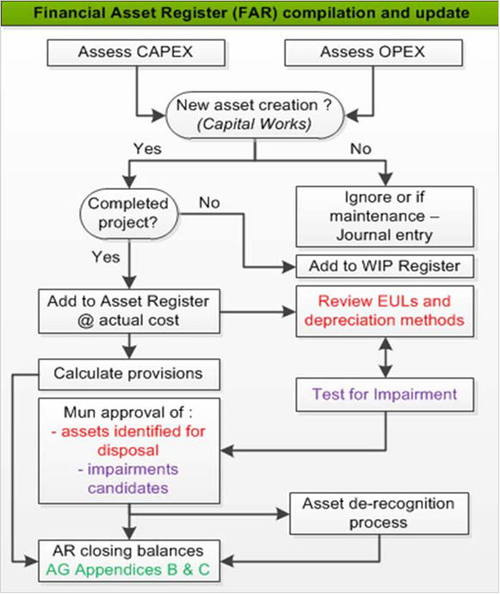
Fixed asset register and compilation

Slide 24
WIP register
24

Slide 25
Projects taking significantly longer to complete
GRAP 17.87(a) require an entity to disclose the cumulative expenditure recognised in the carrying value of investment property and property, plant and equipment in the process of being constructed or developed, respectively.
Expenditures should be disclosed in aggregate, per class of asset.
Projects taking significantly longer – GRAP 17.87 b and c requires that a note in the financial statements
For work-in-progress, it would be the cumulative cost of the capital work-in-progress less any accumulated impairment losses at the reporting date.
An entity discloses the carrying amount recognised and not the total value of the contract or the budget.

Slide 26
Common Audit findings on the assets
Incorrect application of the Directive 7 – Deemed cost and impracticality to determined cost provision.
Incorrect valuation of PPE and Investment property
Incorrect/ lack of methodology for the impairment and residual values
Depreciation and impairment incorrectly calculated as the useful life used in the assets register differ with those contained in the Accounting Polices of the Municipality.

Slide 27
Common Audit findings on the assets
Lack of processes for the accounting and transferring of assets implemented by the Implementing Agencies to the municipalities
Incorrect classification of land owned
Incorrect classification of land to be disposed
Incorrect application of GRAP 3 on fully depreciated assets or assets with R 1 values.

Slide 28
Common Audit findings on the assets
Lack of supporting documents for the work done especially the Journals, impairments calculation and the use of impractically determination of costs.
Assets not in the control of the municipalities included in the asset registers.
Non reconciliation of the valuation roll to the Fixed Asset Registers.
Deeds search for Property, Plant and Equipment not agreeing with the Fixed Assets Register

Slide 29
Common Audit findings on the assets
Non- response by management to audit findings and request for information
Completeness of Fixed Asset registers
Overstatement of work in Progress (WIP) as projects completed were not unbundled and transferred to the competed Assets and depreciated accordingly in line with the requirements of GRAP 17. The none availability of supporting documents especially the completion certificates and Bill of Quantity (BOQ )or tender documents.

Slide 30
Common Audit findings on the assets
Derecognition process not followed on the disposal of assets.
Assets to be sold not regarded as inventory.
Difference between the Fixed Assets register, and the General ledger submitted to the Auditor General.
Opening Balances not disclosed or supported in line with the requirements of GRAP 3
Heritage Assets not properly accounted for in line with GRAP 103

Slide 31
31

