Slide 1
REVENUE MANAGEMENT
CIGFARO NORTH WEST BRANCH
22 – 23 JULY 2019

Slide 2
CONTENT
Background
Revenue Management - Intergration
Data Integrity
Key Issues
Balancing Act
Debt Management
Indigent Management
Conclusion

Slide 3
BACKGROUND
Municipalities are finding it increasingly difficult to generate and collect sufficient revenue to supplement their equitable share and grant funding allocations.
While many are reliant on conditional grant funding, it must be reiterated that this source of funding is now steadily declining.
The weak performance in respect of municipal own revenue collection is a consequence of several operational inefficiencies which makes it exceedingly difficult for municipalities to achieve funded budgets, healthy cash flows and provide adequate services.

Slide 4
BACKGROUND
S139(1)(b) invoked to 11 municipalities due to poor financial management.
National Treasury embarked on a program to support Municipalities in the management of various fields aimed at improving their financial status - Municipal Finance Improvement Program (MFIP) in 2018.

Slide 5
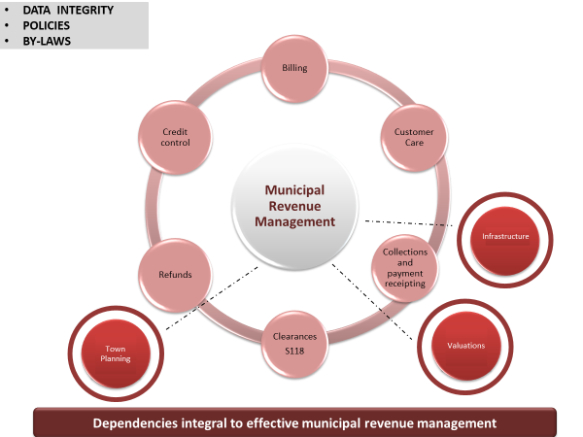
MUNICIPAL REVENUE MANAGEMENT INTERGRATION

Slide 6
MUNICIPAL REVENUE MANAGEMENT INTERGRATION
The lack of functional integration, limited accountability, are among the contributing factors to municipal revenue management inefficiencies.
The municipal town planning, property valuation, water and electricity infrastructure provisioning functions are undertaken by different departments.

Slide 7
MUNICIPAL REVENUE MANAGEMENT INTERGRATION
While these functions impact on the municipality’s revenue, none are integrated with the revenue management section in the BTO
It is important to note that the integrated approach endeavours to ensure that the functional areas and interdepartmental dependencies are sufficiently addressed for seamless transaction processing.

Slide 8
Data Integrity
Revenue base
Location
Valuation
Usage
Category
Registered ownership
Trading services
Meter location
Prepaid/smart/conventional
Regular reading
R&M/loss management
Property data
Metered
services
data
Customer
Identity
Postal address
Telephone; email contact
Indigent?
Service delivery
Communication
Awareness
Query resolution
Timely presentation of accurate account/billing information
Customer data
Service delivery
Strengthening the revenue base & achieving accurate billing

Slide 9
DATA INTEGRITY
Property – Assessment Rates
Registered owner accurate Details – Deeds office.
Type of use – Residential, Business, School, Mining etc..
Valuation – Valid Valuation Roll
Accurate tariff – Captured in the financial system.
Other Property related services.
Refuse Removal – Accurately captured in the financial system.
Sewerage – Accurately captured in the financial system.
Basic charges – Accurately captured in the financial system.

Slide 10
DATA INTEGRITY
METERED SERVICES
Accurate meter numbers linked to property captured in the financial system.
Actual readings collected and captured in the financial system monthly.
Meter management – Resources made available to attend to faulty meters.
Continuous monitoring of illegal consumption, both water and electricity.
Monthly Municipal bill statement.
Presenting a credible bill to the consumer monthly – Posting, email or SMS.

Slide 11
KEY ISSUES

Slide 12
BALANCING ACT

Slide 13
DEBT MANAGEMENT
DEBT PROFILING
Government Debt
Businesses
Residential
Schools
Churches
Farms
Mining
Indigent Households
Deceased Estates
Municipal employees and Counsellors
The purpose of this exercise is to assist in deciding the type of collection action to be taken to each class of debtors.

Slide 14
INDIGENT MANAGEMENT
Registration of the Indigent Households
Granting of monthly subsidy to the approved Indigent Households.
Restricting monthly consumption of the indigent households.
Write-off Indigent households debt.

Slide 15
THANK YOU

