Slide 1
CDM LEKGOTLA Revenue and Debt Management Strategy 04 April 2019

Slide 2
PRESENTATION LAYOUT
Background
Purpose of the Strategy
Revenue management value chain
Legislative mandate
Strategic focus areas
Stakeholders
Key Strategic Objectives
Strategies
Action Plan
Progress on implementation
Conclusion

Slide 3
BACKGROUND
Poor Financial Management in municipalities;
Lack of capacity in Financial Management;
Unfunded budgets;
Inability to meet obligations.

Slide 4
PURPOSE OF THE STRATEGY
To enhance revenue management and debt recovery owed to municipalities;
To address challenges and inefficiencies identified in the municipal revenue generation with the exclusive drive to improve revenue and debt collection;
Reduction of debt owed to municipalities by public institutions both nationally and provincially and residential customers;
To improve municipalities’ reliance on grant funding and any other external support to enhance their self-sustainability.

Slide 5
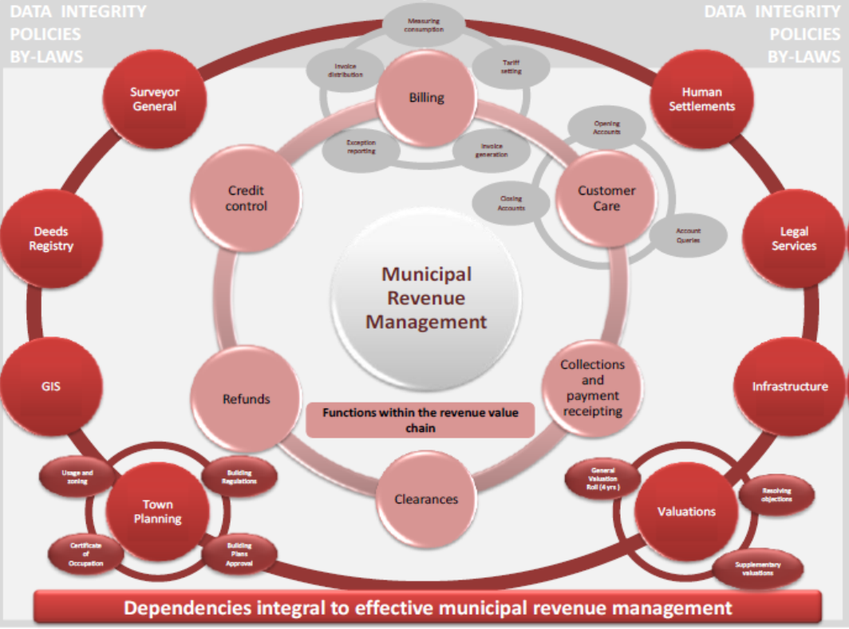
REVENUE MANAGEMENT VALUE CHAIN

Slide 6
PROPERTY VALUE CHAIN

Slide 7
LEGISLATIVE MANDATE
Section 154 (1) of The Constitution provides for support and municipalities capacitation,
Section 5(4) of the MFMA requires the provincial treasuries to monitor municipalities,
Section 64 (3) of the MFMA details the role of municipality in revenue management,
Other key legislations relevant to these engagements, amongst others include:-
Public Finance Management Act (Act 1 of 1999);
Municipal Systems Act;
Municipal Structures Act;
Municipal Fiscal and Functions Act;
Municipal Properties Rates Act;
Intergovernmental Fiscal Relations Act of 1997;
Intergovernmental Relations Framework Act of 2006 (Act 13 of 2005);
Treasury Regulations;
Division of Revenue Act; and
The Government Immovable Asset Management Act (GIAMA);
MFMA circulars.

Slide 8
KEY OBJECTIVES OF STRATEGY
To determine the current municipal capacity and level of municipal revenue and dept management operations,
Develop a practical approach to enhancing overall own revenue base in municipalities,
To ensure that all municipalities have credible own revenue and debt management frameworks (strategies and plans),
Foster alignment and implementation of the municipalities own revenue enhancement strategies and / or plans with the provincial plans,
Develop monitoring and reporting tools to sustain own revenue enhancement in municipalities,
Determine practical methodologies of reconciling and payments of government debts owed to municipalities,
Establish good working relations between municipalities, Eskom and Water boards to enhance compliance to section 41 (2) (a) of the MFAM.

Slide 9
STRATEGIC FOCUS AREAS
Key Performance Area | Specific Strategies
Deeds Register | Updated property ownership;
Geographic Information System (GIS) | Regularly updated GIS
Town Planning | Complete zoning of land parcels
Valuation | Up to date municipal valuation roll;
Infrastructure | Minimise distribution losses; Maintenance of infrastructure;
Billing | Accurate and complete customer billing (Integrity of customer data);
Credit Control Management | Effective implementation of policies and by-laws; Improved revenue collection;
Clearance | Smooth and legal transfer of ownership of properties
Collections and Payment Receipting | Timeous allocation of receipts from customers;
Customer Care Management (Communication) | Effective customer services and convenient customer environment
Indigent Management | Up to date indigent management register; Realistic and reasonable indigent budget;
Institutional Arrangements | Capacity building initiatives; Establish relevant municipal structures;

Slide 10
STAKEHOLDERS
Stakeholder | Responsibility
Limpopo Provincial Treasury | Facilitation and coordination
CoGHSTA | Co-facilitation and coordination
DPWR&I | Provision of accurate information and participation in meetings
SALGA | Participation in meetings
Provincial and National Departments | Attend meetings and honour resolutions and agreements
Municipal Entities | Attend meetings and honour resolutions and agreements
Eskom | Provision of accurate information and participation in meetings
Water boards | Provision of accurate information and participation in meetings
District Municipalities | Provision of accurate information and participation in meetings
Local Municipalities | Provision of accurate information and participation in meetings

Slide 11
STRATEGIES
Key Performance Area | Specific Strategies
Municipal revenue enhancement | Assessment and / or facilitate the development of municipal revenue management policy frameworks Municipal revenue management capacity building, Maximisation of revenue generation options, Check alignment of municipal functions supporting revenue management, Confirm municipal revenue customer database, Strengthen internal controls for revenue through evaluation of and ensuring effective municipal billing system, and introduce SMSs as means of communicating billing to consumers. Tariffs in the billing system must reconcile with the approved tariffs approved by council, Tariffs should take into account inflationary increases and should factor in other incremental costs associated with providing the service, Constant review of tariffs to assess whether they are cost reflective and to ensure that the council approve the proposed tariff increase, Reconciliation between the billing system and the valuation roll to ensure that all properties in the valuation roll and are included in the billing system for completeness of revenue and correct billing, Maintenance of water meters and water infrastructure by municipal staff to ensure that there is no water leakages, Introduce service cuts as a last resort to enforce payments of services, Monitor the implementation of revenue enhancement strategies.

Slide 12
STRATEGIES
Indigent management | Assessment and / or facilitate the development of indigent policy frameworks and strategies, Establish the indigent clients register, Monitoring implementation of indigent policy frameworks and strategies,
Debt Management | Assessment and / or facilitate the development of municipal debt management policy framework and strategies, Compile and monitor implementation of the Financial Recovery Plan, Create conducive environment for debt reconciliation between municipalities and public institutions, LPT to engage departments to commit and pay municipal debts within prescribed timeframes, Monitor implementation of dept management policy framework,

Slide 13
STRATEGIES
Management of Creditors’ accounts | Assessment and / or facilitate the development of municipal creditors’ accounts management policy framework and strategies, Establish and verification of all creditors accounts, Facilitate the reconciliation of invoices within stipulated periods, Facilitate the development and signing of Payment Agreements, Monitor implementation of policy frameworks, strategies.
Building relations between municipalities and customers | Assess and / or facilitate the development of strategies to manage relations with customers, inclusive of; Enforce customer care as it will reduce the turnaround time on customer care queries, Awareness with the customers on the importance of paying the accounts on time, Enhance support from municipalities in the district or province through Inter-Governmental Relations (IGR) structures to secure payment arrangements with officials employed by municipalities and Government. E.g. Introduction of stop orders Monitor implementation of communication strategy.

Slide 14
ACTION PLAN
Key Performance Areas/ Dependencies | Short to Medium Term Goals (1 – 5 years) | Long Term Goals (5 – 10 years) | Planned Interventions | Key stakeholders in support of LPT
Deeds Register | Updated property ownership | Updated property ownership | Engage municipalities and departments on the registration of ownership of properties at Deeds Offices; Monitor the reconciliation of municipal valuation roll, departments’ asset registers and the Deeds Register. | CoGHSTA SALGA Municipalities
Geographic Information System (GIS) | Continuous update of GIS | Completeness of revenue billing | Assessment and / or monitor the development of ICT policies and by-laws; Identify municipalities in use of the GIS; Recommend for acquisition of GIS; | CoGHSTA SALGA Municipalities

Slide 15
ACTION PLAN
Key Performance Areas/ Dependencies | Short to Medium Term Goals (1 – 5 years) | Long Term Goals (5 – 10 years) | Planned Interventions | Key stakeholders in support of LPT
Town Planning | Linkage between the town planning and revenue department | Completeness of revenue billing | Engage municipalities on establishment of Town Planning Functions; Engage municipalities on Town Planning capacity building initiatives; Advice town planning unit at municipalities to update the property ownership as per changes from the Deeds office. | CoGHSTA SALGA Municipalities
Valuation | Up to date and accurate valuation roll | Completeness and accuracy of revenue billing | Assess the accuracy of valuation roll reconciliation on the system; Confirm if the municipality has an approved property rates policy and by-laws; Advise municipalities to identify new property developments and update the valuation roll thereof; Monitor the municipal valuation roll process compliance in terms of MPRA; | CoGHSTA SALGA Municipalities

Slide 16
ACTION PLAN
Key Performance Areas | Short to Medium Term Goals (1 – 5 years) | Long Term Goals (5 – 10 years) | Planned Interventions | Key stakeholders in support of LPT
Infrastructure | Manage non-technical distribution losses (Water and electricity) | Minimise non-technical distribution losses to an acceptable norm (Water and electricity) | Assessment and / or facilitate the development of policies, by-laws and/or strategies on managing distribution losses; Facilitate the development of infrastructure maintenance plan in an effort to reduce distribution loss; Recommend the employment of energy balancing technique to detect periods with less non-technical losses; Recommend the use of technology to track illegal connections; Monitor community awareness programmes on danger and impact of illegal connections; Assis municipalities to develop the infrastructure maintenance strategies and policies; Monitor the implementation of the infrastructure maintenance strategies and policies; Monitor that maintenance of water meters and water infrastructure is done by municipal staff where there is capacity. | CoGHSTA SALGA NERSA Eskom Water and Sanitation Municipalities

Slide 17
ACTION PLAN
Key Performance Areas | Short to Medium Term Goals (1 – 5 years) | Long Term Goals (5 – 10 years) | Planned Interventions | Key stakeholders in support of LPT
Billing | Accurate and complete customer billing (Integrity of customer data); | Accurate and complete customer billing (Integrity of customer data); | Assessment and / or facilitate the development of municipal revenue management policies, by-laws and/or strategies; Monitor the implementation of the policies, by-laws and strategies; Assess the accuracy of the customer data on the billing system; Support the strengthening of internal controls over issuing of bills to customers e.g. issuing of bills through SMSs, emails etc.; Verification of tariffs uploaded in the billing system against the approved tariffs structure; Support and guide the municipalities in developing tariff setting models; Facilitate reconciliations between the billing system and the valuation roll; Assess whether the revenue related budget is realistic and provide recommendations thereof; | CoGHSTA SALGA NERSA Eskom Water and Sanitation Municipalities

Slide 18
ACTION PLAN
Key Performance Areas | Short to Medium Term Goals (1 – 5 years) | Long Term Goals (5 – 10 years) | Planned Interventions | Key stakeholders in support of LPT
Credit Control | Instil culture of payment of services | Customers willingly paying for services | Assessment and / or facilitate the development of municipal debt management policies, by-laws and strategies; Monitor implementation of credit control and debt management policies, by-laws and strategies; Assess and support on strengthening internal controls over credit control; Advise on ways to improve turnaround time on payments of services; Assist in the conduct of awareness campaigns; Advice on introduction of various payments methods; Advice on introduction of incentives for accounts settled in full and on time; Monitor timeous allocation of receipts; Advice on introduction of policy for deduction of overdue accounts on services and rates by municipal officials and councillors; Advice on establishment of mechanism to identify government officials with outstanding municipal’s accounts; Create conducive environment for departmental debt reconciliation between municipalities and public institutions; LPT to engage departments to commit and pay municipal debts within prescribed timeframes; | CoGHSTA SALGA NERSA Eskom Water and Sanitation Municipalities

Slide 19
ACTION PLAN
Key Performance Areas | Short to Medium Term Goals (1 – 5 years) | Long Term Goals (5 – 10 years) | Planned Interventions | Key stakeholders in support of LPT
Clearances | Smooth and legal transfer of ownership of properties | Smooth and legal transfer of ownership of properties | Assess whether the municipality's process in respect of issuing of rates, levy and electrical clearance certificates is appropriately followed when transferring ownership of the property. | Municipalities Others
Collections and Payment Receipting | Timely payment of services and allocation of receipts | Timely payment of services and allocation of receipts | Support on strengthening internal controls over revenue collection e.g. introduction of EFT payments, payments at supermarkets; Support on strengthening internal controls over revenue collection e.g. introduction of EFT payments, payments at supermarkets; Encourage timeous allocation of receipts; Encourage timeous submission of remittance advices by government departments; | Municipalities Government Institutions

Slide 20
ACTION PLAN
Key Performance Areas | Short to Medium Term Goals (1 – 5 years) | Long Term Goals (5 – 10 years) | Planned Interventions | Key stakeholders in support of LPT
Customer Care Management | Improved turnaround time on customers queries | Effective and efficient customer care | Assessment and / or facilitate the development of the customer care policies, by-laws and strategies; Monitor implementation of policies, by-laws and strategies on customer care; Improve support to municipalities through Inter-Governmental Relations (IGR) structures; Assess/improve customer care processes; Assist with development of efficient and convenient communication systems. | CoGHSTA SALGA NERSA Eskom Water and Sanitation Municipalities

Slide 21
ACTION PLAN
Key Performance Areas | Short to Medium Term Goals (1 – 5 years) | Long Term Goals (5 – 10 years) | Planned Interventions | Key stakeholders in support of LPT
Indigent Support Management | Monitor and maintain indigent register | Reliable system generated indigent register comprised of legible customers linked with other social services. | Assessment and / or facilitate the development of indigent policies, by-laws and strategies in accordance with Local Governance Municipal System Act and other related legislations; Monitor the implementation of indigent policies, by-laws and strategies; Assess the existence and monitor the update of indigent support register; Monitor awareness programmes to indigent customers on the importance of indigent support programme and why is should be managed properly; Assess the reasonability of the indigent support package/tariff during budget processes and provide recommendations; Confirm eligibility of indigents through use of other government departments’ data e.g. SARS, Home Affairs etc. | CoGHSTA SALGA NERSA Eskom Water and Sanitation Municipalities

Slide 22
ACTION PLAN
Key Performance Areas | Short to Medium Term Goals (1 – 5 years) | Long Term Goals (5 – 10 years) | Planned Interventions | Key stakeholders in support of LPT
Institutional Arrangements | Governance and communication | Mature system of intergovernmental relations | Municipal revenue management capacity building on planning, technical and revenue functions; Review and provide support on alignment of municipal functions which are linked to revenue management function; Establishment of revenue management committees comprising IDP manager, Town Planner, Infrastructure Manager, Chief Financial Officer and other relevant officials; Improve support on revenue and debt management issues by establishing revenue and debt management awareness programs e.g. trainings and workshops; | CoGHSTA SALGA NERSA Eskom Water and Sanitation Municipalities

Slide 23
CORDINATION
The LPT assumes the facilitation and coordination role of the strategy,
LPT to implement the Action Plan in collaboration with other stakeholders,
A steering committee be established between LPT and CoGHSTA to facilitate the implementation of Provincial Debt Management forum resolutions and follow-ups of departmental debt payments,
Municipalities will be required to commit for the implementation of the specific strategies,
IGR structure (preferably Provincial Debt Management forum) be assigned the responsibility of reconciling departmental debt owed to municipalities,

Slide 24
PROGRESS ON THE IMPLEMENTATION
Billing and Valuation roll
Customer Care Management
Indigent Management Support
Credit Control Management

Slide 25
CONCLUSION
The LPT to benchmark with other provinces (KZN and Gauteng provinces) on revenue and debt management,
Municipalities are urged to own the process which is intended to improve their performance.

Slide 26
THANK YOU

