Slide 1
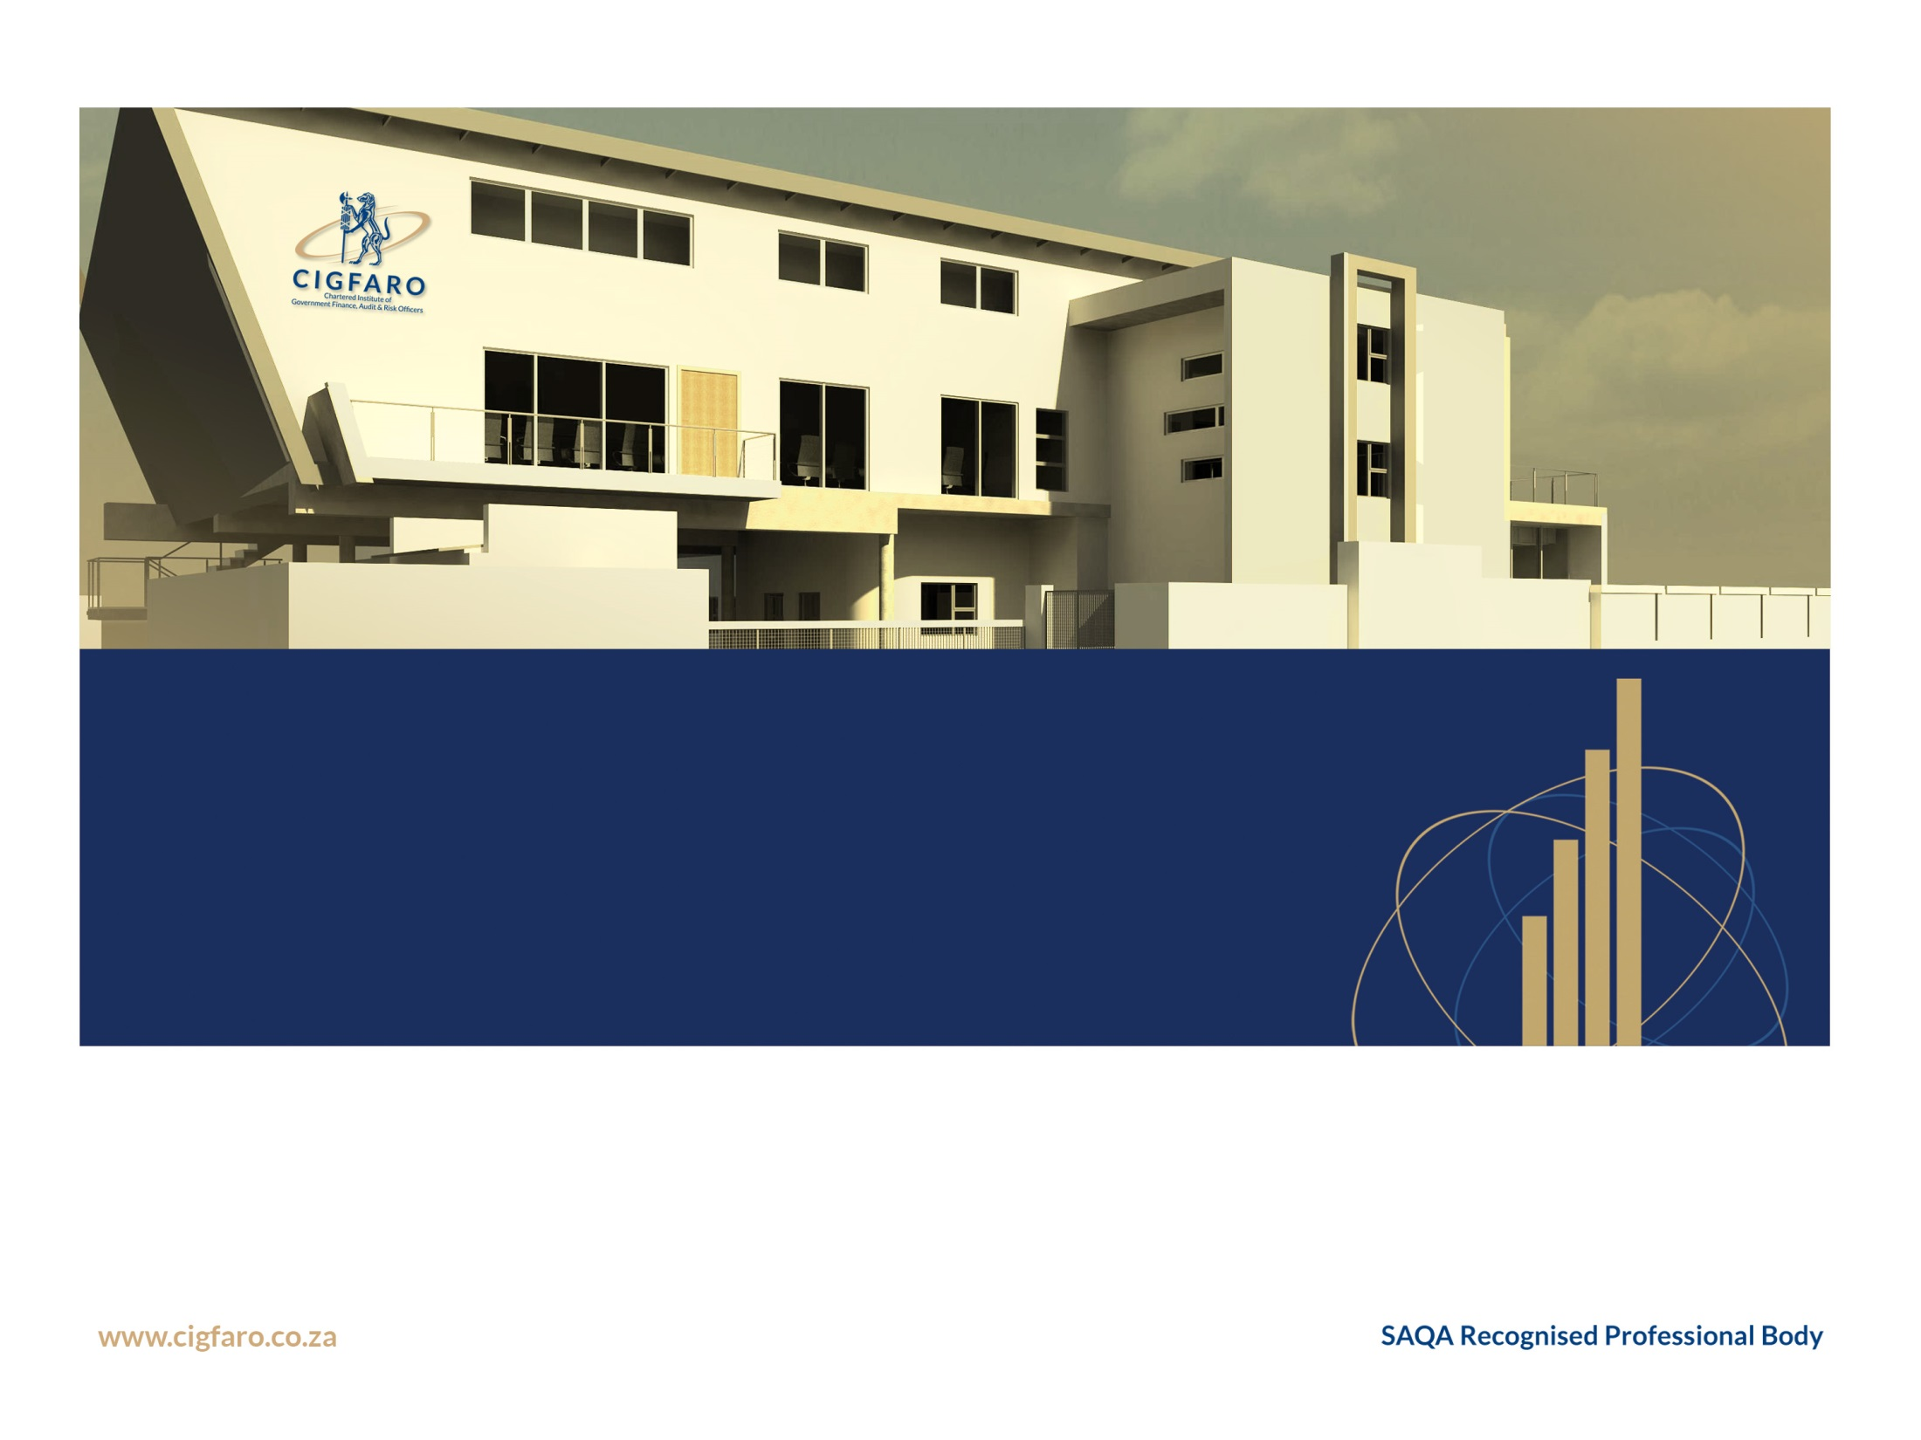


2017 DIVISION OF REVENUE ACT
WENDY FANOE
NATIONAL TREASURY

Slide 2
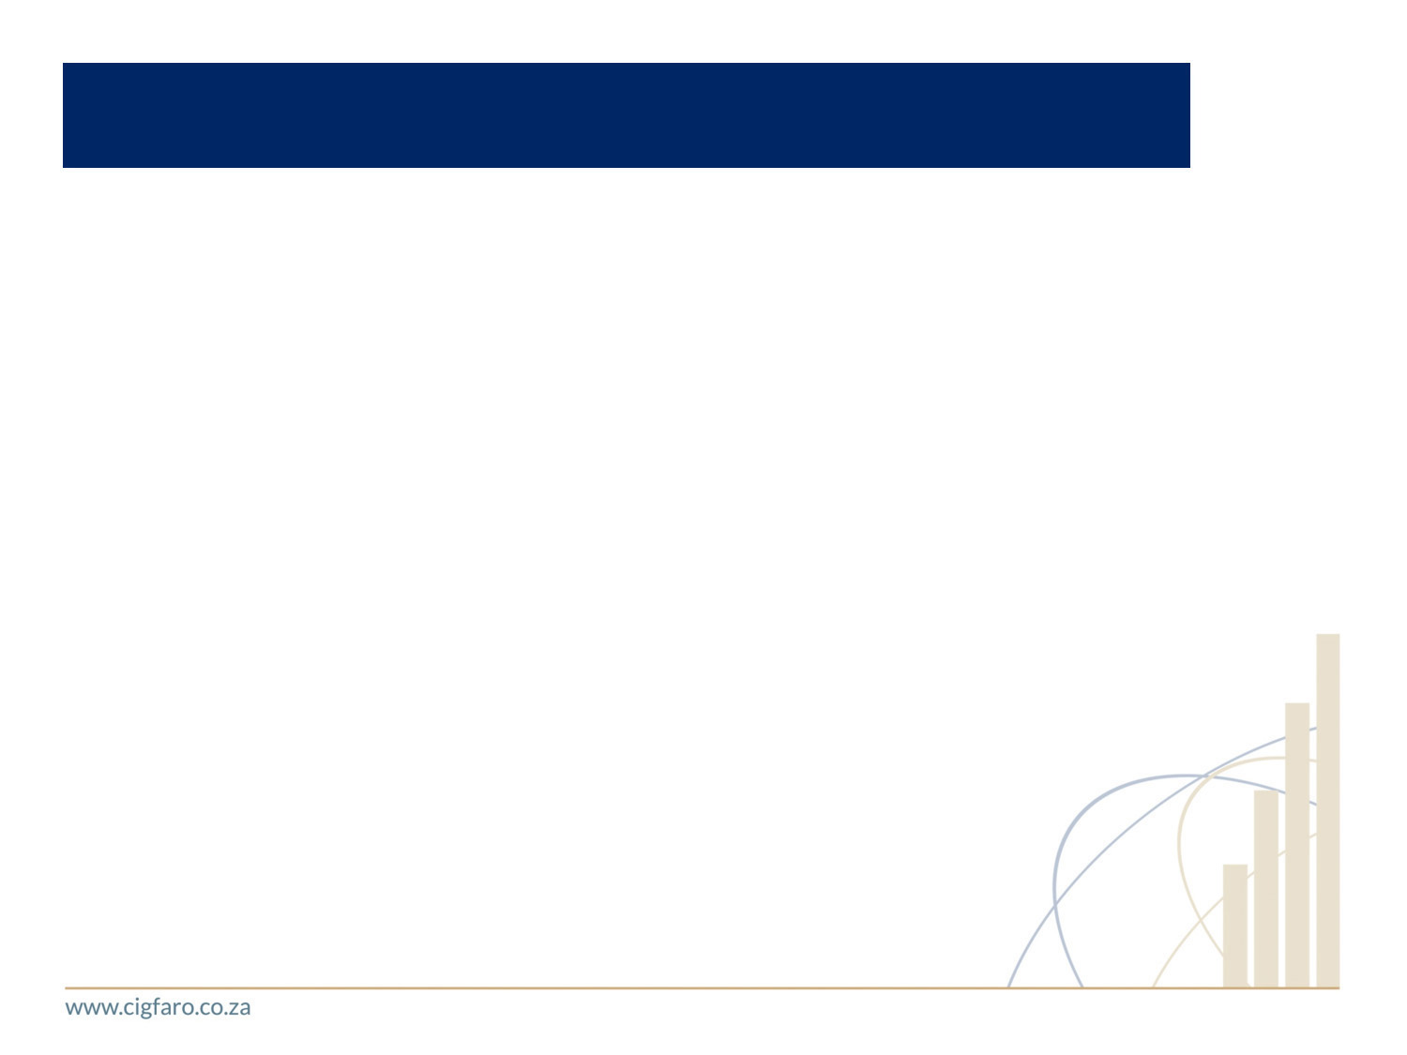

PRESENTATION OUTLINE HEADER A
Local Government (LG) Fiscal Framework
  Design of the LG fiscal framework
  Division of revenue
  LG Equitable Share Formula
  Issues for Consideration
Reforms Currently Underway to the LG Infrastructure Conditional Grant System
  Infrastructure Grant Review
  A New Fiscal Package to Transform our Cities
Conclusion
Note that proposed changes to the LG fiscal framework may be announced in the Medium Term Budget Policy Statement that will be tabled on 25 October 2017

Slide 3

LOCAL GOVERNMENT (LG) FISCAL FRAMEWORK

Slide 4
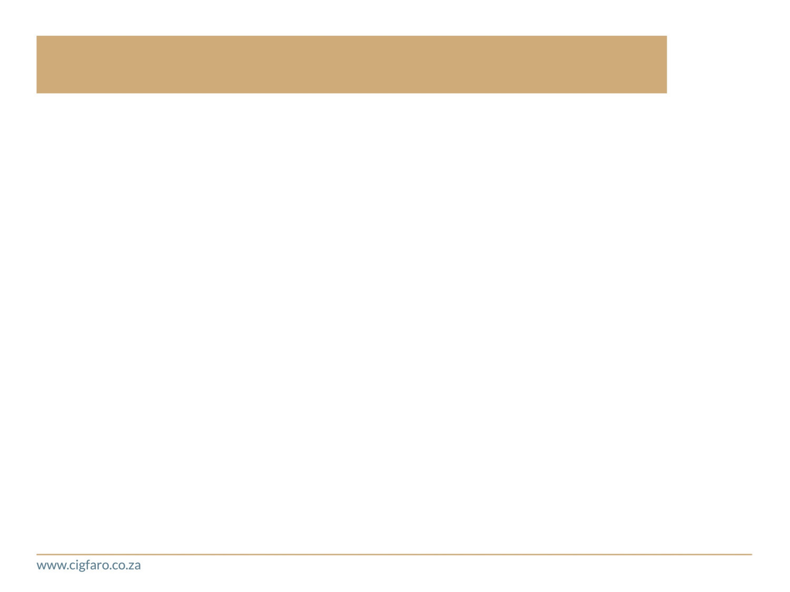


Design of the LG fiscal framework
The LG Fiscal Framework recognises the economic inequalities across the country, where certain municipalities have less own revenue resources
The LG equitable share (LGES) formula is designed to enable municipalities “to provide basic services and perform the functions allocated to it”, taking into account “fiscal capacity and efficiency” and “developmental and other needs“ of municipalities
The LGES cannot fund municipalities for lack of revenue raising efforts or inefficiencies (s227(1)(a) and 227(2) of the Constitution)
The LGES should mainly be used to subsidise or fund the provision of municipal services to poor households
Municipalities are expected to fund basic services and functions like the provision of water, electricity, refuse removal, fire-fighting and emergency services to the non-poor from their own revenue

Slide 5
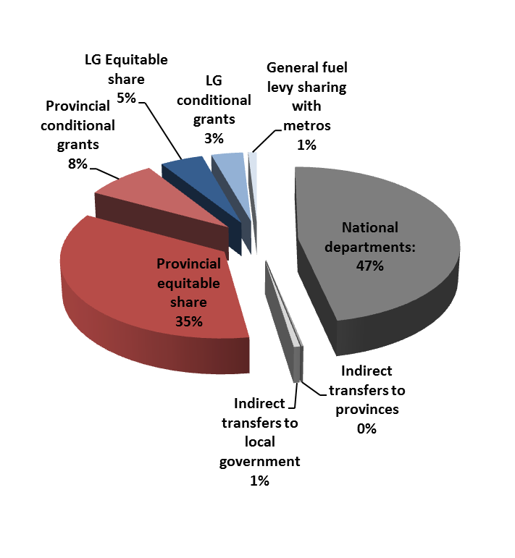
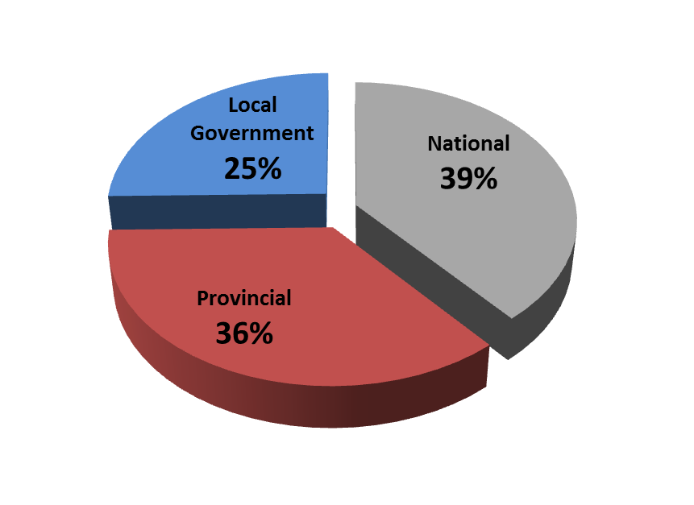
Division of revenue to LG
Local Govt
9.1%
LG’s share:
9.1% vs 25%
National 47.5%
Provinces
43.4%
Division of Revenue including Provincial and Municipal Own Revenue (2016/17)

Slide 6
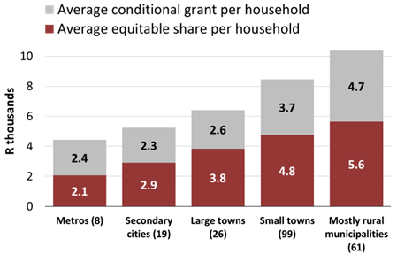
Redistributive nature of LG fiscal framework
The division of revenue achieves a substantial redistribution of revenues raised through taxes in relatively wealthy (mainly urban) areas to areas where demand for subsidised public services is highest
As a result, the most rural municipalities receive twice the allocation per household that is transferred to metros (although 70% of tax revenue is raised in metros) revenue

Slide 7




How the LGES formula works
Free basic services
R41.1b
R359 p.m. for a package of free basic services for 59% of SA households with an income of less than 2 old age pensions p.m.
These funds are only allocated to poorer municipalities (some cities can fund these from own revenues)
Institutional
R4.1b to assist with administration costs
Community Services
R6.1b to fund community services
Allocated through a formula to ensure fairness for all 257 municipalities
A new LGES formula was introduced in 2013/14 after extensive consultation, with 5-yr phase-in
The formula is updated annually with cost data to account for price increases; estimates of household growth. From 2018/19 formula will be updated with 2016 CS data
Final allocation to each munic. determined by this formula and impact of phase-in and guarantees

Slide 8
What has been impact of new LGES formula?
Old formula - Allocation per poor household
New formula - Allocation per poor household
Analysis of impact of new LGES on sampled group of rural municipalities indicate that much of the increased transfers they received were used to increase employee costs
The analysis also shows a strong linear correlation between number of employees employed and the LGES, an indication that additional funding in future is likely to be used for staff costs
More work is needed to unpack what the impacts of this have been on service delivery, but it does appear that rural municipalities, which typically already spent large proportions of their budget on administration has had limited impact on improved services own revenue

Slide 9
REFORMING LG INFRASTRUCTURE GRANTS TO MAXIMISE/IMPROVE PERFORMANCE

Slide 10

Reforming LG infra. grants
LG Infrastructure Review

Slide 11

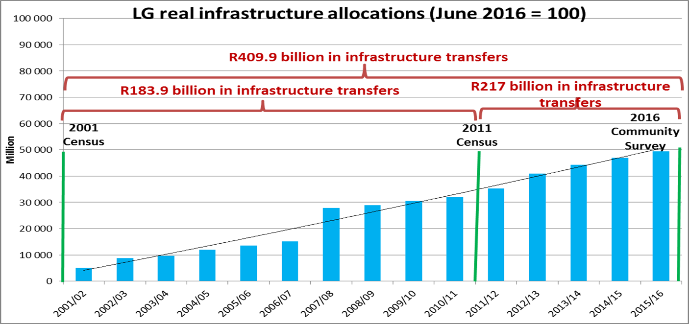
Real infrastructure allocations increasing while service provision is decreasing
Although allocations have substantially increased between 2011-2016 (5 years), there is less service delivery progress than between 2010-2011 (10 years)

Slide 12
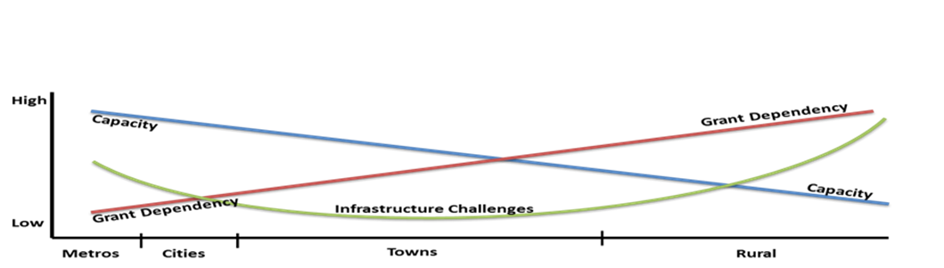
LG Infrastructure Grant Review: LT Vision for Reform
A municipality’s context should determine its grant system
Consolidated Urban Grant (limited conditionality, supplements capital budget)
Limit other grants to national priorities / regionally strategic projects (eg RBIG)
MIG
(allow municipal discretion, coordination with sectors, and emphasis on asset management)
Water & Sanitation
INEP
General Infrastructure & Community Services Funding
Cities
Extend metro grant reforms to some secondary cities over time
Metros
Towns
Rural

Slide 13



LG Infrastructure Grants Reform Priorities
1. Improved Grant Structure
Greater differentiation for urban and rural challenges – no more one-size-fits-all
Consolidation and rationalisation in the number of grants each municipality receives
Increasing grant reliance (especially in urban areas)
Proliferation in the number of grants
Coordination problems between grants
2. Emphasis on Asset Management
Incentivise improved asset management and maintenance (though not funding maintenance through capital grants)
Shift grants to fund existing assets for renewal, not always ‘new’ infrastructure
Problems addressed:
Non-functional infrastructure (due to poor maintenance)
3. Management and efficiency of the Grant System
Clearer roles for national departments and stronger central/holistic management of system
Rationalised, functional and accountable reporting system that enables performance to be accurately measured
Increasing reporting burden for municipalities
Weak support and oversight by national depts
Inefficiency and wasteful spending

Slide 14
Reforming LG infra. grants
Reforms of fiscal package to cities

Slide 15
Urban cities face structural constraints
Structural constraints manifested in declining growth in large urban centres. Driven by urbanisation patterns:
    Spatial dislocation of people and jobs
    Jobless population growth
    High levels of inequality
Driven by fragmented, inefficient and inequitable urban spatial form
  Transfers costs to poor households, the state and ultimately the real economy, dampening growth and deepening inequality
    Creates inefficient and rising local expenditure pressures
Current programmes deepen fiscal challenge through addressing symptoms not causes
Low density, segregated cities are a reflection of the infra investment and land use development choices we make
We are using conditional grants to encourage cities to focus on spatial transformation through their Built Environment Performance Plans, and expanding these reforms to secondary cities, are key priorities over MTEF

Slide 16
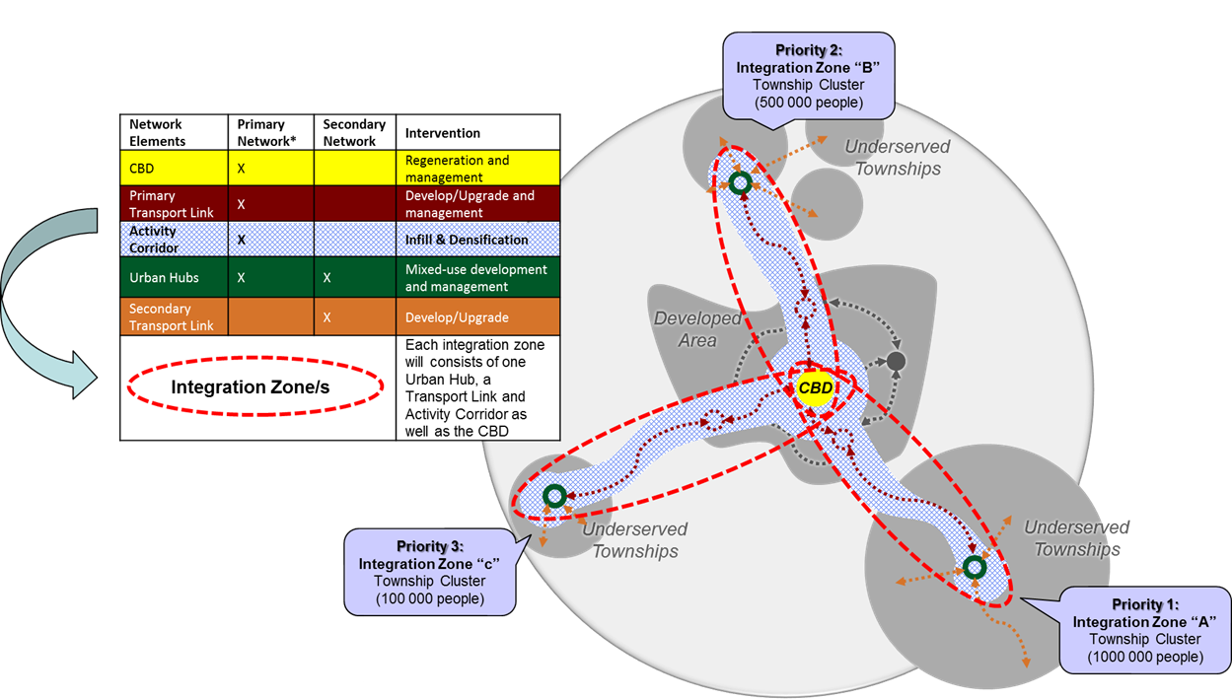
A new fiscal package to transform our cities (1/2)
What the NDP says:
Urban sprawl should be “contained and possibly, reversed as denser forms of development are more efficient in terms of land usage, infrastructure usage and environmental protection”
“The major concentrations of urban poor should be spatially linked into the mainstream of city life through investments in transport infrastructure and the connecting corridors of development”

Slide 17
A new fiscal package to transform our cities (2/2)
SA cities still defined by apartheid spatial patterns, with poor residents living in dormitory townships far from opportunities
Infra investments need to change the shape of our cities will come from NG (grant funding increased tremendously over the last decade) and cities’ own revenues, as cities account for the majority of the economy and national tax base
Measures to support cities to increase their contribution to infrastructure development include:
  Modifying the infra grant system by reducing number of grants, introducing more flexible grant conditions and increasing certainty of transfers over a longer time period
  Refocusing the Neighbourhood Development Partnership Programme to support the development of economic hubs in large urban townships
  Reforming the system of development charges to improve fairness and transparency, and reduce delays in infrastructure provision for private land developments
  Reviewing the sustainability of existing own-revenue sources for metropolitan municipalities
  Expanding opportunities for private investment in municipal infra through the DBSA increasing its origination of longer-term loans
  Project preparation facility provided in partnership with DBSA
  Infrastructure delivery management system is being expanded

Slide 18
IN CONCLUSION

Slide 19

Root Causes of Municipal Liquidity Challenges
A well functioning municipality has:
  Community oversight and accountability
  Sound political leadership
  Strong organisational capacity
    Governance
    Priorities, policies and plans (IDPs aligned with budgets)
    Staff
    Systems
    Budgets, SCM and financial management
What are the root causes resulting in municipal liquidity challenges
  External contributing factors
    Misaligned legislation, powers and functions, impact of municipal amalgamations, agency agreements for services delivered for other spheres
  Internal contributing factors links back to any (or all) of the above

Slide 20
Perceived contributory factors to municipal failures ...
Some stakeholders argue LG is underfunded?
  That their share of nationally raised revenue as articulated in the annual Division of Revenue Act at 9% is not sufficient …
Others argue that municipalities…
  are not viable?
  Or that it is a Governance Failure?
  Or the design of our Intergovernmental System is the problem?
  Or that National Government is the reason for this failure?
  Or a combination of all the above?
Yet, municipalities
  collectively underspent each year…
  Have substantial revenue sources assigned to them relative to provinces and if one takes this into account, their share of the total national revenue raised is in fact 25%
  The AG’s findings largely indicate that mismanagement, lack of internal controls, leadership challenges, massive water and electricity losses are the issues that need immediate remedial action
  So what is really the problem/situation…and is it informed by factual information – empirical evidence?

Slide 21
…………. THE END

