Slide 1


Audit & Risk Management
The role of Combined Assurance to achieve transformational service delivery strategies
PRESENTATION TITLE

Slide 2


AGENDA
What is combined assurance
Suggested Combined Assurance Model;
Logic Model as an implementation strategy for Combined Assurance;
The 3 Lines of Defence;
Facilitated discussion.

Slide 3



WHAT IS COMBINED ASSURANCE?
Combined assurance has its origins in the King III Report on Corporate Governance. In terms of King III, the audit committee should ensure that a combined assurance model is applied to ensure that a system of sound risk governance over key organizational risks through the application of a coordinated approach to all assurance activities

Slide 4
WHAT IS COMBINED ASSURANCE
In terms of Principle 15 of the King IV
a combined assurance, is a model that incorporates and optimises all assurance services and functions so that, “taken as a whole, these should
enable an effective control environment;
support the integrity of information used for internal decision-making by management, the governing body and its committees and
support the integrity of the organisation’s external reports.”

Slide 5
WHAT IS COMBINED ASSURANCE
Essentially combined assurance, is a process of effective co-ordination and collaboration between management and internal as well as external assurance providers with the objective of ensuring that risks are well managed so that Institutions can achieve their strategic goals and objectives resulting in good performance as well as transformational service delivery .

Slide 6

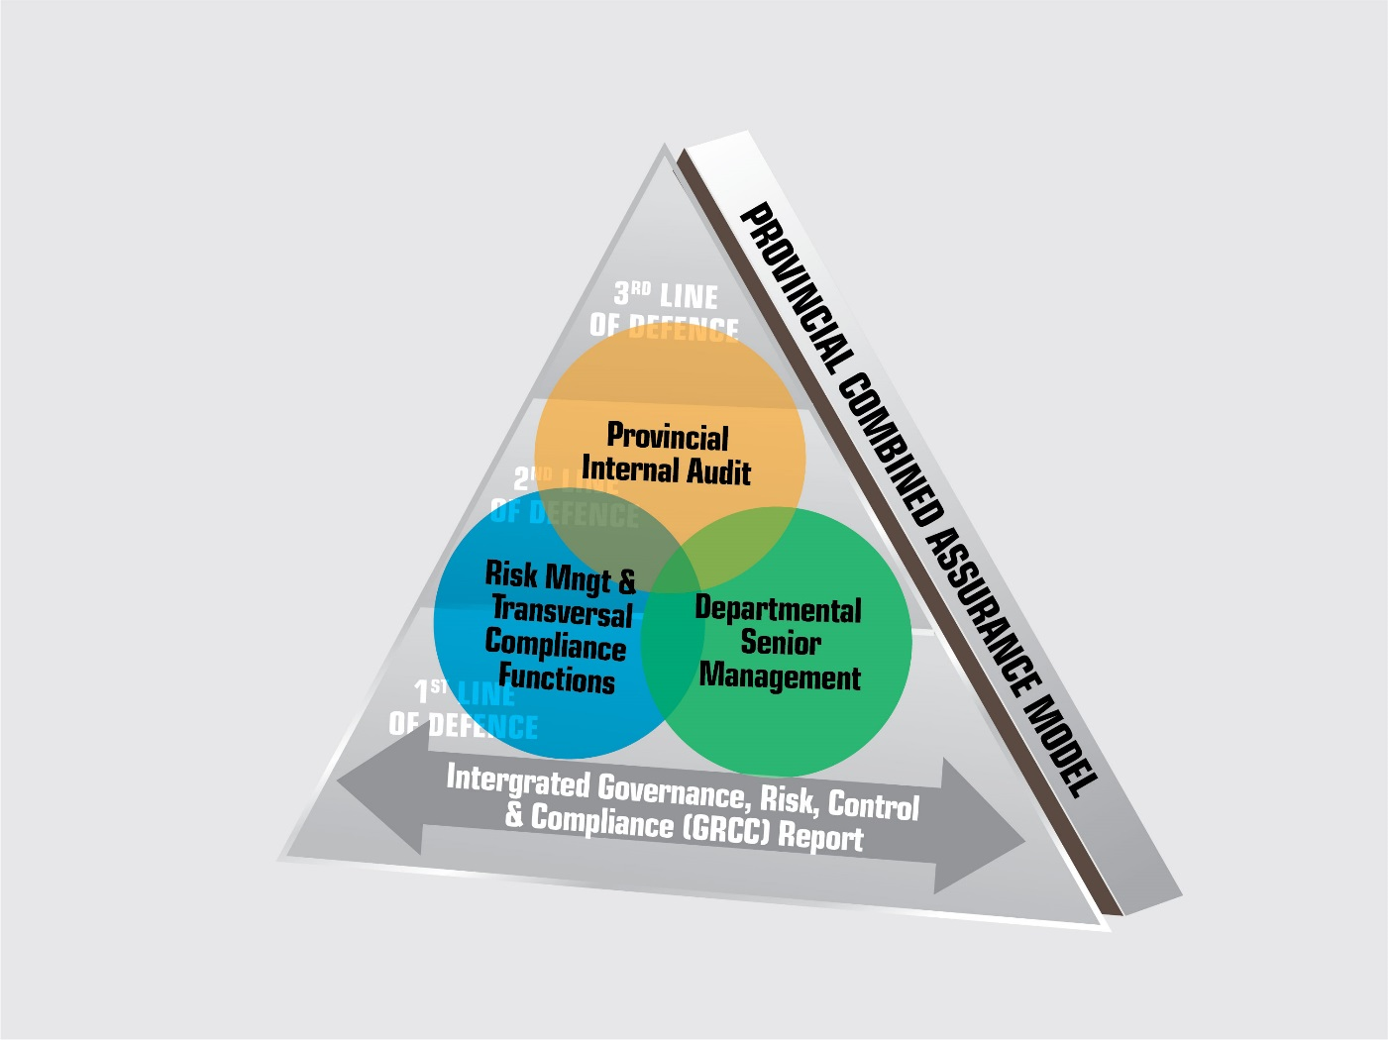
LIMPOPO PROVINCIAL COMBINED ASSURANCE MODEL

Slide 7
LEGISLATIVE MANDATE
Treasury Regulations para 3.2.10 requires, that “The internal audit function must co-ordinate with other internal and external providers of assurance to ensure proper coverage and to minimise duplication of effort”.
Specifically, Standard 2050 of the Institute of Internal Auditors (IIA) Coordination and Reliance states that:
The chief audit executive should share information and coordinate activities with other internal and external providers of assurance and consulting services to ensure proper coverage and minimize duplication of efforts.

Slide 8
SOME BENEFITS OF A COMBINED ASSURANCE APPROACH
Common view of risks and issues across the organization;
Coordinated and relevant assurance efforts are directed to the risks that matter most;
Commitment to enhance effective internal controls to mitigate risks is demonstrated;
Combined Assurance Dashboards that provide an integrated, insightful view;
Combined Assurance practices and activities produce valuable, integrated data, based on collaboration and not silos (silositus);
Resources are not wasted on unnecessary duplication and assurance fatigue and costs are reduced through reduction / elimination of duplications and better resource allocation;
A comprehensive and prioritised approach in tracking of AG:SA and Internal Audit findings, internal control weaknesses and opportunities for a common/transversal approach to remedial actions can be identified;

Slide 9

IMPLEMENTATION OF COMBINED ASSURANCE
DESPITE ALL THE BENEFITS OF COMBINED ASSURANCE, A CRITICAL SUCCESS FACTOR IS ITS:
  IMPLEMENTATION
  IMPLEMENTATION
  IMPLEMENTATION

Slide 10
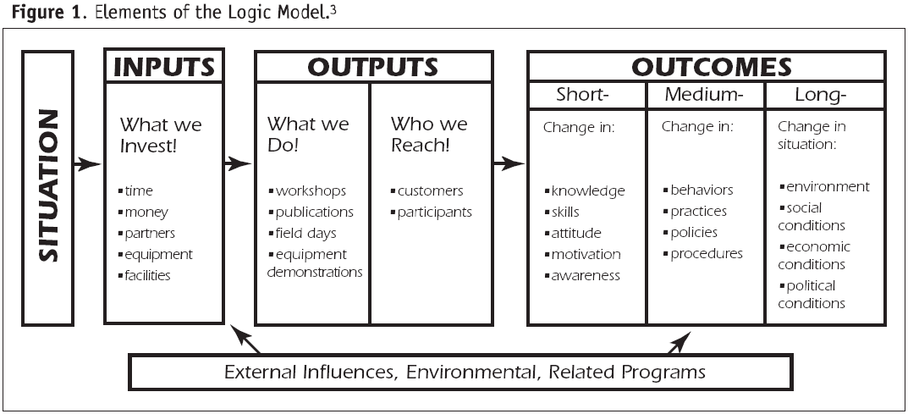
PROVINCIAL COMBINED ASSURANCE METHODOLOGY
A suggested methodology for implementation of Combined Assurance is the Logic Model

Slide 11
A CIRCULAR PRESENTATION OF THE LOGIC MODEL

Slide 12
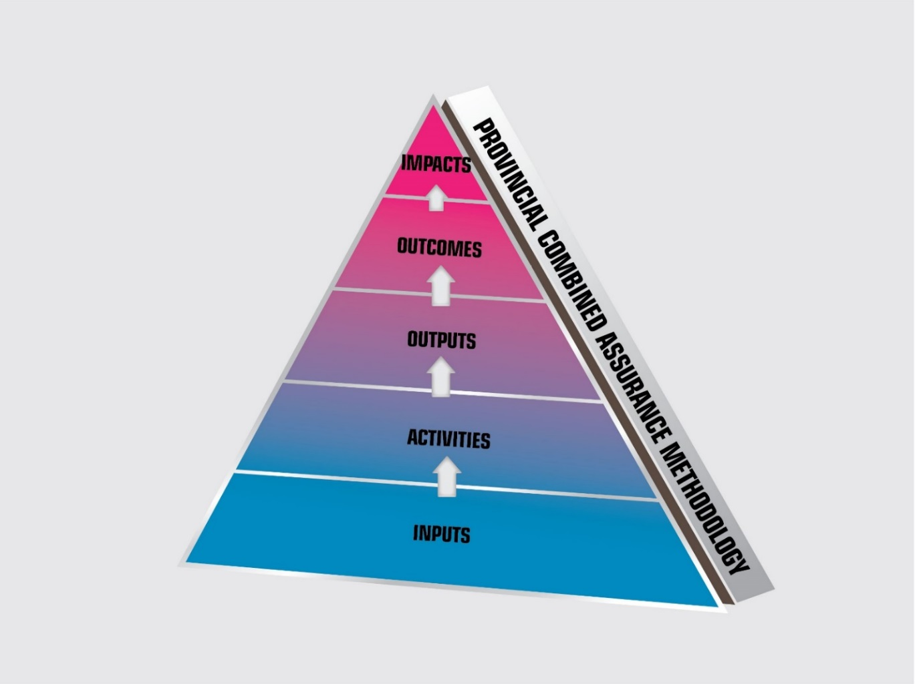
PROVINCIAL COMBINED ASSURANCE METHODOLOGY
The Limpopo Provincial Combined Assurance Methodology uses the Logic Model.

Slide 13
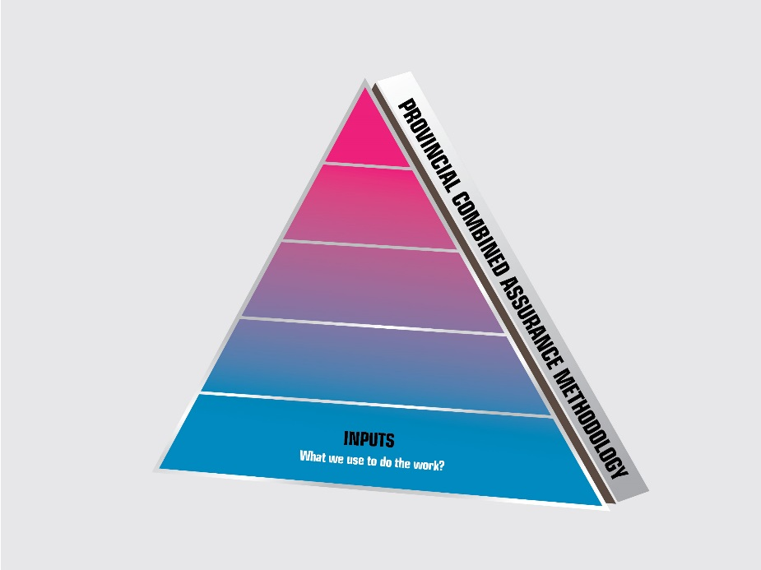
COMBINED ASSURANCE - INPUTS
1. KEY QUESTION (KQ) - WHAT WE USE TO DO OUR WORK?

Slide 14
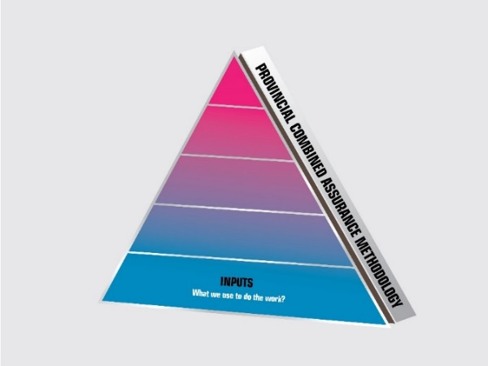
INPUTS -– What we use to do our work?
Inputs represent the resources and capabilities that contribute to production and delivery of outputs.
Applied in a Combined Assurance Model, these include:
  Identifying and evaluating a) who are potential Assurance Providers and b) to whom assurance will be provided to;
  Determining the assurance / audit universe;

Slide 15
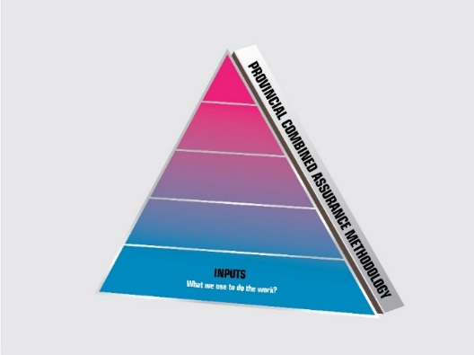
INPUTS -– What we use to do our work?
Inputs cont.;
  Establishing and promoting a common understanding and language for combined assurance,
      Promote a common understanding of the Establish the Objective-Risk-Control Infrastructure;
      Define Key assurance terminology;
      Identify the Key Business Risks on which assurance will be provided;

Slide 16
INPUTS -– What we use to do our work?
Inputs cont.;
  d) Identifying Key Role Players in Combined Assurance i.e. Who are either i) recipients of assurance services and / or ii) are the providers of assurance services.
  e) Promote a common understanding of the three lines of defense model;
  f) Foster an understanding of integrated reporting in respect of GRCC
  Governance – Risk – Control - Compliance

Slide 17
INPUTS -– What we use to do our work?
Inputs cont.;
  Establishing and promoting a common understanding and language for combined assurance,
    Promote a common understanding of the Establish the Objective-Risk-Control Infrastructure;
    Define Key assurance terminology;

Slide 18
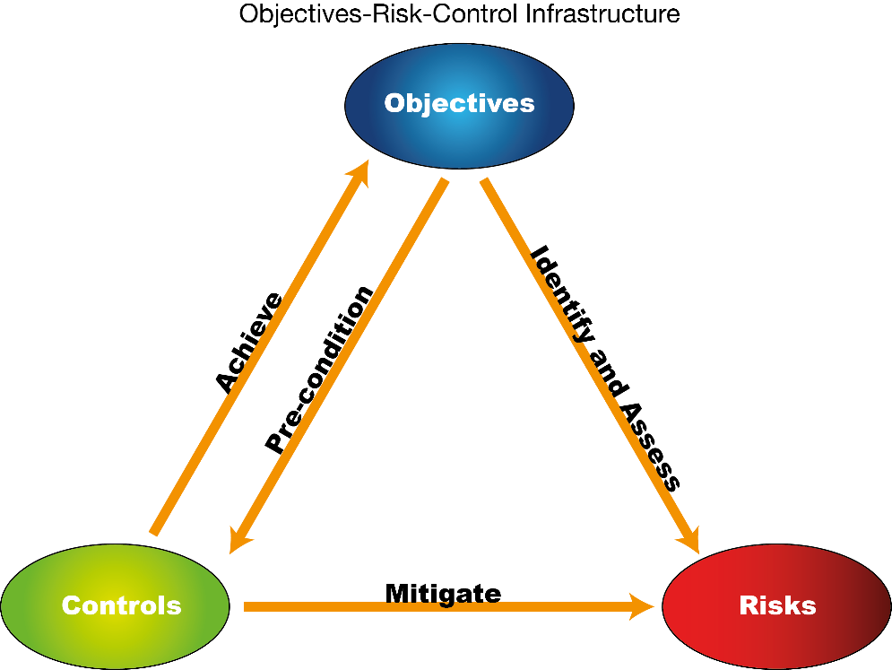
Common understanding of the Establish the Objective-Risk-Control Infrastructure

Slide 19
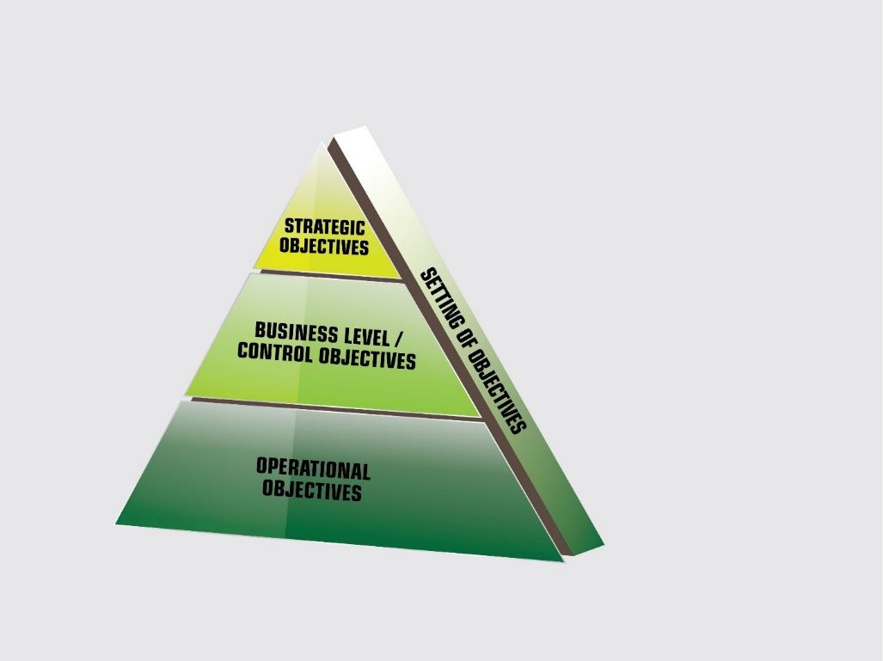
Objective setting
It essential the all Assurance Providers have a common understanding of the category of organizational objectives.

Slide 20
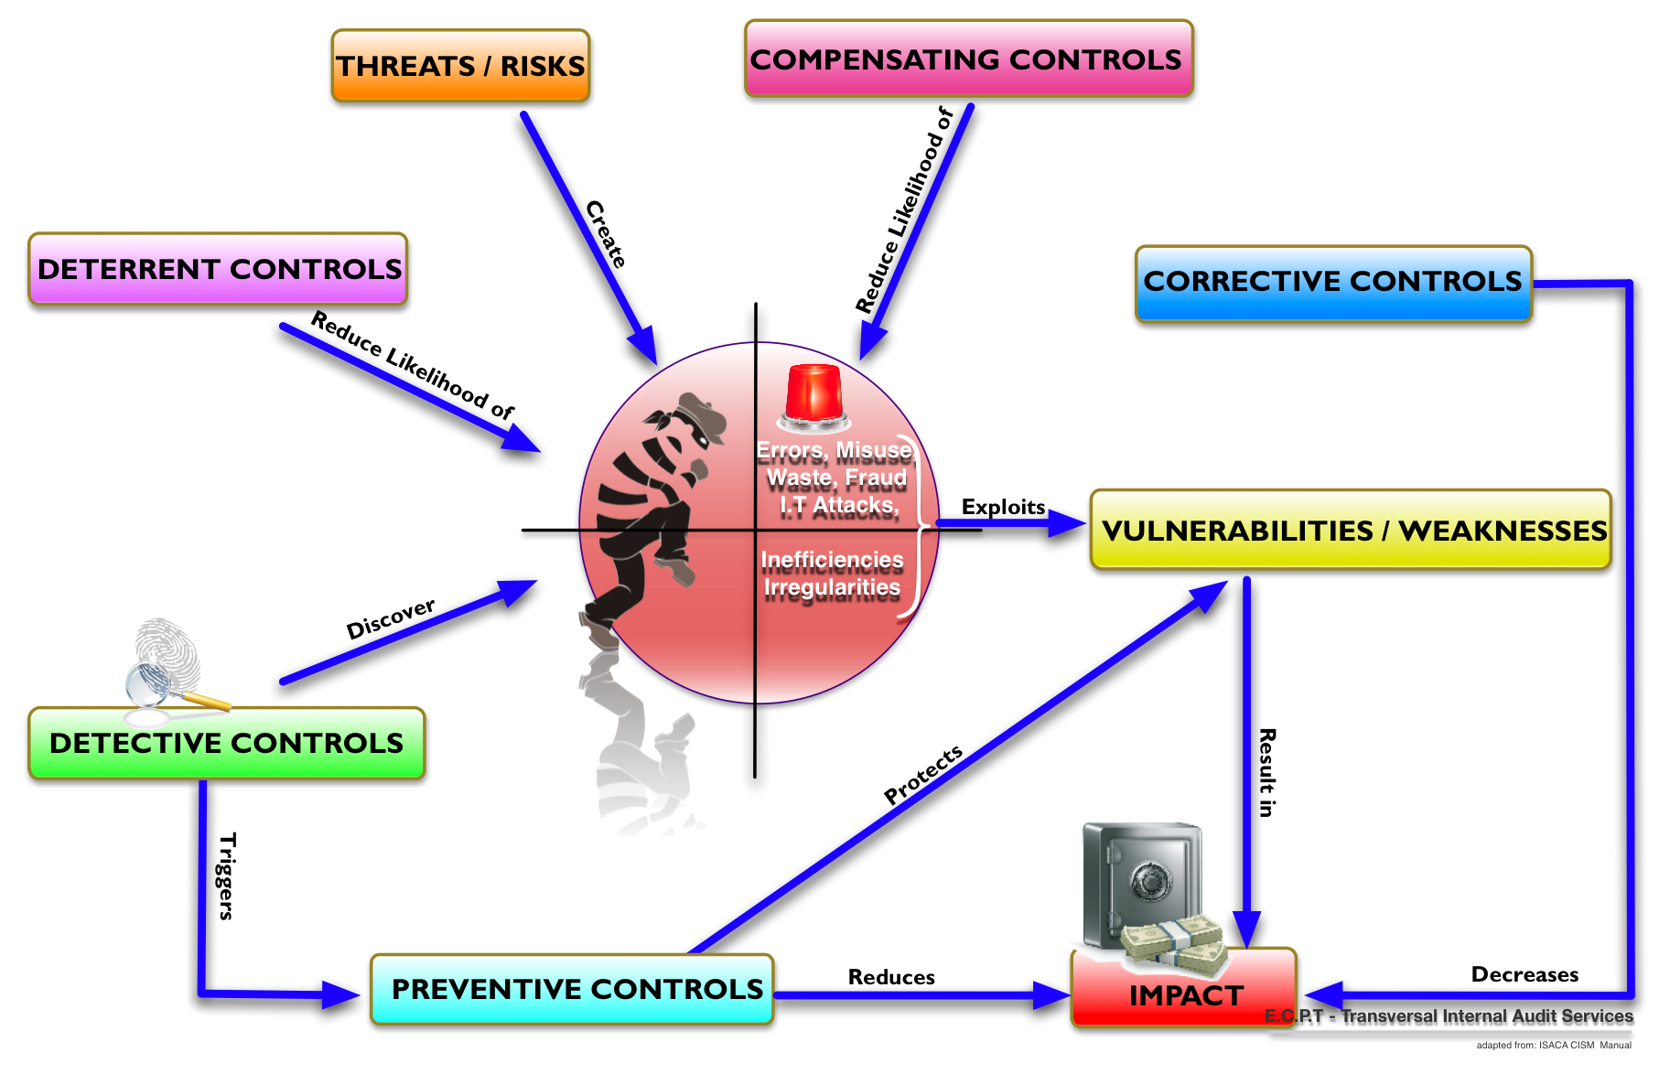
RISKS AND CONTROLS
Risks and controls should be viewed as two sides of the same coin

Slide 21
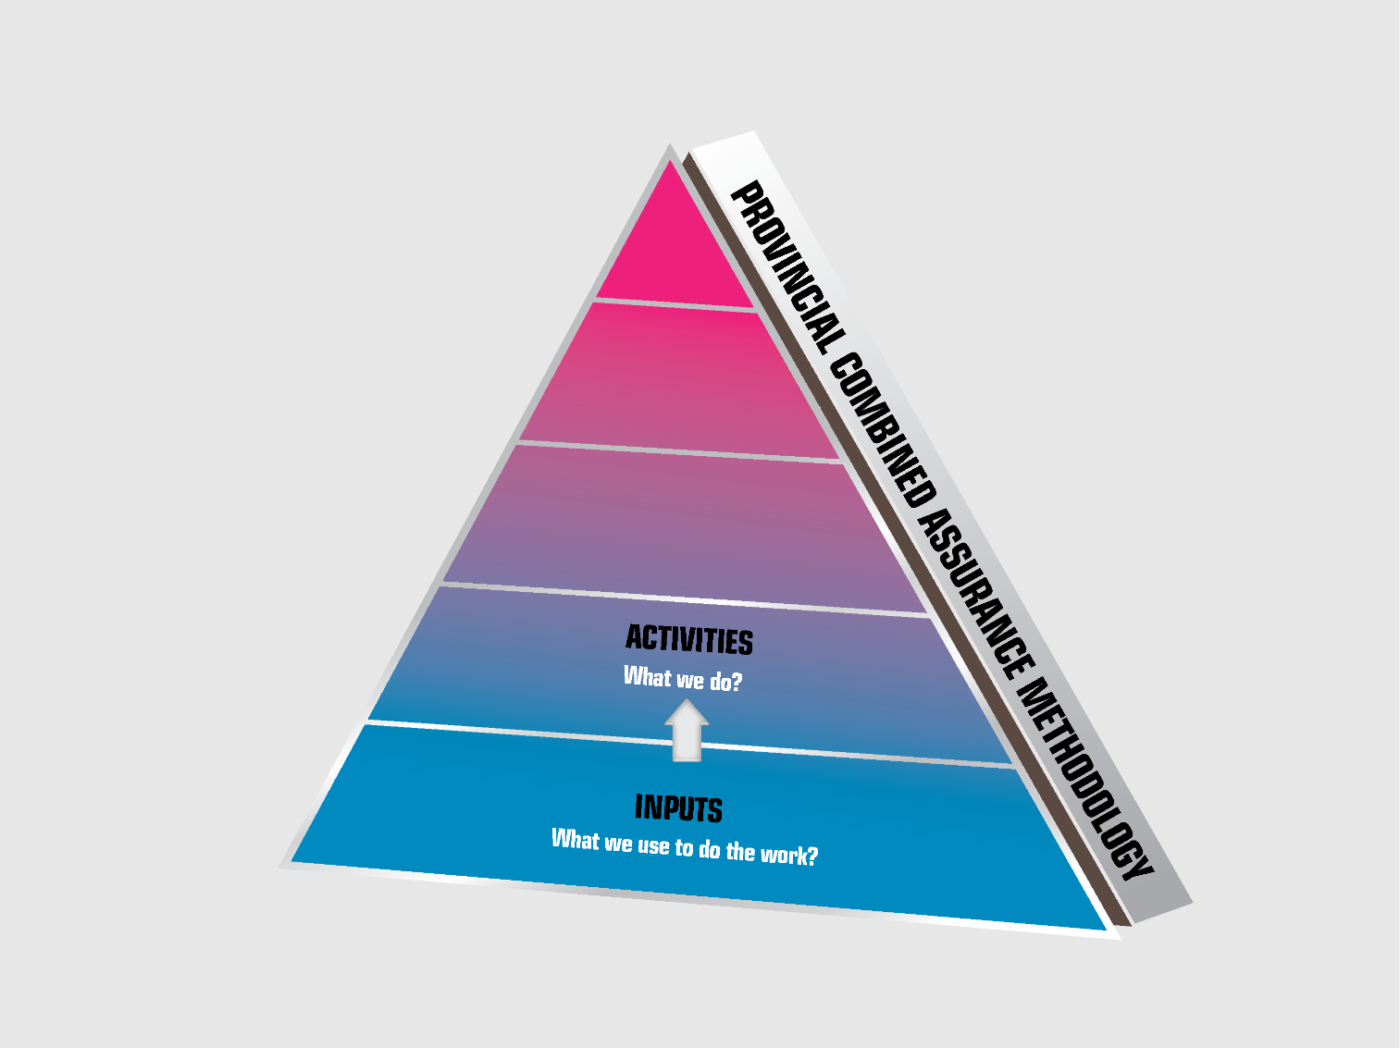
COMBINED ASSURANCE - ACTIVITIES
2. KEY QUESTION (KQ) - WHAT WE DO?

Slide 22

ACTIVITIES -– What we do?
Activities represent processes or actions that use a range of inputs to produce the desired outputs and ultimately outcomes.
Applied in the a Combined Assurance
Approach – Activities are performed through the application of the:
Three Lines Of Defense Model (3 LoD

Slide 23
What is the 3 LoD Model?
?
The underlying premise of the 3 LoD model, is to clarify the roles and responsibilities of three separate groups (or “lines”) with the aim of enhancing risk management and internal control processes.
The purpose of establishing lines of defense is that when each “Line” performs its assigned control activities, the likelihood that a risk will penetrate and expose the organisation is diminished.

Slide 24
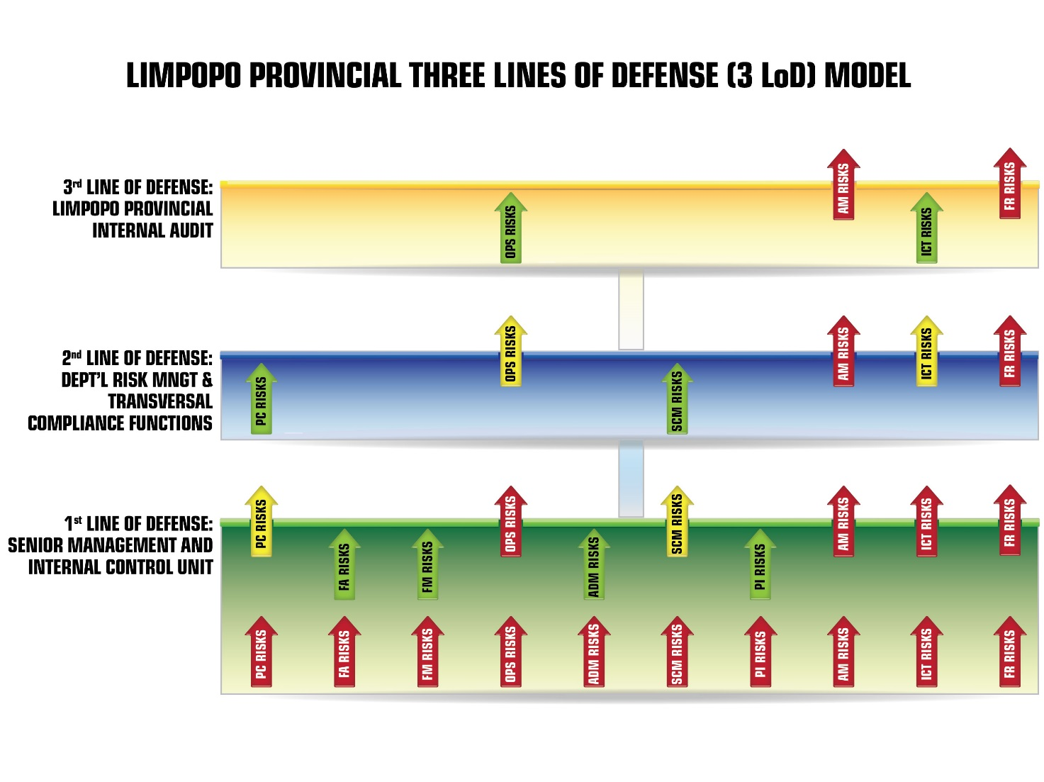
How the three lines of defense operates

Slide 25
Responsibilities of 3 LoD
The overall responsibilities of each of the three lines of defense are as follows:
1st LoD - own and manage risks and controls. This group consists of Senior Management as well as operating management who own and manage risks and controls. Assurance is provided through conducting control and risk self-assessment.
2nd LoD – monitor risks and controls in support of management. This group consists of specialist and transversal functions that provide compliance, monitoring and support services.
3rd LoD – provide independent assurance to the Audit Committee, Executive Management, and other stakeholders concerning the effectiveness of the management of risks and controls. This group consist of the Provincial Internal Audit Function.

Slide 26
External Assurance Providers
The role of external assurance providers is 3 LoD Model:
Firstly there is no hard and fast rule of who the role players are in the 3 LOD Model;
However, it is essential that the 3 LoD Model recognizes:
  The role of AG:SA ;and
  The Audit Committee; and
  Other External Assurance providers

Slide 27
The Audit Committee
The role of external assurance providers is 3 LoD Model:
The Audit Committee should review whether the organisation’s combined assurance model implemented through the three lines of defense is effective.
The Audit Committee should validate the integrated combined assurance report (GRCC Report) received from the Chief Audit Executive (CAE).
Upon satisfactory scrutiny of the Integrated GRCC combined assurance report received from the CAE, the Audit Committee will prepare a summary report for inclusion in the Institution ’s annual report.

Slide 28
The AG:SA
The role of external assurance providers is 3 LoD Model:
Provide independent objective assurance on the effectiveness of Governance, Risk, Control, and Compliance with recommendations for improvement;
Independently confirm compliance and recommend improvements ; and
Review of 1 st and 2nd and particularly the 3rd Lines of Defense to determine whether reliance could be placed on these lines to reduce assurance fatigue

Slide 29
How Business Risk are derived

Slide 30
KEY RESPONSIBILITIES OF ALL ASSURANCE PROVIDERS
Essentially Assurance Providers should:
Compliance - Provide assurance that the Province’s / Institution’s applicable policies, procedures, laws, regulations, provincial frameworks and norms & standards have been complied with.
Financial Reporting objectives – Provide assurance that the fulfilment of accountability obligations relating to internal and external reported financial information is reliable, credible and complete.
Operations objectives – Provide assurance that the Province’s / Department’s operations have been performed orderly, ethically, economically, efficiently, effectively and equitably. Also, operations are consistent with the Institution’s vision, mission and values.
Performance Reporting Objectives – Provide assurance that performance (non-financial) information is useful, reliable, credible and complete.
Safeguarding objectives – Provide assurance that the Province’s / institution’s assets and resources have been safeguarded against loss, misuse and damage due to abuse, waste, mismanagement, errors, fraud, irregularities and fruitless use.
Risks Management Processes – Provide assurance that the Province / institution has an adequate and effective system to identify, assess and manage risks within the approved tolerance range and appetite of the Province / Institution.

Slide 31
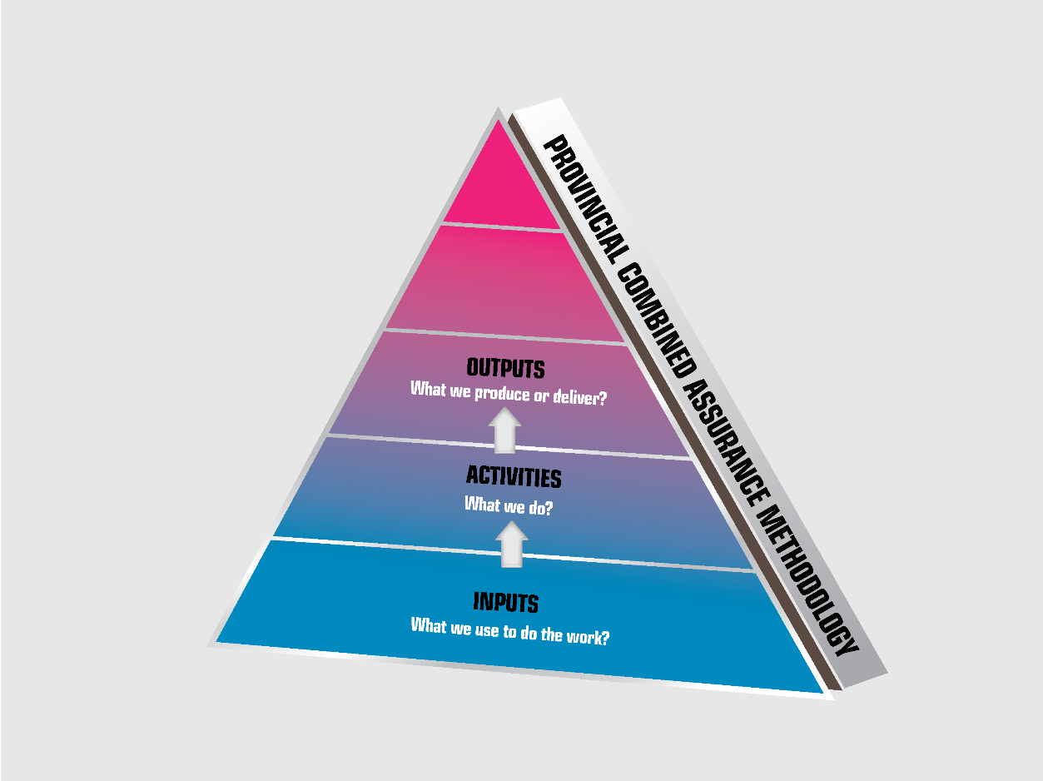
COMBINED ASSURANCE - OUTPUTS
3 KEY QUESTION ((KQ) – WHAT WE PRODUCE?

Slide 32

COMBINED ASSURANCE - OUTPUTS
3 KEY QUESTION ((KQ) – WHAT WE PRODUCE?
Essentially the main outputs of Combined Assurance is a Plan indicating the following:
Details of all the key business risks of the institution and an indication of relevant assurance providers, in 3 LoD that will validate them and how often; and
Details all the key activities and the key controls of the institution and an indication of relevant assurance providers, in 3 LoD that will validate them and how often.

Slide 33
EXAMPLE OF A COMBINED ASSURANCE PLAN FOR RISKS
EXCERPT OF PLANS

Slide 34
EXAMPLE OF A COMBINED ASSURANCE PLAN FOR CONTROLS

Slide 35

COMBINED ASSURANCE - OUTCOMES
4 KEY QUESTION ((KQ) – WHAT WE WISH TO ACHIEVE?

Slide 36

COMBINED ASSURANCE - OUTCOMES
3 KEY QUESTION ((KQ) – WHAT WE WISH TO ACHIEVE?
In terms of King IV, the Chief Audit Executive, must provide governing body an annual statement on the effectiveness of the Governance, Risk, Control and Compliance Processes. That means an Integrated GRCC Report
Compliance has been added because of the importance of legislative compliance.

Slide 37
COMBINED ASSURANCE - OUTCOMES
4 KEY QUESTION ((KQ) – WHAT WE WISH TO ACHIEVE?
In terms of King IV, the Chief Audit Executive, must provide governing body an annual statement on the effectiveness of the Governance, Risk, Control and Compliance Processes. That means an Integrated GRCC Report
Compliance has been added because of the importance of legislative compliance.

Slide 38
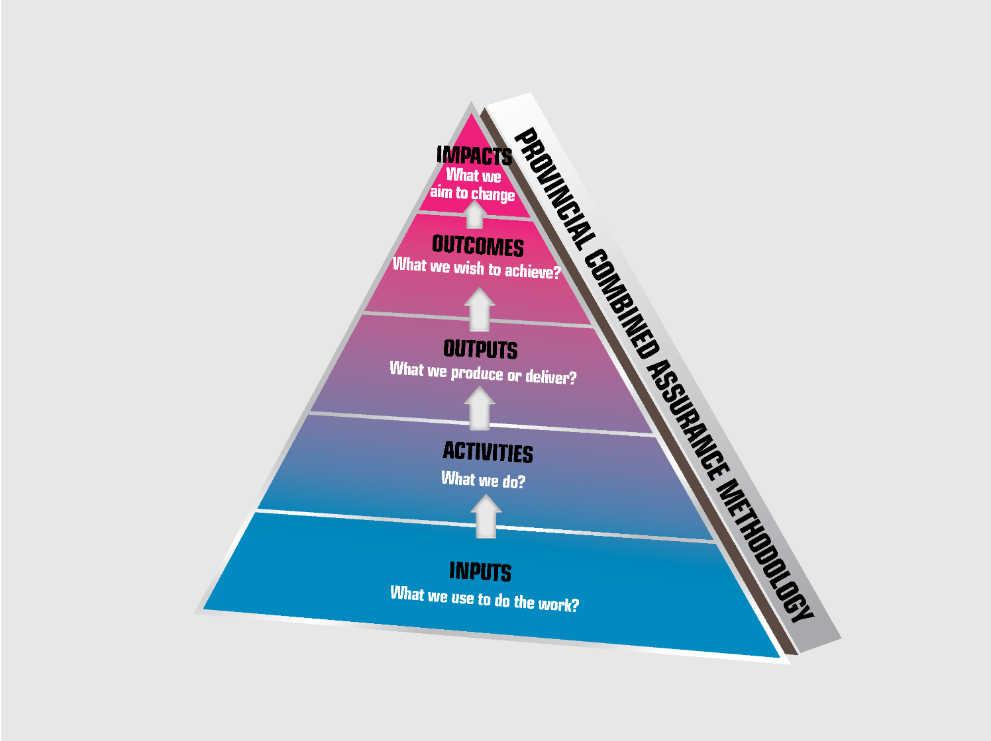
COMBINED ASSURANCE - IMPACT
3 KEY QUESTION ((KQ) – WHAT WE AIM TO CHANGE?

Slide 39

COMBINED ASSURANCE - IMPACT
3 KEY QUESTION ((KQ) – WHAT WE AIM TO CHANGE?
The ultimate aim of Combined Assurance is to provide:
Enabling an effective internal control environment. (Reporting Criteria of Internal Control)
Support the integrity of information used for internal decision-making by management, the governing body and its committees. (Quarterly Reports)
Support the integrity of external reports.(Annual Reporting)

Slide 40
CONCLUSION
IN SO DOING THE INSTITUTION WILL:
Improve AG:SA external audit outcomes;
Achieve transformational service delivery strategies
Enhance its ethical culture;
Enhance it legitimacy
Increase its good performance

Slide 41

THAT CONCLUDES THE
COMBINED ASSURANCE METHODOLOGY

Slide 42

THANK YOU
SUB HEADING PLACED HERE

