Slide 2
THE ROLE OF THE ASSURANCE FUNCTION WITHIN THE SCM ENVIRONMENT
CIGFARO NATIONAL CONFERENCE
Durban, Inkosi Albert Luthuli ICC Complex
8 October 2019

Slide 3
OVERVIEW
Governance in context
Purpose
Regression in SCM Audit Findings: 2017/18 FY
Response plan to address SCM challenges
Roles and Responsibilities of IA, CAE, Risk officers, SCM
Transversal SCM Audit Findings: Deviations, Bid Committees, Contract Management, Local Content
Conclusion

Slide 4
The Objective of Governance
Achieving national, provincial and local government developmental goals – “By 2030, we seek to eliminate poverty and reduce inequality. “We seek a country where all its citizens have the capabilities to grasp the ever broadening opportunities available.” (National Development Plan, 2011)
Always act in the public interest – Restoring public trust
Resources are being applied in such a manner, that service delivery will be achieved; equitably, economically, effectively and efficiently in an agreed ethical environment.
WCG Governance Principles
Constitutionalism
Rule of Law
Evidence Based
Partnerships
Whole of society approach
Citizen centric
Public Value

Slide 5
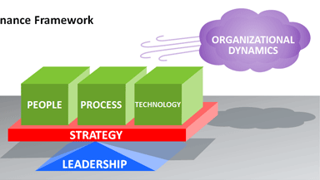
Governance – A holistic view
Having the right talent and sufficient resources to deliver on the long-term objectives of the municipality.
Well defined processes for enablement
Effective systems plays an integral role in fostering integration and effective utilisation of data
Taking into consideration these influential factors:
Organisational dynamics (Culture)
Impact of the political sphere
Current economic state
Existing legislative frameworks
Partnerships and collaboration
ETHICS
PEOPLE
PROCESSES
SYSTEMS
Clear strategy assists the organization to align its strategic goals to key processes that enables the identification of emerging risks and challenges and proactively managing the risks.
Leadership is the fundamental element for establishing an ethical environment that enforces the efficient and effective collaboration of people, processes and systems in order to achieve goals.
LEGISLATIVE FRAMEWORK
VALUES

Slide 6
An integrated and outcome-based Governance Approach
Provincial Treasury’s mandate: To drive the good financial governance across the provincial and local government spheres that enables:
effective resource mobilisation and sound fiscal management,
the effective and efficient use of resources,
effective financial oversight (Leadership on all levels including the focus on culture),
building capabilities of local governance to enable resilience, agility and innovation.
The Western Cape Provincial Treasury therefore takes an integrated outcome-based approach to good financial governance.

Slide 7
Drivers to Enhance Financial Governance
Integrated Training and Capacitation
Financial Governance Maturity
Data and Systems Enablement
EFFICIENCY
INTEGRATION
COMMITMENT
IMPACT

Slide 8
Current governance environment
Challenges with effective political and administrative leadership
Shortage of requisite skills and competencies in local government
Increased allegations i.t.o fraud and corruption
Ineffective utilisastion of assurance providers to improve the design and implementation of internal controls
Ineffective consequence management
Stagnant Economic outlook for the Western Cape - Transversal economic, budget and service delivery risks must be considered.
Financial viability of municipalities linked to cost and quality of services
Progressive MFMA reform agenda vs the municipal capacity to implement
Continuous introduction of new laws without the pre-emption of implementation challenges and the impact on efficiency of service delivery
Increase cost of compliance with little/no impact on service delivery

Slide 9
SCM Audit Outcomes: 2017/18 FY
Notes:
Commenced in 2012
First published in 2013
At the time and still is the only one of its kind published by any administration in South Africa

Slide 10
AGSA Outcomes: Irregular Expenditure
Irregular expenditure increased from R165 million to R666 million (404% increase)
20% (R104 million) of the R517 million represents non-compliance in 2016-17.
22% (R149 million) of the irregular expenditure was payments/ expenses in previous years only uncovered and disclosed for the first time in 2017-18
Nature
98% of occurrences caused by non-compliance with SCM legislation
Main areas of non-compliance within SCM that caused irregular expenditure:
Procurement without competitive bidding or quotation process (20%)
Non-compliance with procurement process requirements (50%)
Non-compliance with legislation on contract management (30%)

Slide 11
SCM Audit Outcomes - 2017/18 Audit
Transversal SCM Risk identified:
Application of local content and production prescripts;
Non-Compliance to SIPDM;
MFMA Section 116 – Contract Management;
SCM Regulation 13 (MBD4) versus the CSD;
Application of SCM Regulation 32;
SCM Regulation 36 repetitive deviations and reasons not properly justified;
Interpretation of CIDB Regulations;
Multi-year infrastructure projects and subsequent expenditure attached to these projects;
Inconsistencies of the audit on application of VAT;
Interpretation of SCM legislation and other MFMA prescripts; and
Inconsistencies of the overall audit practices and processes when auditing SCM across the WC.
Other SCM related findings i.e. advertising period, taxes, SCM Reg,44, over reliance on CSD, etc.

Slide 12
SCM Enhancement Project - PT SCM/Assurance Support Initiative

Slide 13
Purpose of assurance function within SCM
As part of the annual auditing process in municipalities the compliance within supply chain management has become a key focus area, and rightly so, given the prevalence of excessive amounts of irregular expenditure exposed nationally in South Africa.
To assist municipalities with the improvement and implementation of supply chain management and internal control mechanism to meet the conformance and performance requirements.
To identify and strengthen the internal control gaps and inherent risk framework for supply chain management and utilising the assurance functions to support compliance and improve audit outcomes.
To assist municipalities to sustain good governance by addressing better internal controls and thereby improving its service delivery obligations.
Impact: to drive maximum citizen impact.

Slide 14
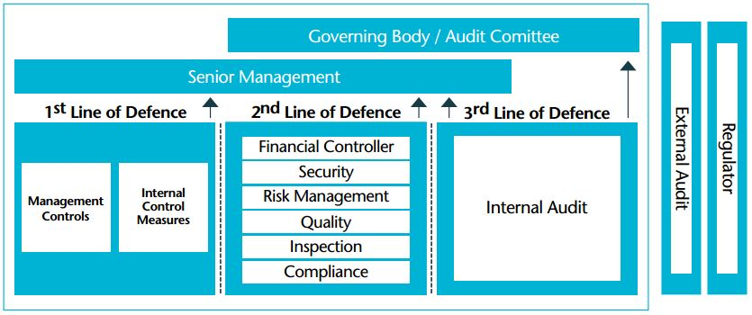
Applying the 3 Lines of Defence to the SCM Environment
To assist municipalities to strengthen the internal control and inherent risk framework for supply chain management through a coordinated/collaborative approach by Line Mangers, SCM, internal audit and risk management functions toward achieving conformance and performance requirements.

Slide 15
Assurance Roles
First Line of Defence
Management to identify and manage risks
Management to comply with SOP designed by SCM
Second Line of Defence
SCM unit to develop adequate system of internal control
SCM to ensure continuous monitoring of SCM processes
CRO to assist management in risk process
CRO to ensure risks are managed to within the risk appetite
Third Line of Defence
IAA to provide assurance on adequacy and effectiveness of SCM system of internal control
Audit Committee to monitor roles of the 3 lines of defence
Audit committee to ensure that assurance is received commensurate with the risk
Audit committee to monitor progress with audit action plan (standing agenda item for audit committee meetings)

Slide 16
Deviations
Notes:
Commenced in 2012
First published in 2013
At the time and still is the only one of its kind published by any administration in South Africa

Slide 17
Deviations: Challenges and Pitfalls
Not testing the market vs sole suppliers
Emergency cases vs lack of proper planning
Deviating without the necessary delegation
Failure to record deviations
Repetitive deviations and reasons for impractically, not justifiable.
Reasons not adequately motivated
Improved planning linked to the request for Deviations
By-passing laws and legislation governing SCM to motivate a deviation
Increases the risk of fraud and corruption
Are motivations supporting deviations a true reflection of the requirements of Regulation 36?

Slide 18
Deviations: How to improve the process?
Deviations, all the necessary steps have been taken before approving deviation and its in line with regulation 36(1) of Municipal SCM Regulation.
Improved planning linked to the request for Deviations.
The reasons for the deviations must be recorded and reported to the next meeting of the council and also be included in the Annual Financial Statements.
Maintain a proper audit and paper trail.
Ensure reasons for deviating from the normal procurement process are properly justified.
Proper checks and balances.
Training

Slide 19
Local content and production
Notes:
Commenced in 2012
First published in 2013
At the time and still is the only one of its kind published by any administration in South Africa

Slide 20
Local Content: Challenges and Pitfalls (1)
Awareness of the legislative requirements in the supplier community
No database exist of suppliers that comply with local content requirements
Application of legislative requirements by municipal officials
Thresholds of when local content should be applied, is not consistent (preferably above R200k)
Incompleteness of MBD 6.2 and annexures
Exemption certificates not attached to bid submission
Negative impact on service delivery because of non-awards
No database exist of suppliers that comply with local content requirements
Deliberate non-competition on the part of manufacturers

Slide 21
Local Content: Challenges and Pitfalls (2)
Exorbitant bid prices charged by suppliers
possible false declarations made by bidders on the MBD 6.1 form
Bid and tender documentation did include the local content requirements.
Role of SABS regarding the verification local content.
DTI is the custodian of the local content but NT is the policy maker.

Slide 22
Bid Committee System

Slide 23
Bid committee system Challenges (1)
2015 Public Sector Supply Chain Management Review issued by the National Treasury
Lack of appropriate bid committees highlighted by the Auditor-General of SA
Appointment of bid committee members not aligned with policy requirements
Failure to use competitive bidding processes
Inadequate controls and procedures for handling of bids
Bid Committees Challenges:
Bid Specification Committee
Inexperienced bid committee members
Biased specification
Inappropriate functionality criteria applied
Over reliance on Consultants
Incomplete scope of work

Slide 24
Bid committee system Challenges (2)
Bid Evaluation Committee
Inexperienced committee members
Separate physical inspection and presentation from functionality evaluation.
No objective scoring in some stances.
Incorrect calculations.
Non-declaration of interest
Bid Adjudication Committee
Inexperienced committee members.
Endorsing unfair disqualification.
Endorsing incorrect calculations.
Consider BEC as a subcommittee of BAC.
Non-declaration of interest
Awarding to restricted supplier

Slide 25
Contract Management

Slide 26
Contract Management: Challenges and Pitfalls
Ineffective/non-existent contract management system:
Expansion (modification) of contracts.
Variation orders beyond prescribed percentage.
Excessive use of variations - “Month to month” extension.
Deviation from normal competitive bidding process.
Poor documents management.
Abuse of participation into a contract arranged by another organ of state.
No penalties on the SLA to address poor performance.
No contract management system (quantities of required deliverables and prices) i.e. not knowing when contracts will end.

Slide 27
How to respond to the challenges?

Slide 28
How to Address these challenges? (1)
Regular training of SCM practitioners and bid committee members
SCM officials and bid committee members must sign code of conduct
Open and transparent quotation system
Every six month rotate buyers
Automate the rotation of suppliers for quotations
Departments must conduct market research
SLA must include penalties
Restrict suppliers for poor performance and misrepresentation
Accounting Officers must take disciplinary measures against those officials caused irregular, fruitless and wasteful expenditure

Slide 29
How to Address these challenges? (2)
Strengthen internal audit and monitoring of risk register
Accounting Officers must comply with instruction note 3 of 2016/17 on prevention of abuse of SCM systems.
implement detection processes and measures, to identify root causes to be able to put appropriate preventive measures in place.
Review of the audit action plans to ensure repeat SCM non-compliance is effectively addressed.
Adhere to Local Content Instruction Notes

Slide 30
Conclusion
Notes:
Commenced in 2012
First published in 2013
At the time and still is the only one of its kind published by any administration in South Africa

Slide 31
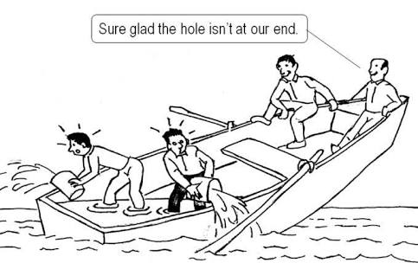
Officials involved in the SCM

Slide 32
Not to be Compromised in the SCM Domain
Overall Good Governance
Compliance to laws and regulations governing SCM
Ethical and Professional Behaviour
SCM Competency
Procurement Planning
SCM Norms and Standards
Effective and Efficient SCM Processes and Procedures
SCM E-Procurement Systems
Manage SCM Risk
Sound SCM Reporting

