Slide 1


Photo Credit: Ida Jacobs (link)
Source: C40 Cities Climate Leadership Group
CLIMATE IMPACTS, SECTOR INTERDEPENDENCIES AND CASCADING FAILURES IN CITIES
Hastings Chikoko, Regional Director for Africa,
C40 Cities Climate Leadership Group

Slide 2




₉₁
C40 MEMBER CITIES REPRESENT
⁶⁵⁰⁺
25%
MILLION OF PEOPLE
OF GLOBAL GDP

Slide 3
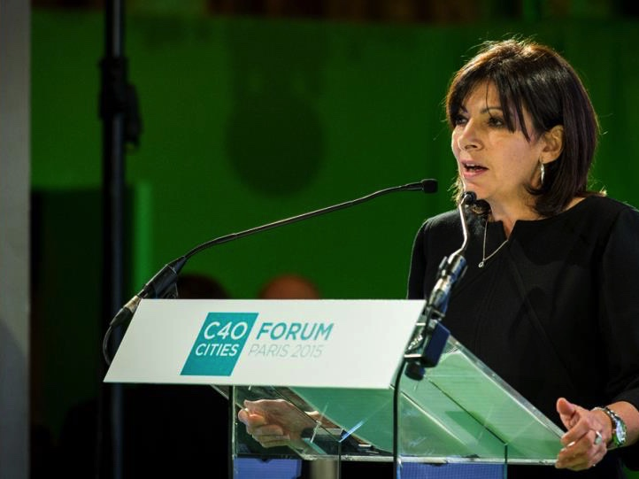
As mayors, we all face similar challenges and have to innovate to solve them, often in the same ways
Mayor of Paris, Anne Hidalgo

Slide 4

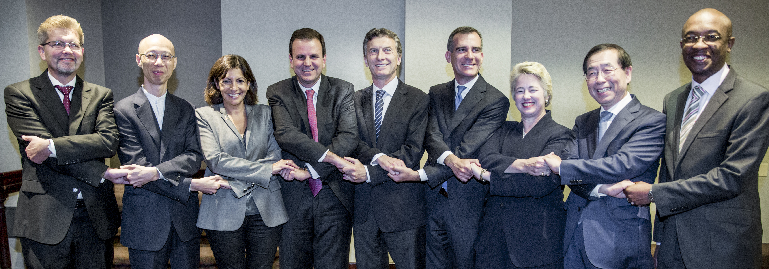

Sustainable cities plan and act: Mayors have a model of global collaboration that works

Slide 5

Climate change is here now!

Slide 6
WHY UNDERSTAND CLIMATE RISKS?
“98% of C40 Cities say the effects of climate change present significant risks for their city” Climate Action in Megacities 3.0
“70% of C40 cities already experiencing the effect of climate change” Climate Action in Megacities 3.0
“64% of C40 Cities are concerned or very concerned about the flooding effects of climate change” Climate Action in Megacities 3.0
“61% of our cities face the risk of heatwaves” Climate Action in Megacities 3.0
“47% of C40 cities have identified being at risk of droughts” Climate Action in Megacities 3.0

Slide 7
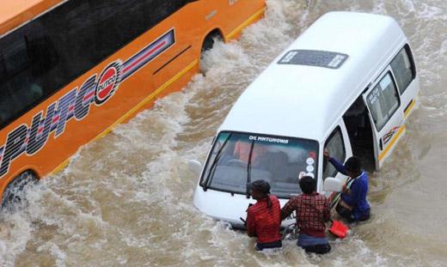

Not only about tomorrow: Flooding in Johannesburg (EWN Photo)

Slide 8
Climate Change is everyone’s problem

Slide 9
UNDERSTANDING CLIMATE RISKS: 3 KEY MESSAGES
Infrastructure and services are interdependent
Climate Change is a big risk and compromises public services
Climate Change is not only for environmentalists : one aspect cannot be managed independently of the other
Photo: myjoyonline – David Andoh

Slide 10
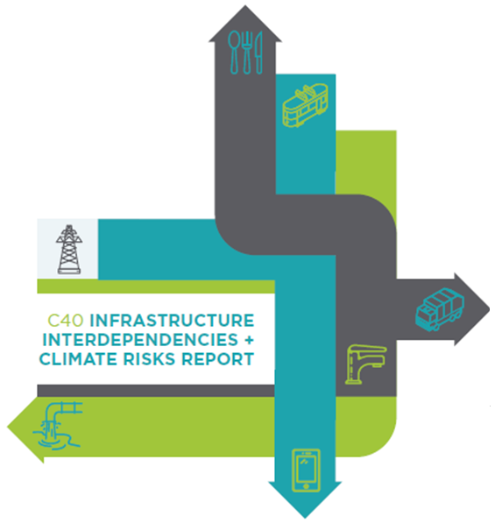
CLIMATE RISKS: EXPERIENCES FROM 5 CITIES
Amsterdam
Bogota
Johannesburg
Melbourne
Toronto

Slide 11
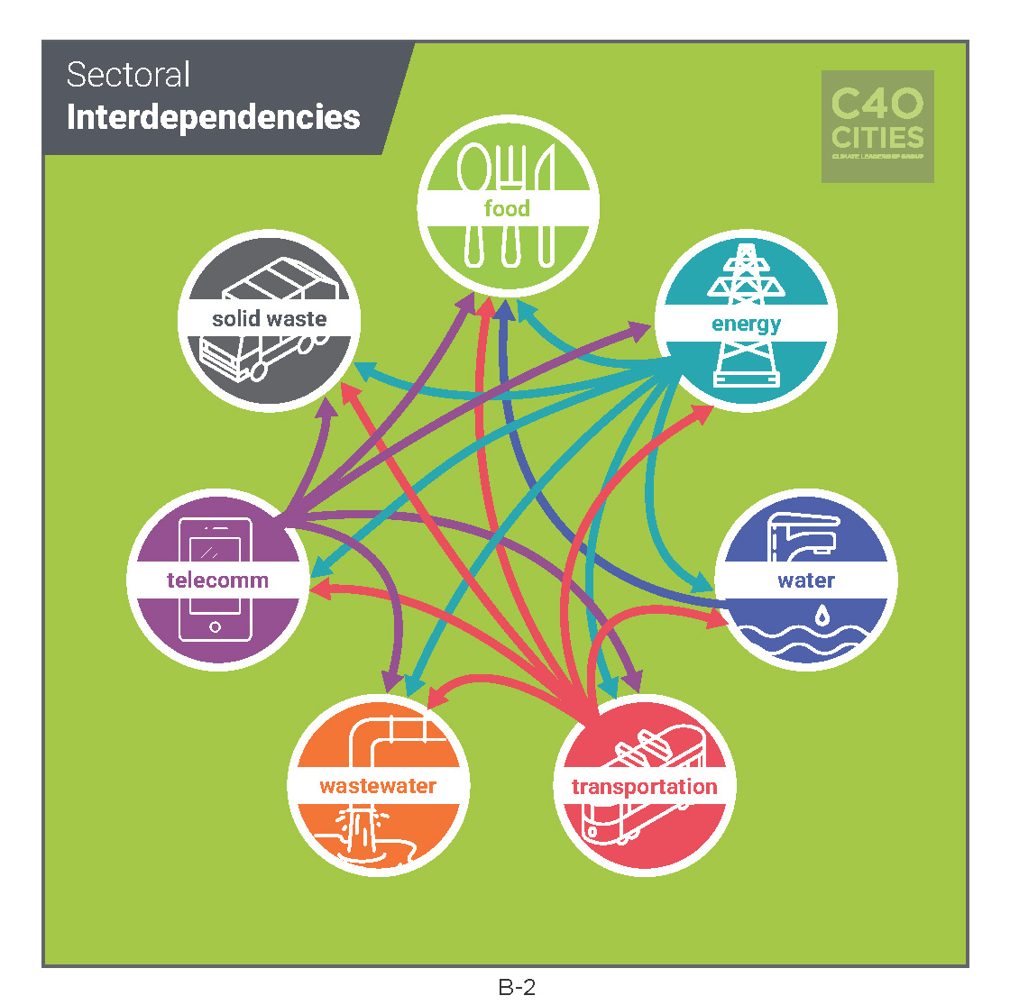
INFRASTRUCTURE SECTOR INTERDEPENDENCIES

Slide 12
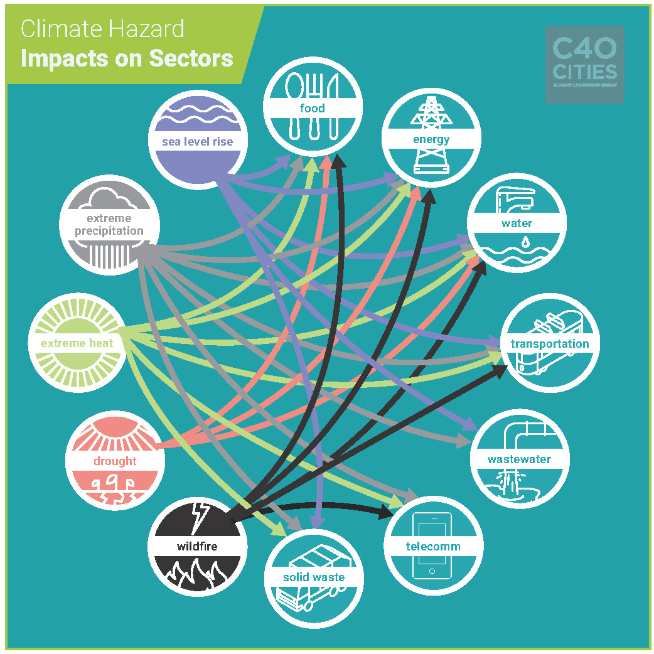
CLIMATE HAZARD IMPACTS ON INFRASTRUCTURE SECTORS

Slide 13
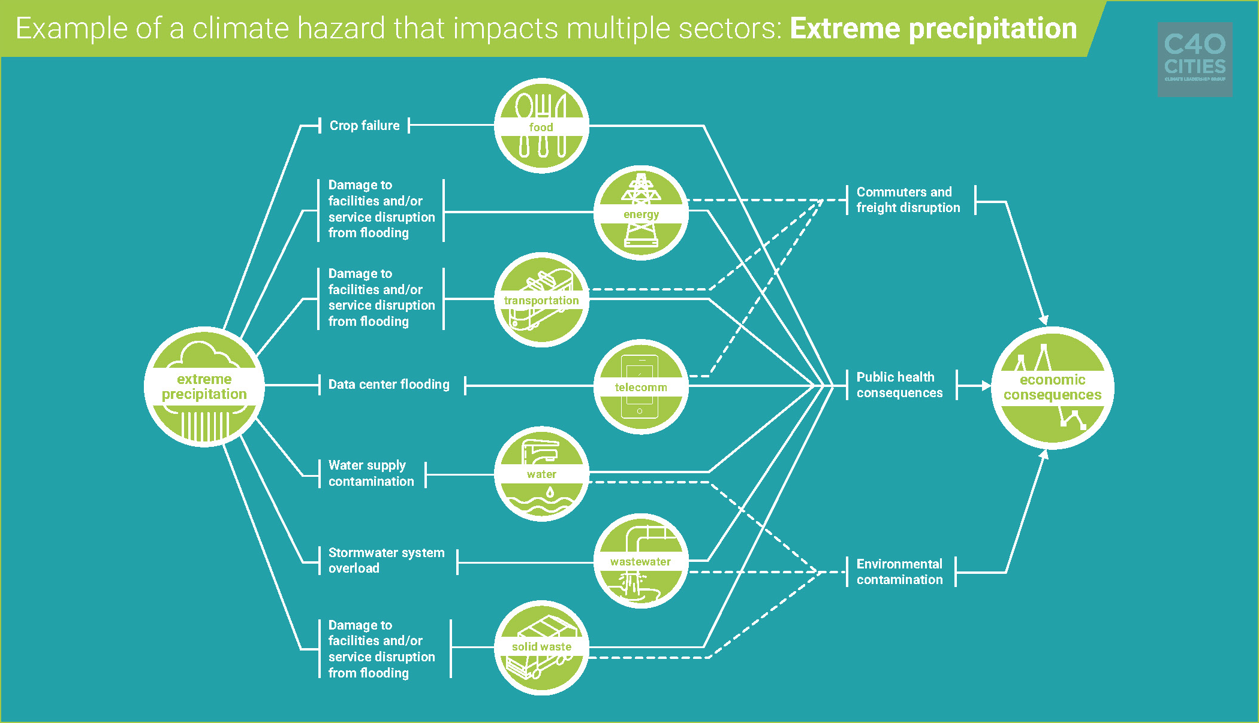
CASCADING IMPACTS OF EXTREME PRECIPITATION EVENTS

Slide 14
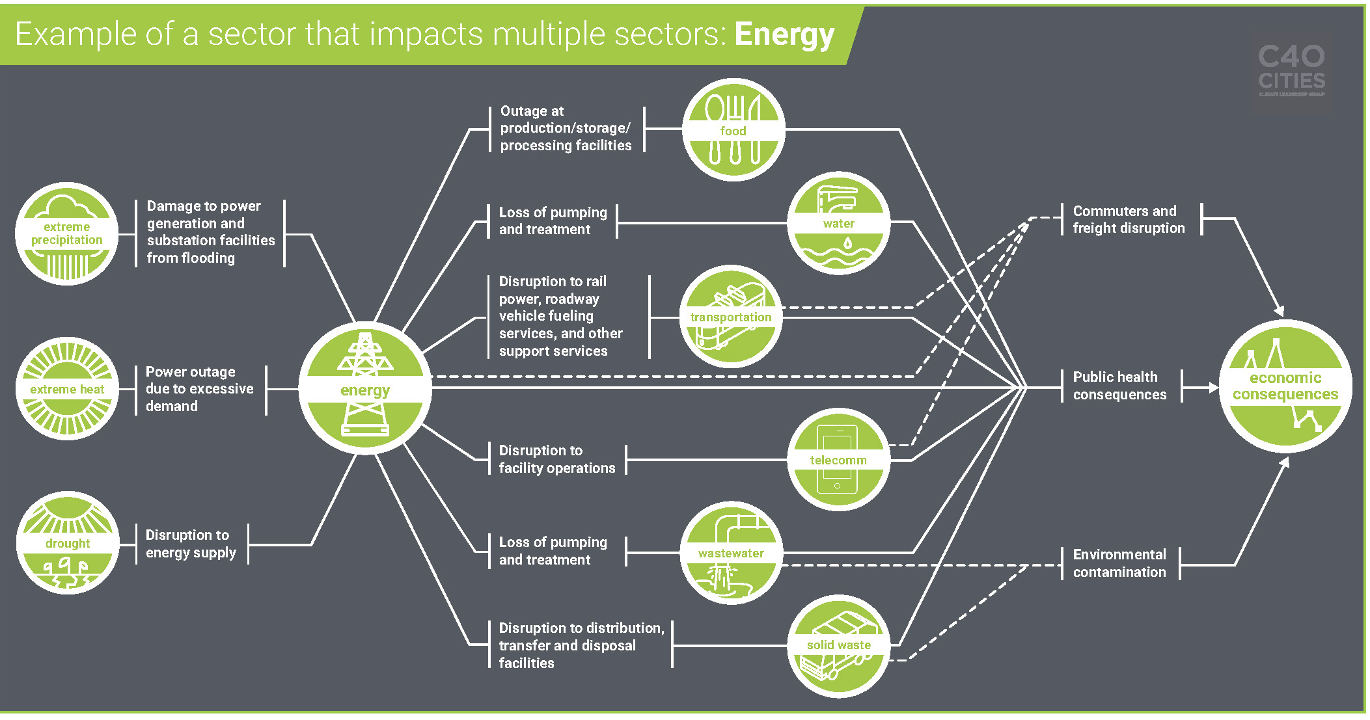
CASCADING IMPACTS FROM DISRUPTIONS TO THE ENERGY SECTOR

Slide 15
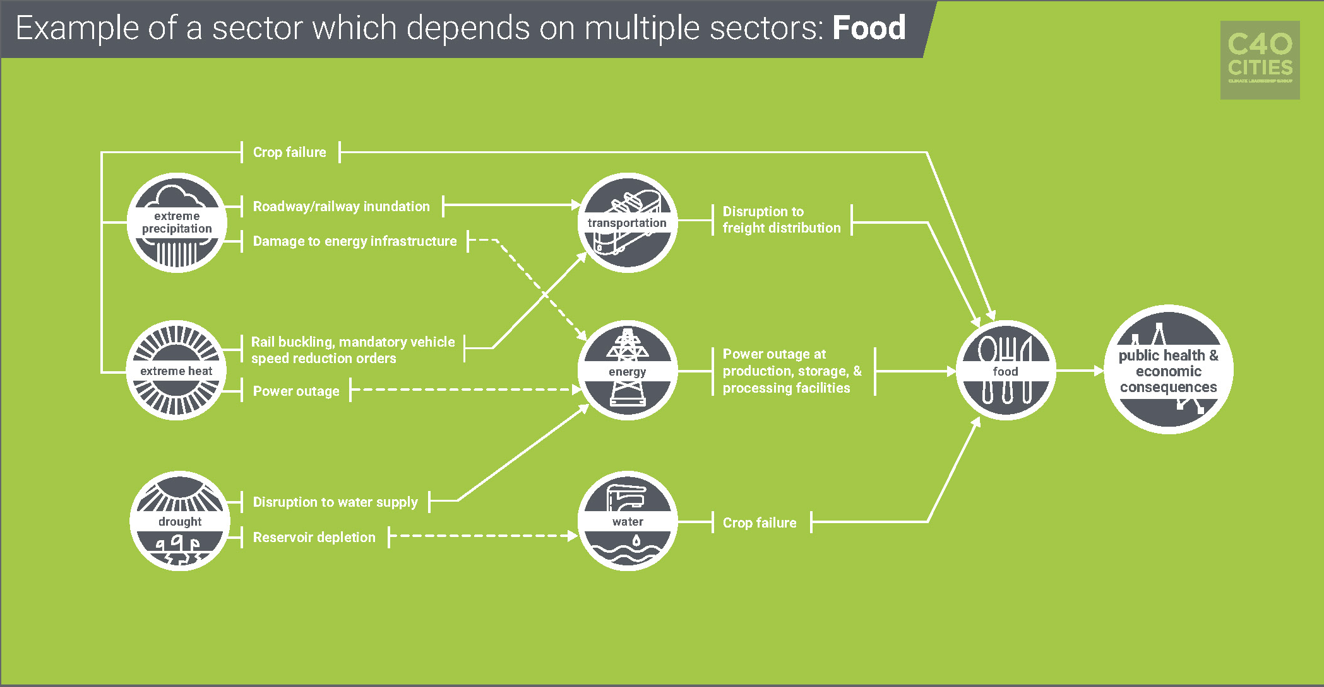
CASCADING IMPACTS FROM MULTI-SECTORAL DISRUPTIONS ON THE FOOD SECTOR

Slide 16
Climate Change has wider impacts
Climate impacts are costly. Investment in disaster preparedness produces high returns: US$1 investment in climate adaptation yields US$7 in reduced damage

Slide 17
Source: Climate Council

Slide 19
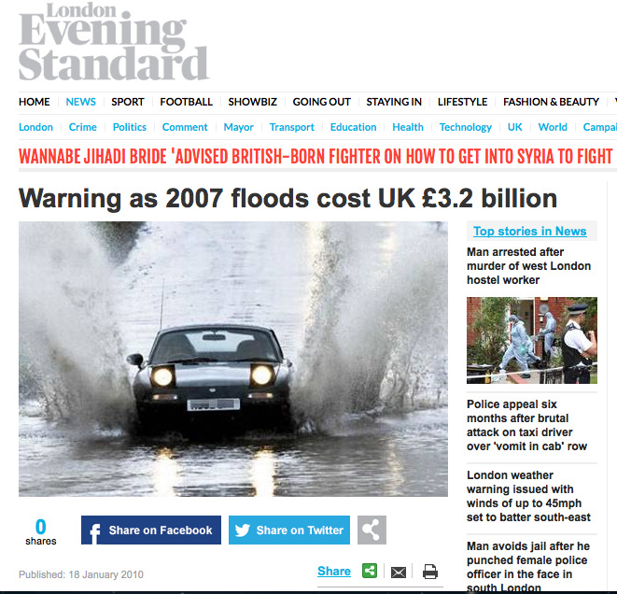

Slide 20
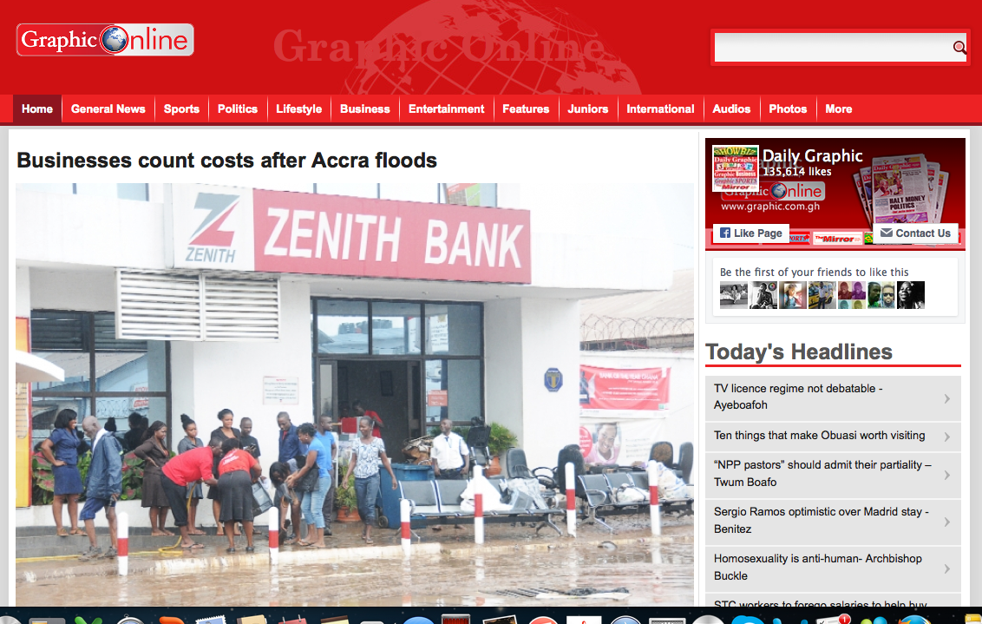

Slide 22
CONCLUSION: 3 TAKE AWAYS
Because of sectoral interdependencies, climate change is a big risk and compromises public services
Finance, audit and risk professionals can help cities understand the strategic and practical implications of sustainable business practices
Finance, audit and risk professionals are equipped with tools and techniques that can ensure cities understand the scale of the problem of climate change, come up with viable solutions and ensure they are properly implemented

Slide 23
Our best hope is in the global delivery of the CoP21 Agreement

Slide 24
Thank you

Slide 25
Photo Credit: Ida Jacobs (link)
Source: C40 Cities Climate Leadership Group
CLIMATE IMPACTS, SECTOR INTERDEPENDENCIES AND CASCADING FAILURES IN CITIES
Hastings Chikoko, Regional Director for Africa,
C40 Cities Climate Leadership Group

