Slide 1
WE CHALLENGE LIMITING CONVENTION TODAY, TO CREATE INNOVATIVE CHANGE TOMORROW.
INNOVATION IN FINANCE

Slide 2
CONTENTS
01
END-TO-END PRODUCT OFFERING
GEOGRAPHIC MANDATE AND INVESTMENT FOCUS
PROJECT PREPARATION
FINANCING DEVELOPMENT IN SOUTH AFRICA
DEVELOPMENT SUPPORT PROVIDED TO MUNICIPALITIES
02
03
04
05

Slide 3
CONTENTS CONTINUED
06
INFRASTRUCTURE INVESTMENT IN REST OF AFRICA
INFRASTRUCTURE DELIVERY AND PROJECT IMPLEMENTATION
EXAMPLES OF RECENT PROJECTS: SOUTH AFRICA
EXAMPLES OF RECENT PROJECTS: ZAMBIA
EXAMPLES OF RECENT PROJECTS: INFRASTRUCTURE IMPLEMENTATION
07
08
09
10

Slide 4
END-TO END PRODUCT OFFERING OVERVIEW

Slide 5
PROJECT PREPARATION & ADVISORY SERVICES
PROJECT FINANCE
ACCELERATING INFRASTRUCTURE DELIVERY
PROGRAMME/
PROJECT IMPLEMENTATION
^{Feasibility assessments}
^{Financial structuring}
^{Project preparation}
^{Lead Arranger}
Senior debt- term loans (variable & fixed); both balance sheet loans and limited/non-recourse lending – ZAR/USD/EUR/Local Currency
Mezzanine finance/subordinated debt
^{Guarantees}
Managing the design and construction of key projects in the education, health and housing sectors
^{Project management Support}
DBSA municipal funded project implementation support
Delivery & supporting the development, maintenance and/or improvement of key infrastructure projects
SERVICES
^{Municipalities}
^{Public-private partnerships}
^{Public-public partnerships}
^{Municipalities}
^{State-owned enterprises}
^{Public-private partnerships}
^{Public-public partnerships}
^{Private sector}
National and Provincial government departments
^{Municipalities}
National and Provincial government departments
^{Municipalities}
CLIENT

Slide 6
GEOGRAPHIC MANDATE AND INVESTMENT FOCUS

Slide 7
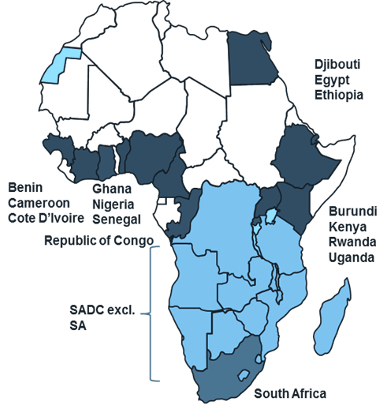
WHERE AND HOW WE OPERATE
CORE SECTORS
^{Energy}
^{Transport}
^{ICT}
^{Water}
^{Municipal Infrastructure}
SECONDARY
SECTORS
^{Education}
^{Housing}
^{Health}
GEOGRAPHIC MANDATE :
^{SADC Region}
+ recently expanded to entire continent + oceanic islands

Slide 8
PROJECT PREPARATION

Slide 9
PROJECT PREPARATION
Plan
Prepare
PURPOSE
Preparing sustainable projects within DBSA’s mandate to bankability in all African Countries
Project preparation financed through own funds and SADC Facility + EU €100m Facility managed by DBSA
PRODUCTS & SERVICES
Enabling environment
Project
Definition
Pre-
feasibility
Bankable
Feasibility
Originating deals by:
Identifying project opportunities from a project developer/sponsor perspective
Define project concept and scope
Obtain a mandate to act as project developer / sponsor / owner
Conducting pre-feasibility study as project developer or sponsor
Act as project owner or co-owner
Managing the preparation & de-risking processes
Participating/ conducting the bankable feasibility study as developer/ sponsor of the project
Act as project owner or co-owner
Lead arranging funding process

Slide 10
FINANCING DEVELOPMENT IN SOUTH AFRICA

Slide 11
FINANCING DEVELOPMENT IN SOUTH AFRICA
FOCUS AREAS
PRIORITY AREAS
FINANCING INSTRUMENTS
Economic Infrastructure
Energy / Power
Liquid fuels (Oil & Gas)
Senior debt-term loans (variable & fixed); both balance sheet loans and limited/non recourse project finance
Mezzanine/subordinated debt
Short term bridge facilities
Guarantees
Project Finance
Subsidized interest for local government municipalities
Broad Base Black Economic Empowerment (BBBEE) facilities-sub debt/quasi equity
Generation
Transmission
Distribution
Storage
Distribution
Transportation/Logistics
Roads
Rail
Ports
Airports
Storage
Hubs
Social
Infrastructure
Bulk water
Education
New water resources, e.g. dams, boreholes
Transfer Schemes
Primary & secondary bulk distributions -pipelines
Primary reservoirs
Treatment, e.g. water treatment works
Pumping stations
Higher Education
Colleges
Schools
Municipal Infrastructure
Water reticulation
Sanitation
Waste management
Electricity reticulation
Local Road networks
Bulk water

Slide 12
DEVELOPMENT SUPPORT PROVIDED TO MUNICIPALITIES

Slide 13
NON FINANCIAL & FINANCIAL
PLANNING
SUPPORT
Sector and master plans
Feasibility studies
Infrastructure investment plans
FINANCE
SUPPORT
Long Term Loans
Bridge Finance
Fiscal transfers
IMPLEMENTATION
SUPPORT
Project management/
implementation
Operations & Maintenance
STAKEHOLDER COLLABORATION
STAKEHOLDER PARTNERSHIPS

Slide 14
INFRASTRUCTURE INVESTMENT IN REST OF AFRICA

Slide 15
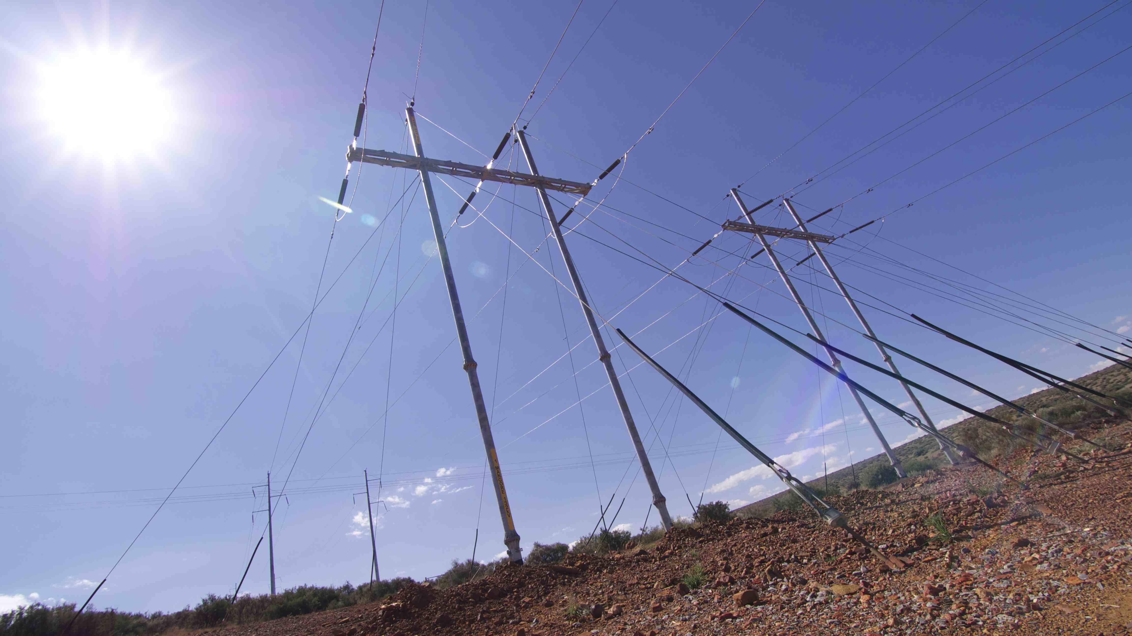
INVESTMENT IN THE REGION
PURPOSE
Providing financing for infrastructure projects contributing to economic development, growth, and regional integration in Africa.
PRODUCTS
SECTORS
Primarily senior debt
Up to 15 year US$ funding
Local currency funding
where hedging possible
Political risk mostly taken on balance sheet
Public sector involvement
Sovereign lending with project see-through
Sub-sovereign lending (utilities)
Public Private Partnerships
ENERGY
WATER
TRANSPORT
ICT

Slide 16
INFRASTRUCTURE DELIVERY AND PROJECT IMPLEMENTATION

Slide 17
PURPOSE
Accelerated delivery by shortening timeframes from concept to delivery
Value for money through setting new cost norms by delivering projects more cost-efficiently
Sustainability through life cycle costing, maintenance plans and partnerships to drive full functionality
Maximizing development impact- job creation, localization/industrialization and contractor support
PRODUCTS & SERVICES
Implementation Agent Services
Management of the design, upgrades, refurbishment maintenance of social infrastructure
projects
Programme management Services
Provision of management and specialist expertise to support planning, design, budgeting,
execution and maintenance of infrastructure projects and programme

Slide 18
EXAMPLES OF RECENT PROJECTS: SOUTH AFRICA

Slide 19
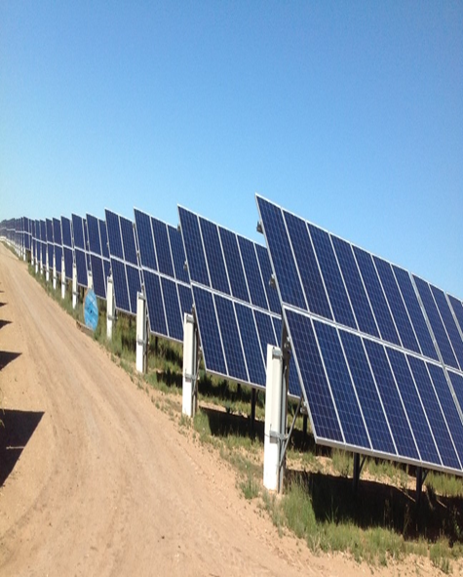
SA ENERGY IPP PROGRAMME
Assisted Govt Dept with Programme Preparation and Rollout
Thus far financed projects with aggregate 2,550 MW output
13 of these projects operational and delivering power onto the national grid.
8 under construction.
Mix of concentrated solar power (CSP) plant projects (4 CSP Troughs & 1 CSP Tower), 9 PV projects, 5 Wind projects & 2 Peaking Plants

Slide 20
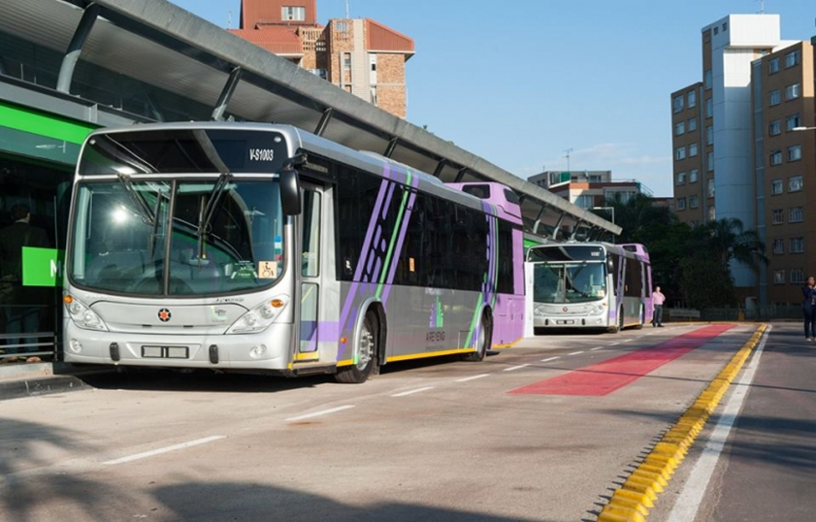
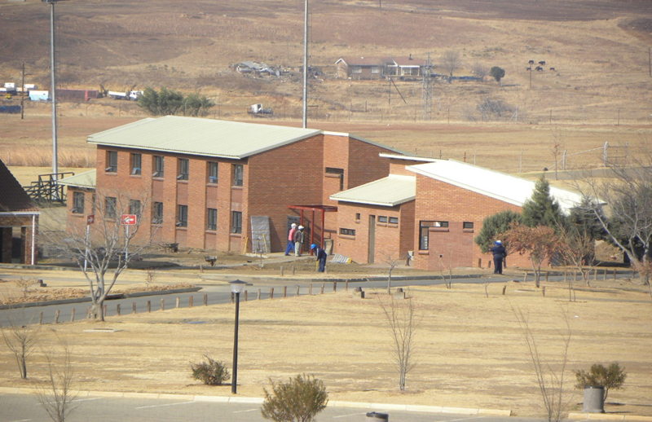
EXAMPLES OF RECENT PROJECTS: SOUTH AFRICA
Tshwane Bus Rapid Transit Project
The University of Venda Student Residence Project
Transportation for 127,000 passengers per day once phase 1 is operational.
1000 sustainable jobs to be created
Construction of on-campus student housing
Accommodation for 1800 students when completed

Slide 21
EXAMPLES OF RECENT PROJECTS: ZAMBIA

Slide 22
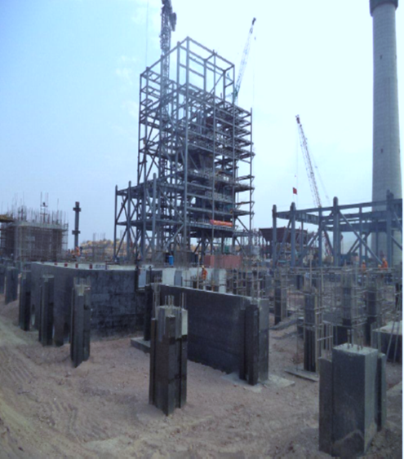
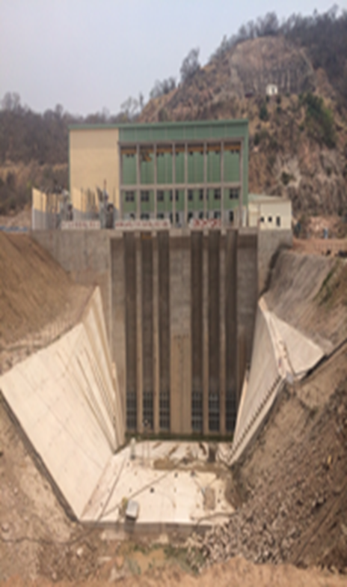
EXAMPLES OF RECENT PROJECTS: ZAMBIA
Maamba Coal Fired Power Plant
Ithezi-Thezi (ITT) Hydropower Generation Project
Construction of a 300MW base load coal-fired power plant
To diversify Zambia’s energy mix and reduce the reliance on hydro generation
Provide cost-effective and reliable electricity to the countries of the Southern Africa Power Pool (SAPP)- to generated 120MW

Slide 23
EXAMPLES OF RECENT PROJECTS: INFRASTRUCTURE IMPLEMENTATION

Slide 24
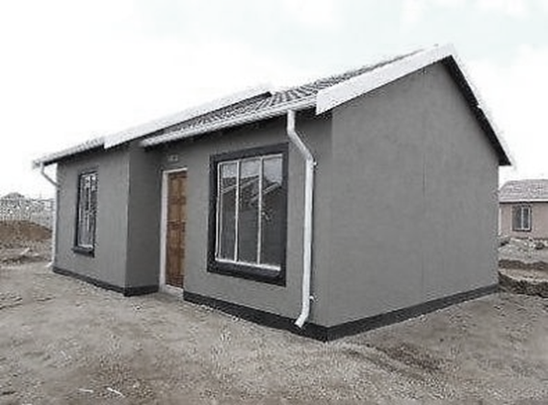
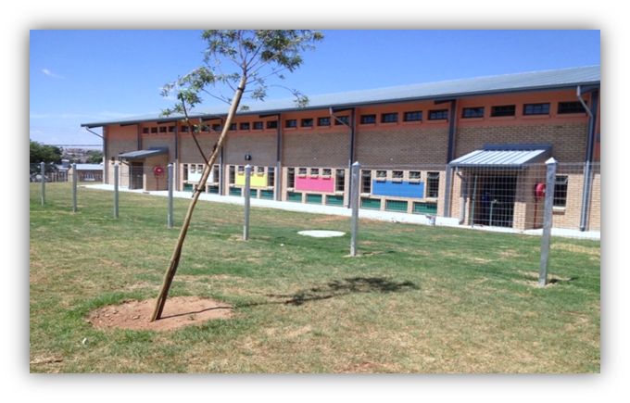
EXAMPLES OF RECENT PROJECTS: INFRASTRUCTURE IMPLEMENTATION
Housing Programme Eastern Cape
Accelerated Schools Infrastructure Delivery (ASIDI) Programme
Delivering of affordable housing for rural communities in the Eastern Cape.
3 270 houses completed since Phase 1
More than 9 800 households benefited from completed houses
Acting as Implementation Agent for the Dept. Basic Education on the construction of 121 schools
99 schools completed since 2012
16 schools provided with libraries
36 000 learners benefited since inception of the programme

Slide 25
Plan
Prepare
THANK YOU

