Slide 1
MUNICIPAL AUDIT SUPPORT PROGRAMME

Slide 2
TABLE OF CONTENTS
2. Municipal Audit Support Programme (MASP)
3. 2017/18 MFMA Outcomes
4. MASP Support Plan
5. Stakeholder Matrix
1. SALGA Strategy

Slide 3
MANDATES
Lobbying, Advocacy & Represent
Employer Representation
Capacity Building
Support and Advice
Strategic Profiling
Knowledge and Information Sharing
SALGA STRATEGY at a glance (2017-2022)
GOAL 2:
Good Governance & Resilient Municipal Institutions
GOAL 1:
Sustainable, Inclusive Economic Growth Underpinned by Spatial Transformation
Inspiring Spatial Justice & Social Justice through Integrated Management of Space, Economies & People
GOAL 3:
Financial Sustainability of Local Government & Greater Fiscal Equity
Information and Communication Technology
Data Intelligence
Innovation
Research and Knowledge Management
Effective and Efficient Administration
Marketing and Communication
Strategic Partnerships
Responsive
Innovative
Dynamic
Excellence
VALUES

Slide 4
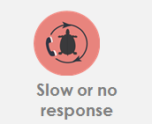
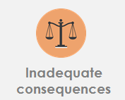
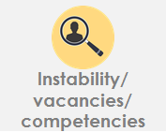
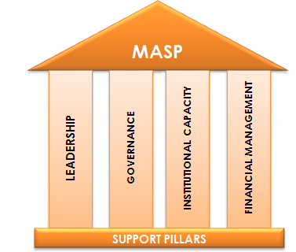
MUNICIPAL AUDIT SUPPORT PROGRAMME (MASP)
Auditor-General identified root causes leading to poor audit outcomes in municipalities – Slow or no response by leadership, Inadequate Consequence Management, Instability, vacancies and competencies of key personnel.
In responding to the challenge, SALGA has conceptualised the MASP programme, a multi-disciplinary approach founded on four basic pillars of support i.e. Leadership, Governance, Institutional Capacity and Financial Management. MASP aimed at supporting municipalities that have obtained poor audit outcomes based on the Auditor-General report.
Lack of urgency to address risks and improve internal controls Disregard for compliance
Inaction due to lack or poor performance management – culture of no consequences
Political instability, high vacancy rate and dependency on consultants

Slide 5
Audit Outcomes National Picture
Notes:
Unqualified no findings: 19
Unqualified with Findings: 99
Qualified 72
Disclaimed 25
Adverse 10
Not finalized 34

Slide 6
Findings per audit area

Slide 7
Municipal Audit Outcomes
The 2017/18 MFMA audit outcomes for municipalities in the Gauteng province showed a positive result overall as were there was no movement (improvement or regression) when compared to 2016/17 results.
Ten (10) municipalities obtained Unqualified Audit opinions with Midvaal Local Municipality being the only auditee that managed to sustain the Clean Audit outcome for four years consecutively.

Slide 8
MASP SUPPORT PLAN
Developing customised support plans for municipalities that covers all 4 pillars of the MASP by considering the following documents:
Audit Action Plan or Audit Improvement Plan of the municipality
Audit Report of the municipality
Management Report of the municipality
Engaging key stakeholders to discuss and share support plans in order to agree on an integrated multi-stakeholder support plan for a municipality setting out clear responsibilities per stakeholder.
Implementing MASP through a multi-disciplinary approach with key stakeholders.
Reporting progress to SALGA governance structures and other stakeholders.

Slide 9
MASP DELIVERY MODEL
Capacity Building
Workshops
Accredited
Training
Support & Advice
Profiling
Accountability
The Voice
Knowledge Sharing
Municipal secondment
Hands-on Support

Slide 10
STAKEHOLDER MATRIX
MASP
Treasury
COGTA
Auditor-General SA
Audit Firms
Accounting Standards Board (ASB)
LGSETA

Slide 11
CONCLUSION
Appetite to partner with SALGA to support municipalities based on the audit findings raised by the Auditor-General
Identify municipalities for support (Amalgamated municipalities, s139, audit not finalised, metros, districts, locals)
Identify areas of support (mSCOA, SCM / Procurement, Asset, Records Management, Performance Management, Asset Management, IUFW, Annual Financial Statements etc.)
Agree on type of support (Capacity Building, Hands-on support, Profiling)
SALGA - MASP Stakeholder Engagement Breakfast

Slide 12
Thank you!

