Slide 1
mSCOA
Role of Internal Audit
Notes:
Good afternoon Ladies and Gentleman. Today I am addressing you on the topic of the role of internal audit in the mSCOA process. I am an employee of Mubesko Africa (Pty) Ltd that forms part of the bigger MicroMega Group. The presentation contains my own views and not necessarily that of the MicroMega Holdings group and or Mubesko Africa (Pty) Ltd. I have structured my presentation based on the following brought topics.

Slide 2
INDEX
Background
Legislative framework
Audit Committee Expectations
Management Expectations
mSCOA – Internal Audit
Closing

Slide 3
BACKGROUND
Excitement
Ethics
Changes
Challenges
Success stories
Notes:
I think that we have not recently seen so much excitement in the local government sphere impacting directly on the work that internal audit is doing.
Business processes
Internal control redesign
Understanding our core and non-core functions
Assessing the adequacy of our funding and appropriateness of tariffs
The array of risks associated with the adequacy or inadequacy of our Information Technology and responses by service providers
The responses by Council, senior management and staff of the municipality
The adequacy or inadequacy of training provided and offered to internal auditors and risk managers
The uncertainty of the future and impact of decisions on equitable share allocations and trances
The fear of the unknown and the retreat into corners of safety of the known and unknown, and
The brave courageous internal auditors that saw the opportunities entrenched in an mSCOA process
Are YOU ready for 1 July 2017 as Councillors, Accounting Officers, CFO’s, Internal auditors and risk managers?

Slide 4
IIA Code of Ethics - Principles
Integrity The integrity of internal auditors establishes trust and thus provides the basis for reliance on their judgment.
Objectivity Internal auditors exhibit the highest level of professional objectivity in gathering, evaluating, and communicating information about the activity or process being examined. Internal auditors make a balanced assessment of all the relevant circumstances and are not unduly influenced by their own interests or by others in forming judgments.
Confidentiality Internal auditors respect the value and ownership of information they receive and do not disclose information without appropriate authority unless there is a legal or professional obligation to do so.
Competency Internal auditors apply the knowledge, skills, and experience needed in the performance of internal audit services.
Notes:
1. Integrity
Internal auditors:
1.1. Shall perform their work with honesty, diligence, and responsibility.
1.2. Shall observe the law and make disclosures expected by the law and the profession.
1.3. Shall not knowingly be a party to any illegal activity, or engage in acts that are discreditable to the profession of internal auditing or to the organization.
1.4. Shall respect and contribute to the legitimate and ethical objectives of the organization.
2. Objectivity
Internal auditors:
2.1. Shall not participate in any activity or relationship that may impair or be presumed to impair their unbiased assessment. This participation includes those activities or relationships that may be in conflict with the interests of the organization.
2.2. Shall not accept anything that may impair or be presumed to impair their professional judgment.
2.3. Shall disclose all material facts known to them that, if not disclosed, may distort the reporting of activities under review.
3. Confidentiality
Internal auditors:
3.1. Shall be prudent in the use and protection of information acquired in the course of their duties.
3.2. Shall not use information for any personal gain or in any manner that would be contrary to the law or detrimental to the legitimate and ethical objectives of the organization.
4. Competency
Internal auditors:
4.1. Shall engage only in those services for which they have the necessary knowledge, skills, and experience.
4.2. Shall perform internal audit services in accordance with the International Standards for the Professional Practice of Internal Auditing (Standards).
4.3. Shall continually improve their proficiency and the effectiveness and quality of their services.

Slide 5
LEGISLATIVE FRAMEWORK
Audit Committee
Internal Audit
Management

Slide 6
AUDIT COMMITTEE
MFMA 166(2) An audit committee is an independent advisory body which must—
advise the municipal council, the political office-bearers, the accounting officer and the management staff of the municipality, or the board of directors, the accounting officer and the management staff of the municipal entity, on matters relating to—
internal financial control and internal audits;
risk management;
accounting policies;
the adequacy, reliability and accuracy of financial reporting and information;
performance management;
effective governance;
compliance with this Act, the annual Division of Revenue Act and any other applicable legislation;
performance evaluation; and
any other issues referred to it by the municipality or municipal entity;

Slide 7
INTERNAL AUDIT
Section 165 requires that each municipality and each municipality must have an internal audit unit. In addition, the responsibilities prescribed by this act indicates that the internal audit unit of a municipality or municipal entity must:
prepare a risk-based audit plan and an internal audit program for each financial year;
advise the accounting officer and report to the audit committee on the implementation of the internal audit plan and matters relating to:
internal audit;
internal controls;
accounting procedures and practices;
risk and risk management;
performance management;
loss control;
compliance with this Act, the annual Division of Revenue Act and other applicable legislation; and
perform such other duties as may be assigned to it by the accounting officer.
In addition to the above legislative requirements the internal auditors conduct their work based on the International Standards for the Professional Practice of Internal Auditing (ISPPIA) issued by the Institute of Internal Auditors (IIA) and subscribe to the King III report.

Slide 8
MANAGEMENT
62. General financial management functions.—(1) The accounting officer of a municipality is responsible for managing the financial administration of the municipality, and must for this purpose take all reasonable steps to ensure—
that the resources of the municipality are used effectively, efficiently and economically;
that full and proper records of the financial affairs of the municipality are kept in accordance with any prescribed norms and standards;
that the municipality has and maintains effective, efficient and transparent systems—
of financial and risk management and internal control; and
of internal audit operating in accordance with any prescribed norms and standards;
that unauthorised, irregular or fruitless and wasteful expenditure and other losses are prevented;
that disciplinary or, when appropriate, criminal proceedings are instituted against any official of the municipality who has allegedly committed an act of financial misconduct or an offence in terms of Chapter 15; and

Slide 9
MANAGEMENT
that the municipality has and implements—
a tariff policy referred to in section 74 of the Municipal Systems Act;
a rates policy as may be required in terms of any applicable national legislation;
a credit control and debt collection policy referred to in section 96 (b) of the Municipal
Systems Act; and
a supply chain management policy in accordance with Chapter 11.

Slide 10
MANAGEMENT - Regulations
Section 168(1) of the MFMA states that:
The Minister of Finance, acting with the concurrence of the Cabinet member responsible for local government, may make regulations for, among other things-
Any matter that may be prescribed … and
(p) Any other matter that may facilitate the enforcement and administration of the Act

Slide 11
REGULATIONS
Local Government: Municipal Finance Management Act (56/2003): Municipal Regulations on Standard Chart of Accounts (Gazette No. 37577) –Key Objectives in preamble
• improved data quality and credibility;
• the achievement of a greater level of standardisation;
• the development of uniform data sets critical for 'whole-of-government‘ reporting;
• the standardisation and alignment of the 'local government accountability cycle' by the regulation of not only the budget and in-year reporting formats but also the annual report and annual financial statement formats;
• the creation of the opportunity to standardise key business processes with the consequential introduction of further consistency in the management of municipal finances;
• improved transparency, accountability and governance through uniform recording of transactions at posting account level detail;
• enabling deeper data analysis and sector comparisons to improve financial performance; and
• the standardisation of the account classification to facilitate mobility in financial skills within local government and between local government and other spheres as well as the private sector and to enhance the ability of local government to attract and retain skilled personnel.

Slide 12
AUDIT COMMITTEE EXPECTATIONS
Are we doing the right things?
Are we doing them in the right way?
What are our risk exposure?
What is the risk tolerance level of management in relation to mSCOA?

Slide 13
MANAGEMENT EXPECTATIONS
Based on my own perception of Management Expectations at the entities where I am involved with, the expectations may include:
An independent and objective advisor to the Accounting Officer and APRC
Use mSCOA to improve the understanding of the business processes and internal control design
Perform objective risk assessments and report on any concerns timeously
Perform assurance engagements on various matters that may include:
Validity and accuracy of processing of expense items
Validity and accuracy of tariff code links to very specific revenue items

Slide 14
mSCOA
Internal audit

Slide 15
ROLE
The International Standards for the Professional Practice of Internal Auditing (ISPPIA) defines internal auditing as “an independent, objective assurance and consulting activity designed to add value and improve an organisation’s operations. It helps an organisation accomplish its objectives by bringing a systematic, disciplined approach to evaluate and improve the effectiveness of risk management, control and governance processes.”

Slide 16
PROCESSES
Internal Audit should provide assurance and/or advice to senior management Council, the Audit Committee and other stakeholders on:
Project governance, including policies, procedures and controls.
Business case validity, viability and if worthwhile and feasible.
Project planning matters such as the critical path, completeness and suitability.
Change management attending to adherence to controls in the business processes and timeliness.
Risk and issue management addressing depth, coverage and resolution.
Project costs considering actual compared to budgeted.
Sign-off and criteria for stage gates.
Approach to vendor management for example contracting, dependencies and management involvement in process ownership and decision making.
Business readiness “pre-go-live”.
Project communications being accurate, sufficiently detailed and realistic.

Slide 17
PROCESS
Verify that standard operating procedures are in place.
Validate completion of testing and data conversion processes.
Advise and help identify relevant key process-level risks and control gaps.
Support the design of business process controls to mitigate process-level risks and provide certification analysis.
Evaluate go-live processes such as the creation of a transition team, parallel runs, crossover steps, contingency plans (including roll-back), end-user computing and output demands, risk management and issue escalation and resolution.
Evaluate transition plans and identify any operational and organisational issues that are critical to launch.
Assess whether any duplications exist in systems or efforts.
Ensure interdependent risks are being managed.

Slide 18
TECHNOLOGY
Ensure that functional needs, including forms and reports, are in place.
Audit hardware and software environment (operating system, network, user workstations, printers).
Check interface projects.
Measure application, operating system and network security.
Evaluate transition plans for technical processes and data.
Evaluate IT system integration and data migration in terms of both quality and security.
Validate and track benefits and cost savings.

Slide 19
PEOPLE
Check whether end-user training and guides, including transition readiness are in place.
Provide an analysis on post-implementation sustainability.
Measure resource utilisation.
Control and assess culture within the organisation.
Analyse whether skills and capability of the team are well suited to the project.

Slide 20
RISK MANAGEMENT
Be the eyes and ears of the audit committee.
Evaluate the risks inherent in the conversion process.
Monitor changes to the overall organisation risk profile.
Re-prioritise audit focus, as appropriate, given the demands of conversion.
Communicate audit plan focus and changes to the audit committee.
Collaborate and coordinate with other risk management functions.
Monitor the conversion impact on the internal controls.

Slide 21
INTERNAL AUDIT NOT YET INVOLVED?
What are your options if you as internal audit have not been involved to date?
What can be done to deal with the expectations of your stakeholders?
Are you sufficiently equipped to respond to the demands of mSCOA?

Slide 22
mSCOA
Transactions

Slide 23
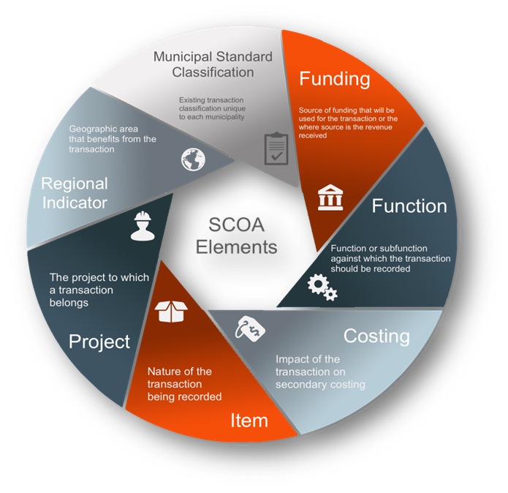
mSCOA TRANSACTIONS INFO

Slide 24
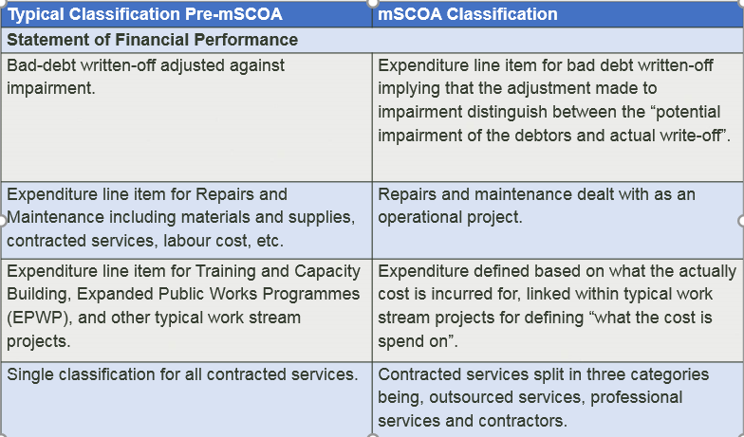
mSCOA TRANSACTIONS INFO

Slide 25
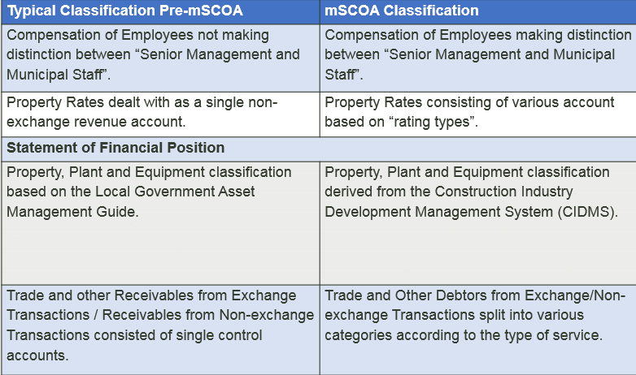
mSCOA TRANSACTIONS INFO

Slide 26
mSCOA TRANSACTIONS INFO
1

Slide 27
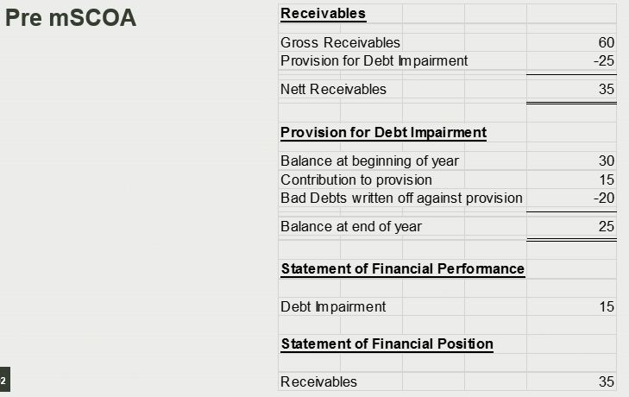
mSCOA TRANSACTIONS INFO

Slide 28
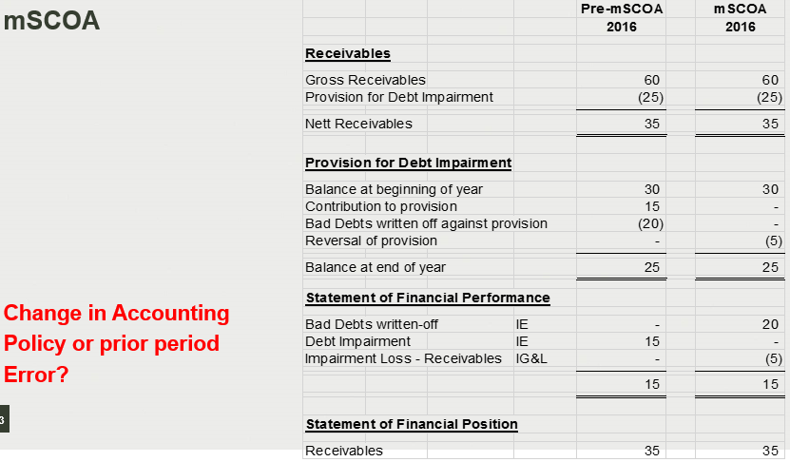
mSCOA TRANSACTIONS INFO

Slide 29
mSCOA
Internal audit activities - assurance

Slide 30
IMMEDIATE ASSURANCE
Status reports on progress made with mSCOA implementation
Training of municipal staff on new Chart of Accounts
Training on correction of processing errors
Existence of user manuals on the new systems

Slide 31
IMMEDIATE ASSURANCE
Validity and accuracy of information reported to:
Accounting Officer
National/Provincial Treasury
Audit Committee
Council
Auditor-General
74. General reporting obligation.—(1) The accounting officer of a municipality must submit to the National Treasury, the provincial treasury, the department for local government in the province or the Auditor-General such information, returns, documents, explanations and motivations as may be prescribed or as may be required.
(2) If the accounting officer of a municipality is unable to comply with any of the responsibilities in terms of this Act, he or she must promptly report the inability, together with reasons, to the mayor and the provincial treasury.

Slide 32
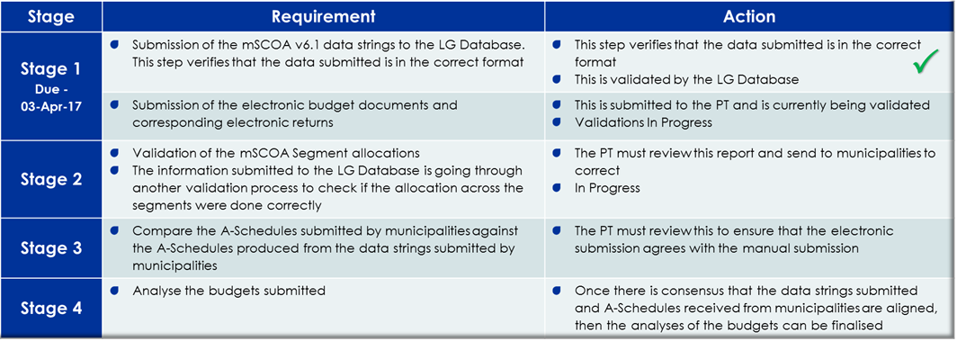
IMMEDIATE ASSURANCE
Confirm that the data string submitted is the result of transacting at all 7 segments at transactional level!

Slide 33
THE END

