Slide 1
ENHANCING SERVICE DELIVERY THROUGH INTEGRATING PERFORMANCE, RISK AND SUSTAINABILITY
Audit and Risk INDABA
April 2019

Slide 2
Agenda
1
Introduction / Background
Performance Management, Risk Management and Sustainability
2
Legislative Overview
Municipality Political and Administrative Leadership
3
Performance, Risk and Sustainability Management in Municipal Environment
Why Performance Management in Municipalities?
Practical Considerations
4
Performance, Risk and Sustainability Integration
Key take-outs
5
Firm’s Experience
Previous Projects – Ntiyiso Consulting experience
2

Slide 3
INTRODUCTION

Slide 4
Introduction
Performance Management
Risk Management
Process of defining desired outcomes, setting performance standards, and holding individuals accountable for results.
Performance Support Framework
Develop design principles
Design framework
Outline any technology or infrastructure requirements
Identify performance measures and populate framework
Pillars of the framework
Process of identifying the significant risks to a project through all phases of the project life cycle
Risk Management Framework
Create value – resources expended to mitigate risk should be less than the consequence of inaction
be an integral part of organizational processes
explicitly address uncertainty and assumptions
be a systematic and structured process
Sustainability
The integration of social, economic and environmental factors into planning, implementation and decision-making so as to ensure that development serves present and future generations
4
Notes:
Sustainability (talk)

Slide 5
LEGISLATIVE OVERVIEW

Slide 6
Legislative Overview
Local Government Municipal Systems Act 2000
A municipality must set key performance indicators, including input indicators, output indicators and outcome indicators, in respect of each of the development priorities and objectives referred to in section 26(c) of the Act.
The Act requires the Municipal Manager and the Managers reporting directly to the Municipal Manager to enter into annual Performance Agreements. The employment contract of the Municipal Manager and other Section 57 Managers should be directly linked to their Performance Agreements.
The Act requires that every municipality must have a remuneration policy that sets out the link between performance and reward for the Municipal Manager and Managers reporting directly to the Municipal Manager.
6
Notes:
Section 57 managers contracted

Slide 7
Legislative Overview
Additional Legislative Guidelines
A municipality must review its key performance indicators annually as part of the performance review process. Whenever a municipality amends its integrated development plan in terms of section 34 of the Act, the municipality must, as part of the process review those KPIs that will be affected by such amendment. (Local government: municipal planning and performance management regulations, 2001)
The King Committee on governance issued the King Report on Governance for South Africa – 2009 (the Report) and the King Code of Governance Principles – 2009 (the Code), together referred to as ‘King III’ on 1 September 2009
7
Notes:
Section 57 managers contracted

Slide 8
BACKGROUND

Slide 9
Performance Management Key Aspects
Process and Policy
Process and Policy
Financial
Financial
What should we measure to
What should we measure to
What should we measure to
What should we measure to
understand if we are excelling at
understand if we are excelling at
understand if we are succeeding
understand if we are succeeding
our internal business processes?
our internal business processes?
financially?
financially?
Customer and Constituent
Customer and Constituent
Organisation and Learning
Organisation and Learning
What should we measure to
What should we measure to
What should we measure to
What should we measure to
understand if we are creating an
understand if we are meeting
understand if we are creating an
understand if we are meeting
organisational environment that
customer expectations and
organisational environment that
customer expectations and
people develop in and want to be
achieving effective outcomes?
people develop in and want to be
achieving effective outcomes?
a part of?
a part of?
*The Balanced Scorecard Framework was developed by Kaplan and Norton in 1996
The Balanced Scorecard Framework can be used as a guide to focus the development of performance measures across the four dimensions of the framework.
9

Slide 10
Performance Management Design Process
The outcome of this design process is a performance measurement framework with the following functional features:
Scorecards
Aggregation of performance measures
Reporting process
Exception and variance reporting process
Performance measure information
Design
Principles
Pillars
Focus
Accountability
Alignment
Balance
Focus
Accountabili
Alignment
Balance
Accountabil
Balance
Focus
Balance
Focus
Alignment
Alignment
Data
Data
Data
Data
Foundations
Reporting
Reporting
Reporting
Reporting
Systems
Systems
Systems
Systems
The design principles form the starting point for the design of the performance measurement framework. They are informed by best practice principles of performance management
Notes:
Process and Systems
Process to cut across

Slide 11
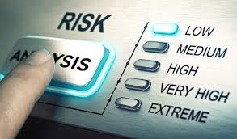
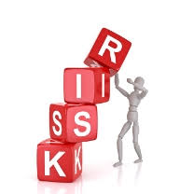
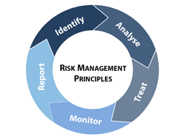
Risk Management
Any factor, event or influence that threatens the successful completion and operation of a project in terms of cost, time or quality
Risk defined as ‘the effect of uncertainty on objectives’ as per ISO 31000:2009
Risk Management is the process of identifying the significant risks to a project through all phases of the project life cycle

Slide 12
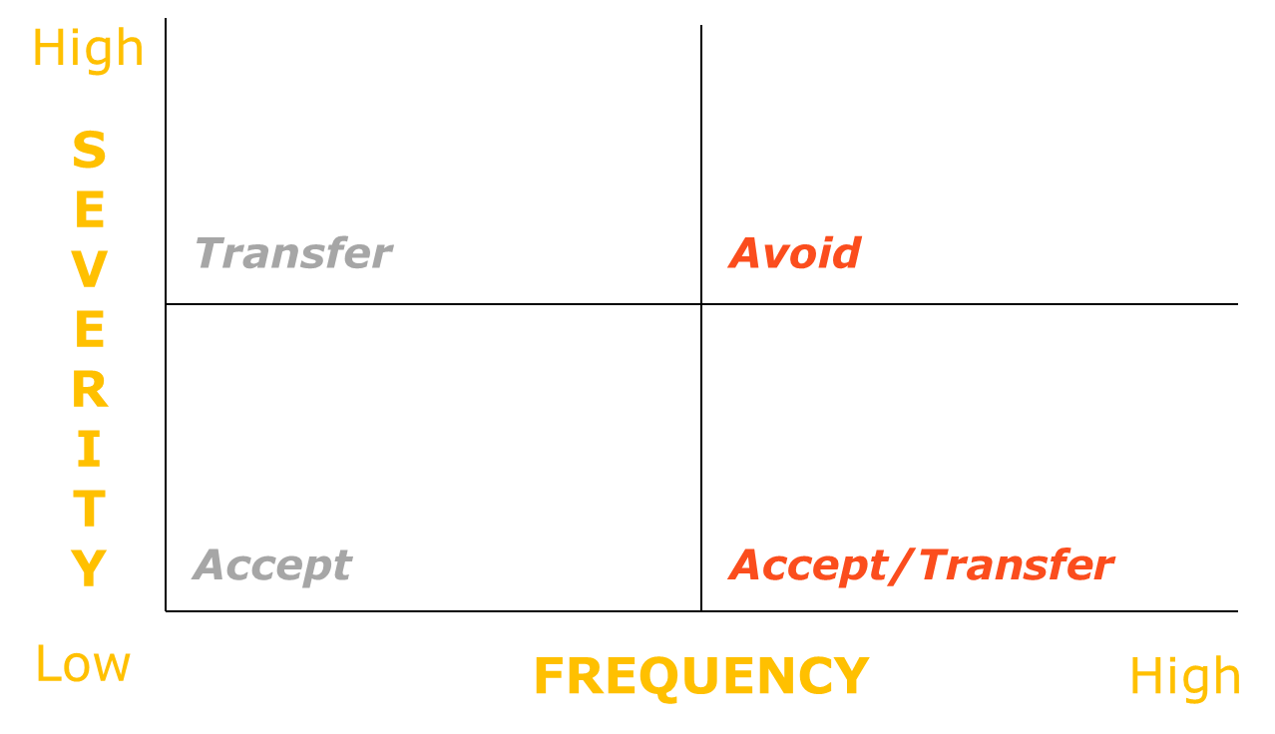
Risk Response
Risk will always be present in projects but can be managed and reduced
Quantification of risk exposure
Options available:
- Accept = monitor
- Avoid = eliminate (get out of situation)
- Reduce = institute controls
- Transfer = partner someone (e.g. insurance)

Slide 13
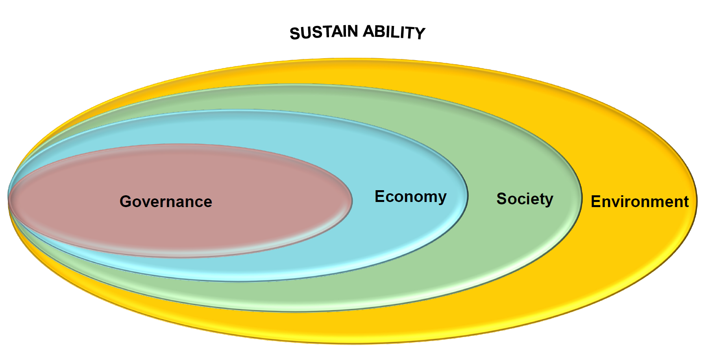
Sustainability
Each enterprise balances the need for long-term viability and prosperity – of the enterprise itself and the societies and environment upon which it relies for its ability to generate economic value – within the requirement of short term competitiveness and financial gain
Why Sustainability?
Society / Client’s becoming more aware of sustainability issues
Indicates good corporate governance – shareholders want to know companies act responsibly in all aspects, not only in the bottom line but the triple bottom line

Slide 14
Monitoring and Evaluation
Monitoring | Evaluation
Continuous | Periodic: at important milestones and at the end of a substantial period after programme conclusion
Keeps track, oversight, analysis and progress | In-depth analysis; Compares planned with actual achievements
Focuses on inputs, activities, implementation processes, continued relevance, likely results and outcome level | Focuses on outputs in relation to inputs, results in relation to cost, processes used to achieve results, overall relevance, impact, and sustainability
Answers what activities were implemented and the results achieved | Answers why and how results were achieved; Contributes to building theories/models for change
Alerts managers to problems and provides options for corrective actions | Provides managers with strategy and policy options
Supervisors, community stakeholders and donors | Internal/external programme managers, supervisors, community stakeholders, donors/evaluators
Notes:
Role of mayor, MM, managers etc. (bring home)
City manager, dvision heads
Political oversights (mayor and council)
Oversight role of admin function (mm, SECTION 57 managers)

Slide 15
PERFORMANCE MANAGEMENT IN PUBLIC SECTOR / MUNICIPAL ENVIRONMENT

Slide 16
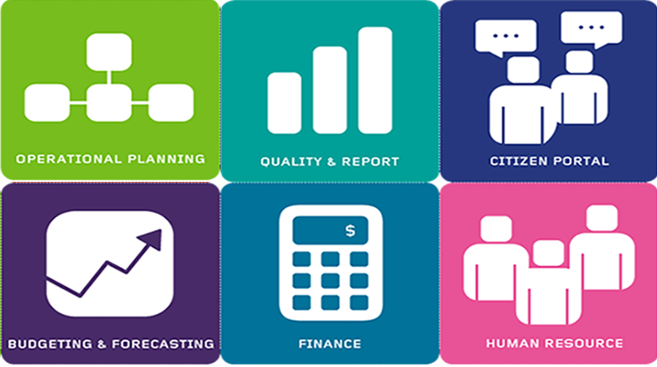
Why Performance Management in Munics?
Performance management is a critical aspect of organisational effectiveness because it is the key process through which work is accomplished, and should therefore be a top priority of managers.
A performance programme can also reduce conflict, moderate incentives for deviant behavior, performance evaluation and enhance the service delivery
One of the most important aspects of the performance management process is actually the individual development and career opportunity offered by the process. (Bussin 2013: 10).
Notes:
Key to service delivery

Slide 17
Performance Management Process and cycle
Phase 1: define goals, standards and measurements
Phase 2: Provide ongoing coaching and feedback
Phase 3: Conduct performance appraisal and evaluation discussion
Phase 4: determine rewards/consequences
Phase 5: the annual development and career opportunities evaluation and discussion
The performance management cycle must align to the municipal planning cycle
Notes:
Cycle?
Planning cycle of municipalities
IDP, SDBIP..this is what we do next year..
Performance manageemnt cycle to align with that (shud go into the performance contracts)
Performance, Risk – how does it come together
Performance management and cycle (3-4min)
Risk Management and cycle (3-4 min)
How does it come together to improve service delivery

Slide 18
Practical Considerations
Performance management system should provide a mechanism for ensuring increased accountability between:
The community and the municipal council
The political and administrative components of the municipality
Each department and the office of the municipal manager
Community
Political Leadership
Administration
Allows accountability to flow from community to the municipal administration

Slide 19
Practical Considerations
MUNICIPAL COUNCIL
MAYOR AND MAYORAL COMMITTEE
An oversight role and consider reports from the Mayoral committee on the functioning of different portfolios and the impact on the overall objectives and performance of the municipality
Review and Approval of Performance Management System annually
Appointment of audit committee, which provides impartial recommendations on performance ratings to the Mayoral committee
MUNICIPAL / CITY MANAGER
DIVISIONAL/DEPARTMENT HEADS
Employment contract to be directly linked to MM’s performance contracts
Annual Performance Agreements
Performance Plan: Municipality Business Plan or scorecard transcends into MM’s Performance Plan
Goal Setting: Performance agreement involves the negotiation of goals that the MM will accomplish
Section 57 managers
Employment contract to be directly linked to their performance contracts
Annual Performance Agreements
Performance Plan: Departmental Business Plan or scorecard transcends into their Performance Plan/s
Goal Setting: Performance agreement involves the negotiation of goals that employees will accomplish
19
Notes:
MAKE SLIDE 9 LIKE SLIDE 18

Slide 20
RISK MANAGEMENT IN MUNICIPALITIES / PUBLIC SECTOR

Slide 21
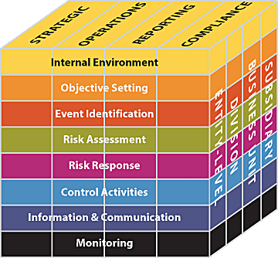
Risk Framework
Enterprise risk management (ERM) requires an entity to take a portfolio view of risk
Management considers how individual risks interrelate
Management develops a portfolio view from two perspectives - Business unit level and Entity level
The eight components of the framework are interrelated
Enterprise Risk Management (ERM)
Source: COSO Enterprise Risk Management – Integrated Framework. 2004. COSO.
ERM in business includes the methods and processes used by organizations to manage risks and seize opportunities related to the achievement of their objectives.

Slide 22
Strategy and Risk Interrelate?
STRATEGIC PLANNING FRAMEWORK
RISK-RETURN ANALYSIS
RISK APPETITE INTEGRATION
CONTINGENCY INTEGRATION
ATTRIBUTE | DESCRIPTION OF ATTRIBUTE (Source: ABMI © Resources)
Strategic planning framework | A formal strategic plan is defined, implemented and communicated across the organisation
Risk integration | In formulating the strategic plan, the relevant strategic choices are risk assessed before finalisation of the elected strategic choices and direction
Risk appetite | Risk appetite levels are considered in the selection and assessment of strategic choices
Risk contingency integration | Contingency plans are implemented as part of the planning and implementation process to deal with potential uncertainty in attainment of desired strategic outcomes

Slide 23
Sustainability and Risk Management Integrate?
SUSTAINABILITY PLAN (& RISKS)
SUSTAINABILITY REPORT
CONTINGENCY PLANNING
ATTRIBUTE | DESCRIPTION OF ATTRIBUTE (Source: ABMI © Resources)
Strategic sustainability | A formal sustainability programme and sustainability management process is developed and implemented entity-wide
Sustainability reporting | Sustainability monitoring and reporting is done and shared with relevant stakeholders on a periodic basis
Contingency management | Formal business contingency management processes are in place and fully implemented across the organisation

Slide 24
Practical Consideration (Risk Profiling)
Top 10 Capital Programmes
(illustrative example)
COMMUNITY
Reputational
2
1
1
Solar Water Heaters
10
9
2
Smart Meters & Prepaid
3
Water Reticulation
miscellanous
Schedule
3
PROJECT
RISKS
7
10
4
Road Construction
5
5
Electrification
9
5
6
Public Lighting
7
Substation Upgrade
1
8
Corridors of Freedom
7
Financial
10
SHEQ
9
SCADA
10
10
Theft & Vandalism
Regulatory

Slide 25
PERFORMANCE, SUSTAINABILITY AND RISK MANAGEMENT

Slide 26
How does Performance and Risk Interrelate?
WHY SHOULD WE MANAGE RISK?
The only impediment to performance is risk
RISK CAN CAUSE TOTAL DESTRUCTION ; CAN ALSO CAUSE A SPIKE IN PERFORMANCE OUTCOMES. EITHER WAY, IT MUST BE UNDERSTOOD, MANAGED
RISK IS MUCH CLOSER TO PERFORMANCE AND SUSTAINABILITY.
IT IS ALWAYS EVIDENT IN THE EXTREME RIGHT OF MOST M&E REPORTS (PERFORMANCE, FINANCIAL)

Slide 27
Evolving Institutional Management
THE OLD vs. EVOLVING VIEW
SILOS
INTEGRATION
STRATEGIC PLANNING
RISK MANAGEMENT
PERFORMANCE MGT
BUSINESS MODEL
OPPORTUNITY & INNOVATION
SUSTAINABILITY
COMPLIANCE MGT
STRATEGIC PLANNING
RISK MANAGEMENT
PERFORMANCE MGT
COMPLIANCE MGT
BUSINESS MODEL
OPPORTUNITY & INNOVATION
SUSTAINABILITY

Slide 28
Performance and Risk Management Integrate?
PERFORMANCE & RISK INDICATOR INTEGRATION
RISK ADJUSTED PERFORMANCE TARGETS
INTEGRATION WITH STAFF & STAKEHOLDER PERFORMANCE
ATTRIBUTE | DESCRIPTION OF ATTRIBUTE (Source: ABMI © Resources)
Performance indicator/ measure integration | Relevant strategic performance indicators/ measures are in place and are integrated and aligned with applicable risk indicators. These are measured and reported upon on a periodic basis
Risk adjusted performance targets | Performance indicators and targets at organisational level are adjusted in line with the expected impact of risk there-on
Integration with staff performance | Organisational performance, as well as performance of the risk management process is linked and integrated directly into the performance expectations of staff members and relevant stakeholders

Slide 29
Key Take Outs
INTEGRATE YOUR STRATEGIC PLANNING, PERFORMANCE AND RISK ASSESSMENT CYCLES IN ORDER TO ENSURE THAT STRATEGIC PLANS ARE PERFORMANCE ALIGNED, RISK INTELLIGENT & RESILLIENT
OPPORTUNITY CANNOT MERELY BE EXPLOITED WITHOUT CONSIDERING PERFORMANCE & RELEVANT RISKS
INCOPRORATE RISK MANAGEMENT AND SUSTAINABILITY CONSIDERATIONS IN DECISION MAKING. ENHANCE SERVICE DELIVERY THROUGH PERFORMANCE MANAGEMENT

Slide 30
ABOUT NTIYISO CONSULTING

Slide 31
About Ntiyiso
PAST and CURRENT
CLIENTS
OVERVIEW
LOCATIONS
SERVICES
Management consulting firm
100% black owned and managed
Over 10 years in existence
Over 70 consultants
14 projects across 8 municipalities just in 2017
Centurion
Bedfordview
Durban
Malamulele
Revenue enhancement and management
Data Management and Analytics
Governance and strategy
Organisation Design
Business Process Engineering
Fundraising and development of catalytic projects
City of Tshwane
City of Ekurhuleni
City of uMhlathuze
Emfuleni Local Municipality
Ngqushwa Local Municipality
Dr Kenneth Kaunda District Municipality
Collins Chabane Local Municipality
Mafube Local Municpality
Road Accident Fund

Slide 32
THANK YOU
ADDRESS
Unit 3, Standford Office Park
12 Bauhinia Street
Highveld Technopark
Johannesburg
South Africa
PHONE & WEB
T: +27 12 940 54 35
F: +27 12 940 54 36
www.ntiyisoconsulting.co.za
CONTACT PERSON
stephen.mabunda@ntiyisoconsulting.co.za

