Slide 1
Presenter: Zipho Mdluli CA (SA), RA
Executive – Bonakude Gauteng

Slide 2
Geared up for New Dawn, New Environment
(Role of internal audit)

Slide 3
“Hope begins in the dark, the stubborn hope that if you show up and try to do the right thing, the dawn will come. You wait and watch and work: you don’t give up.” – Anne Lammot

Slide 4
What is a new dawn?

Slide 5
Dawn - The beginning of a phenomenon or period of time, especially one considered favourable. The change from darkness to light
The president said he was "determined to build a society defined by decency and integrity that does not tolerate the plunder of public resources nor the theft by corporate criminals of the hard-earned savings of ordinary people".

Slide 6
Improve the conditions of life for all South Africans, especially the poor
Clean Governance and intensified Anti- Corruption Drive
Economic Growth and job creation
Education and Training
Strengthen the capacity of the state to address the needs of the people

Slide 7
Clean Governance and intensified Anti- Corruption Drive
The fight against corruption must not only be widespread, it must be intensified to put on notice all those who have already been charged and send a strong message to those who are contemplating looting the state from their privileged positions in the state. This must be a total and unrelenting war against graft that the entire nation must support. Clean governance is what the nation demands.
Economic Growth and Job creation
The most pressing task for our country is to set the economy on a higher path of shared growth and to transform the structure of our economy to provide opportunities for millions of South Africans.
Education and Training
The fourth industrial revolution is upon us and only a properly equipped citizenry will be able to take advantage of the benefits of the new revolution. Basic, secondary and tertiary education must be revved up to prepare the youth of the nation for the challenges of the future.

Slide 8
Recent challenges

Slide 9
The biggest question is always “where were the auditors” when issues of corruption, fraud and irregularities emerge.
Some of the topical issues have been on:
State Capture matters (Eskom, DENEL, DCS, SARS, PIC)
VBS Mutual Bank
Steinhoff Limited
Governance issues in local government
Continued rise in irregular expenditure (per the Auditor General)
Non performance by the SOEs
The stories we hear from the commissions are somewhat transversal as they relate mostly to Fraud, Corruption and ineffective use of public funds.

Slide 10
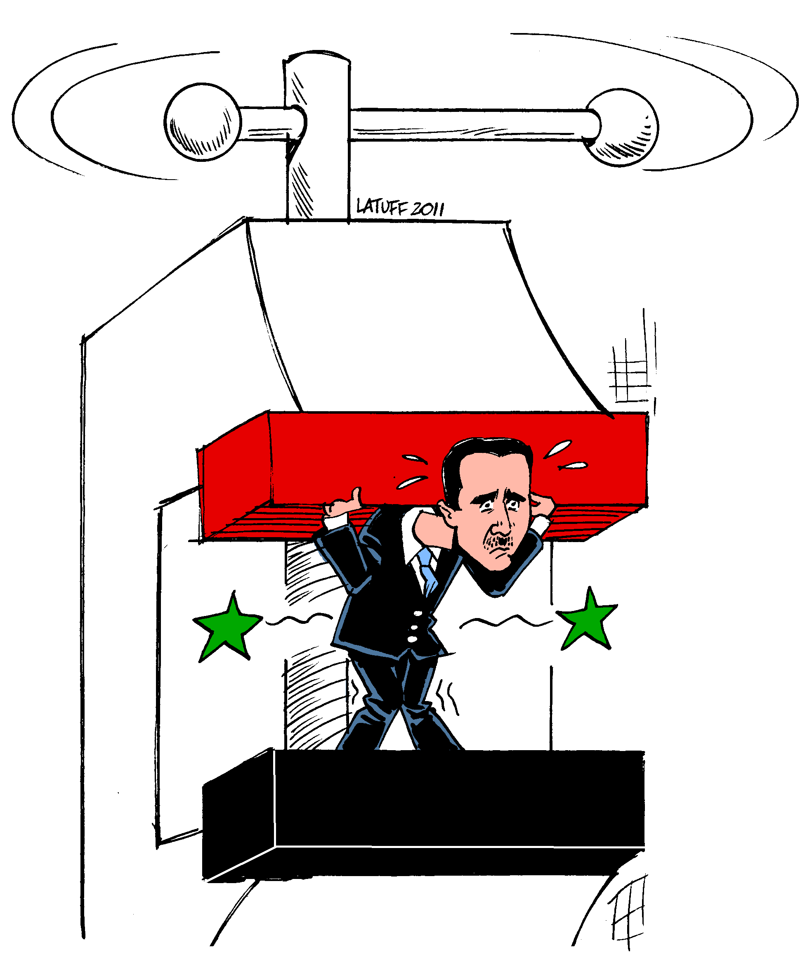
Political and working environment
Influence of the political principals/senior officials involved in fraud and corrupt activities on the functions and the role of internal audit
Is the internal audit playing it’s role? Are internal auditors the right people to deal with issues that the political influences bring about?
^{ENEMY or COMPROMISE}

Slide 11
Regulatory/ legislative environment
Treasury Regulations require that internal audit perform their activities in accordance with the IIA standards – is this appropriate to address Public Sector challenges?
Is internal audit fulfilling its role entirely as required, e.g. TR 3.2.10
“The internal audit function must assist the accounting officer in achieving the objectives of the institution by evaluating and approving the process through which-
(a) objectives and values are established and communicated;
(b) the accomplishment of objectives is monitored;
(c) accountability is ensured; and
(d) corporate values are preserved.”
Are we adequately addressing the risks identified (Risk – based approach: MFMA 165 (2)) – Is our approach robust enough?

Slide 12
Auditor General
AGSA continues to be the most influential stakeholder in Public Sector Finance Management – Are we playing our role in upholding the combined assurance model?
The recent amendments to the Public Audit Act give certain powers to the AG – Has internal audit assessed these and amended their approach?

Slide 13
Expectations of internal audit in a new dawn

Slide 14
^{3 Critical traits}
^{Independence and objectivity}
^{Resources}
^{Power to influence}

Slide 15
What can we contribute as internal auditors and risk officers?
Based on the lessons learnt, let us build highly skilled auditors and risk officers for the future.
Let us strengthen relationship with state security agencies and chapter 9 institutions because together we can proactively and effectively deal with corruption and state capture.
Let us relook at audit focus to do more performance audit in support of the new dawn.
Let us create forums to share knowledge about trends and transversal risks so that we are more proactive.

Slide 16
In conclusion:
We encourage the adoption of collaborative approach in dealing with matters of fraud and corruption.
Internal auditors must avoid working in isolation, that’s when you become isolated and become vulnerable.

Slide 17
DURBAN OFFICE
84 Seventh Avenue, Morningside, Durban 4001 PO Box 50112, Musgrave, 4062
Tel: 031 201 1241/2 • Fax: 087 231 4072 Email: admin@bonakude.co.za
GAUTENG OFFICE
Pinewood Square, Pinewood Office Park 33 Riley Road, Westmead PO Box 785553, Sandton, 2146 Tel: 011 881 5452 • Fax: 087 231 4072 Email: admin@bonakude.co.za
www.bonakude.co.za

