Slide 1
ROLE OF ICT IN SERVICE DELIVERY (VALUE)
CIGFARO 88th Annual Conference
10 October 2017
DPSA

Slide 2
PRESENTATION OUTLINE
INTRODUCTION
BACKGROUND
BACKGROUND
MPSA LEGISLATIVE MANDATE
PERSISTING AG FINDINGS
ADOPTION OF THE FRAMEWORK
PUBLIC ADMINISTRATION MANAGEMENT ACT
WHY GOVERNANCE FRAMEWORK
ASSESSMENT OF CGICT IMPLEMENTATION
IMPROVEMENT MADE BY DEPARTMENTS (AG AND MPAT RESULTS)

Slide 3
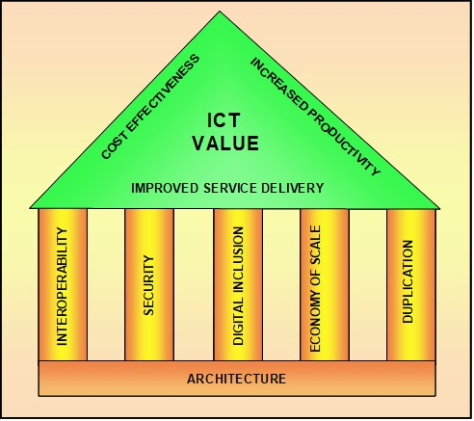
INTRODUCTION

Slide 4
IT ADOPTION CHALLENGES
Some of the IT challenges identified in the Presidential Review Commission Report 1998 are:
Lack of clear roles and responsibilities for IT in the public sector
Lack of coordination
Incompatibility of systems
Inability to attract and retain scarce IT skills
IT not business process driven
Inability to leverage buying muscle
Duplication of systems

Slide 5
Government Response to Challenges
Government’s response to the challenges
Legislative | Institutional
SITA Act-1999, amended 2002 Cab Memo 38a 2000 E-government Policy Framework 2001 Corporate Governance of Information and Communication Technology Policy Framework (CGICTPF) 2012 | Government Chief Information Office IT Agency -SITA Government Information Technology Officer (GITO) Government Information Technology Officer’s Council (GITOC)

Slide 6
Legislative Mandate
The Minister for public service and Administration is responsible for establishing norms and standards relating to-
(a) the functions of the public service;
(b) the organisational structures and establishments of departments and other organisational and governance arrangements in the public service;
(c) the conditions of service and other employment practices for employees;
(d) labour relations in the public service;
(e) health and wellness of employees;
(f) information management in the public service;
(g) electronic government;
(h) integrity, ethics, conduct and anti-corruption in the public service; and
(i) transformation, reform, innovation and any other matter to improve the effectiveness and efficiency of the public service and its service delivery to the public.

Slide 7
PERSISTING AG FINDINGS
Government-wide IT Governance Framework (IT Plan)
Government –Wide information Technology governance framework not developed and implemented
Fragmented approach to policies and standards
Strategic alignment of information technology with business objectives
Government-wide information technology plan not established to align information technology with business objectives
Accountability structures for Information Technology governance
Mandated responsibility of Government Information Technology Officers not fulfilled
Performance measures
No indicator, measurable goals or performance criteria were established for effective performance measure
Notes:
ISO 38500
KING 111
COBIT 5.0

Slide 8
CORPORATE GOVERNANCE OF ICT
Government realised the weakness to unlock the value of ICT and its detrimental impact on service delivery. To address these weaknesses Cabinet adopted the Corporate Governance of Information and Communication Technology (ICT) Policy Framework (CGICTPF) in November 2012, and it was issued per directive by the Minister for Public Service and Administration in January 2013.
At the time that DPSA took the framework to cabinet for approval; cabinet approved it and also extended the frameworks applicability to both the local government and other organs of the state SOE's.
Through the CGICTPF, corporate governance of ICT is institutionalised in the Public Administration as defined in Section 195 of the Constitution (national, provincial and local government, Organs of State and Public Entities) as an integral part of the corporate governance of the institution in a uniform and coordinated manner.
Notes:
ISO 38500
KING 111
COBIT 5.0

Slide 9
CORPORATE GOVERNANCE OF ICT (cont)
As the value and importance of information as an asset is significant, it necessitates strategic leadership to extend to ICT the departmental core corporate governance principles of setting strategic aims, providing strategic leadership, overseeing and monitoring executive management reporting and to ensure that ICT is aligned with the strategic objectives of government and departments.
Risk and Audit Practice

Slide 10
PUBLIC ADMINISTRATION MANAGEMENT ACT
Objectives of the ACT is to promote the basic values and principles governing the Public Administration referred to in Section 195 (1) of the constitution
PAMA ICT Mandate
Chapter 5, Section 14
Use of information and communication technologies in public administration
14. The head of an institution must—
(a) acquire and use information and communication technologies in a manner
which—
(i) leverages economies of scale to provide for cost effective service;
(ii) ensures the interoperability of its information systems with information
systems of other institutions to enhance internal efficiency or service
delivery;
(iii) eliminates unnecessary duplication of information and communication
technologies in the public administration; and
(iv) ensures security of its information systems;

Slide 11
PAMA CHALLENGES
(b) use information and communication technologies to develop and enhance the
delivery of its services in the public administration;
(c) align the use by staff of information and communication technologies to
achieve optimal service delivery; and
(d) promote the access to public services through the use of information and
Communication technologies.
PAM Act is not yet in operation
The DPSA still needs to work with COGTA and SALGA to device ways to roll out this framework to local govt. Efforts are currently underway with DPE to organize a workshop to assist SOE under DPE to implement.

Slide 12
WHY GOVERNANCE FRAMEWORK
Corporate governance of ICT requires that all important ICT decisions should come from the senior political and managerial leadership and not to be delegated to ICT management. This accountability enables the department to align the delivery of ICT services with the department’s strategic goals.
The corporate governance of ICT is a continuous function that should be embedded in all operations of a department, from Executive Authority (Mayor) and Executive Management level to the business and ICT service level. In the execution of the corporate governance of ICT, the leadership should provide for the necessary strategies, architectures, plans, frameworks, policies, structures, procedures, processes, mechanisms and controls, and ethical culture.
Through practices, principles and implementation approach, the CGICT Policy Framework seeks to provide the departments with direction to implement corporate governance of ICT within their spheres of accountability and responsibility.

Slide 13
CGICT POLICY FRAMEWORK (cont)
Corporate governance of ICT involves evaluating and directing the achievement of strategic goals and using ICT to enable the departmental business and the monitoring of ICT service delivery to ensure continuous service improvement. It includes determining strategic goals and plans, and annual performance plans for ICT service delivery.
The HoD (Municipal Manager) and Executive Management (Mayor) are respectively accountable and responsible for implementing corporate governance of ICT in the department. Effective corporate governance of ICT is achieved in a department through:
Institutionalising a Corporate Governance of ICT Policy Framework that is consistent with the corporate governance of the department;
Aligning the ICT strategic goals with the departmental strategic goals;
Ensuring that optimum business value is realised from ICT-related investment, services and assets;

Slide 14
CORPORATE GOVERNANCE PRINCIPLES
The Executive Authority (Mayor) provides the political leadership and must ensure that CGICT achieves the political mandate.
The Head of Department (Municipal Manager) provides the strategic leadership and is accountable for the implementation of the corporate governance of ICT (CGICT) and must ensure that CGICT achieves strategic plans, create a CGICT enabling environment.
Executive Management is responsible for ensuring that the corporate governance of ICT is implemented and managed. They must ensure that ICT is aligned with strategic goals; business accounts for current and future capabilities of ICT is fit for purpose; monitor and evaluate major ICT expenditure; ensure management of ICT risks within the departmental risk management practice; ICT function is audited and demonstrates the understanding of and respect for organisational behaviour/culture.

Slide 15
CORPORATE GOVERNANCE PRACTICES
The Executive Authority (Mayor) must:
Provide political leadership, direction, determine policy and provide oversight;
Ensure that ICT service delivery enables the attainment of the strategic plan; and
Ensure that the department’s organisational structure provides for the CGICT.
The HoD (Municipal Manager)must:
Provide strategic leadership, management and alignment to ICT;
Ensure that Departmental Corporate Governance of ICT Policy Framework, Charter and related policies are developed and implemented;
Determine the delegation of authority;
Ensure that CGICT and GICT capability and capacity are provided;
Ensure that Governance Champion is designated;
Ensure Monitoring and evaluation of the effectiveness of the CGICT system;
A Risk and Audit Committee must assist the HoD (Municipal Manager) in carrying out his/her corporate governance of ICT accountabilities and responsibilities.

Slide 16
CORPORATE GOVERNANCE PRACTICES (cont)
Executive Management must ensure:
ICT strategic goals are aligned with strategic goals and support strategic business processes;
ICT strategic goals are cascaded for implementation and are reported on; and
ICT expenditure and ICT security is managed.
The adoption of and implementation of these practices in departments will result in the effective and efficient corporate governance of ICT in departments.
ICT governance roles and responsibilities should be defined and performance measures implemented to ensure adequate service delivery

Slide 17
ASSESSMENTS OF CGICT IMPLEMENTATION (MPAT)
Within the mandate of the Public Service Act of 1996, as amended, the Minister for Public Service and Administration may prescribe uniform norms and standards for effective and efficient management of the Public Service. In order to improve the efficient and effective utilisation of ICT in its service delivery efforts the MPSA issued the Corporate Governance of ICT Policy Framework (CGICTPF) of which its implementation is measured through the Corporate Governance of ICT Assessment Standard.
The Department of Planning, Monitoring and Evaluation (DPME) ensures continuous improvement in service delivery through performance monitoring and evaluation. The DPME measures and monitors the compliance, conformance and performance of departments through an online Management Performance Assessment System (MPAS) and Tool (MPAT). The results are reported to Cabinet, who in turn holds the Executive Authorities accountable for performance against set standards.

Slide 18
ASSESSMENT (cont)
The DPSA, as policy department for inter alia corporate governance of ICT conduct monitoring and evaluation through MPAT as administrated by the DPME. The purpose of the Standard is to articulate the recommendations of the Corporate Governance of ICT Policy Framework (CGICTPF) into measurable criteria against which the Head of the Department (HoD) (Municipal Manager) can measure the ICT conformance and performance of a department.
The measurements defined in this Standard is applicable to all departments in the Public Service and provides for:
A standard approach to conform to and perform according to the CGICTPF;
Standard criteria for conformance and performance measurement; and
Common measurement standard for the mandates of both the DPSA and DPME.

Slide 19
ASSESSMENT (cont)
Corporate governance of ICT has the potential to transform the way in which the Public Service deliver services to the citizens. This Standard, as an extension to the CGICTPF, provides a platform through which HoDs (Municipal Managers) and Executive Management (Mayors) can assess their conformance and performance in governing and managing ICT as a business enabler.

Slide 20
IMPROVEMENT MADE BY DEPARTMENTS (AG AND MPAT RESULTS)

Slide 22
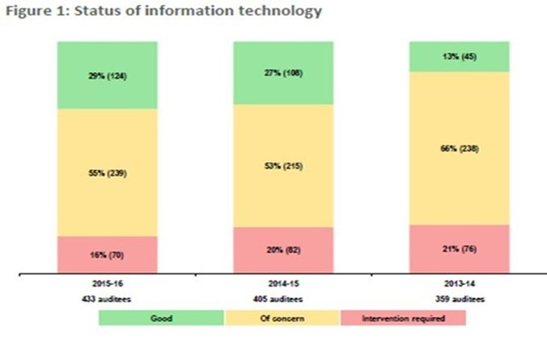

Slide 23
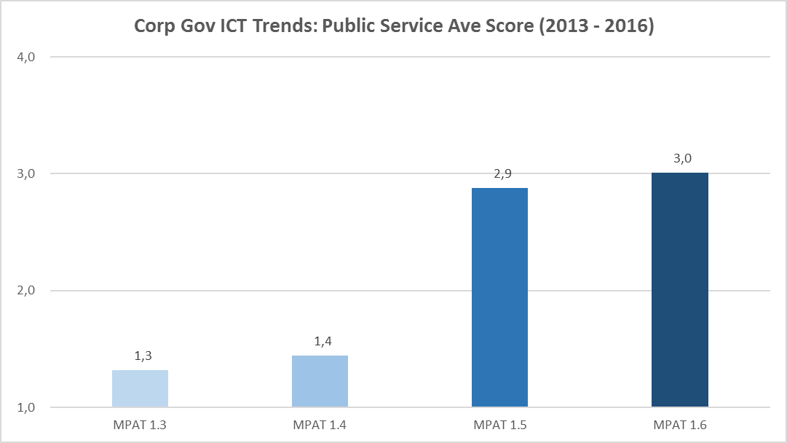

Slide 24
