Slide 1
PRESENTATION THE IMPORTANCE OF SETTING PROPER TARIFFS FOR REVENUE IMPROVEMENT
Local Government Budget Analysis – 8 November 2019

Slide 2
Tariff Setting
Proper Revenue Management play an important role in determining local government’s ability to fund their budgets & deliver services.
The ability of a municipality to generate its own revenue/income is an important sign of its independence, and can be enhanced through the appropriate setting of sustainable tariffs structures and suitable revenue streams.
Clearly, getting tariffs levels right and maximising the revenue available from tariffs is vital for ensuring financial sustainability.
Tariffs are also a key point of engagement between municipalities and the people that they serve.

Slide 3
What is the basis of a good tariff?
Revenue sufficiency. The main purpose of a tariff is to generate sufficient revenue to ensure that a service can be provided sustainably.
Economic efficiency. Efficiency is an economic term which means that tariffs must accurately reflect the costs incurred in providing a service.
Equity. This requires that people who are the same be treated the same and those who are different be treated differently. In tariff design, this means that users should pay for a service in proportion to the costs that are incurred in providing them with that service.
Fairness. An important characteristic of a good tariff that is often ignored by pure economic theory is fairness. In countries with large number of poor people, it is widely accepted that tariffs must be affordable in order to be fair.

Slide 4
Primary sources of municipal revenue

Slide 5
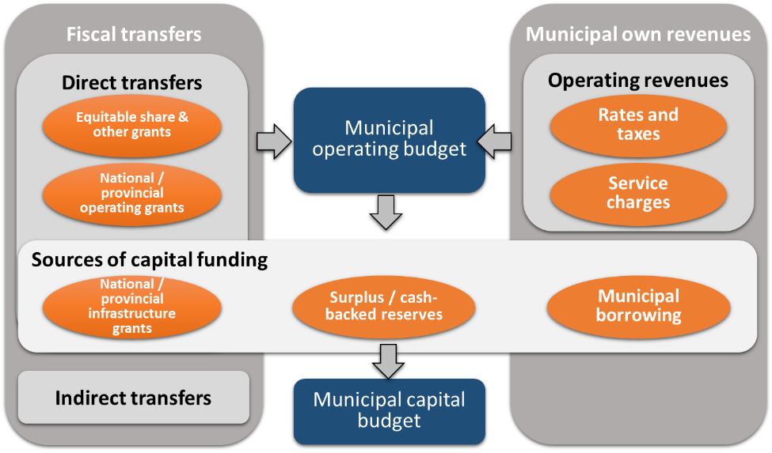
Local Government Fiscal Framework

Slide 6
Tariff Principles
Tariff principles are required to guide the tariff setting process. A summary of these principles based on national policies and legislation are presented in the table below:
Tariff setting principles
Principle
Description

Slide 7
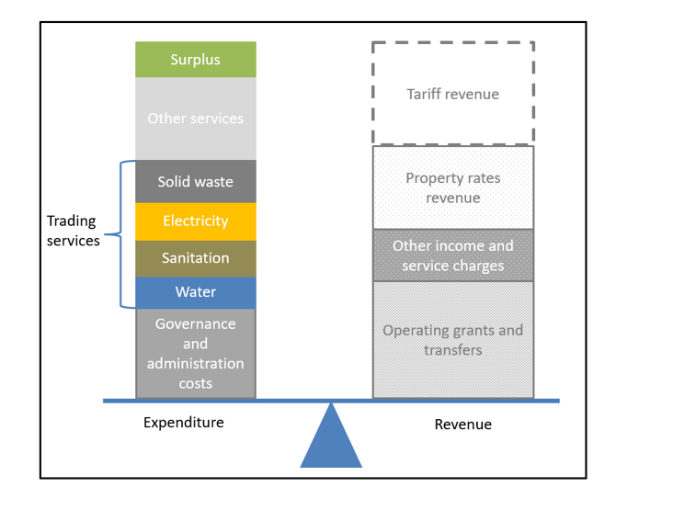
The Tariff Balancing Act
The municipal finance and fiscal system outlines the sources of revenue received and managed by municipalities
Tariff setting
Decisions about accepting profits or losses on services can only be made by looking at all services together, and ensuring that in balance the municipality will fully recover costs. Tariff revenue losses will be made on some services.
These must be balanced against tariff revenue profits on other services, as well as other income sources such as assessment rates and subsidies. Getting the balance right is one of the most difficult parts of tariff setting.

Slide 8
Cost Recovery Principles
The rationale for setting fees and charges at adequate levels is to promote financial stability by recovering all the costs associated with the rendering of a service.
Using cost accounting principles to manage the full cost of providing services enables a municipality to determine appropriate tariffs and ensures that the community receives fair value for the tariffs they pay.
Although it is important to achieve full cost recovery, adjusting prices to achieve equity considerations are important factors impacting on municipal pricing decisions and for determining the appropriate level of cost recovery for given services. This involves balancing the desire to distribute costs equally to all users who benefit from the service with ensuring equal access to those with less capacity to pay.
While full cost recovery represents the optimum pricing outcome, it is important to note that there will be situations where it is necessary to address socio-economic issues such as indigence by using a redistributive mechanism (cross-subsidisation). Even in cases where services are subsidised, it is important to calculate the full cost of the service to be able to determine the subsidy that is being provided.

Slide 9
Key Tariff Questions ?
To give effect to these pricing principles, and to make informed, rational decisions about the allocation of resources, councils need to be able to answer the following questions:
• Which costs should be recovered?
• Are these costs promoting the efficient allocation of resources?
• Are these costs allocated in a reasonable and equitable manner?
• How should these charges be structured?
• Have the primary and secondary costs associated with the tariff determination been considered?

Slide 10
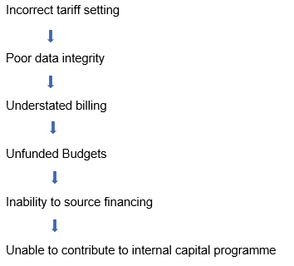
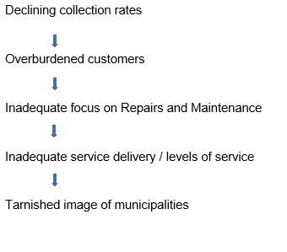
Ramifications / Consequences of Setting Wrong Tariffs = Revenue Decline Chain

Slide 11
A recent study on tariffs commissioned by NT (with selected municipalities in NW & GP ) revealed the following practices

Slide 12
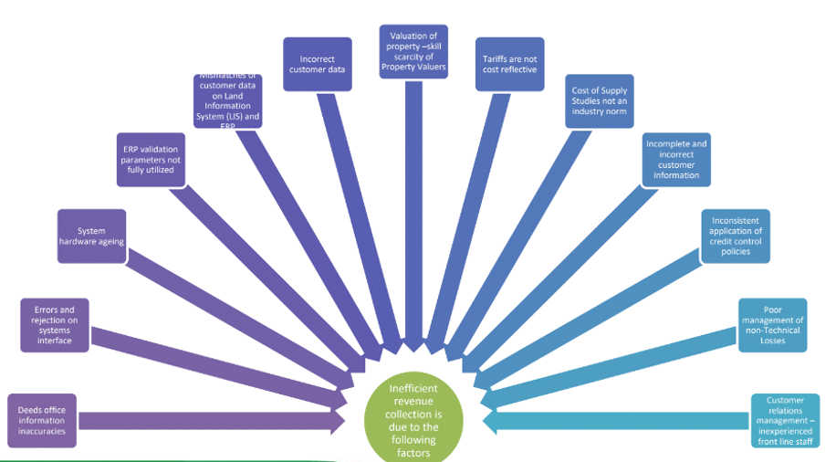
The IMTT technical team indicated the following reasons for inefficient revenue collections

Slide 13
Tariff Methodology
Implementing a successful full cost recovery methodology for tariff services requires a team effort by all department heads and officials. All personnel involved in the implementation need to understand the purpose of the methodology, as well as their role in it.
A prerequisite to any costing exercise is developing a clear description of the output or the process used for the production of goods and services. Without a clear definition, it is impossible to verify costs, compare alternatives or benchmark against similar services over time.
Municipalities need to understand the level (or standard) of service that is to be delivered, as well as the impact on sustainability in providing a service at that level. The higher the service level, the greater the impact on input costs, which ultimately results in higher tariffs for the consumer, which then impacts on affordability

Slide 14
The Development of Tariff Costing Models
Many municipalities assume that the development and maintenance of tariff costing models require significant resources. This is not necessary the case, as there are various options that can be used for full cost recovery calculation, ranging from a simple Excel spreadsheet to something more complex such as a full tariff costing module (specialist software).
The complexity of the design will solely depend on the following factors:
• The size of the municipality
• The staff capacity
• The level of information required
• The frequency at which costs are required
• The complexity and diversity of cost objects
• The reporting structure within departments
• The cost of maintaining the system.
The design of a costing system should focus on the magnitude, desired outputs, affordability and maintenance requirements of the system, as well as which information is useful, to whom and when.
• Are the cost recovery charges based on actual costs?
• Does the allocation method reasonably link to the level of service and/or benefit received?

Slide 15
Balancing Tariff Model Requirements
A higher level of complexity does not automatically imply that the method is superior.
A more complex system will yield more accurate results; however, a more granular approach may be more suitable.
The argument between accuracy and complexity needs to be balanced by adopting an approach that is manageable, not overly complicated and fit for purpose.
Ideally the operation must be as simple as possible, while providing maximum accuracy. As the demand for additional modelling capabilities and reporting mechanisms grow, more complex specialist software can be acquired. Therefore, the choice of a costing system will depend to a large extent on the particular municipality’s requirements.
BLOATED ORGANISATIONAL STRUCTURES = BLOATED TARIFF STRUCTURES

Slide 16
Future Initiatives
The National Treasury, LGBA unit Revenue Management Section have evaluated the existing tariff setting tools generally used by municipalities; and have commissioned the development of a fairly basic, standardized methodology and tool for utilisation by yourselves.
The tool is in its final stages of completion
It was this week presented to Provincial Treasuries, and sector departments, and will be rolled out soon

Slide 17
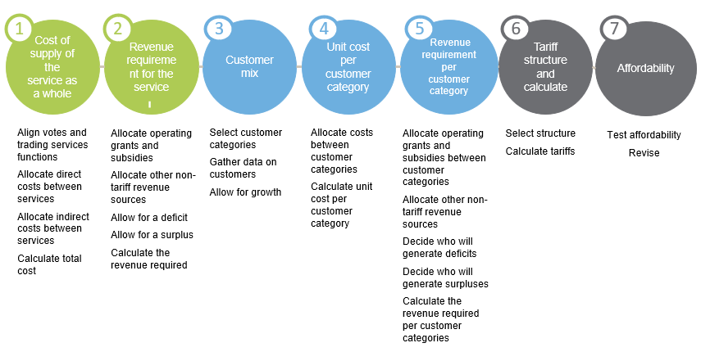
Steps to Setting Tariffs

Slide 18
Tarif Tool – Basic steps to determine cost reflective
tariffs
1
2
3
A credible budget
Determining a basic cost of supply
Determining the revenue requirement
Definition
Characteristics
Allocating indirect costs
Allowing for a surplus
4
5
6
Allocating non-tariff sources of revenue
Growth in volumes and customers
Calculating cost reflective tariff increases
Allocating grants and subsidies
Accounting anticipated growth
Weighted tariff increase

Slide 19
THANK YOU
For additional information on national and provincial budgets, please visit our new budget data portal: https://vulekamali.gov.za
For information on local government finances, please visit: https://municipalmoney.gov.za

