Slide 1
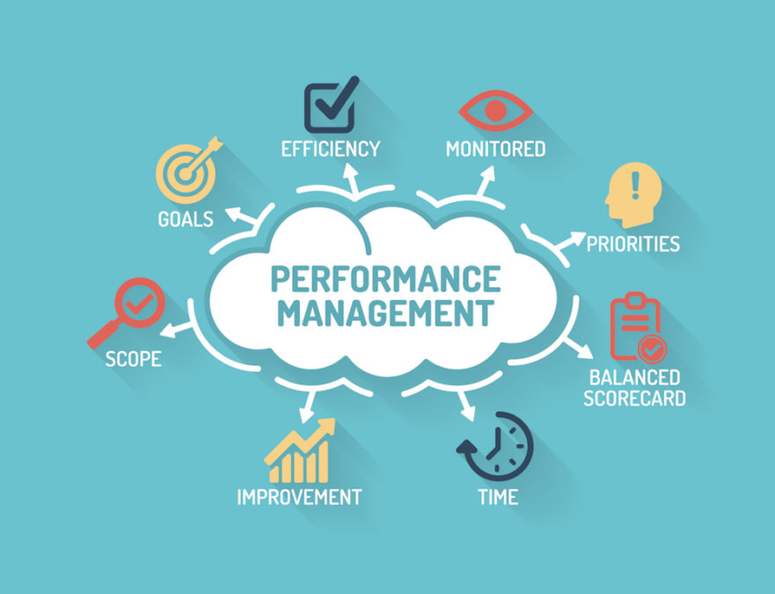
SDBIP PRESENTATION TO CIGFARO
29 JULY 2019
ZEBULA

Slide 2
PURPOSE OF PRESENTATION
To provide the legislative requirements for Performance Management in the local government environment
To outline the requirements for a credible Service Delivery and Budget Implementation as per the regulations
To provide for SMART Targets in the SDBIP as per FMPPI (WHAT, WHERE & WHEN)
To provide for the Indicators as per FMPPI( Verifiable, Reliable, Cost Effective etc.)
To reflect the alignment between SDBIP, IDP & BUDGET
To outline institutional arrangements for Performance Management and the role of various stakeholders in the performance management space

Slide 3
LG TRANSFORMATION TRAJECTORY

Slide 4
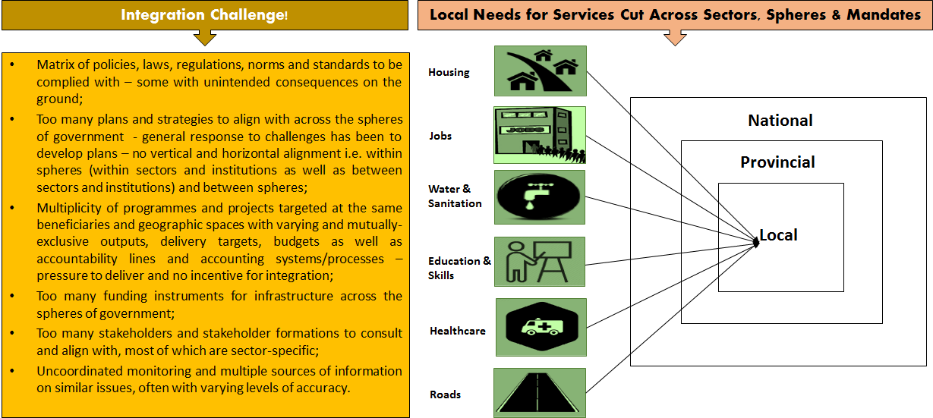
LOCAL GOVERNMENT PERFORMANCE ISSUES

Slide 5
LEGISLATIVE & POLICY CONTEXT-LOCAL GOVT. MANDATE

Slide 6
REQUIREMENTS FOR A CREDIBLE SERVICE DELIVERY AND BUDGET IMPLEMENTATION PLAN AS PER THE REGULATIONS
The provisions of MFMA define the SDBIP as a detailed plan approved by the Mayor of a municipality in terms of section 53 (1) (c) (ii) for implementing the municipality’s delivery of its service and annual budget and which must indicate:
Projections for each month of
(i) Revenue to be collected, by source and
(ii) Operational and capital expenditure by vote
b) Service delivery targets and performance indicators per quarter, and
c) Any other matter that may be prescribed including, and includes any revision for such a plan by the Mayor in terms of section 54 (1) (c)
In terms of section 53 (1) (c) (ii) the SDBIP must be approved by the Mayor within 28 days of the adoption of the IDP and Budget

Slide 7
OTHER KEY LEGISLATIONS WITH A BEARING ON PERFOMANCE
The Public Audit Act of South Africa (Act no. 25 of 2004 empowers the Auditor-General of South Africa to report material findings on the reported performance information against predetermined objectives for selected key performance areas presented in the annual performance report.
The AGSA performs procedures to identify findings on audit of performance information
The procedures address the reported performance information which must be based on the approved performance planning documents of the municipality

Slide 8
STATE OF PERFOMANCE IN SOUTH AFRICAN MUNICIPALITIES
The performance of the local sphere of government is an interesting aspect which is not only confined to government structures
Various non-government entities and the media have placed their radar on the performance of municipalities
Some of those entities include Ratings Afrika which has published The Municipal Financial Stability Index which assesses how the country’s municipalities manage their money, and how this impacts service delivery in those areas.
For the year ending June 2018 100 municipalities were sampled by Ratings Afrika, and 23 of the municipalities had budget surpluses while 77 had budget deficit. This report was extrapolated from financial statements submitted to National Treasury
Most of the municipalities with a surplus were from the Western Cape
Another think tank entity of great interest is called Good Governance Africa (GGA). In April 2019 they released Government Performance Index for 2019
GGA’s index ranks 213 local municipalities from best to worst based on how they deliver across three main indicators: quality of administration, economic development, and service delivery.

Slide 9
TOP TEN BEST PERFORMING MUNICIPALITIES 2019 INDEX BY GOOD GOVERNANCE AFRICA
MUNICIPALITY | PROVINCE | PARTY
1. Mossel Bay | WC | DA
2. Senqu | EC | ANC
3. Swartland | WC | DA
4. Sol Plaatje | NC | ANC
5. Greater Kokstad | KZN | ANC
6. Midvaal | GP | DA
7. Khai-Ma Local | NC | ANC
8. Bergrivier | WC | DA/KGP
9. Cape Agulhas | WC | DA
10. Prince Albert | WC | DA/KGP

Slide 10
BOTTOM TEN WORST PERFORMING MUNICIPALITIES 2019 INDEX BY GOOD GOVERNANCE AFRICA
NO | MUNICIPALITY | PROVINCE | PARTY
204 | Nguthu | KZN | IFP
205 | Umzube | KZN | ANC
206 | Mbizana | EC | ANC
207 | Engcobo | EC | ANC
208 | Matatiele | EC | ANC
209 | Nkandla | KZN | IFP
210 | Ntabankulu | EC | ANC
211 | Port St Johns | EC | ANC
212 | Umhlabawalingana | KZN | ANC
213 | Msinga | KZN | IFP

Slide 11
WHAT SEPARATES WORST PERFORMERS FROM BEST PERFORMERS?
Good governance practices (including, but not limited to, sound financial management, performance management and political oversight)
Proper systems (including, but not limited to, billing, IT etc)
Accountability
Municipalities which display the availability of the above happen to excel in their mandate while those that don’t have the above happen to encounter serious challenges including community unrests

Slide 12
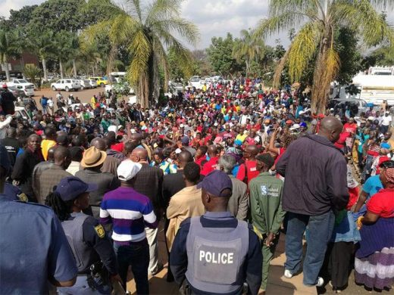
WHAT MAY HAPPEN IF COMMUNITIES ARE NOT HAPPY WITH THE PERFORMANCE OF A MUNICIPALITY
Poor performance management in a municipal environment may lead to a total breakdown in service delivery, with catastrophic consequences for residents and businesses, which in turn could encourage political unrest.

Slide 13
ALIGNMENT BETWEEN SDBIP, IDP & BUDGET
IDP is a Five Year Strategic Plan of the Municipality which amongst others constitute of projects to be implemented in a period of five years. It is a legally binding document given effect by the Municipal Systems Act( MSA) 32 of 2000
BUDGET:A municipal budget is the projected financial operating plan. In general, a budget accounts for expected revenues and allocates resources to particular expenditures
SDBIP: MFMA requires municipalities to prepare a service delivery and budget implementation plan as a strategic financial management tool to ensure that the budgetary decisions that are adopted by municipalities are aligned with the IDP strategy
The SDBIP serves to provide an implementation plan that covers all functional areas of the municipality and focuses on actual implementation and delivery with mechanism for regular review

Slide 14
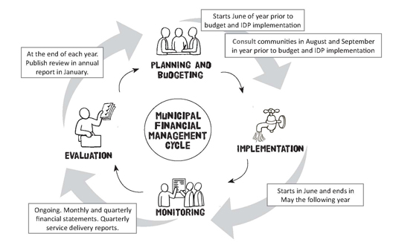
ALIGNMENT BETWEEN SDBIP, IDP & BUDGET

Slide 15
THE SMART PRINCIPLES OF THE TARGET
A useful set of criteria for selecting performance targets is the "SMART" criteria:
Specific: the nature and the required level of performance can be clearly identified
Measurable: the required performance can be measured
Achievable: the target is realistic given existing capacity
Relevant: the required performance is linked to the achievement of a goal
Time-bound: the time period or deadline for delivery is specified.

Slide 16
THE SMART PRINCIPLES OF THE TARGET
Performance targets express a specific level of performance that the institution, programme or individual is aiming to achieve within a given time period.
It is of utmost important as organizations to consider the level of performance recorded in the prior year when developing the current year performance targets
To have a SMART target in the SDBIP consider answering the three W’s in most of the external targets to be implemented like projects to be implemented to communities , i.e. the What? What is that we want to do as a Municipality, e.g. Km of a road constructed .
NB: It should be noted that it will depend on the type of Targets one is to develop, some targets might not still answer all the three W’s but still to meet a SMART Principle
Where? Answer the question in your target, Where is the road going to be constructed? e.g. at Mtsetweni
When? Address the question in your target? When is the road going to be constructed? By 30 June 2020
Therefore a SMART target will look like,
2.8 km Ring road constructed at Mtsetweni by 30 June 2020

Slide 17
THE SMART PRINCIPLES OF THE TARGET CONT…
Examples of other targets that did answer the three W’s but still meet a SMART principle:
Workshop tools purchased by 30 June 2020 , On this type of Target only two W’s are answered, i.e. the What and the When. The activity to be done is clarified that is purchasing of workshop tools, when they must purchased is also addressed that is by 30 June 2020 .
Another example of such target look like the following:
20 posts filled in lign with the approved Organogram by 30 June 2020
12 LLF Meetings convened by 30 June 2020

Slide 18
A GOOD PERFORMANCE INDICATOR SHOULD BE:
Reliable: the indicator should be accurate enough for its intended use and respond to changes in the level of performance.
Well-defined: the indicator needs to have a clear, unambiguous definition so that data will be collected consistently, and be easy to understand and use.
Verifiable: it must be possible to validate the processes and systems that produce the indicator.
Cost-effective: the usefulness of the indicator must justify the cost of collecting the data.
Appropriate: the indicator must avoid unintended consequences and encourage service delivery improvements, and not give managers incentives to carry out activities simply to meet a particular target.
Relevant: the indicator must relate logically and directly to an aspect of the institution's mandate, and the realisation of strategic goals and objectives.

Slide 19
EXAMPLES OF A GOOD IDICATOR
Indicators can be developed in a form of Percentage, Numbers or Measurable Objectives
Indicators as a measurable Objectives :To develop and review municipal policies and submit to Council for approval by 30 June 2020
Indicators in form of a percentage: % litigation cases attended to by 30 June 2020 ( Number of Litigation cases received by Number of Litigation Cases attended to)
Indicators in form of Numbers: Number of LLF Meetings convened by 30 June 2020

Slide 20
ROLES AND RESPONSIBILITIES

Slide 21
ROLES AND RESPONSIBILITIES

Slide 22
ROLES AND RESPONSIBILITIES

Slide 23
ROLES AND RESPONSIBILITIES

Slide 24
ROLES AND RESPONSIBILITIES

Slide 25
ROLES AND RESPONSIBILITIES

Slide 26
ROLES AND RESPONSIBILITIES

Slide 27
ROLES AND RESPONSIBILITIES

Slide 28
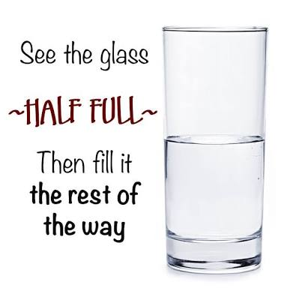
IMPLEMENTATION OF LIMPOPO LOCAL GOVERNMENT PMS…WHERE ARE WE AND WHERE ARE GOING, 2019/20 AND BEYOND?
The Municipalities are currently implementing performance Management System at organizational level and at the level of Senior Managers
Annually the organizations are developing the SDBIP which is the contract between the Council and Communities and on quarterly basis develop SDBIP progress reports to report progress on the implementation of the SDBIP
Quarterly reports are submitted to Council, COGHSTA and uploaded on Municipal website by Municipalities

Slide 29
IMPLEMENTATION OF LIMPOPO LOCAL GOVERNMENT PMS…WHERE ARE WE AND WHERE ARE GOING, 2019/20 AND BEYOND? CONT….
Most Municipality have developed nice policies and adopted by Councils
There are structures in place established for the implementation of performance management
Every year IDP’s, Budget and SDBIP are developed and approved by Councils in consultation with communities
Most Municipalities are implementing Performance Management only at Organization level
Most Municipalities every year plan to cascade the implementation of Performance Management below senior managers
NB:Collins Chabane Local Municipality appointed the Service Provider for the development of Automated Performance Management System and the Municipality will be automating performance management system and cascade it to level below senior managers and maybe other municipalities also can learn from what we are doing as the Municipality or we can also learn from other Municipalities the best practices

Slide 30
2019 BUT MOST MUNICIPALITIES ARE STILL IN 2000

Slide 31
WHAT NEEDS TO BE DONE TO TURN THE SITUATION AROUND?
We need to have proper systems in place
All stakeholders to play their roles and responsibilities
Development and Policies and Implementation of such policies
Performance standards and performance targets should be specified prior to the beginning of a service cycle, which may be a strategic planning period or a financial year
The institution and its managers know what they are responsible for, and can be held accountable at the end of the cycle
Targets need to be set in relation to a specific period.
An institution should use standards and targets throughout the organisation, as part of its internal management plans and individual performance management system

Slide 32
NDZA NKHENSA

