Slide 1


Assets - Alignment of Finance and Engineering Outcomes for Effective and Efficient Service Delivery
ALIGNING THE ENERGY REVENUE VALUE CHAIN TO FACILITATE FINANCIAL SUCCESS
PRESENTED BY DR. FRED FRYER
+27 82 821 4807
Notes:
Read title
Link to assets

Slide 2
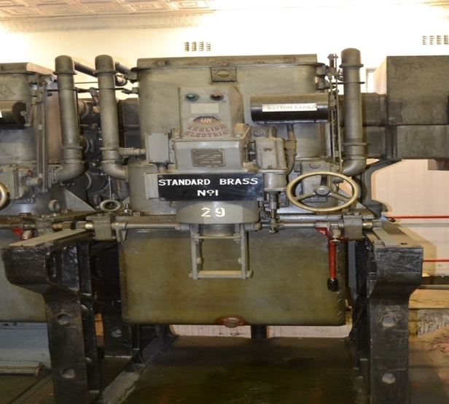
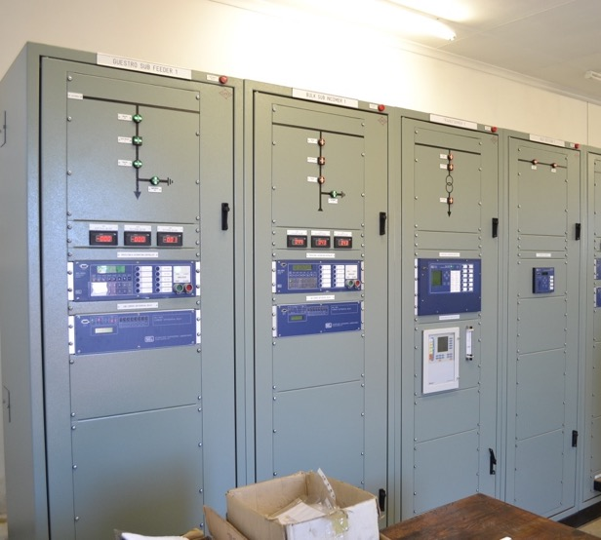
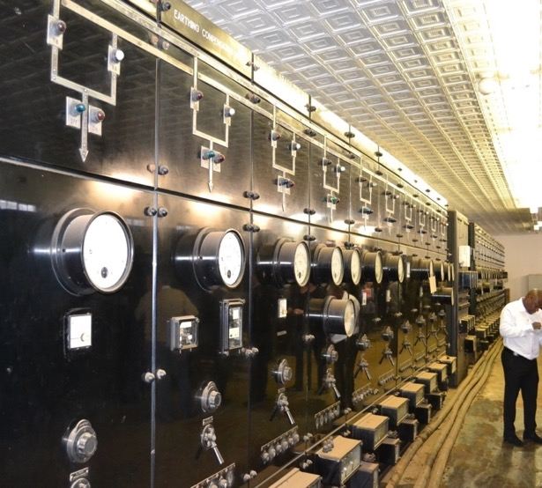
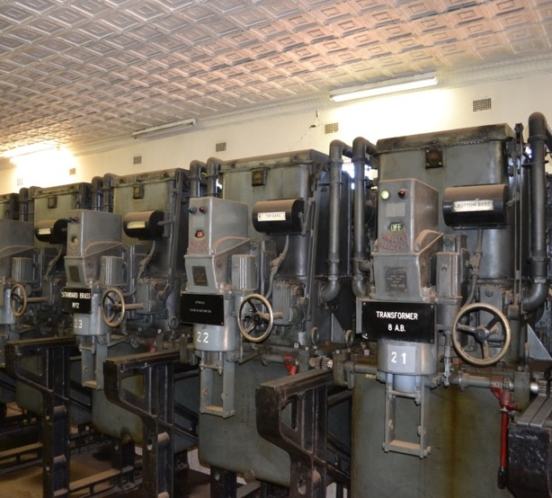
WHY DO WE NEED TO MAINTAIN INFRASTRUCTURE?
An electricity grid is enduring and tolerant, it will persevere and withstand long-time abuse
Many grid transformers are overloaded for many hours in a day, possibly even to twice its rated capacity
When load is increased the windings heat up, when load decreases, they cool down
In most cases, it will take many years to destroy a transformer
BUT, when it finally lets go…
Notes:
Quick

Slide 3
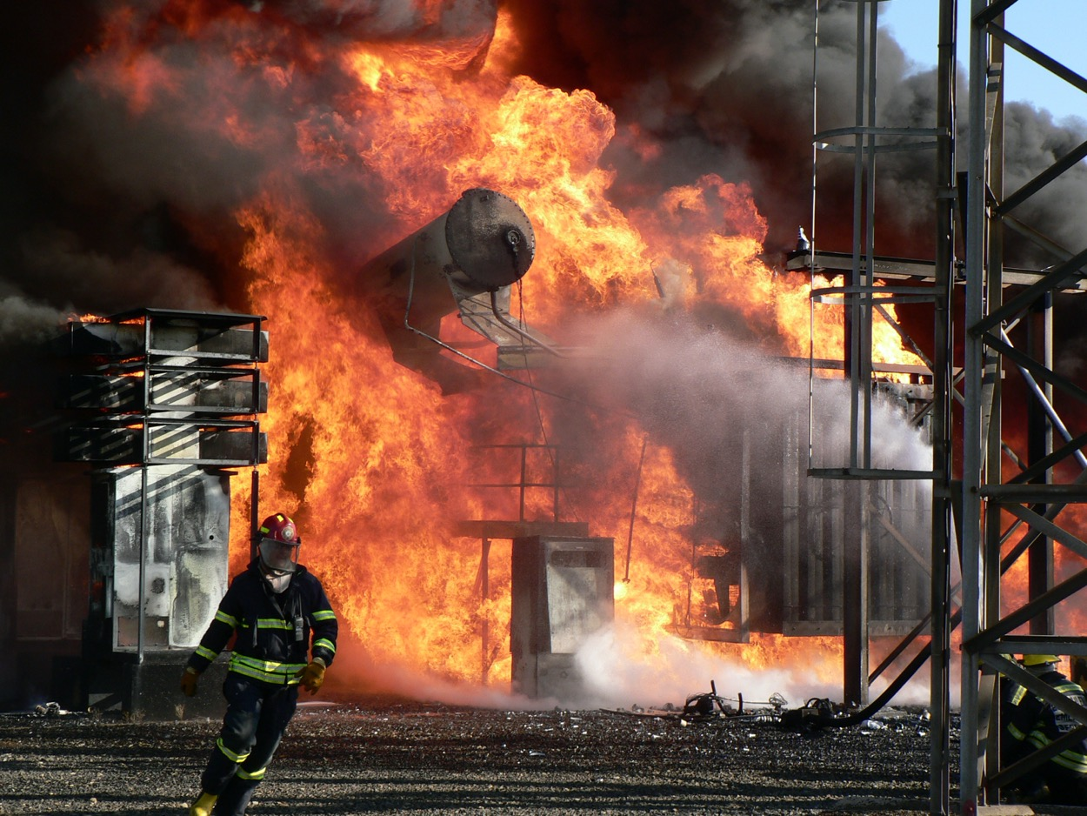
IT COULD BE A BIT OF A TRAIN SMASH…
Notes:
Quick

Slide 4
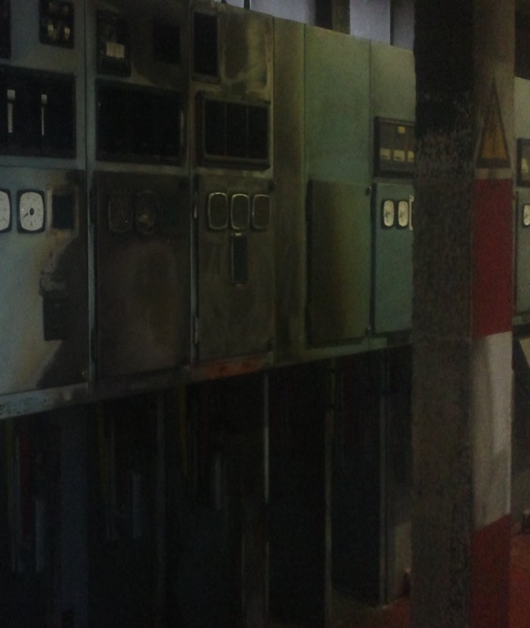
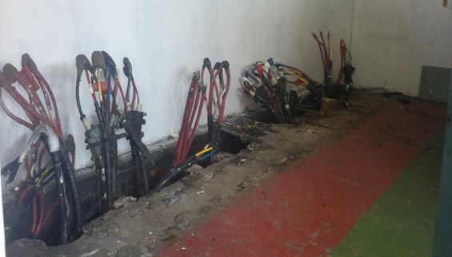
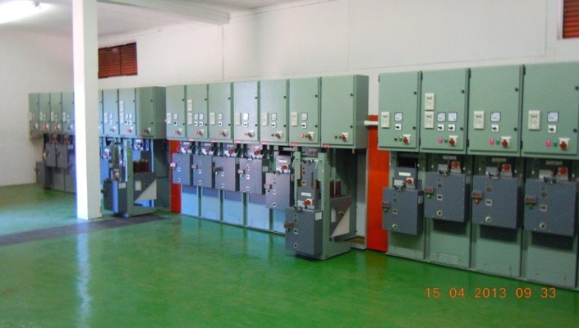
SUBSTATION – CATASTROPHIC FAILURE
Left: Substation after 6,6kV cable end failure
Top right: Substation after damaged switchgear were stripped away
Bottom right: Refurbished substation
This event occurred in a CBD, the power was off for a week.
It was a costly exercise.
It was a customer relations nightmare.
Notes:
Quick

Slide 5
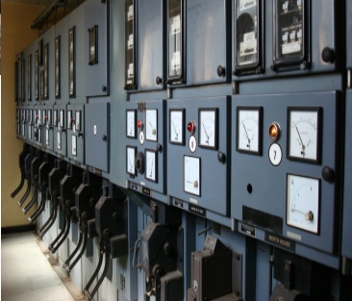
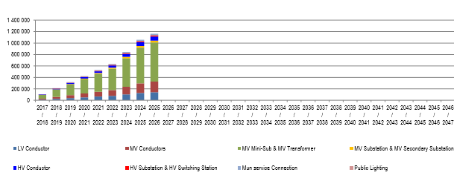
SEVERITY OF THE INFRASTRUCTURE BACKLOGS (QUANTIFY BACKLOG)
The heading is an exact Moody’s Rating Agency question to a municipality.
When it comes to infrastructure asset management, most municipalities will have some form of quantification of what is required, and at what cost.
The green section below refers to Medium Voltage mini-substations and transformers, in this illustration R700 million will be required to be spent in the year 2025.
That is, if R600 million was spent in 2024, and R500m was spent in 2023.
If not, the values accumulate…
Income from the sales of electricity can fund asset maintenance.
Dr. Fred Fryer
+2782 821 4807
Notes:
Brief

Slide 6

THE ENERGY REVENUE VALUE CHAIN
This paper aims to discuss the Energy Revenue Value Chain, AND make recommendations on the final slide.
Finance and Engineering are close partners, also several other support functions such as Legal, (Metro) Police, HR, Internal Audit and more.
AND so are National Treasury and other Government Departments.
When the various revenue components are managed properly, the additional income will change any municipality to the better.
A better financial position enables a municipality to achieve its many obligations.
This is not an impossible task – one person can make a difference with committed support from political heads and senior management.
Notes:
Each point

Slide 7
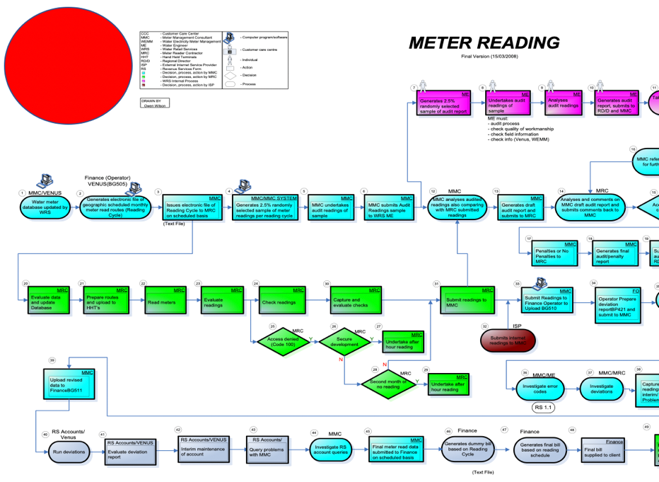
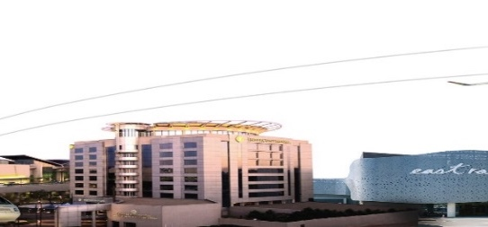
THE ENERGY REVENUE VALUE CHAIN
“Exactly how difficult can it be to read my meter and then provide me with an accurate bill?”
Honestly speaking, it could be a handful…
There are many components to be managed before electricity revenue will become sustainable, such as…
Dr. Fred Fryer
+2782 821 4807
Notes:
Quick

Slide 8
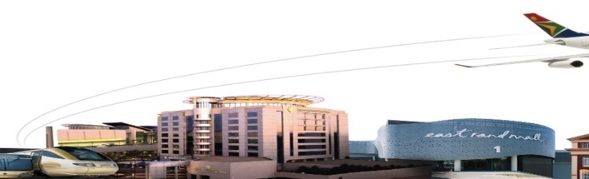
ENERGY REVENUE PLAN – detailed and practical strategy on main and back-office supportive projects
ENERGY BALANCE METHODOLOGY APPROVED BY COUNCIL - provides a true reflection on losses, specifically non-technical losses
TARIFFS, BUDGETING AND FORECASTING – critical elements
PART OF SDBIP – in addition, micro performance management via KPI’s, largely on loss mitigation
SUPPORTIVE POLICIES, PROCESSES – e.g. a Residential metering policy, additional standard operating procedures, electronic workflows and more
ELECTRICITY BY-LAWS – legally supporting and guiding Energy and the City / Town
DAILY OPERATIONAL ASPECTS – such as un-bypassing meters, issuing and managing reinstatement fees, repairs to meters, more
CAPITAL BASED PROJECTS – larger projects in specific areas, numerous smaller projects (meters, protective structures in the main)
RISK MANAGEMENT AND RISK MITIGATION PROJECTS – very high levels of risk exist, related to the various forms of metering and their supportive systems, tariff levels, and more
EVER-INCREASE THE RISK FOR INTERFERING WITH A METER – tampering must carry a high risk to the user of the electricity, e.g. once off penalty, plus back-billing, possible criminal prosecution
DEALING WITH ILLEGAL CONNECTIONS – consistent removal, mitigation in terms of access points, prosecution, and
SKILLED RESOURCES TO PLAN AND EXECUTE – this plan comes to naught, unless highly skilled resources are retained, and highly skilled external resources are contracted.
BILLING AND COLLECTION – Finance
Dr. Fred Fryer
+2782 821 4807
Notes:
Briefly, do not mention every point
These points ARE your revenue plan
Dealing with them WILL yield positive results

Slide 9
THE MAIN ENERGY REVENUE VALUE CHAIN COMPONENTS
CORE | SYSTEMS | PROJECTS | CONTRACTS | GOVERNANCE | DEPENDENCIES
Technical Skills | Prepayment Vending System | Day to Day Audits | Automated Meter Read | Political Leadership | Political Leadership
Effective Management | Smart Meter System | Conventional Meter to Prepayment (or Smart) | Meter Management | NERSA | Finance (billing, collection, budget, supply chain)
Reduce Losses | Finance Billing System | Large Users on AMR | Meter Installation | By-laws, Policies, Standard Operating Procedures | ICT (communication, hosting, etc)
Innovate | Business Process Management | Replace Faulty Meters | Meter Read | Revenue Plan | Metro Police
Tariffs | Geographical Information System | CAPEX, restore and protect meter integrity | Third Party Vending | Energy Balance | Legal
Budgeting | Complaint Management | Remove Illegal Connections | Material Supply (many) | Risk Management | HR
KPI’s | Large Power User Fault Management | Un-bypass Meters | Free Basic Electricity (Eskom supply areas) | Internal Audit | Energy (Operations and Maintenance)
Eskom Bulk Purchases | Reporting Software | Prosecute Customers with Bypassed Meters | Meter Seals | AGSA | Energy (Planning)
Track Sales | Meter Fraud Detection Algorithms | Back-billing of Lost Units | Prepayment Vending System Maintenance |  | SAPS / Courts
Predictive Analysis | SCADA or Power Outage Detection | Interim Readings Eradicate | Smart Meter System Maintenance
Defend Rights to Supply and to Surplus |  | Check Meters on Eskom Supply Points
Dr. Fred Fryer
+2782 821 4807
Notes:
Mention CORE, PROJECTS, CONTRACTS, brush over the rest

Slide 10
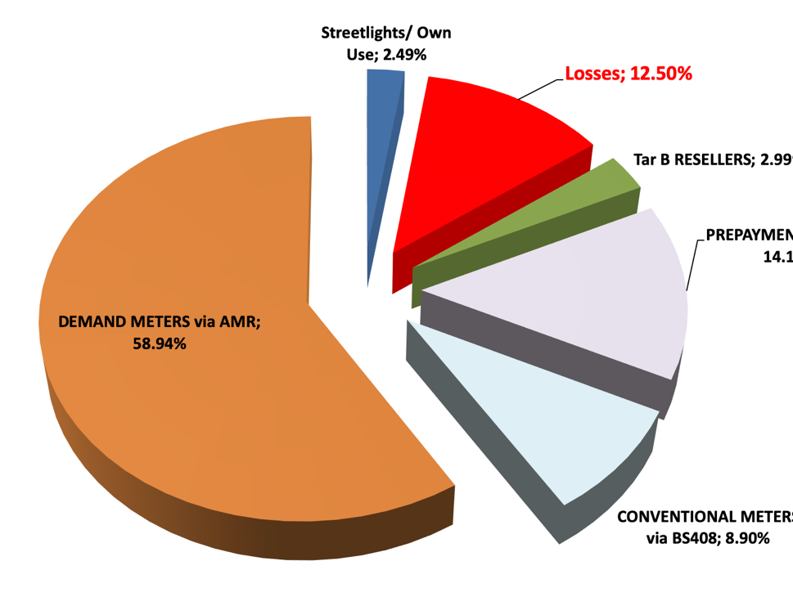
1. THE ENERGY BALANCE AND ITS SEGMENTS
CRITICAL FIRST STEP
CREATE ON EXCEL
SELECT CUSTOMER SEGMENTS TO HELP WITH ANALYSIS
CAN IT BE DONE IN THE BILLING SYSTEM?
Notes:
Quick

Slide 11
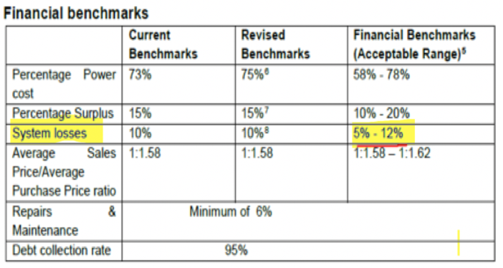
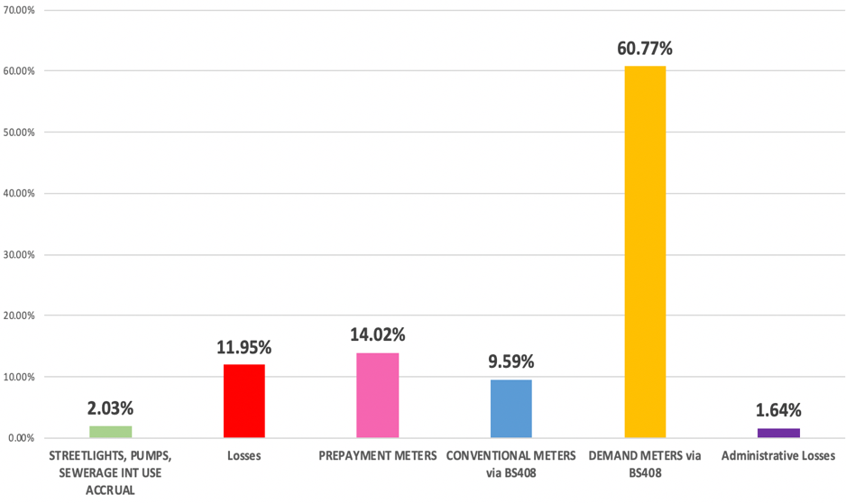
ENERGY BALANCE: ELECTRICITY KILOWATT-HOUR LOSSES (target is 12%)
LOSSES ARE SIMPLY THE DIFFERENCE BETWEEN UNITS BOUGHT AND UNITS SOLD
Technical – heat in cables, transformers, etc
Non-technical – illegal connections, billing errors, bypassed meters, etc
  The segments chosen for the example municipality are shown in the graph (from the left):
    Street lights and own use (est) – 2,03%
    Total losses – 11,95%
    Prepayment metering (exact value) – 14,02% (319,433 meters)
    Conventional meters (exact value + est) – 9,59% (87,171 meters)
    Large Power Users (exact value) – 60,77% (9,884 meters)
    Admin losses – recovered units after meter faults were corrected*
Dr. Fred Fryer
+2782 821 4807
Notes:
GRAPH ONLY

Slide 12
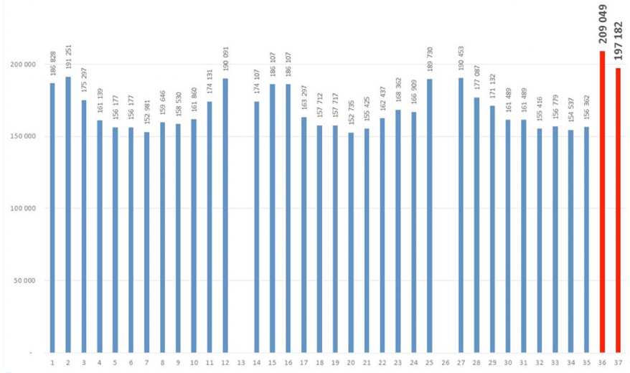
ENERGY BALANCE: MANAGE THE ESKOM POINTS OF DELIVERY
The ESKOM supplied units form part of the Energy Balance.
It is very important to install check meters on the Eskom infeed point(s).
If Internal Audit did not have a finding on this in the past, they are bound to produce one soon.
There will be numerous technical obstacles to overcome, but understanding the exact Eskom supply profile is a critical part of managing electricity kilowatt-hour unit losses.
The graph is an example of a second reason for check metering. The blue lines show two normal years at a large infeed point. The third year shows a 50,000 kVA increase, completely unexpected. The readings returned to normal two months later.
Dr. Fred Fryer
+2782 821 4807
Notes:
READ most points

Slide 13
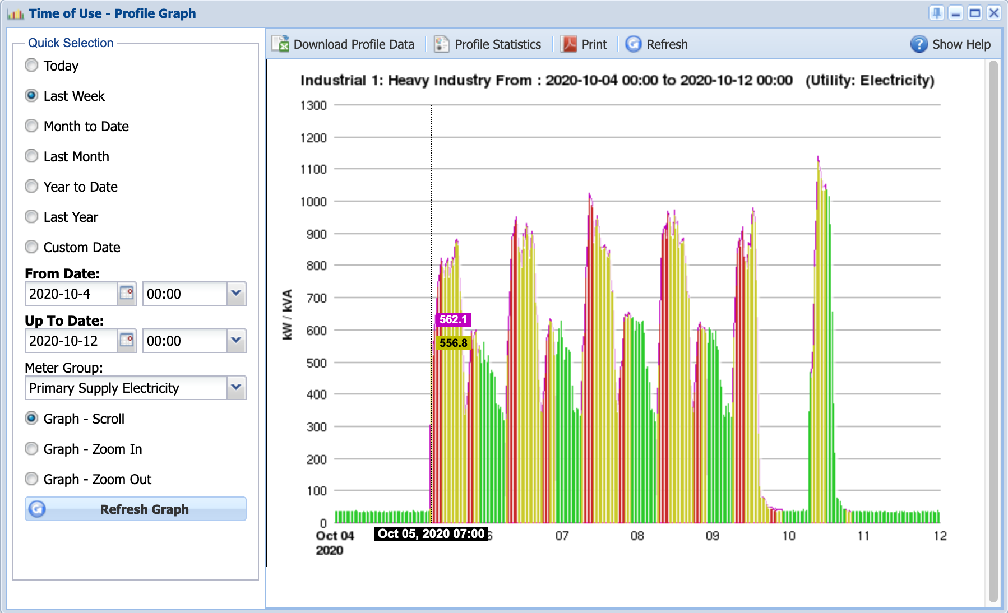
ENERGY BALANCE: LPU SEGMENT METERING (1)
Large Power Users are often sophisticated users of electricity. Expect to find electrical engineers and chartered accountants in their direct employ, or on contract. Given the cost of electricity, such appointments make financial sense.
In 2020, the days of forcing this segment of customer to pay a vague or unsubstantiated account are over.
The software and skills required to manage daily exceptions are just not within the reach of a municipality.
The next number of slides aim to bring across the depth of this statement.
The meter and its configuration are important, but equally so is the multiplication values that may be stored in the billing system, accurate uploads, i.e. do each register find each other correctly every month? This point is the source of huge losses, often continuing over decades. TOU vs 3-part tariffs…
Unless your LPU meters are in exceptional hands, there is a 100% chance that they are under-reading in more instances than you can afford.
Dr. Fred Fryer
+2782 821 4807
Notes:
Longer
Focus on 100% chance statement

Slide 14

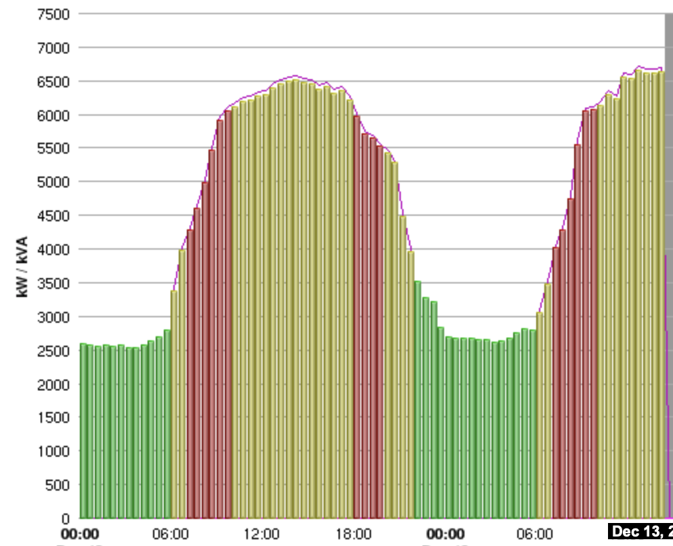
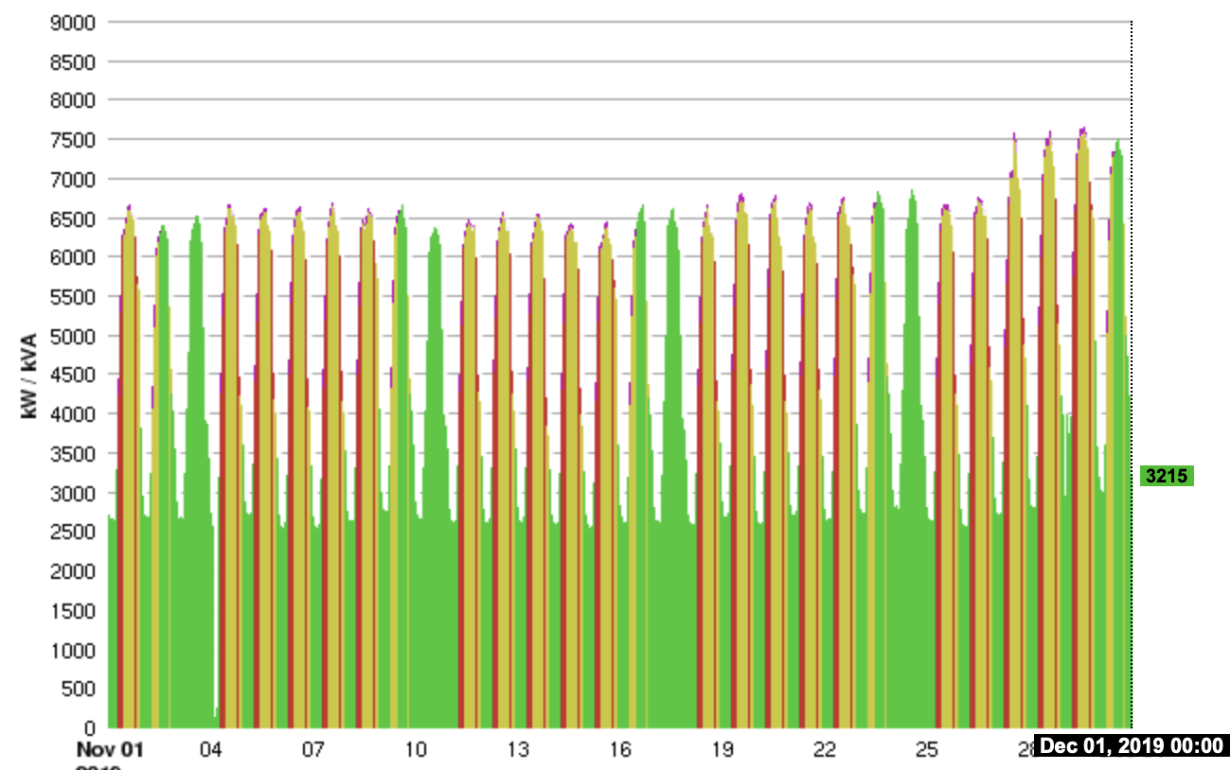
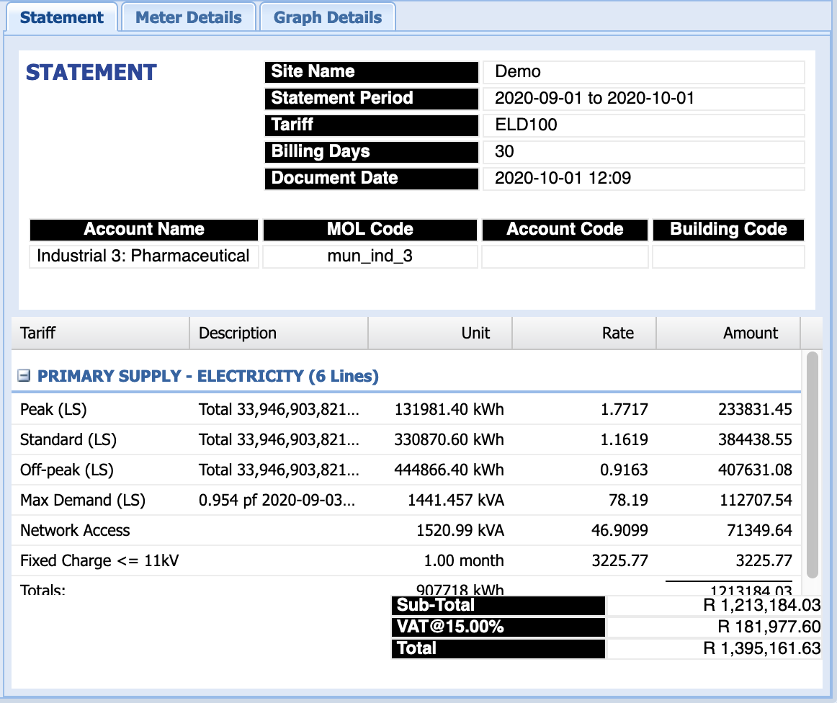
ENERGY BALANCE: LPU SEGMENT METERING (2)
The meter read data must be displayed on the web in various formats ranging from the raw 30 minute data to scalable graphs and account values
The profile and account for a large shopping centre are shown in this slide
Dr. Fred Fryer
+2782 821 4807
Notes:
Discuss shopping centre
Every day identical
Note end of month increase
Daily profile

Slide 15
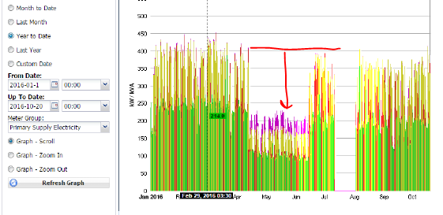
ENERGY BALANCE: LPU SEGMENT METERING (3)
These users must be measured in 30 minute intervals, therefore a set of readings is uploaded from the meter 1,440 times per 30-day month (2 reads/h x 24h x 30d).
If less than 1,440 reading sets are counted, a reason must be determined for the missing periods, eg power outage related? If not, the gaps must be accounted for by either re-reading the meter, or by creating a correction report that will be journaled to the account.
The 30 minute data is summated at the end of each calendar month into billable readings.
This type of data makes it very difficult for a consumer to question readings and takes away many of the opportunistic challenges experienced in the pre-data era (and legal action).
A list of meter / installation failures must be kept electronically and actioned and tracked daily by several responsible teams.
The graph shows an actual business customer, annual account about R3 million.
There is an event where the meter wiring was deliberately cut and buried in the wire trunking, this tamper was found and back-billed with R245,000.
Dr. Fred Fryer
+2782 821 4807
Notes:
Discuss
1440 readings in 30 days
If there are less, they must be accounted for
Discuss graph

Slide 16
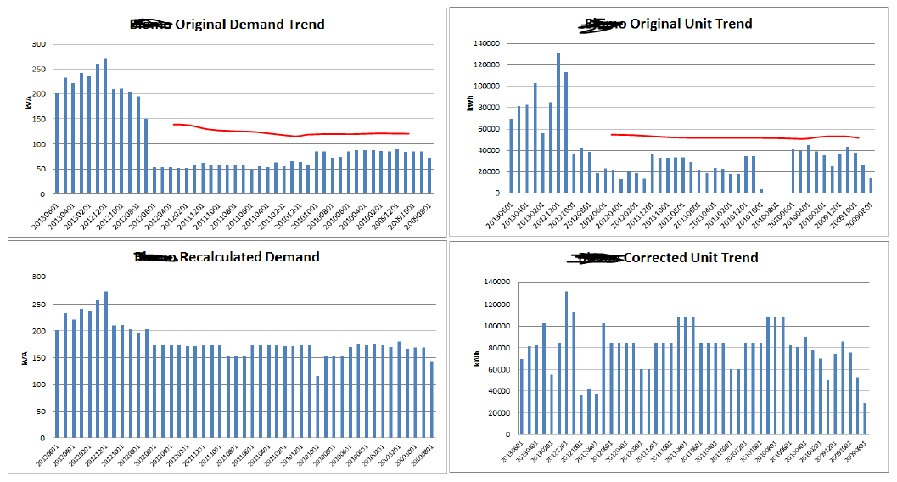

ENERGY BALANCE: LPU SEGMENT BILLING CORRECTION (4)
When a meter or one of its components fail, the consumption (and account) can be reliably reconstructed, based on the large volume of data collected
The correction report should be discussed with the customer and billed by Finance
Back-billing raises the risk of tampering with a meter
Link this function to the by-laws
Dr. Fred Fryer
+2782 821 4807
Notes:
Discuss briefly
Top 2
Bottom 2

Slide 17
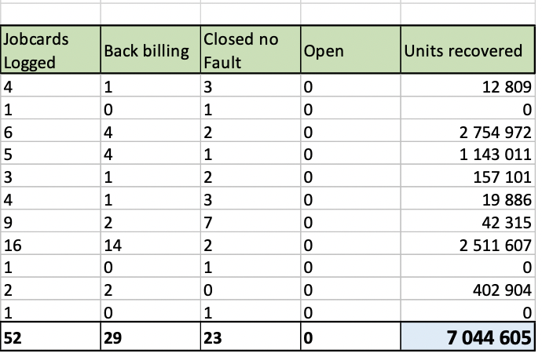
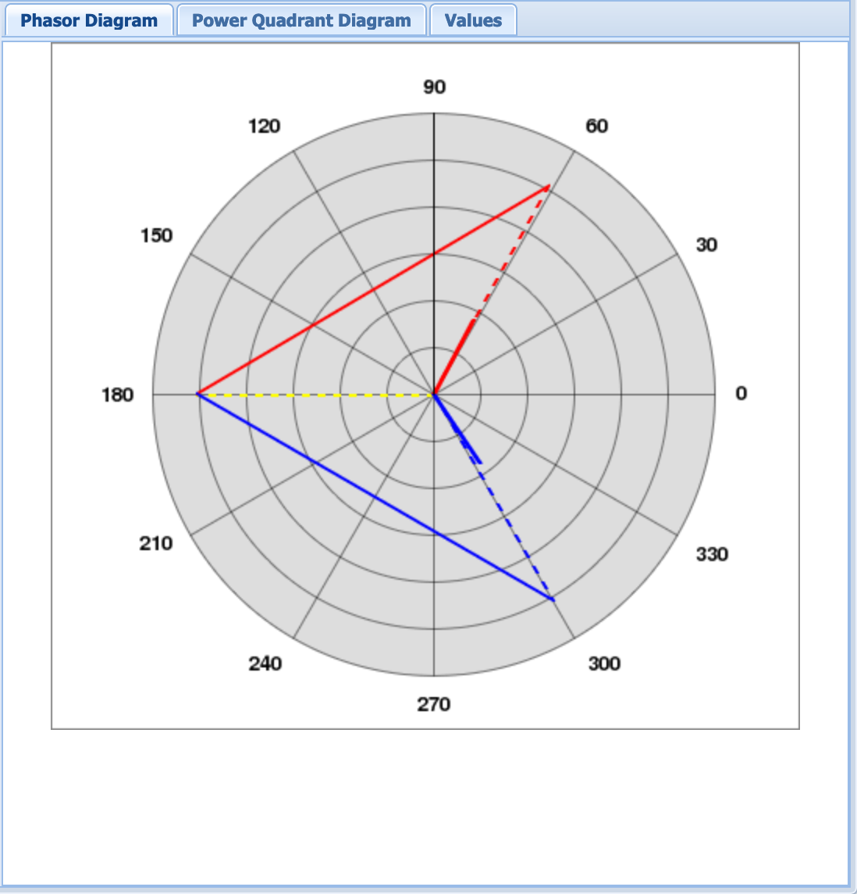
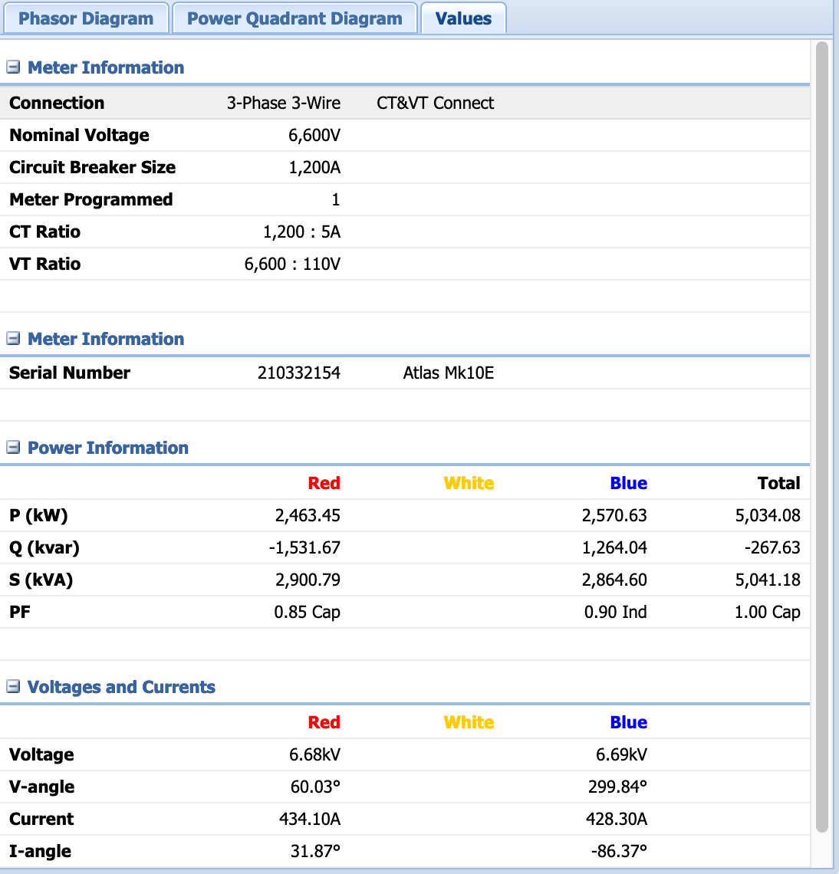

ENERGY BALANCE: LPU SEGMENT BUSINESS INTELLIGENCE (5)
The meter faults found by this type of data analysis are the kind that are humanly impossible to find.
For example, a dry joint inside a meter that intermittently creates full contact and then again partial or no contact, resulting in under registration of units on the meter (factory defect).
7 million units recovered within 3 months.
Relationship between voltages and currents.
The left hand diagram shows the expected angles associated with 3 wire metering – 2 phases, balanced, 120 degrees away from the yellow phase.
These diagrams confirm the correctness of the meter wiring.
Dr. Fred Fryer
+2782 821 4807
Notes:
Discuss briefly

Slide 18
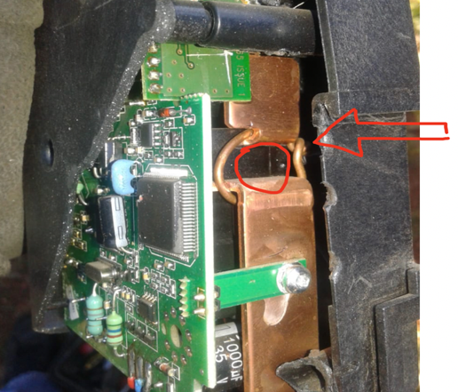
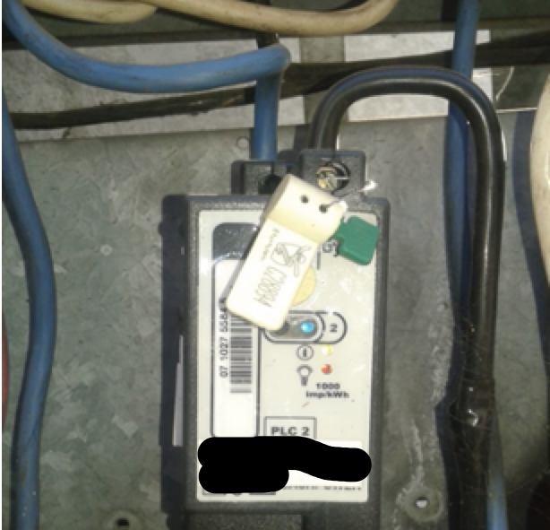
ENERGY BALANCE – MANAGE THE BYPASSING OF SPU METERS
  Random isolated properties where Small Power User meters are bypassed to defraud the municipality of income – these are often in upper and medium income areas
  Meter is bypassed using innovative methods
  And the customer still purchased (often > R500) per month to mislead the municipality:
    This meter is a typical example – the customer denied any knowledge.
    A likely estimate would be that this customer defrauded on an amount of R2,000 per month, or R24,000 pa, AT THE VERY LEAST.
    There are thousands of these bypassed meters.
THIS PROBLEM CAN BE MANAGED BY:
Algorithms to identify these meters
Metro Police assistance when required
Criminal prosecution
BUT
  This exposes a fatal flaw in pre-smart STS prepayment metering. Meters with two-way communication (smart) will be the only solution to this growing problem.
Dr. Fred Fryer
+2782 821 4807
Notes:
Discuss
Fatal flaw in pre-smart prepayment

Slide 19
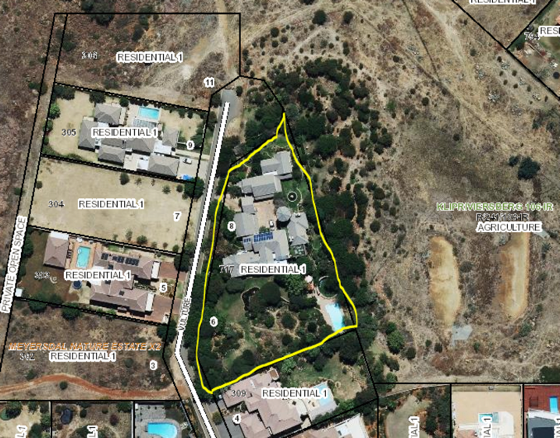
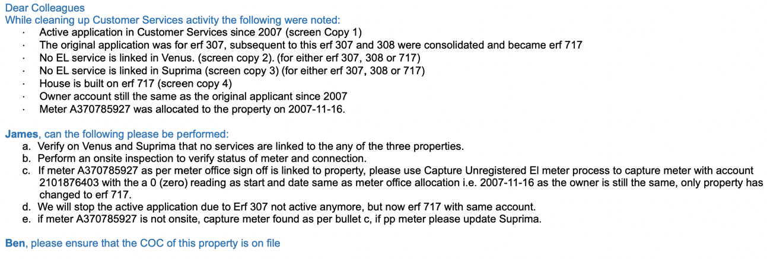
ENERGY BALANCE: SPU METERS - ANALYSE ACCOUNTS ON THE BILLING SYSTEM
Complicated account situations exist in the billing system and these need to be resolved
This high end residential stand was found with no electricity service linked
The data was corrected in the billing system and the prepayment vending system
The root cause was that the BPM process was not concluded
Dr. Fred Fryer
+2782 821 4807
Notes:
Discuss
High end residential property
2007, no electricity meter on any system

Slide 20
ENERGY BALANCE: GENERAL POINTS
The previous slides focused on LPU meters and touched on SPU meters.
Each of these two segments warrants its own presentations.
The Energy Balance will also have at least the following segments:
  Municipal own use - estimate street lights truthfully, eg One 125W MV lamp uses 150W, for 10hrs a day for 365 days. At other municipal points, install AMR meters where possible. List the points that remain and transparently estimate consumption for each.
  Conventional electro-mechanical meters – manually correct out-shooter accounts (eg a house using 1 million units this month). Interims, or estimated readings for meters complicate this segment, especially if they continue for many years without a reading.
  When a faulty meter is located and repaired, the account should be back-billed (check by-laws, they differ). These estimated units have now been “found”. They should be factored back into the Energy Balance over the last 12 months. *If back-billing was for 36 months, only 12 months can be factored in.
Can the Energy Balance be done in the billing system?
  Yes, but a fully automated process will need to take at least the above into account.
  A degree of manual intervention may be required, with an audit trail.
Always keep an audit trail of units included.
Dr. Fred Fryer
+2782 821 4807
Notes:
Brief on indented bullets

Slide 21
2. TARIFFS, BUDGET, FORECAST
STATISTICAL DATA MUST BE CAPTURED
TARIFFS SHOULD FOLLOW ESKOM
TAKE CARE NOT TO SELL FOR LESS THAN YOU PURCHASE

Slide 22
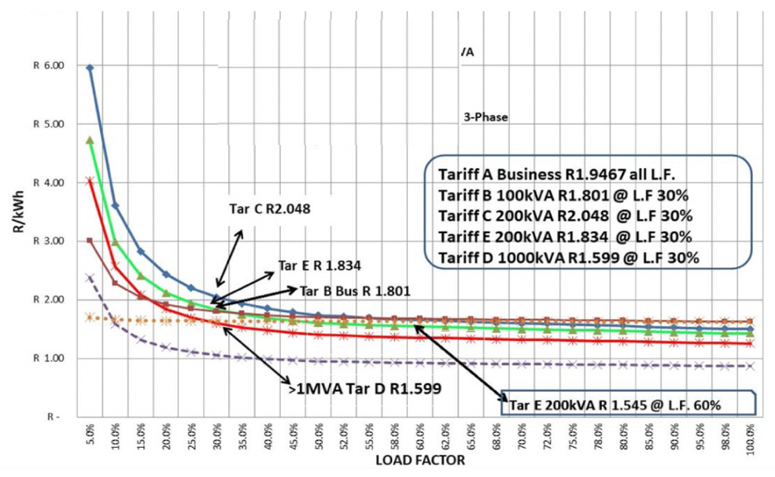
ENERGY TARIFFS ENSURE INCOME
The lowest line on the graph shows the Eskom purchase rate at all load factors.
The business tariffs all show a clear markup on Eskom, at all load factors.
This is a healthy set of tariffs:
  There is a markup on every sales tariff.
  At every load factor.
  And it follows the Eskom pricing signals.
Although this sounds logical, there are instances where municipalities under-recover.
Dr. Fred Fryer
+2782 821 4807
Notes:
Tariffs should follow Eskom
Discuss

Slide 23
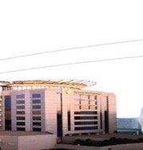
BUDGETING AND FORECASTING – maintain stats
Only one method will ensure that the municipality moves towards accurate budgeting and forecasting.
That is the careful capturing of all key data on an Excel spreadsheet.
This must be done for every month, for every year and must never stop.
The data must be as detailed as possible, without capturing useless information.
Examples of this data would be:
  On its own sheet, Eskom kWh in peak, standard and off-peak
  All forms of demand
  All tariff components, numbers and costs
  Derive average c/kWh and any other useful statistics.
For the municipal sales statistics:
  Per tariff, at least the kWh sold per month
  Demand values sold
  Other tariff components, numbers and costs
  Derive average c/kWh and any other useful statistics
  Determine future sales by adding growth
  Losses will increase unless they are managed…
Create graphs to track deviations.
Dr. Fred Fryer
+2782 821 4807
Notes:
brief, keep stats NB

Slide 24
3. PART OF SDBIP
PROGRESS MUST BE PROVEN
PROPER KPI’S ARE NEEDED
LIGHTWEIGHT KPI’S ARE A WASTE OF GOOD TIME

Slide 25

SUGGESTED KPI’S AND MOTIVATION
KPI 1: DEMAND METER UPLOADS > 97%
    LPU’s could account for 60% of total income from electricity sales, often small meter volumes.
KPI 2: TURNAROUND TIME TO REPAIR FAULTY LPU METER <30 DAYS
    This aspect is often neglected. Bill corrections done months later are almost always disputed and sometimes lead to legal action.
KPI 3: PREPAYMENT METERS BYPASS RATE <12%
    This measures the larger meter volume segment, SPU’s but thousands of them.
KPI 4: ELECTRICITY UNIT LOSSES <12%
    The most important revenue related KPI.
KPI 5: BILLED VALUES COMPARED TO PREDICTED VALUES <5% DEVIATION
    This will test the accuracy of forecasting, which is very critical for a municipal budget.
KPI 6: NUMBER OF ILLEGAL CONNECTIONS REMOVED
    This may not always be a popular KPI but ignoring the problem will see it grow. There is an OHS factor involved.
Dr. Fred Fryer
+2782 821 4807
Notes:
Good set of KPIs discuss

Slide 26
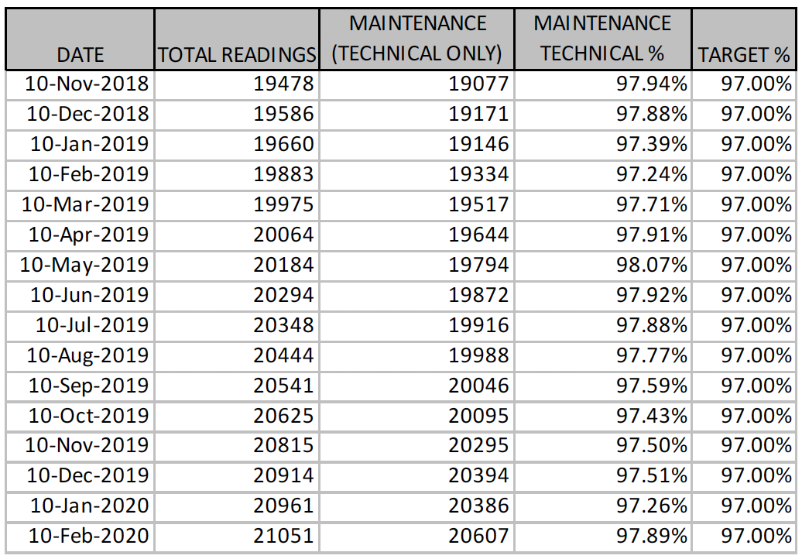
KPI 1 FOR LARGE POWER USERS - ACTUAL EXAMPLE OF MONTHLY SUCCESSFUL UPLOAD VALUES INTO A BILLING SYSTEM
It is critical for meter reads to translate into accurate monthly billing.
A target of 97% accurate uploads can be set once processes are in place.
Note the volume of total readings uploaded every month, >20,000.
For example, the last row shows that 21,051 readings were expected by the billing system, but 20,607 were loaded.
The missing readings relate to faulty meter installations that must be repaired.
Dr. Fred Fryer
+2782 821 4807
Notes:
Quick

Slide 27
4. SUPPORTIVE POLICIES AND PROCESSES
THIS A NEGLECTED ASPECT
SPEAKS TO GOOD GOVERNANCE

Slide 28
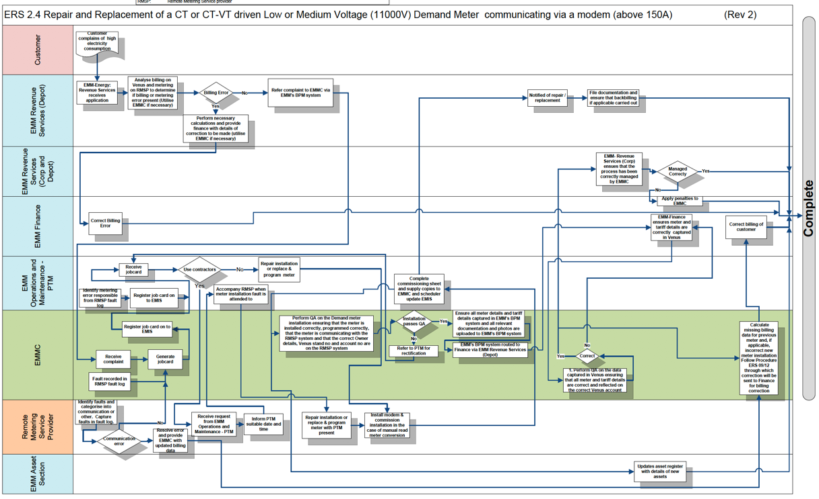
METER MANAGEMENT: USE OF STANDARD PROCEDURES AND BPM
The flow diagram shows the exact flow of work to be followed in each case.
This flow indicates the process to repair or replace a CT-VT driven low or medium voltage demand meter.
Given the volumes and financial amounts involved, these procedures AND BPM are critical to success.
Dr. Fred Fryer
+2782 821 4807
Notes:
Brief
Different stakeholders on the left
Steps and decisions on the right

Slide 29

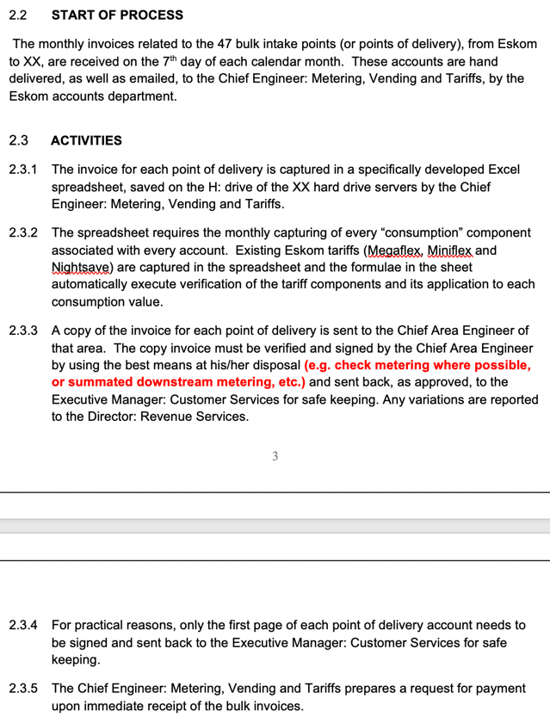
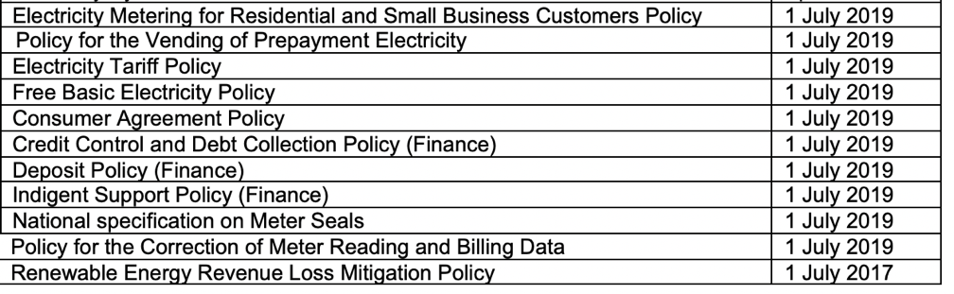
POLICIES SPECIFIC TO ENERGY REVENUE
Dr. Fred Fryer
+2782 821 4807
Notes:
Brief
Policies, list on right
Do you have all of these?

Slide 30
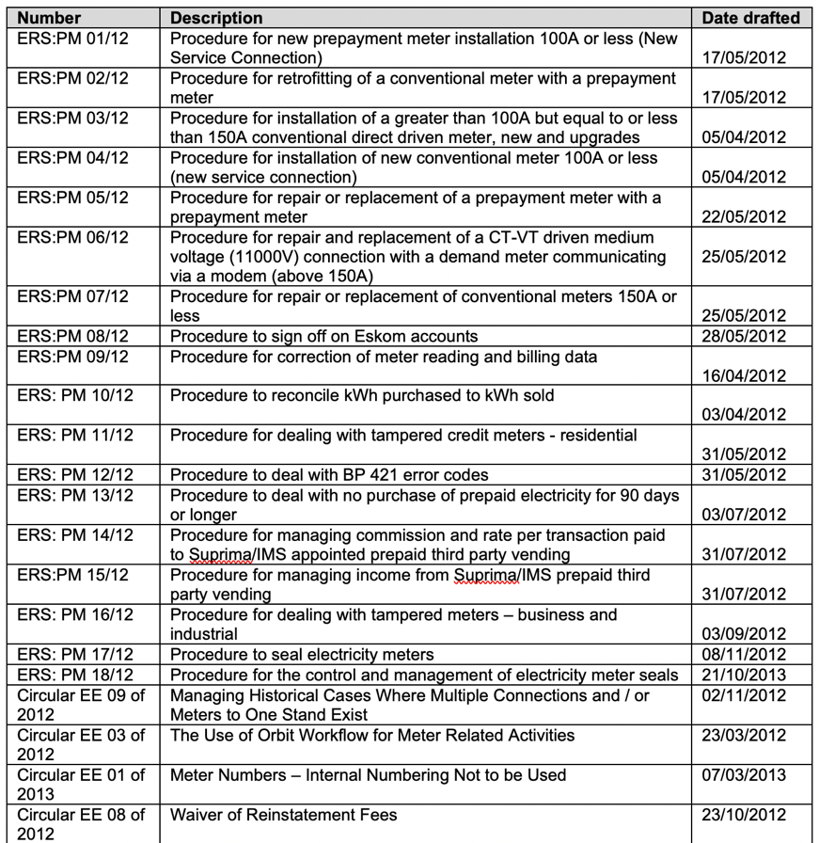

STANDARD PROCEDURES TO GOVERN TECHNICAL PROCESSES
Numerous standard procedures must be drafted by subject experts to guide operations.
These are critical to mitigate risk
The number can easily grow to more than 30 procedures.
Dr. Fred Fryer
+2782 821 4807
Notes:
Brief on procedures
Read a name or 2

Slide 31
5. ELECTRICITY BY-LAWS
VERY LIKELY, ALL ELECTRICITY BY-LAWS IN SA ARE OUTDATED
GIVE CAREFUL CONSIDERATION TO THE AVAILABILITY OF DATA, RENEWABLE ENERGIES, WHEELING AND MUCH MORE
Notes:
Brief

Slide 32

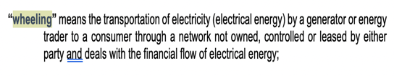

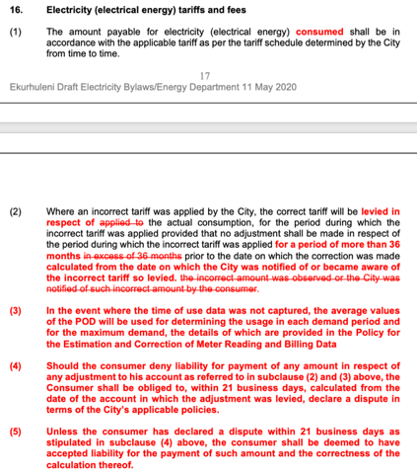
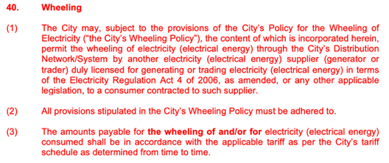
ELECTRICITY BY-LAWS
The by-laws is a critical component in the revenue value chain.
Much changed in recent years and by-laws must be kept updated.
The process of updating by-laws should not be taken lightly.
It will be advisable to involve senior Counsel, academic professionals and industry experts to achieve the desired results.
Once the first City revised their by-laws, it may provide a standard platform for other municipalities.
Dr. Fred Fryer
+2782 821 4807
Notes:
Bit more time
You will find the outdated when a customer takes you to court

Slide 33
6. DAILY OPERATIONAL ASPECTS
CONTINUOUS DAILY PROJECTS THAT MUST PUSH BACK ON LOSSES
DO NOT FALL BEHIND…

Slide 34
DAILY OPERATIONAL ASPECTS – MANAGE THE SMALL PROJECTS NON-STOP
# | Operational event (continuous, within operational budget allocation) | Main participants
1 | Register new prepayment meter connection | Energy, Finance
2 | Register new credit meter (also demand meter) connection | Energy, Finance
3 | Retrofit credit meter with prepayment meter | Energy, Finance
4 | Replace faulty meter with new meter | Energy, Finance
5 | Tariff change request | Energy, Finance
6 | Meter audit small meters | Energy
7 | Meter audit large meters | Energy
8 | Issue re-instatement fee for tampered meter, disconnect supply | Energy
9 | Ensure meter is accessible for meter reading | Energy
10 | Analyze meter reading deviation report for every meter read cycle, daily | Energy
11 | Respond to remove meter read error codes | Energy
12 | Analyze demand meter readings | Energy
13 | Manage demand metering installation errors | Energy
14 | Identify billing gaps and fill these with correction reports | Energy
15 | Monthly demand meter read upload report, to be above 97% | Energy
16 | Create reports on prepayment statistics | Energy
17 | Analyze the reports in detail and take corrective action | Energy
18 | Create the 90 day non-purchase deviation report | Energy
19 | Respond to the 90 day non-purchase report | Energy
20 | Create the low-purchase deviation report | Energy
21 | Respond to the low-purchase report | Energy
22 | Maintain and update metering data on billing system | Energy, Finance
23 | Manage the testing and calibration of meters | Energy
24 | Register upgrade of a supply connection and upgrading of metering equipment | Energy
25 | Indigents retrofitting of credit meters to prepayment meters | Health, Finance and Energy
26 | Removal of illegal connections | Energy
27 | By-laws enforcement operations | Energy, EMPD
28 | Meter seal management | Energy
29 | Deal with error 30 meters as they are reported (communications error between keypad and meter) | Energy
30 | Deal with interim read meters | Energy
Dr. Fred Fryer
+2782 821 4807
Notes:
Read a few small projects
Do noy fall behind

Slide 35
7. CAPITAL BASED PROJECTS
CREATE SUSTAINABILITY THROUGH SELECTIVE PROJECTS

Slide 36
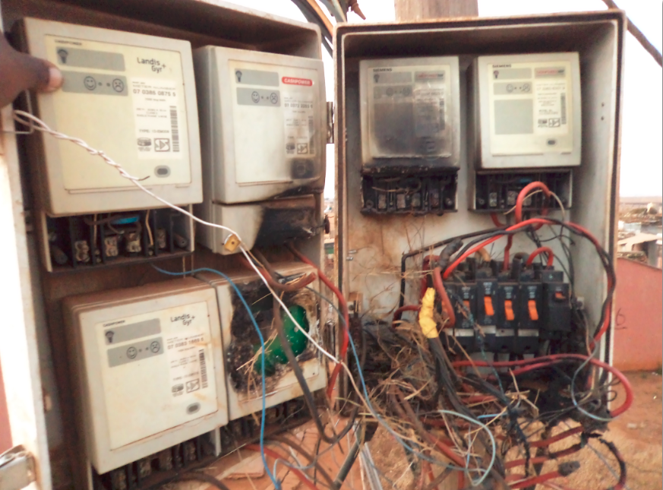
CAPITAL BASED PROJECTS: CREATE SUSTAINABILITY
Manage vandalism and theft.
6 prepayment meters in one pole top box, all bypassed, at least 4 meters destroyed.
A capital intervention is required involving protective structures and new meters.
The uncontrolled electricity consumption destroys transformer and cable insulation, even to the point that they catch fire.
Dr. Fred Fryer
+2782 821 4807
Notes:
Quick

Slide 37
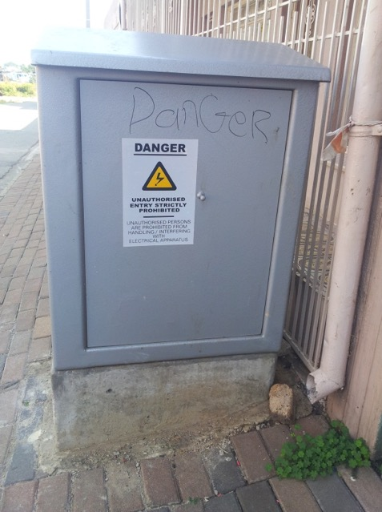
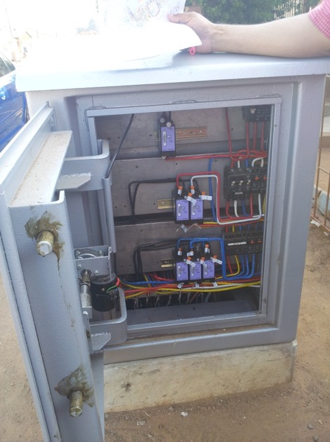
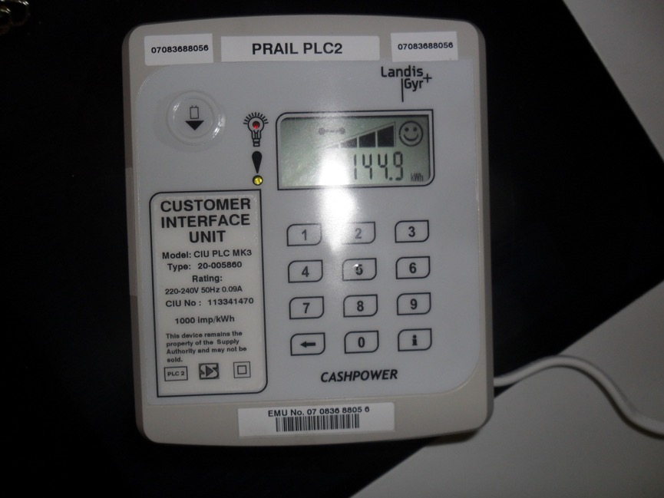
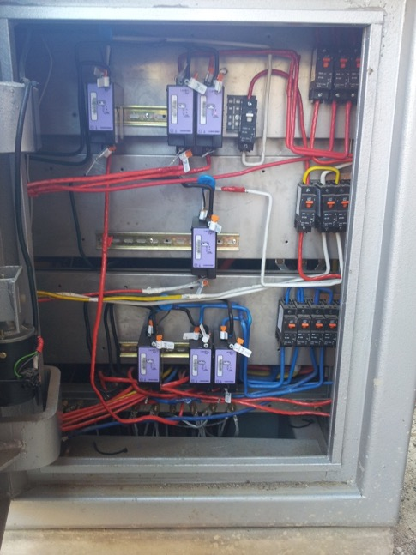
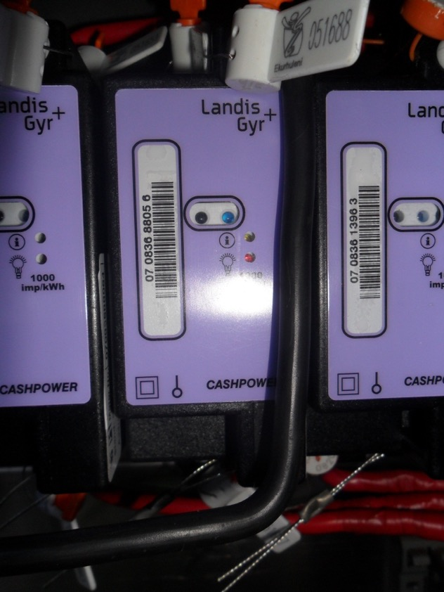
PROTECTIVE STRUCTURES AND TYPICAL METERING USED
Dr. Fred Fryer
+2782 821 4807
Notes:
Quick

Slide 38
8. MANAGE RISK
THERE ARE NUMEROUS RISKS THAT SHOULD BE REMOVED OR MITIGATED

Slide 39


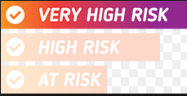

ENERGY REVENUE RISKS (not comprehensive)
Key event | Risk level
Effective technical meter maintenance and error resolution (if it already exists) | LOW
Resources, internal and external, coping with monthly workload | MEDIUM
Retention of high skilled, cross-functional resources to plan and execute progressive projects | VERY HIGH
Refining supportive processes to maintain sustainable revenue | LOW
Business Process Management – if none exist | HIGH
Intimidation of councilors, officials and contractors by community members, areas where access is restricted | HIGH
Fraud and corruption by internal staff, contractors | HIGH
Managing of meter box enclosures | HIGH
Fraud and corruption by external sources (eg meter bypass) | HIGH
Illegal connections | HIGH
Dr. Fred Fryer
+2782 821 4807
Notes:
Short list of main risks
Read one or two

Slide 40
9. INCREASE THE RISK FOR METER INTERFERENCE
EXISTING PENALTIES ARE OFTEN IGNORED
CRIMINAL PROSECUTION SHOULD BE EXPLORED

Slide 41
INCREASE THE RISK TO A CUSTOMER OPTING TO TAMPER
Tampering with a meter is prevalent in all customer segments, inclusive of high income residential, business and industry.
Existing penalty structures do the following in broad terms:
  Fine or reinstatement fee (not much of a deterrent)
  Back-billing (this could hurt when it runs to a 36 month term)
  Remove electricity supply (this hurts)
Actual arrests and prosecutions are seldom taking place, if ever.
There are legal difficulties that must be overcome for arrests to become an effective deterrent.
  This presentation does not aim to explore this aspect, but basically, proof is required that a user did in fact tamper their meter.
  This stance should be changed to: “Who benefitted from a tampered meter?”
  This beneficiary should be prosecuted in a criminal court.
Dr. Fred Fryer
+2782 821 4807
Notes:
Key points
Who benefitted?

Slide 42
10. DEAL WITH ILLEGAL CONNECTIONS
HEALTH AND SAFETY MATTER
IGNORING THE PROBLEM WILL SEE IT GROW

Slide 43
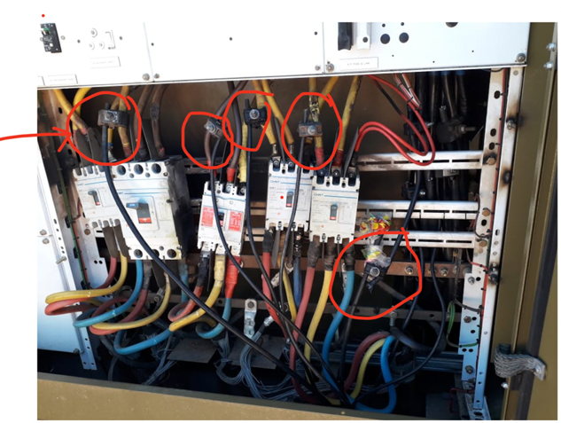
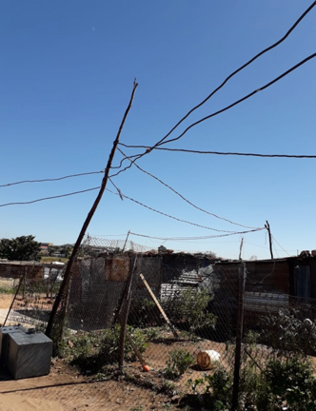
ILLEGAL CONNECTIONS
  Metro Police assistance is of exceptional value
  There is a general respect for Metro Police and its abilities which is VERY CRITICAL to achieve any success in this segment
DISCUSSION:
Electrification removes the reason and “legitimacy” for communities to do illegal connections.
Do not underestimate the organized crime component that is present in illegal connections.
Depending on volumes, these can be a significant contributor to losses, especially in winter (space heating).
Dr. Fred Fryer
+2782 821 4807
Notes:
Quick

Slide 44
11. SKILLED RESOURCES TO PLAN AND EXECUTE
RETAIN CRITICAL STAFF
FIND STAFF IF NONE ARE LEFT
OUTSOURCE TO CREDIBLE CONSULTANTS AND CONTRACTORS

Slide 45

The Revenue Value Chain is a highly specialized field. Once it starts to slide, it may take years or decades to bring it back to health.
Depending on the size of the municipality, key people leaving can literally cost the municipality hundreds of million per annum.
There are many “nuances” in the Revenue Value Chain that can only be understood after years of intense dedication. For example, adhering to principle when it comes to decisions related to correction reports. Specialist lawyers and consultants will find any inconsistency in approach and the municipality will be punished for that.
Some Energy structures still have no provision for skills and cross-functional skills such as electricity/ICT, electricity/data analysis, BPM and more.
These positions should be on an Energy structure.
It may mitigate against the risk of skilled people leaving the municipality for better opportunities.
Nuance is a subtle difference in or shade of meaning, expression, or sound.
SKILLED RESOURCES TO PLAN AND EXECUTE REVENUE TASKS
Dr. Fred Fryer
+2782 821 4807
Notes:
Discuss in detail, point by point
Once it slides, years to bring back
Key people leaving can collapse parts of the revenue chain
Data driven meters and assets, specialized skills needed

Slide 46
ACTUAL ENERGY REVENUE FIGURES THAT WERE ACHIEVED
Financial year | 2019/2020 | 2018/2019 | 2017/2018 | 2016/2017
Income budget value to be generated through technical means | R15,8 billion | R13,7 billion | R12,9 billion | R13,2 billion
Income budget achieved | 99%, by end Dec 19 | 100,7% | 99,7% | 98,8%
Electricity unit losses achieved, total | 12,5%, by end Dec 19 | 11,95% | 11,7% | 12,39%
Capital budget value (approx.) | R83 million | R85 million | R80 million | R75 million
Capital budget expenditure | >50%, by end Dec 19 | >95% | >95% | >95%
% of Large Power User accounts accurately billed per month (10,000 accounts) | 98% | 98% | 98% | 98%
% of prepayment meters bypassed (340,000 customers) | <11% | <11% | <11% | <11%
These values were not achieved in a perfect environment:
There were 11 core officials in the team.
8 officials had long-term HR related grievances.
1 official was seconded for >13 years.
4 others seconded for >9 years.
Each of the seconded officials had specialized skills, all ICT related.
The secondments left uncomfortable “vacancies” in the operational positions that they were appointed for.
Budget allocations restrained an even higher level of success (no blame here, it is understandable that there are competing priorities).
Yet, the team achieved remarkable results. Not only on the surface, but also success that was deeply embedded into back-office systems!
Dr. Fred Fryer
+2782 821 4807
Notes:
Read all of right side, work through KPIs

Slide 47
RECOMMENDATIONS

Slide 48

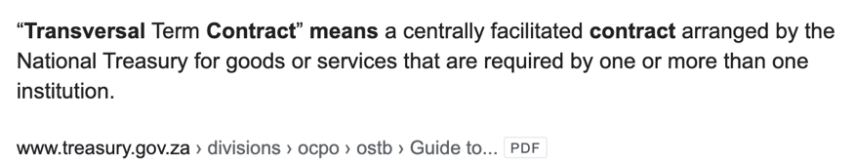

RECOMMENDATIONS
Electricity sales can change the financial situation at most municipalities.
There are basic principles that should be followed and these WILL unlock more income.
National Treasury or another State Department may want to consider the following:
  Creating transversal contracts for Automated Meter Reading, Meter Management, Meter Material Supplies, Strengthened Meter Boxes (including online electronic locks), LPU meter components (such as CT’s, VT’s and skills to install these).
  Centrally sourcing skills to draft a RSA wide meter management strategy. This must not be a typical 1000 page theoretical document. More like the practical REVENUE PLAN described in this presentation. Real KPI’s to be set for each individual municipality.
  Centrally sourcing experienced skilled individuals to be allocated a number of municipalities each, where the CENTRAL REVENUE PLAN will be implemented.
  Ensure a fair allocation of funding to each municipality to commence with revenue work.
The income that WILL come from this work will more than justify the initial outlay.
THIS IS THE LAST SLIDE..
THANK YOU
Dr. Fred Fryer
+2782 821 4807
Notes:
Read all, discuss

