Slide 1




SKILLS NEEDED BY AUDIT COMMITTEES IN DISTRICT AND LOCAL MUNICIPLAITIES
Presented By: Vela Mtshali

Slide 2

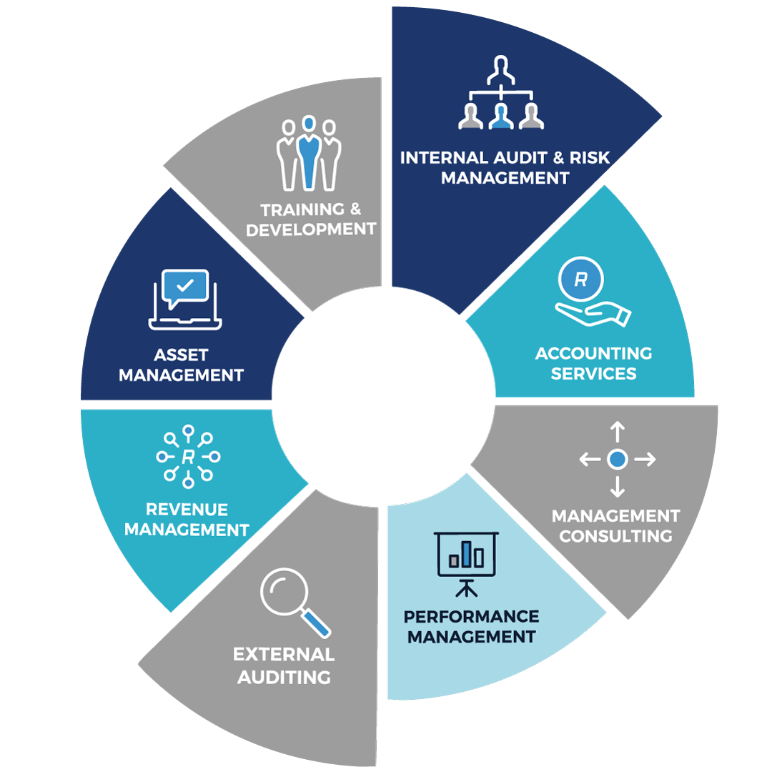


Our Service Offerings
Bonakude has been in existence for the past 12 years
We offer a complete package of services related to audit, training, and advisory requirements.

Slide 3
“The systematic implications of poor governance are not merely academic or emotional, but has real-world, on-the-ground consequences .”
- Andrew C. Canter

Slide 4

Introduction
AGSA’s assessment of Audit Committees
Status of Audit Committees within Local Government
Skills needed by Audit Committees and legislative/recommended requirements
Problem Statement
Methods of Assessments
Benefits of a assessment
Closing Remarks
Discussion Points

Slide 5

Poll
Are Audit Committees in local Government effective and add value???

Slide 6
Introduction
Section 166 of the MFMA states:
“(1)Each municipality and each municipal entity must have an audit committee.
(2) An audit committee is an independent advisory body which must advise the municipal council, the political office-bearers. the accounting officer and the management staff of the municipality, or the board of directors. the accounting officer and the management staff of the municipal entity on matters relating to:
  (i) internal financial control and internal audits;
  (ii) risk management;
  (iii) accounting policies;
  (iv) the adequacy, reliability and accuracy of financial reporting and
  (v) performance management;
  (vi) effective governance; information;
  (vii) compliance with this Act, the annual Division of Revenue Act and any
  (viii) performance evaluation; and other applicable legislation:
  (ix) any other issues referred to it by the municipality or municipal entity:
  (x) review the annual financial statements to provide the council of the municipality or, in the case of a municipal entity.
  (xi) carry out such investigations into the financial affairs of the municipality or municipal entity as the council of the municipality, or in the case of a municipal entity”.

Slide 7

Introduction cont…
King IV requires that audit committees possess the following skills as a collective:
  Internal financial controls
  External audit process
  Internal audit process
  Laws and regulations that affect the entity
  Risk management
  Sustainability issues
  Integrated reporting, which includes financial reporting
  Governance of information and technology
  The general governance processes within the entity

Slide 8
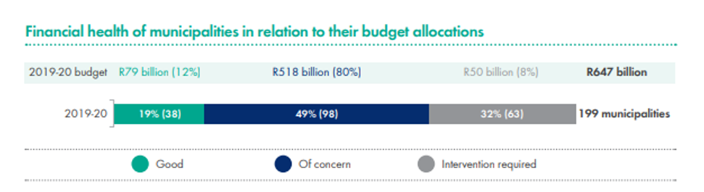
AGSA’s Assessment of Municipalities
AGSA assessment of internal control across Municipalities nationally :
Financial health is regressed:
Problem statement ?????? …………………………………………………….

Slide 9
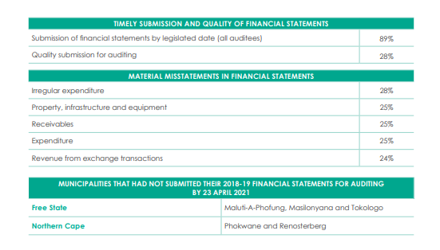
AGSA’s Assessment of Municipalities
Poor quality of financial statements of the financial year was also identified:

Slide 10
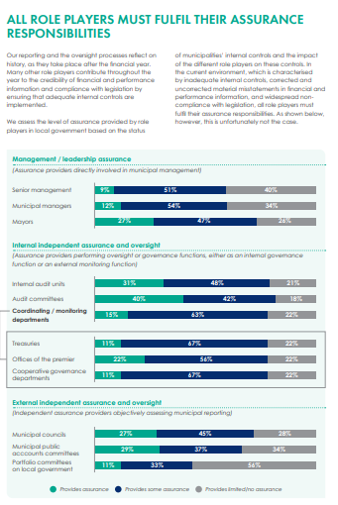
AGSA’s Assessment of Municipalities
  AGSA’s assessment of assurance provided by various role player
  Low levels of assurance provided by Municipal Senior Management
  Assurance provided by Audit committees requires improvement

Slide 11
Status of Audit Committees
SALGA Findings on study conducted in 2012 :
Low levels of compliance relating to audit committees (84/137 audit committees were non-compliant)
Low levels of perceived oversight in terms of overall audit outcomes
Meetings held were less than 4 times a year
Limited reviews of financial reporting and financial statements
Non-existence of performance committees
Low levels interaction between audit committees and executive management
Poor terms of reference for existing Audit Committees
Appointed Committee members lack critical skills to deal with compliance, risk management and performance management

Slide 12
Poll
What are the skills that Audit Committee as a collective should possess?

Slide 13
Key Skills of Audit Committees
Financial Acumen specifically relating to Financial Management and GRAP
Understanding of performance requirements of the municipality (IDP and SBDIP)
Advanced understanding of applicable laws and regulations (e.g. MFMA, MSA, Treasury Regulations, POPIA, BCEA etc.)
Risk Management relating to current and emerging risks
Information and Technology principles (e.g. COBIT, Governance, Cyber Security)
Appreciation for fraud and corruption indicators and embedding of ethical practices and principles
Ability to interact with executive management, internal and external assurance providers

Slide 14

Problem Statement
Audit Committees in local government as oversight /advisory functions

Slide 15
Recommendations
Performance of Audit Committee Assessments to identify any gaps and deficiencies
The Review of Audit Committee Charters and Terms of Reference and ensure alignment of responsibilities to the Municipality’s expectations
Frequent training and induction of Audit Committee on legislative updates and skills not currently possessed by the committee
Review of Audit committee budgets to assess room for enhancements when compared to the responsibilities of the committee (creation of management committees that report to the committee, procurement of specialists to provide assurance)
Review of Audit Committee Meeting compositions, agendas and Work Plan – to ensure all monitoring aspects are being looked at by the committee

Slide 16

How is the Assessment Implemented – per level
1) Internal Assessments:
  Recommended that this be performed on a frequent basis (i.e. quarterly)
  Can be performed by both Accounting Officer with the assistance of Internal Audit
  Based on predetermined key performance objectives
  Quality and timelines of audit committees’ counsel and recommendations on risk management and compliance matters
  Capacity of the Audit committees
  2) Self Assessments:
  Should be performed annually
  Should be performed against agreed key performance indicators
  Results should be reviewed by the accounting Officer and Internal Audit
  Results and corrective action plans should be submitted to the council
  3) Exetrnal or Council Assessments of the Audit Committees
  External assessments are performed at least annually based on agreed be against agreed key performance indicators
  Gaps identified should have adequate action plans that address competencies and functionalities

Slide 17

Benefits of Assessments
Identify Improvement Opportunities
Assess performance against critical areas
Enhanced oversight over functional areas such as finance departments, IT and risk management
Enhanced professionalism and specialised skills
Improved audit outcomes and AGSA assessments

Slide 18

Closing Remarks
The mere existence of an audit committee is not enough. The audit committee must be vigilant, informed, diligent and probing in fulfilling its oversight responsibilities”
Notes:
If we can become more accountable, it will help us achieve a culture of accountability, which will then contribute to better results.
How do you hold yourself and your teams accountable?

Slide 19
“An Active and informed audit committee provides the ultimate independence and objective oversight” – Ford Motor Company
________________________________

Slide 20

Questions and Answers

Slide 21
Thank You

Slide 22
Johannesburg
Unit G12, Pinewood Office Park
33 Riley Road
Woodmead
T 010 442 5796
Durban
Bonakude House
84 Seventh Avenue
Morningside
T 031 201 1241
East London
Unit 1F1, 44 ON PEARCE Building
44 Pearce Street
Berea
T 043 050 0339
Polokwane
37 Ismini Avenue
Bendor
T 015 590 0395
www.bonakude.co.za

