Slide 1












CIGFARO AUDIT & RISK INDABA

Slide 2
INTERNAL AUDIT- An Essential tool for Audit Committee

Slide 3


Background
Advisory committee – role is to advise the accounting officer/ accounting authority in terms of the MFMA/PFMA
Structure- outside organisational structure but provides insight on internal processes
Independence – independent from management and oversight bodies
Appointed- Council (municipalities) or Accounting officer/ accounting authority (PFMA entities)

Slide 4
Background
Audit Committees and internal audit play a significant role in oversight in relation to
  Improving financial management and internal controls
  Improving performance reporting
  Assist entities to achieve their mandates
AGSA audit outcomes reports
  MFMA (Local government)
  PFMA (National and Provincial)

Slide 5


The Role of Internal Audit
Promoting the Audit & Risk Function
Often referred to as the “eyes and ears” of the audit committee
What does this mean- what should audit committees do
PSACF has developed a number of guidelines to assist

Slide 6
The Oversight Role of ARC
Minimum requirements- PFMA/ MFMA/ Internal audit Standards
  Internal Audit charter and Audit Committee charter
  Appointment of CAE/ IAF
  Three year rolling plan- one year detailed plan
  Review quarterly progress reports
  Review reports on specific audits
  Combined assurance
  Capacity
  Performance of the IAF

Slide 7
Relationship with AGSA & IA CIGFARO
Continuous cycle of internal audit
Continuous cycle of internal audit
Coordination of the audit effort and impact on the internal audit plan
Planned use of the work of internal audit where possible (timing, nature and sample sizes appropriate)
ISA 610 – external audit standards
Encouragement of continuous engagements between the two service providers
Always bear in mind primary mandates of both

Slide 8
Evaluation of internal audit
Two guidance papers
First is a questionnaire template for management, external audit, internal audit and audit committee to assess internal audit
Second paper provides detailed guidance on the assessment processes
  Assess whether the CAE/ IAF is appropriately placed
  Strategic impact of the IAF
  Recognises differing levels of maturity, capacity, skills, experience and qualifications

Slide 9
Reporting Internal Audit Activities
Reporting as part of the audit committee activities
Annual report as well as quarterly report
Capacity
Role
Activities including achievement of the plan
Quality assessment of the IAF
Summarised findings
Part of the assessment of internal controls of the entity

Slide 10
Conclusion
Papers are designed to assist members
Improve - Professional relationship between the Audit Committee and the IAF
Trust, honesty, integrity, professionalism and objectivity
Result in a mutually beneficial relationship
All in this together

Slide 11


Thank You!

Slide 12
THE PUBLIC SECTOR AUDIT COMMITTEE FORUM

Slide 13
What
Why
Who

Slide 14
What
A forum of like minded institutes and organisations collaborating for the upliftment of public sector audit committees

Slide 15
Why
Awareness - matters relating to the function, duties and composition of public sector audit committees
Database - individuals who are experienced and qualified to serve
Consider - matters concerning public sector audit committees in the public domain
Thought leadership - discussing, researching, developing and disseminating position papers and good governance guidance
Support - public financial management, governance, risk and control initiatives
Improve audit outcomes across all spheres of government

Slide 16
Who

Slide 17

Research &
Guidance
Guidance and position papers - can be found on the PSACF website, www.psacf.co.za
Launch and share knowledge on guidance papers and the opportunity for debate and discussion on the relevant issues
Events
& Round-
tables
  CRM register profile for one of public sector audit committees
  Business intelligence
  Appointment opportunities
Database
Queries portal
  Assistance with public sector audit committee queries.

Slide 18
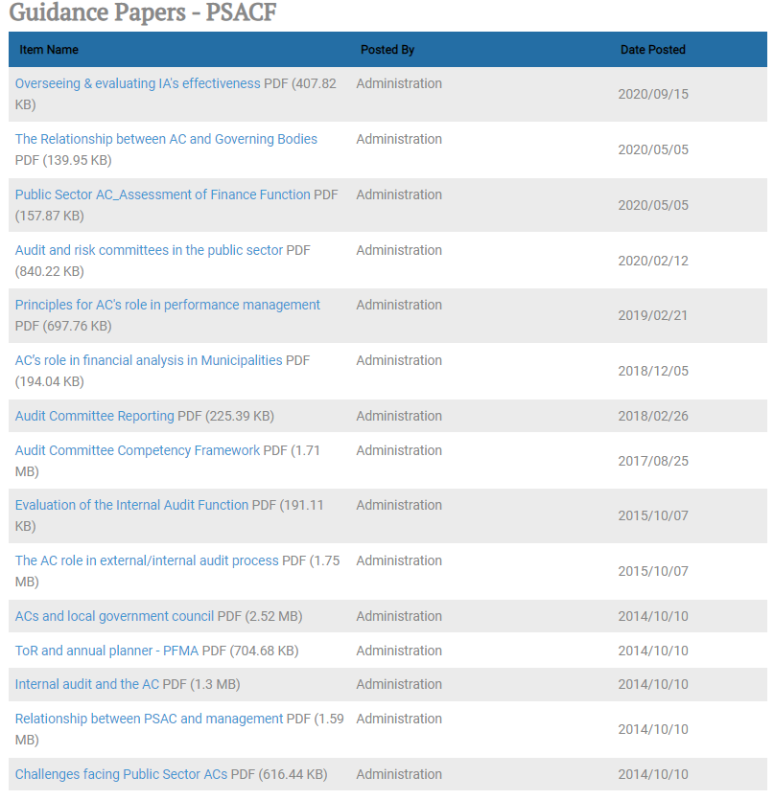
Research &
Guidance

Slide 19


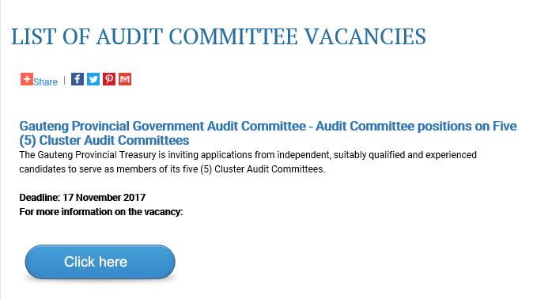

Slide 20
