Slide 1



AGSA OUTLOOK ON MSCOA AND AUDIT OF COMPLIANT AFS
24 June 2019

Slide 2



MISSION
“The Auditor-General of South Africa has a constitutional mandate and, as the Supreme Audit Institution (SAI) of South Africa, it exists to strengthen our country’s democracy by enabling oversight, accountability and governance in the public sector through auditing, thereby building public confidence.”
VISION
“To be recognised by all our stakeholders as a relevant Supreme Audit Institution (SAI) that enhances public sector accountability.”
VALUES

Slide 3
AGSA ASPIRATIONS AND ACCOUNTABILITY MODEL

Slide 4
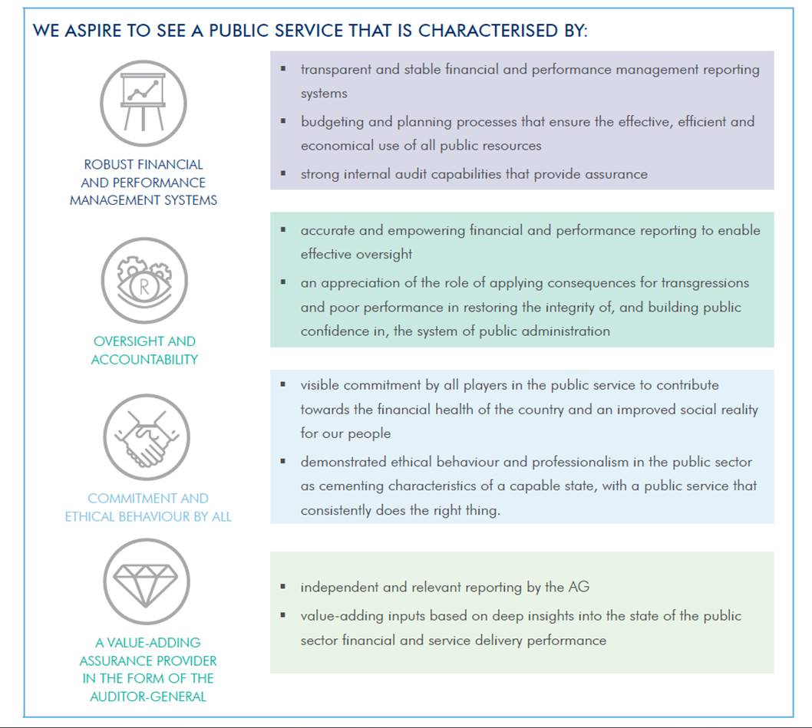
Aspirations of the AGSA

Slide 5
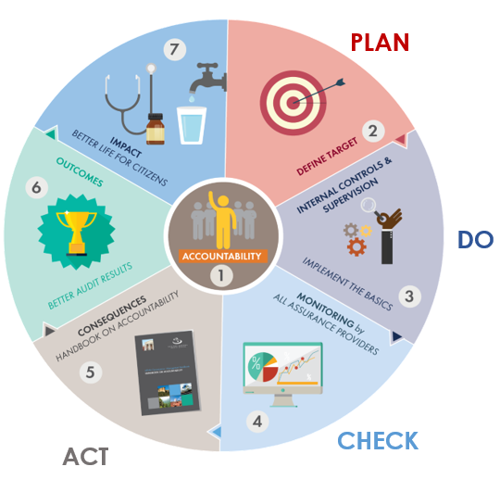
Accountability Model

Slide 6




Auditing scope in Gauteng
The Gauteng Business Unit conducts audits in both the provincial and local spheres of government.
Our PFMA cycle pertains to financial year-ends of 31 March whilst our MFMA audit cycle relates to the audits of municipalities and municipal entities with financial year-ends of 30 June.
Legislated timelines for financial statement submission and performance reporting are 31 May and 31 August respectively for our PFMA and MFMA cycles.

Slide 7
What is required from management ?
Prior to the submission of the annual financial statements and annual performance report for audit:
Perform interim reviews on the information and schedules supporting the annual financial statements and reported achievements in the annual performance report;
Make effective use of internal audit during the year in assessing the controls around the information produced and presented;
Make effective use of the audit committee to scrutinise the information and reports presented and ensure that this is done timeously for corrective action to be taken where needed.
At legislative timeline:
Ensure that you meet the timeline and submit accurate and complete information in support of the annual financial statements and annual performance report.

Slide 8
What we consider to be a complete submission for audit purposes
Paragraph 52 of the AG Directive requires that:
The annual performance report must not be submitted later than the legislated submission date of the annual financial statements;
The trial balance and general ledger that agree with the financial statements, together with the supporting asset register, inventory register and subsidiary ledgers, for receivables and payables, must be submitted together with the annual financial statements. All information in support of disclosures in the financial statements not included in the general ledgers and subsidiary ledgers must also be submitted concurrently with the financial statements;
The strategic development plan and all other documentation and information in support of the annual performance report must be submitted at the latest with the annual performance report;
Picture here

Slide 9
What we consider to be a complete submission for audit purposes
All documentation and information in support of the financial statements, reported performance against predetermined objectives and compliance with legislation must be available on request and be retrievable within a reasonable time, as agreed per the engagement letter;
The withdrawal or resubmission of financial statements submitted for auditing are not permitted; the financial statements and performance results may only be adjusted for matters identified during the audit.
Picture here

Slide 10
Non-compliance and material corrections
Should the information not be provided in the time agreed, it will be regarded as a limitation on the audit, which could result in a modification of the audit opinion;
If material corrections are required as identified during the audit process on information submitted for audit, it will result in non-compliance and will be reported as such in the audit report.
Picture here

Slide 11
BACKGROUND TO MSCOA

Slide 12
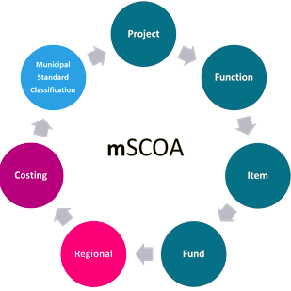




Reflections on the history of MSCOA
The implementation of MSCOA is not simply an information technology project, but rather a business transformation project which should fundamentally transform the way municipalities carry out their operations;
The MSCOA project is complex;
MSCOA reforms should impact positively on internal controls, financial systems, processes and financial management, once fully implemented;
15 core business processes are impacted to various degrees by each of the 7 segments as required by the MSCOA approach and focus.
Picture here
Notes:
Funding
What source of funding will be used for the transaction and from which source is the revenue received?
2. Function
Against which function or sub-function should the transaction be recorded?
3. Item
What is the nature of the transactions to be recorded either being an asset, liability, net asset gain or loss, revenue or expenditure?
4. Project
Does the transaction relate to a specific project and if so, which project?
5. Costing
Impact of the transaction on secondary costing?
6. Regional
What is the relevant geographical location for capital investment or the appropriate service delivery area for operational expenditure?
7. Municipal Standard Classification
Against which organisational vote or sub-vote should the transaction be recorded?

Slide 13



Advantages of MSCOA
Access to municipal financial systems will enable Treasuries to verify municipal information in terms of credibility, reliability and accuracy amongst others
Bring consistency in terms of classification of municipal information at transaction level across all municipalities within the province and nationally
Alignment of reporting formats such as budget and financial reporting
Consistent use of terminology across all municipalities by defining all accounts and labels
The improved quality of data will lead to improved budgeting, financial reporting and result in better decision-making in local government
Reduce the cost of compliance and information gathering in the long-term
Picture here

Slide 14
CURRENT STATUS OF MSCOA IMPLEMENTATION AT MUNICIPALITIES

Slide 15

Current status at municipalities – post 1 July 2017
MSCOA readiness means that municipalities are able to capture all their financial transactions against a predefined classification framework.
Full MSCOA implementation was planned for 1 July 2017;
All municipalities have however faced many practical implementation challenges within the local sphere of government and have not met this deadline;

Slide 16
MSCOA AND THE AUDIT VALUE CHAIN

Slide 17
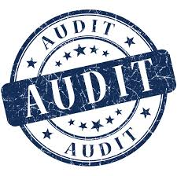
Impact of MSCOA on the audit process
A conversion to a new system is one of the highest risks that an organisation can face;
There is a need for auditors to evaluate both the IT & organisational aspects of the MSCOA system conversion projects. Auditing these conversions provides assurance to management and the municipal council that ‘all that can be done is being done’
Notes:
The Auditor-General does not foresee that MSCOA will have any impact on audit opinions, unless the entire system conversion/ or reimplementation is done in a manner that eliminates any audit trail. Also “Incorrect information” input into the system, before or after MSCOA will result in “incorrect output” and consequently have a possible negative impact on the audit outcome.
As in the past, what an auditee does and the manner it conducts its business results in its audit opinion; and it is crucial that all municipalities have mapped their respective
business processes to align with MSCOA requirements and processes.
Monitoring successful implementation of MSCOA, includes amongst other:
Review and approval of the MSCOA Project Implementation Plan, which should include the required activities, allocates responsibilities for execution of the plan to specific official(s) with set timeframes, deliverables and acceptance criteria;
Review of the MSCOA Project Risk Register, which should include the identified and evaluated risks, allocates responsibilities for mitigation of the risks to specific official(s) with set timeframes, deliverables and acceptance criteria for managing these risks;
Review the of MSCOA Project Issue Log, which should include the identified and resolved project issues, together with the specific solution which was applied and cost of addressing the issue, if applicable;
Monitor the progress made in terms of implementation of the MSCOA project plan, and implement actions to address any challenges/ risks/ issues and backlogs;
MSCOA is a business reform and therefore the Steering Committee should ensure organizational awareness of MSCOA is created by means of internal workshops, information sharing and feedback across the municipality (including all senior managers), the various internal committees and the municipal council. This awareness should form part of the project plan and the success thereof should be reviewed by the steering committee and the project team advised accordingly;
Ensure that MSCOA is adopted as a permanent standing item on the agenda of senior management meetings (MANCO) and lead discussions and presentations in this regard;
Table MSCOA progress reports, including the updated project risk register at the municipal council meeting on a quarterly basis;
Consider the impact of the Municipal Regulation on SCOA on business processes within the municipality and assign responsibility to develop a business process implementation plan to address changes across the municipality; and
Ensure that change management, training and capacity building with specific reference to MSCOA are prioritized across the municipality;
Ensure assessment of current Information Technology infrastructure and software requirements, and commission an investigation into the available alternatives to address any identified needs;
Ensure assessment of the current agreements with infrastructure and software service providers for consideration in planning the way forward;
Oversee the appointment process for the accounting - and other systems service provider(s) by means of providing input to the bid specification and evaluation processes;
Review the Service Level Agreement with the successful service provider(s) to ensure that all MSCOA requirements are addressed and value for money is achieved;
Review the detailed project implementation plan for data conversion and movement to the MSCOA compliant system(s) once the service provider(s) is appointed, with input from all the relevant stakeholders; and
Facilitate the resource planning for the mSCOA implementation project to ensure that the project is adequately resourced for its implementation.
Municipalities should review data sets individually. The review must include, scrutinising the information to ensure that it is complete, correct and securely stored;
Keep and maintain a document trail of the ‘data purification process’;
Keep and maintain a record of all amendments and updates made to information. These records have to be signed by a person authorised to do so in the municipality’s formal delegations; and;
The closing balances of the municipality’s system(s) before converting to MSCOA, together with a detailed reconciliation with the take on balances of the MSCOA aligned system, duly reviewed and authorised, also needs to be kept.
Robust monitoring of implementation plans.

Slide 18
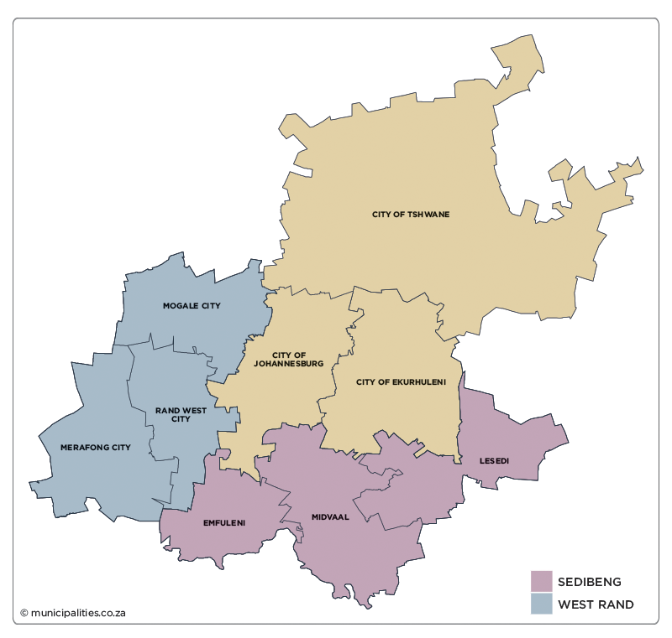
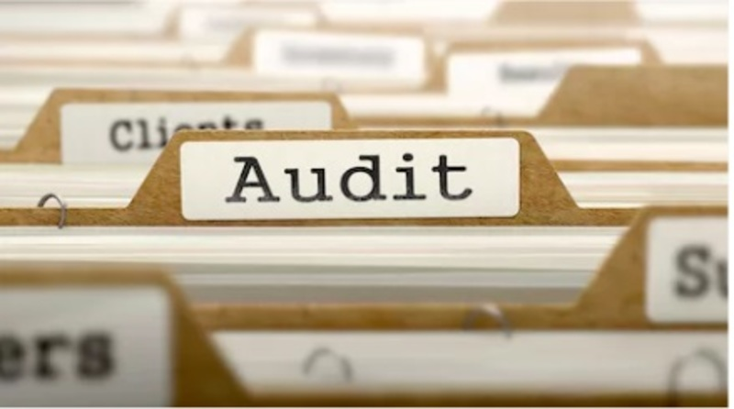
Impact of MSCOA on the audit process
  Auditors are required to gain an understanding of the new business processes as well as related policies and procedures of the auditee due to the system reforms;
  Testing correct migration of data from old to new systems;
  Using IT audit to ensure that data conversion and migration process was complete and accurate;
  Use of internal audit work where feasible;
  Reviewing managements risk assessment and response to MSCOA risks;

Slide 19
Impact of MSCOA on the audit process
  The audit process remains largely unchanged as MSCOA is aligned to GRAP;
  Comparative amounts may require reclassification due to mapping but this does not change recognition and measurement. Proper reconciliations must be maintained.
  Auditees to take note of GRAP 1.49 requirements which states that when comparative amounts are reclassified, an entity shall disclose (including as at the beginning of the preceding period):
  (a) the nature of the reclassification;
  (b) the amount of each item or class of items that is
  reclassified; and
  (c) the reason for the reclassification.

Slide 20
Impact of MSCOA on the audit process
  Reference is drawn to sections 63/64/65 of the MFMA regarding the accounting officers responsibilities for the accounting and information systems for assets/liabilities, revenue and expenditure
  Failure to implement the MSCOA system appropriately could result in material non-compliance with the MFMA where significant deficiencies are identified in the internal controls as determined by the AGSA;

Slide 21
Impact of MSCOA on the audit process
  The internal control deficiencies (corrected or uncorrected) result in material misstatements or compliance deviations;
  Where the internal control deficiencies impact on the recognition and measurement of transactions this impacts on the fair presentation of the AFS;

Slide 22
Data migration process
  The following should be maintained:
  Detailed working papers for the alignment of the general ledger based on the old chart to the MSCOA chart;
  Detailed reconciliation by vote of take on balances to the pre-MSCOA balances;
  Reconciliation of old closing trial balance and MSCOA trial balance,
  Working paper for restatement of balances as disclosed in the annual financial statements.

Slide 23
Role of Internal Audit in the implementation of MSCOA
Leadership (Council, AO, CFO, senior management) and governance structures are key to the success of MSCOA. Much benefit and value can be derived from and effective internal audit function. IA can aid to:
Obtain a detailed understanding of the operational changes driven by the system implementation;
  Evaluate IT system integration and data migration in terms of both quality and security;
  Verify that standard operating procedures are in place;
  Validate completion of testing and data conversion processes;

Slide 24
Role of Internal Audit in the implementation of MSCOA
  Evaluate the risks inherent in the conversion process;
  Re-prioritise audit focus, as appropriate, given the demands of conversion;
  Monitor the conversion impact on the internal controls;
  Validate completion of testing and data conversion processes;
  Evaluate the risks inherent in the conversion process;

Slide 25
Role of Internal Audit in the implementation of MSCOA
Internal audit should work closely with the AO and the audit committee and also:
Internal audit should assist the ASGA in obtaining an in-depth level of understanding of the changes as they are closer to system changes;
The AGSA should provide input into internal audit plans on MSCOA risks;
Key risks and findings should be discussed and shared between internal audit, AC, AO, and the AGSA;

Slide 26
THANK YOU

Slide 27
Our social media platforms

