Slide 1

A Practical Guide to Reporting in mSCOA
Presented by CIGFARO trainer on behalf of National Treasury
Notes:
1

Slide 2
Contents
Background and context
Legislative framework for reporting
The Local Government Database and Reporting System (LGDRS)
  Registration Process
  Information Submission and Verification
Municipal financial year reporting cycle
Compliance and controls
Support to municipalities

Slide 3
Background and Context

Slide 4
Problem Statement – municipal reporting
NT and PT do not have access to a shared financial system like BAS at national and provincial level
Initially municipalities did not have the equivalent of SCOA
Multi-year budgeting is a relatively new concept in local government
Inability to consistently use information for decision making remains a challenge
Before MBRR municipalities produced budget documents and reports in any way they wanted making consolidation of data almost impossible
Municipal departments / votes work in silos
No connection between planning, budgeting and implementation
Many data requests, some asking the same data but in a slightly different format

Slide 5
Are we ready for the mSCOA environment?
The MBRR requires municipalities to upload data on the LG Database and Reporting System (LGDRS) on a monthly, quarterly and yearly basis in a specific format
With the inception of mSCOA on 1 July 2017, municipal data must be uploaded in the format of data strings
However, to date the data strings submitted to NT were not credible for the following reasons:
  Budgets are not prepared and approved directly on the core financial system
  Budgeting, transacting and reporting is not done correctly across the 7 segments
  Reporting periods are not closed before reporting
  Correction of errors are done outside of the financial system in text file
  Reconciliations and check and balances are not done
  Schedules are not produced out of the financial system
From 1 July 2019, municipal data for reporting purposes will be provided in the form of data strings ONLY - as per MFMA Budget Circular No. 93.
The credibility of the data strings are therefore of utmost importance

Slide 6
Why is the credibility of data strings important (1)?
LG Reports are used for:
Internal reporting
  Management needs
  Day-to-day running
  Defined by municipality
External reporting
  Data and information required by external user / reporting entity
  Financial and non-financial information
mSCOA data will be hosted in the Local Government Database and Reporting System (LGDRS)

Slide 7
Why is the credibility of data strings important (2)?
Users of the LGDRS are extensive
National Treasury
Provincial Treasuries
Stats SA
SARB
AGSA
MISA
WorldBank
NERSA
DCOG
SARS
SALGA
DWS

Slide 8


Why is the credibility of data strings important (3)?
Govt. is moving towards system to system communication – no human intervention
Technology
Municipality
LGDRS
Accountability
Responsibility
Timeous reporting
Audit evidence
Technical environment
Receipt of submissions
Register of receipts
Feedback to municipalities
Control reports
Locking of reported periods

Slide 9
Legislative Framework for Reporting

Slide 10
Legislative framework
Constitution
MFMA (2003)
AGSA
ASB
MBRR (2009)
DoRA
mSCOA (2014)
GRAP

Slide 11
National Treasury Circulars and Guidelines
Budget Circular
RSA Economy and inflation targets
Funding choices and Management issues
Specimen Annual Financial Statements
Consistency amongst municipalities and other spheres of government
Guidance on GRAP
Annual reporting circular
• Guidance on preparation of annual report
• Encourage continuous improvement in standard of reporting
• Consolidate range of reporting requirements into 1 report
• Holistic approach that follows the spirit of legislation
Key focus areas for MTREF
Budget process and submissions
Incorporate requirements of MFMA
Demonstrate AFS disclosure of new budget formats

Slide 12
Municipal reforms
Municipal Budget and Reporting Regulations, 2009 (MBRR)
  Sound and sustainable management of budgets
  Uniform norms and standards
  Transparency, accountability and appropriate lines of responsibility
Municipal Standard Chart of Accounts, 2014 (mSCOA)
  Classification framework specific to Local Government
  Acceptable level of uniformity and quality
  Quality data will enhance budget, financial reporting and other decision-making processes impacting on municipalities
MBRR (2009)
mSCOA (2014)

Slide 13
Local Government Databse and Reporting System (LGDRS)

Slide 14
Local Government Database and Reporting System (LGDRS)
Development started in 2002
Implementation progress
  Started with in-year monthly reporting
  Standardised budget formats
  Implemented mSCOA classification framework
Routine publications
  MTREF
  Section 71
  State of municipal finances
  Over and under revenue collection and expenditure
  Local Government Budget and Expenditure Review
  Timing of tabling and adopting municipal budgets

Slide 15
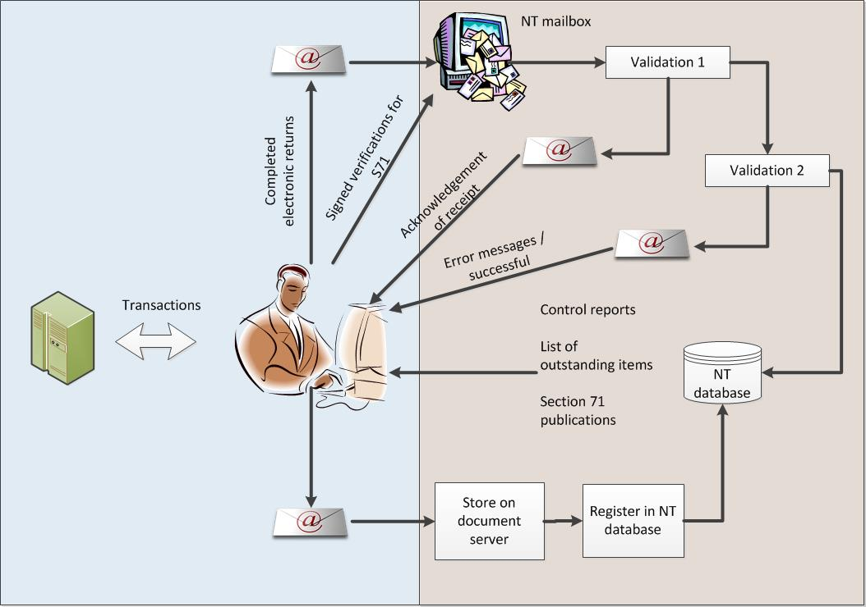
Current collection and processing method

Slide 16
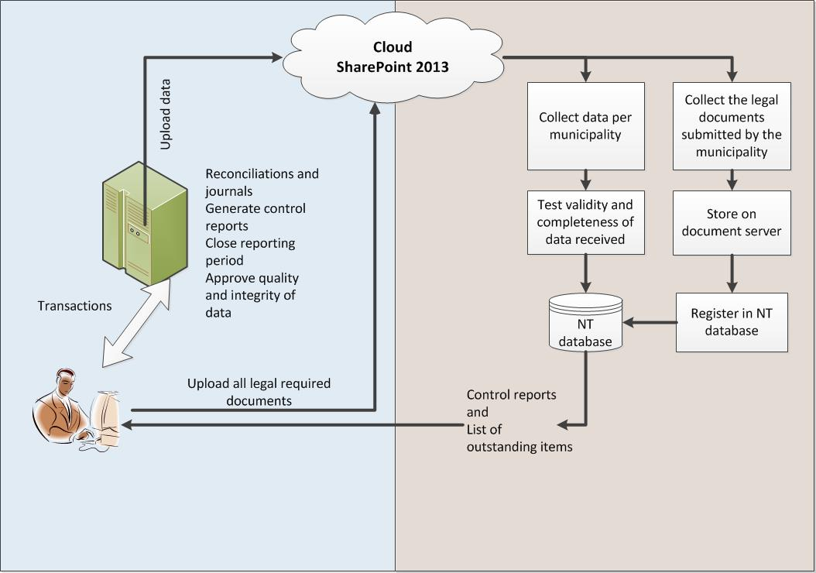
New collection method for submissions

Slide 17
Registration Process

Slide 18
User Registration method for submissions
User registration requirements
  Municipal Manager as Accounting Officer
  CFO
  Delegated officials (permanently employed)
  (NO Personal Assistants and interns)
    Delegation letter on municipal letterhead signed and dated
    Municipality must keep this contact data up to date
  How
    By completing the quarterly contact template circulated from the LGDRS
    By notifying NT when employees with access and proper delegation resign / move
    Submitting a new delegation letter to authorise uploader

Slide 19
Approval of portal registration
National Treasury will assess the registration application and validate the registration information based on the requirements stipulated.
Approved portal registration: If the registration is approved, the user will receive an e-mail notification of the registration approval including the user name and the link to the LG Upload portal sign in page;
Disapproved portal registration: If the registration is not approved, NT will communicate the reason for the decline to approve the registration to the user and the resolution, if applicable.

Slide 20
Information Submission and Verification

Slide 21
Preparing for submissions
Reporting periods must be locked before reporting
Internal system controls to ensure
  Sub-systems in balance
  Bank reconciliations done
  Drill down into detail as required
  Check dashboard on status of finances of municipality

Slide 22
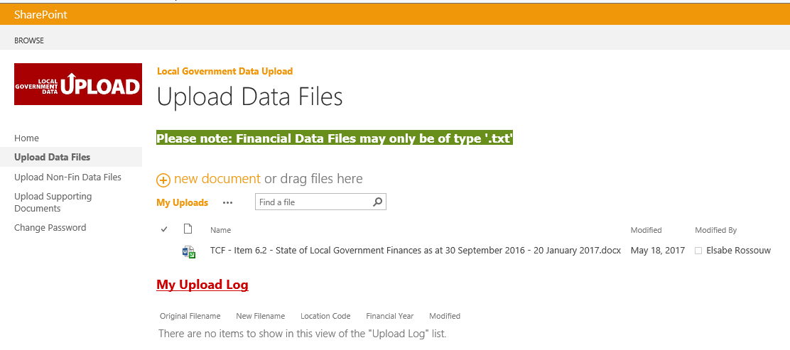
Uploading Financial Data

Slide 23
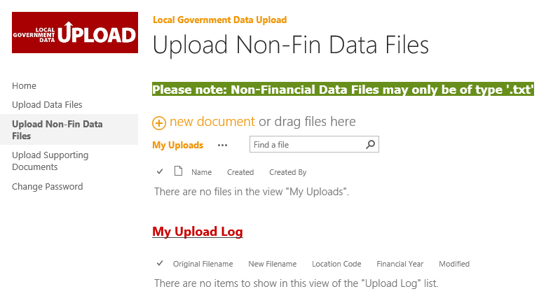
Uploading Non-Financial Data

Slide 24
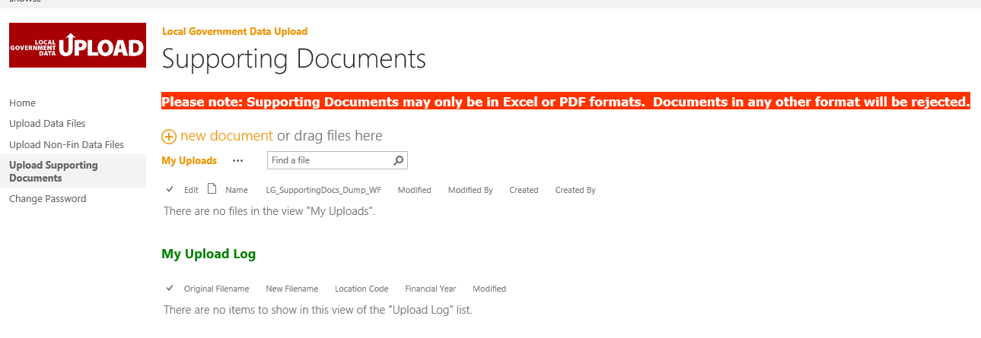
Uploading Municipal Documents

Slide 25
Uploading Supporting Documents
Validations are being done after the successful upload of a supporting document to the LG Upload portal:
Only single documents, corresponding to the selected document type, may be uploaded at a time/ per upload (no combination of documents in one document);
For example: ‘Council resolutions’ or quality certificates may no longer be included in a ’budget document’ but must be uploaded as separate document;
The financial year of the document that is uploaded must be selected. Always choose the end of the financial year (the bigger year number);
For example: If it is the financial year ‘2017/18’, the financial year will end in 2018. Select the ‘2018’;

Slide 26
Uploading Supporting Documents
A manual assessment (human intervention) will be done to confirm that the actual document received is the same as the document type the municipality selected to upload the document;
An email will be sent to the municipality to state the outcome (accepted or rejected and the reason) of the supporting document upload to the LG Upload portal; and
Failed document uploads must be resubmitted to the LG Upload portal.

Slide 27
What Happens After Your Submission?

Slide 28
Municipal Financial Year Reporting Cycle
Electronic returns submissions to NT
  (a) MFMA Section 71 prescribed electronic templates (refer paragraph 5.1 and 5.2 below for more detail); and
  (b) mSCOA data string submissions to the LG upload portal (refer paragraph 7 below for more detail)
Schedules A1 and C control reports
  The provincial treasuries must then publish the consolidated monthly financial information for their province in terms of section 71 of the MFMA; and
  National Treasury aggregates the monthly financial information, requires municipalities to verify and sign-off on it, and then publishes the information on a quarterly basis. This is done in accordance with section 71 of the MFMA and section 30(3) of the annual Division of Revenue Act, 2012.
NB: As per MFMA Budget Circular No. 93, electronic returns will be submitted only until the end of the 2018/19 (current) financial year. From 2019/20 data strings will be used as the source to publish municipal information

Slide 29
Approving accuracy of submissions
The principal of signing-off on publication reports before actual publication, affording the municipality an opportunity to correct any errors in its submissions;
Using the submitted C Schedules received from the municipalities as the benchmark to measure the accuracy of the electronic submissions; and
Publishing Section 71 information together with Conditional Grant information as one process.
Where a municipality has municipal entities, it must be clearly understood that:
  The municipality must submit its information as guided above;
  Each of the municipality’s municipal entities must submit the information as guided and instructed by the parent municipality; and
  The municipality must also submit consolidated information (including the information of every one of its municipal entities) for budget and in-year reporting purposes.

Slide 30
Municipal Reporting Schedule to LGDRS

Slide 31
Tabled budget (1)
An annual budget and supporting documentation tabled in a municipal council in terms of sections 16(2) and 17(3) of the MFMA must be –
  in the format in which it will eventually be approved by the council; and
  credible and realistic such that it is capable of being approved and implemented as tabled.
  Include draft SDBIP
Submit to NT and relevant PT the following:
  the supporting documentation as tabled in the municipal council;
  the draft service delivery and budget implementation plan; and
  any other information as may be required by the National Treasury.

Slide 32
Tabled budget (2)
Procedures to follow
Report | Due Date | Documents Required
Tabled Budget | Immediately after approval by council | Tabled budget A Schedule (draft) Council resolution Quality certificate Draft IDP Draft Spatial Development Framework Draft SDBIP Draft BEPP (Metros) Draft Service standards D Schedule (entities)

Slide 33
Tabled budget (3)
Report | Due Date | Returns required | mSCOA strings required
Tabled Budget | 10 working days after tabled to the council | OSB CA CFB AM BS GSG GSR SP | TABB PRTA

Slide 34
Adopted Budget (1)
The municipal manager must comply with section 24(3) of the MFMA within ten working days after the municipal council has approved the annual budget.
The municipal manager must submit to the National Treasury and the relevant provincial treasury, in both printed and electronic form –
  the supporting documentation within five working days after the municipal council has approved the annual budget;
  the approved service delivery and budget implementation plan within five working days after the mayor has approved the plan; and
  any other information as may be required by the National Treasury.

Slide 35
Adopted budget (2)
Procedures to follow
Report | Due Date | Documents Required
Adopted Budget | Immediately after approval by council | Adopted budget A Schedule (Final) Council resolution Quality certificate Budget locking certificate Final IDP Final Spatial Development Framework Final SDBIP Final BEPP (Metros) Final Service standards D Schedule (entities)

Slide 36
Adopted budget (3)
Procedures to follow
Report | Due Date | Returns required | mSCOA strings required
Adopted Budget | 10 working days after approval by council | OSB CA CFB AM BS GSG GSR SP | ORGB PROR

Slide 37
In-Year Reporting (1)
The monthly budget statement of a municipality must be in the format specified in Schedule C and include all the required tables, charts and explanatory information, taking into account any guidelines issued by the Minister in terms of section 168(1) of the MFMA.
The mayor may table in the municipal council a monthly budget statement submitted to the mayor in terms of section 71(1) of the MFMA. If the mayor does so, the monthly budget statement must be accompanied by a mayor’s report in a format set out in Schedule C.

Slide 38
In-Year Reporting (2)
The mayor’s quarterly report on the implementation of the budget and the financial state of affairs of the municipality as required by section 52(d) of the MFMA must be –
  in the format specified in Schedule C and include all the required tables, charts and explanatory information, taking into account any guidelines issued by the Minister in terms of section 168(1) of the MFMA; and
  consistent with the monthly budget statements for September, December, March and June as applicable; and
  submitted to the National Treasury and the relevant provincial treasury within five days of tabling of the report in the council.

Slide 39
In-Year monthly reports (3)
Procedures to follow
Report | Due Date | Documents Required | Returns required | mSCOA strings required
In-year Reporting | 10 working days after the end of month | S71 monthly report Monthly C Schedule Monthly Quality certificate Monthly Primary Bank recon Monthly Trial Balance Signed S71 quarterly report to council Monthly F Schedule (entities) | OSA CAA CFA BSA AD AC RME | M01 – M12 AD01 – AD12 AC01- AC12 BMQ1 – BMQ4 IMQ1 – IMQ4

Slide 40
Adjusted Budget (1)
An adjustments budget and supporting documentation of a municipality must be in the format specified in Schedule B and include all the required tables, charts and explanatory information, taking into account any guidelines issued by the Minister in terms of section 168(1) of the MFMA.
An adjustments budget referred to in section 28(2)(b), (d), I, and (f) of the MFMA may be tabled in the municipal council at any time after the mid-year budget and performance assessment has been tabled in the council, but not later than 28 February of the current year.
Only one adjustments budget referred to in sub-regulation (1) may be tabled in the municipal council during a financial year, except when the additional revenues contemplated in section 28(2)(b) of the MFMA are allocations to a municipality in a national or provincial adjustments budget, in which case sub-regulation (5) applies.

Slide 41
Types of Adjustment Budgets
Types of adjustments budget | Timeframes | Sections of MFMA and MBRR
Downwards adjustment due to under-collection of revenue | Any time | S. 28(2)(a)
Main adjustments budget | Once a year – between tabling of the mid-year assessment and 28 February | S. 28(2)(b, d & f) Reg. 23(1&2)
Additional funds from national / provincial government | 60 days after the approval of the relevant national / provincial adjustments budget | S.28(2)(b) Reg. 23(3)
Unforeseen and unavoidable expenditure | Within 60 days of expenditure being incurred | S. 28(2)I, 29(3) & 32 Reg. 23(4), 71 & 72
Roll-over of municipal funds | Before 25 August | S. 28I Reg. 23(5)
Authorisation of unauthorized expenditure | In main adjustments budget After the tabling of the annual report for that year (7 months after the financial year end) | S. 28(g), 32, 127(2) Reg. 23(6)

Slide 42
Adjusted budget (2)
Procedures to follow
Report | Due Date | Documents Required
Adjustment Budget | Immediately after approval by council | Adjusted budget B Schedule Council resolution Quality certificate E schedule (entities)

Slide 43
Adjusted budget (3)
Procedures to follow
Report | Due Date | Returns required | mSCOA strings required
Adjustment Budget | 10 working days after approval by council | OSR CAR CFR AMR BSR | ADJB PRAD

Slide 44
Annual Financial Statements - pre
Procedures to follow
Report | Due Date | Documents Required | Returns required | mSCOA strings required
Pre-audit AFS | 10 working days after submission to AG | AFS pre-audited | OSAA CAAA CFAA BSA ADA ACA | PAUD

Slide 45
Annual Financial Statements – post (1)
Procedures to follow
Report | Due Date | Documents Required | Returns required | mSCOA strings required
Audited AFS | 10 working days after receipt of audit opinion and report | AFS audited Audit report Management letter Annual report Oversight report | OSAA CAAA CFAA BSA ADA ACA | AUDA

Slide 46
Annual Financial Statements – post (2)
Procedures to follow
Report | Due Date | Documents Required | Returns required | mSCOA strings required
Restated AFS | 10 working days after submission to AG (following year) | AFS pre-audited (following year) | OSAA CAAA CFAA BSA ADA ACA | RAUD

Slide 47
Close of Financial Year

Slide 48
Compliance and Controls

Slide 49
Compliance and Controls (1)
Budget control
  A1 Schedule (A1 to SA38)
  What if analysis comparisons
  Trend lines including audited outcomes
  Entities? (Parent, entity, consolidated)
  Ratios on finances
    Cash Balance
    Liquidity ratio
    Current ratio
    Cash coverage
    Collection rate (assumed) for property rates, services separately
  Is the budget funded?

Slide 50
Compliance and Controls (2)
In-year control
  C Schedule (M01 – M12)
  Ratios / State of municipal finances
    Cash Balance
    Liquidity ratio
    Current ratio
    Cash coverage
    Collection rate (in-year) for property rates, services separately
  Monthly progress against budget
  Historical trends on revenue and expenditure per month (24)
  Entities? (Parent / Entity / Consolidated)
  Debtors age analysis
  Outstanding creditors

Slide 51
Compliance and Controls (3)
End-of-year controls
  Actual outcomes
    Statement of Financial Performance
    Statement of Financial Position
    Cash Flow
    Appropriation statement (including all of above)
    Capital spending and WIP
    Irregular / Wasteful / Fruitless expenditure
  Trend lines of previous audit outcomes (5 years)

Slide 52
Compliance and Controls (4)
End-of-year controls
  Ratios on finances
    Cash Balance
    Liquidity ratio
    Current ratio
    Cash coverage
    Collection rate (actual) for property rates, services separately (Circular No. 93 Annexure D)
  Debtors age analysis
  Outstanding creditors

Slide 53
Compliance and Controls (5)
Performance and service delivery
  SDBIP targets
    Backlogs
    Quarterly targets (per function: Housing / Electricity / Water / Sanitation / Refuse / Roads)
    Actual delivery per quarter / month against target
    Show reasons for missing target

Slide 54
Reporting Guideline

Slide 55
LGDRS Support to municipalities
mSCOA submissions
Feedback on validation tests
Control reports
  Daily on submissions
  Daily on documents received
  Reminders on outstanding docs and submissions
  Summary reports on finances

Slide 56
Publications
Verification process for electronic submissions
Verification process for mSCOA

Slide 57
Data-string Extract From Database
 |  |  |  | ORGB | ORGB | PROR | ADJB | PRAD | M01 | M02 | M03 | M04 | M05 | M06 | M07 | M08 | M09 | M10 | MCUM | TABB | PRTA
Demarcation Description | Demarc Code | CAP | CAP
Province : GAUTENG ( GT )
City Of Johannesburg | JHB |  | H
City Of Tshwane | TSH |  | H
Ekurhuleni Metro | EKU |  | H
Emfuleni | GT421 |  | H
Lesedi | GT423 |  | M
Merafong City | GT484 |  | H
Midvaal | GT422 |  | M
Mogale City | GT481 |  | H
Rand West City | GT485 |  | M
Sedibeng | DC42 |  | M
West Rand | DC48 |  | M

Slide 58
mSCOA Aligned Financial Reporting Dashboard
Notes:
58

Slide 59
Background
National Treasury requires MMs and CFOs to sign off on reports prior to submission to the LG Database
MMs have no idea what is being submitted but still sign off
To assist MMs to ensure that credible financial data are submitted to the LGDRS and to provide an early warning on the state of the municipality’s finances, some system vendors have developed financial dashboards
MFMA Budget Circular 93 provides guidance to system vendors and municipalities on how financial dashboards must be ‘mapped’ to the mSCOA data strings to automatically populate the prescribed indicators

Slide 60
Structure of the mSCOA Financial Dashboard
The layout of the dashboard are not prescribed by NT – system vendor to develop dashboard as per client requirements with different access levels and dashboard views
NT has requested vendors to incorporate at least the following minimum indicators in their dashboards:
  The uniform financial ratios and norms in MFMA Circular 71
  Ratios on bulk purchases, trade services – sales, employee cost and allocation of Equitable share per service measured against the grant formula allocation
Additional indicators to improve accountability may be introduced by the municipality
The information captured on the financial system will only be released to the LG Database once the MM has approved the release thereof after he/she reviewed the dashboard results

Slide 61
THANK YOU

