Slide 1




CIGFARO, KZN: Revenue Solutions Summit
Integrated Revenue Recovery Solutions
28 - 29 November 2019

Slide 2


Opening Remarks
As a prominent player in the municipal space, we embrace the 7 priorities set by President Cyril Ramaphosa during SONA 2019, with direct emphasis on the 4th priority, namely -
  Spatial Integration, Human Settlements and Local Government – through spatial interventions like economic zones, reviving local industrial parks, business centres, digital hubs and township and village enterprises, we will bring economic development to local areas. We will also focus on small medium enterprises in our cities, townships and rural areas and create places where they trade their products

Slide 3

Objective
To share best practices & solutions specific to the requirements for the Municipality to effectively enhance Revenue & Collections
Specific tailor made solutions for Municipalities include -
  Electronic Meter Reading System, including an all inclusive Exception Management Procedure
  Infrastructure Installations & Maintenance…..
  Stand Data Verification & Cleansing (reconciliation of stand information to billing data)
  Data Cleansing & Debtor Vetting (credit checks & electronic tracing)
  Geo-Spatial Process Management & Analytics
  Automation of Credit Control processes (in line with the Credit Control and Debt Collection Policy of the Municipality)
  Indigent Management – Automated Vetting, Verifications & Registrations
Propose solutions based on our knowledge & understanding of the Management of Operational Field Work, coupled with the essence of data quality & reporting mechanisms to billing data.

Slide 4
Agenda
Problem Statement
Revenue Value Chain
Integrated Revenue Recovery in Action
Integrated Revenue Recovery Solution

Slide 5
Agenda
Problem Statement
Revenue Value Chain
Integrated Revenue Recovery in Action
Integrated Revenue Recovery Solution

Slide 6
Problem Statement -1
Municipalities struggling to manage their revenue and/or optimize their assets
Debt owed to and by municipalities rising consistently year after year
Municipalities focus on short term debt results. Eg Business debt only
Financial and economic sustainability of local government institutions reached critical proportions
Revenue collection remains the problem of the finance department. Silo mentality towards revenue collection remains intact
Municipalities to focus on integrated development, optimising trading services and the property valuation value propositions
Lack of skills to perform all the tasks associated with the revenue value chain
Lack of consequence management because there is very little punitive action taken

Slide 7
Problem Statement - 2
Municipal debt increased in 2018/2019 by R22.3 Billion
Commercial debt decreased by R1.1 Billion, but household debt increased by R15.2 Billion

Slide 8
Fundamentals for Revenue Enhancement
Billing
Credit Control & Debt Collection
Indigent Verifications & Vetting
Infrastructure Maintenance
Debtor Vetting
Meter Reading
Data Cleansing
Prepaid Consumtion Montiroing
Account Balance Notifications after Billing – Quick Cash Gains
Segmentation of debtors book – Specific collection strategies
Automated Credit Control process – Efficient & targeted field actions
Debt Collection process on “No Metered” Services – Soft Collections
Indigent Verifications & Vetting – End to end process to establish authentic register
Infrastructure Maintenance – “Referrals” resulting in unsuccessful credit control & revenue losses
Debtor Vetting – Know Your Customer (KYC) & affordability
Data Cleansing - Improve billing data & revenue anomalies
Meter Reading – Optimize meter reading & value from physical meter inspections

Slide 9
Agenda
Problem Statement
Revenue Value Chain
Integrated Revenue Recovery in Action
Integrated Revenue Recovery Solution

Slide 10

Revenue Value Chain - Schematic
Integrated Revenue Management
Key drivers
Databases
MIS
Strategic planning
L/T financial plan, IDP, SDBIP, Infrastructure masterplans
Spatial planning
Town planning
Valuations
Land based
Property Rates
Trading services
Water and sanitation
Revenue sources
Electricity
Solid waste
Other sources
Sundry revenue
Borrowing and grants
Indigent management and register
External data sources
Town planning scheme
Performance and change management
Valuation roll
Monitoring and evaluation
Revenue integration and organisational alignment
Performance monitoring, reporting and management
Revenue value chain processes and tasks
Functional capacity
Institutional arrangements
Leadership focus (oversight and accountability management)
GIS System
Customer care system
Sundry systems
Service connections
Billing system
New accounts , meters and deposit management
Finance functions
Budgeting and tariffs,
Billing, collections and payment receipting
Credit control and debt collection
Refunds and clearances
Indigent management
Support services
Legal, procurement and human resources
Customer care

Slide 11
Revenue Value Chain – In Short
In short, the revenue value chain is not only the functions performed by the Finance Department.
All departments from Town Planning to Engineering and Human Resources contributes towards the basis on which accounts are generated.
It’s only at the end where Credit Control and Debt Collection starts and if the supporting departments fail the Collection will be very difficult.
  How many times have we heard about water meters not working and not replaced
  How many times have we heard about electricity cubicles that cannot lock
  How many times have we heard about prepayment meters being tampered without any consequences
The previous slide details the value chain and if only the key drivers and customer care is fully in place followed by the fair application of credit control, debt collection and indigent management, that will be your integrated revenue solution

Slide 12
Agenda
Problem Statement
Revenue Value Chain
Integrated Revenue Recovery In Action
Integrated Revenue Recovery Solution

Slide 13

Segmentation of Debtors Book – Collection Strategies
Identify Key Accounts – Regular Payers to enhance payment base
Implement SMS Notifications for defaulters as 1st action – Quick Cash gains
Implement credit control on 30 days for all accounts with metered services
Focus on prepaid customers – Low Buy-No Buy report with tamper penalties
Soft Collection process on Rates and Non-metered accounts – soft listings
Strategy to contain consumption of Indigent Accounts – critical sector of debt book
Address meter infrastructure anomalies affecting revenue & credit control process
Write-off report recommendations
Implement By-Law enforcement
Handover to debt collectors for Legal process

Slide 14
Account Balances after Billing – SMS Communicator
Improved payment of accounts after billing, through immediate SMS notifications
We have found that cash flow at municipalities have been significantly improved through the ability to communicate with it’s customer base.
Customers can communicate via SMS platform with the municipality to address queries & improve payments after billing

Slide 15
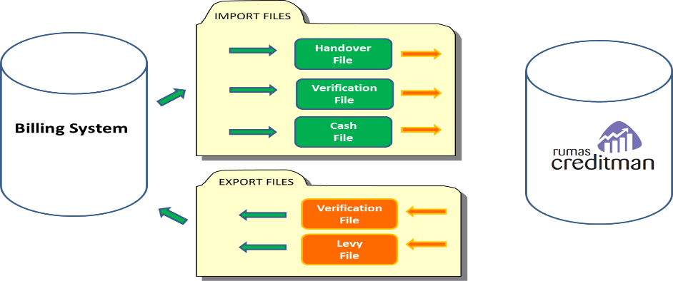
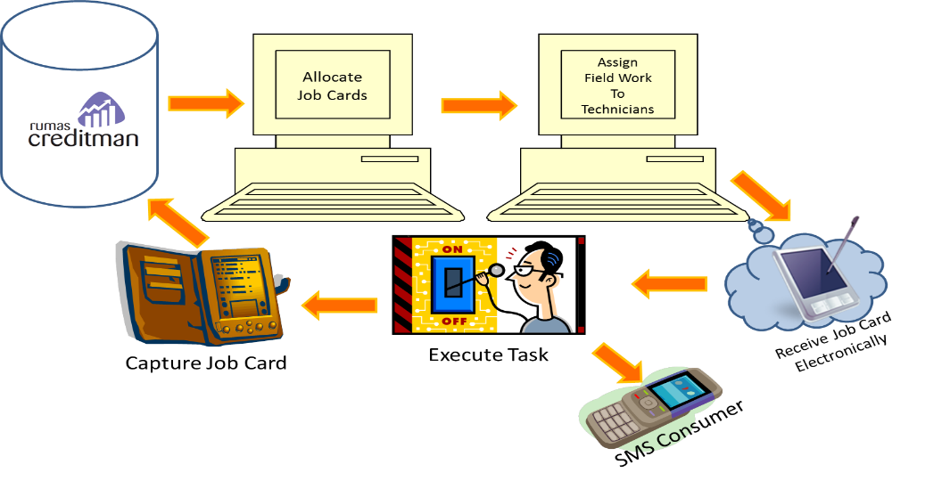
Automated Credit Control Process
A non-discriminatory process to ensure credit control is applied according to policy.
Customised Flow process of credit control actions as per Credit Control Policy
Eliminate paper based credit control – automatically check payment status prior to continuing to next action through interface with billing system
Two way SMS communication to and from the consumers
Integrated with handheld technology – for real time information, performance monitoring and quality control
History of credit control in a central system and real time status of each account in credit control
Integrated SMS communication to consumers/defaulters for disconnections & reconnections
Numerous operational, managerial and executive reports to assist with effective decision making

Slide 16
Indigent Vetting & Registrations
Flexible workflow process according to Indigent Policy
Digitized workflow process to improve record keeping & audit process
SMS integration to communicate to all stakeholder – Communication & Awareness Campaigns
On-site Indigent Registrations per Ward
Subjective site-inspections by trained Verification Officers (VO’s)
Integrated Indigent Vetting model through bureaus - TransUnion & CPB as data providers
Web-based/Mobile/Tablet access to status enquiries & defined Ward Reports for Councillors
Emphasis on skills assessment of Indigent Register as integral part of Exit Strategy
Outcome notifications & letters for all applicants – Approved or Declined
Consumption monitoring services of Indigent households

Slide 17
Agenda
Problem Statement
Revenue Value Chain
Integrated Revenue Recovery in Action
Integrated Revenue Recovery Solution

Slide 18

Integrated Revenue Recovery Solution
Development of a Revenue Management Improvement Plan
RMIP
(Revenue Management Improvement Plan)
Metering, bulk consumers and check meters
Political project champion
Meter Reading & Exceptions Management
Program structure
Administrative project champion
Credit Control & Debt Collection
As-is assessment
RMIP goals and objectives
Legislative compliance and policy review
Focus areas of the RMIP
RMIP workgroups and projects
Indigent Vetting & Registrations
RMIP solutions
Valuation Roll and Billing
People
Systems
Policies and procedures
Execute
Control
Tariffs and Budgeting
Initiate
Close
Plan

Slide 19

Revenue Management Improvement Plan (RMIP)
In short – all departments MUST work together
Ensure you have the tools & technology required to support your plan
If you need help ….

Slide 20

Questions & Answers

Slide 21
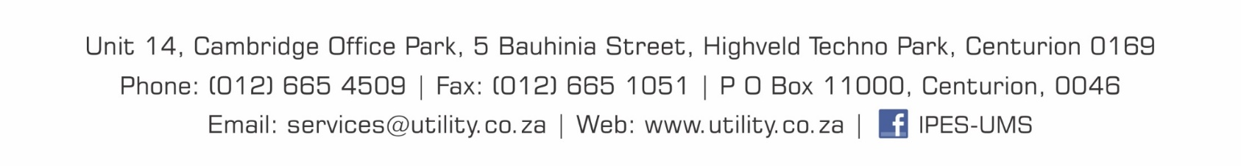
Thank You

