Slide 1


FINANCIAL SUSTAINABILITY-PRACTICALITY OF THE IMPLEMENTATION OF NEW KPIs- CIRCULAR 88: PALEDI MAROTA

Slide 2


OUTLINE
Legislative framework
Introduction
Problem Statement
The collaborative Process
Intergovernmental Reporting Reforms
Framework, Principles and Criteria
Functional Performance Indicators
Assurance Level (Practicality)
Closure

Slide 3
LEGISLATIVE FRAMEWORK
The MSA and MFMA provide the legal framework around which municipal planning must occur( The Municipal Systems Act (MSA) and the MFMA require alignment between planning and reporting instruments such as the Integrated Development Plan (IDP), the Service Delivery and Budget Implementation Plan (SDBIP) and the Annual Report).
The Spatial Planning and Land Use Management Act of 2013, in combination with the DoRA, has given impetus to the introduction of the BEPP as an additional planning instrument for metropolitan municipalities with a distinct spatial imperative for the built environment.

Slide 4
INTRODUCTION
-Circular 88 is informed by the reporting reform initiative undertaken by National Treasury, in collaboration with the Department of Cooperative Governance, the Department of Planning, Monitoring and Evaluation, Statistics South Africa and in consultation with the Auditor-General of South Africa.
-National Treasury collated the reporting requirements for all metropolitan municipalities and identified 2 572 indicators, requiring 18 467 data elements to be reported upon annually as part of their Cities Support Programme (CSP) process.

Slide 5
INTRODUCTION----Continue
- indicators were then catalogued and analysed according to their location on the results-chain, consistent with the provisions of the Framework for Managing Programme Performance Information (FMPPI) (National Treasury, 2007).
-The Circular is for the attention of all municipalities, but only applies to metropolitan municipalities in the current financial year planning (2018/19). It should be read in conjunction with the MFMA Circular No. 13 issued on 31 January 2005 and MFMA Circular No. 63 issued on 26 September 2012.

Slide 6
PROBLEM STATEMENT
National Treasury undertook this initiative in response to the following issues arising from metros reporting on performance information, particularly within the built environment:
• There are too many indicators that national departments expect metropolitan municipalities to report upon and they are not sufficiently strategic;
• There is duplication, fragmentation and insufficient coordination of how this performance information is managed and reporting resulting in an inefficient use of resources; and
• Indicators at the output and outcome level are generally undeveloped and insufficient attention has been paid to the relationship between outputs and outcomes in crafting and selecting performance indicators.

Slide 7
PURPOSE
To rationalise the reporting requirements of metropolitan municipalities
To provides guidance and assistance to metropolitan municipalities on the preparation of statutory planning and reporting documents required for the 2018/19 Medium Term Revenue and Expenditure Framework (MTREF).
To support the alignment of planning and reporting instruments for a prescribed set of municipal performance indicators.

Slide 8
The collaborative process followed
NT
CoGTA
DPME
SACN
SALGA
STATS SA
AGSA
Steering Committee
Dec 2015
Adoption & Application of Framework, Principles & Criteria
Bilateral Engagements with sectoral departments & agencies
Convene sectoral engagements with city sectoral specialists
Technical review & indicator descriptions
Consultative Bilateral engagements with Cities
Early 2016
May-Jun 2017
Oct-Nov 2016
Jun 2017
Dec2016
Aug2017
Mar-Apr 2017
Nov
2017

Slide 9
Intergovernmental Reporting Reforms Project
Impact
Functional Outputs
Functional Activities
Integrated Outcomes
Functional Inputs
Costs
Functional Outcomes
Reporting Reform Project
NDP / IUDF
2572 Indicators
BEPP / SDF
IDP
SDBIP
Annual equivalent of 18467 data elements
MSCOA
Current Emphasis
Notes:
Historically, we have established a reporting regime that is burdensonsome and unstrategic
Results framework, make a key distinction between functional outcomes and integrated outcomes
Integrated outcomes are reflective of the state of the city and the urban transformation agenda
Functional outcomes by providing a municipal service.

Slide 10
Framework, Principles and Criteria
Framework
Principles
Complimentary
Fit for Purpose
Results-based
Simple yet sufficient
Distinguish performance and capabilities
Powers and functions focused
Triangulation and balanced
International alignment
Reciprocation
Open and transparent
Collection at most appropriate scale
Criteria
Precise definition
Verifiable
Cost-effective
Relevant
Accurate
Timeliness
Comparable
Impact
Functional Outputs
Functional Activities
Integrated Outcomes
Functional Inputs
Costs
Functional Outcomes
Reporting Reform Project
Notes:
This slide represents the framework, principles and criteria that are articulated in the document and are used in the rationalisation process.

Slide 11
Through that process new set of KPIs were developed
The new set of indicators for metropolitan municipalities has therefore integrated different sets of indicators, namely those of the various sector departments, the Integrated Urban Development Framework (IUDF), Cities Support Programme (CSP), New Urban Agenda, SDG and the Back to Basics Programme for local government.

Slide 12
Functional Performance Indicators (Outcomes and Outputs level)
The focus during the work of the reporting reforms project has been on the following municipal functions which have informed the development of a set of indicators:
• Water and sanitation;
• Electricity and energy;
• Housing and community facilities;
• Roads and transport;
• Environment and waste management;
• Fire and emergency services and
• Governance.

Slide 13
Common City Transformation Outcomes
The reporting reform process identified a common set of city transformational outcomes viewed through a spatial lens which includes:
• Targeted investments in integration zones;
• Reduction in urban sprawl;
• New housing options with social diversity; and
• Affordable and efficient public transport services.

Slide 14
Phased Implementation
Tier 1 | Indicator conceptually clear, established methodology and standards available and data regularly produced.
Tier 2 | Indicator conceptually clear, established methodologies and some standards but there is variability in interpretation and systems available to support. Data are not yet regularly produced across all stakeholders.
Tier 3 | Indicator for which there is agreed conceptual value, but not yet a common established methodology and standards for data to be produced.
Tier 4 | Indicator for which there is an identified need, but not yet conceptual agreement between stakeholders and this is a placeholder for a future indicator.
Readiness | No. of indicators
Tier 1 | 60 +16
Tier 2 | 28
Tier 3 | 30
Tier 4 | 4
Total | 122 + 16

Slide 15
Indicator breakdown by readiness
Indicator Set | Tier 1 | Tier 2 | Tier 3 | Tier 4 | Total
City Transformation | 16 | - | - | - | 16
Electricity & Energy | 12 | - | 6 | - | 18
Environment & Waste | 10 | 3 | 3 | 3 | 19
Fire & Emergency | - | 3 | 2 | - | 5
Housing & Community Fac. | 10 | 6 | 3 |  | 19
Transport & Roads | 6 | 4 | 11 | - | 21
Water & Sanitation | 13 | 3 | 2 | - | 18
Governance | 9 | 9 | 3 | 1 | 22
Total | 75 | 28 | 30 | 4 | 138

Slide 16


Slide 17
The importance of data elements
Rateable residential properties as a percentage of total households in the municipality
(1) Number of residential properties contained on the valuation roll (From Metro)
(2) Total number of households in the municipality
(From Stats SA)
(3)Number of Informal Settlements (From Metro)
Formula: ((1)Number of residential properties which
are contained on the valuation roll, for all values /
(2)Total number of households in the metro) x 100

Slide 18
Where does the data come from?
Reporting Entity | Unique data elements
Metro | 173
StatsSA | 38
Department of Environmental Affairs | 4
Road Traffic Management Corporation | 3
Department of Human Settlements | 2
National Treasury | 2
Auditor General | 2
Department of Energy | 1
Total National Department or Agency | 52
Total | 225

Slide 19
INTERNALISATION OF A REGULATED SET OF INDICATORS
According to the Circular, it is recognized that metros have their own systems and methodologies in place for their indicators.
Therefore a degree of interpretation involved between how the data elements of a commonly defined indicator are sourced and supplied in one municipality compared to another.
The Technical Indicator Descriptions are therefore expected to be common points of departure for these indicators, which should then be applied to the respective metro systems

Slide 20
Technical indicator description sheet
A1 Indicator short name | Number of dwellings provided with connections to mains electricity supply by the municipality | A1 Alignment | Improved access to electricity | A5 Rationale | The city needs to ensure that all new dwelings are provided with an electricity connection. Additionally, they need to clear backlogs of existing dwellings that do not have electricity connections which fall under their responsibility (as opposed to Eskom's). This indicator which measures the city's progress in this area will contribute to overall access to electricity for the municipality.
 |  | A1 Results-chain level | Output
 |  |  |  | A6 Definition | The number of new residential electricity connections to dwellings provided by the municipality
INDICATOR ASSIGNMENT | EE1.11 | A1 Unit of measurement | Number of connections | A7 Indicator Formula | (1) Count of residential supply points commissioned and energised by the municipality
A3 Indicator origin | B2B framework |  |  | A8 Frequency of reporting | Quarterly
A4 Notes on calculation | This should be a year-to-date figure for the respective financial year. |  |  | A9 Additional notes | Dwellings include all types and is not limited to those connected by INEP grants. New property developments that require electricity connections for residential units will also be counted. Informal developments will also be counted. New areas previously handled by Eskom should not be counted as new connections, unless the municipality puts in new supply points. The municipality should have some way of differentiating between these "new" customers and actual new connections.
Reporting responsibility |  | Metro | When | Now | Readiness | Tier 1
B1 Data Element | (1) Residential supply points energised and commissioned by the municipality | B4 Source | Municipal Customer & Billing Database | C1 Data Element | - | C4 Source | -

Slide 21




RECIPE FOR DISASTER-(SEEK AND HIDE GAME)

Slide 22
REALITIES ABOUT CIRCULAR 88
It clarifies the IDP and SDBIP Interface which Municipalities has been doing it differently as prescribed in Component 3 of MFMA Circular 13
The KPIs are not new to the Municipalities
It is not a new project and doesn't need funding
The prescribed alignment in the Circular has always been there it was just rationalized to inform standard reporting across the country
It has phase in approach which allows more time for preparation
It makes MSCOA implementation more easier
It makes reporting in compliance with Circular 63 more easier

Slide 23

…

Slide 24
Implications of the circular
MFMA Circular 88, jointly issued by NT, DCoG & DPME: Municipal Circular on Rationalisation of Planning and Reporting Requirements for the 2018/19 MTREF
Targeted at metropolitan municipalities in preparation for for 2018/19 FY
As part of a pilot process, a sub-set of these indicators will be introduced to intermediate cities
Be seen as a build-up to the review of the current general key performance indicators for local government
Please note that all current reporting requirements remain until informed otherwise.

Slide 25
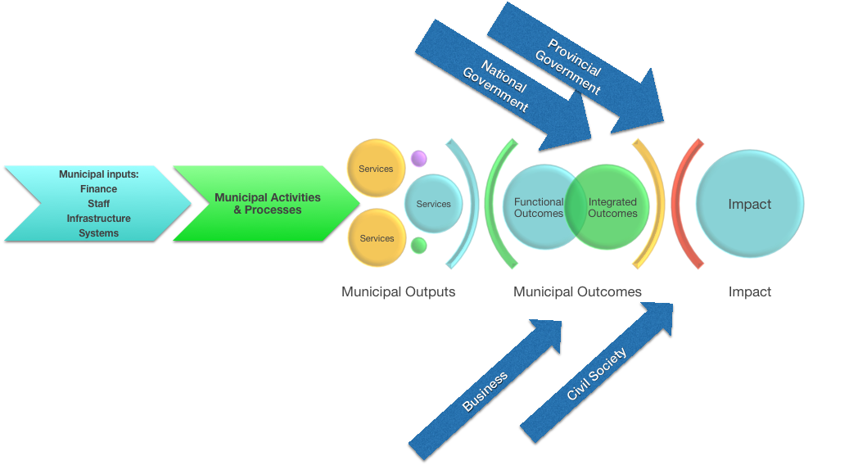
Municipal Results Chain-The Dream

Slide 26

CONCLUSION
SOON THE INTEGRATED PLANNING AND REPORTING IN ALL THE THREE SPHERES OF GOVERNMENT WILL BE ACHIEVED

Slide 27


Slide 28
THANK YOU
BIBLIOGRAPHY:
MFMA Circular 88
National Treasury FMPP
MFMA Circular 13
MFMA Circular 63
Municipal Circular on Rationalisation Planning and Reporting Requirements for the 2018/19 MTREF Presentation: 30 November 2017

