Slide 1
The Future of Work
CIGFARO – 21 September 2021

Slide 2
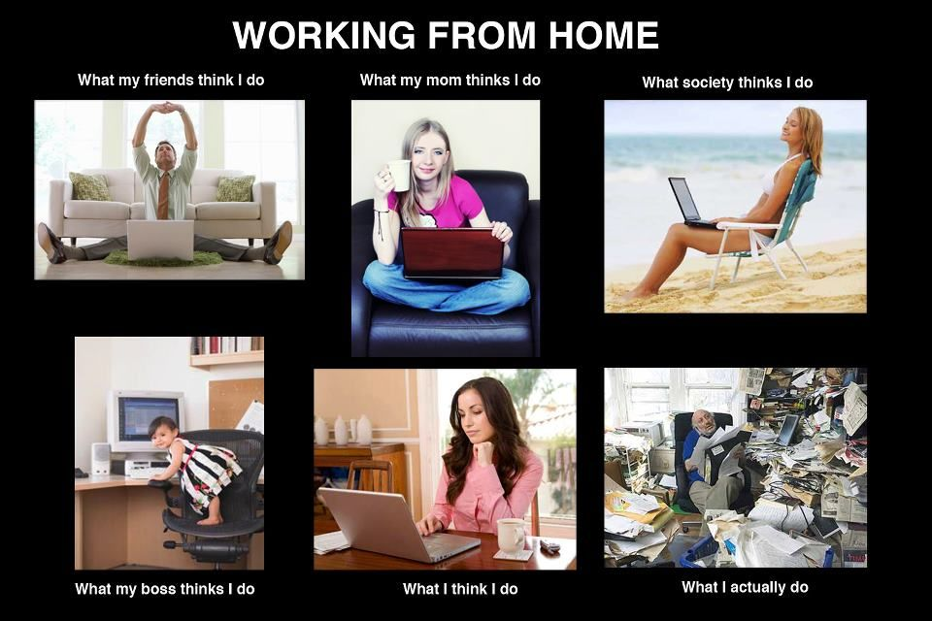
Working from Home sounded so glamourous …

Slide 3
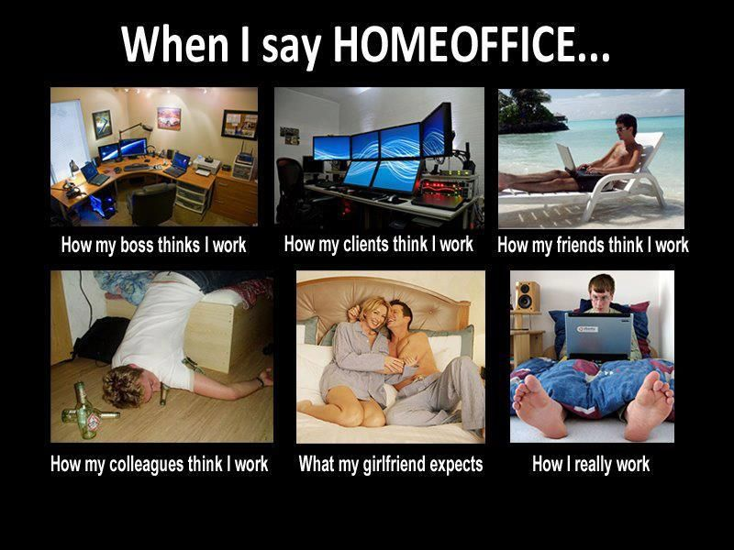

Slide 4
Working From Home - WfH

Slide 5
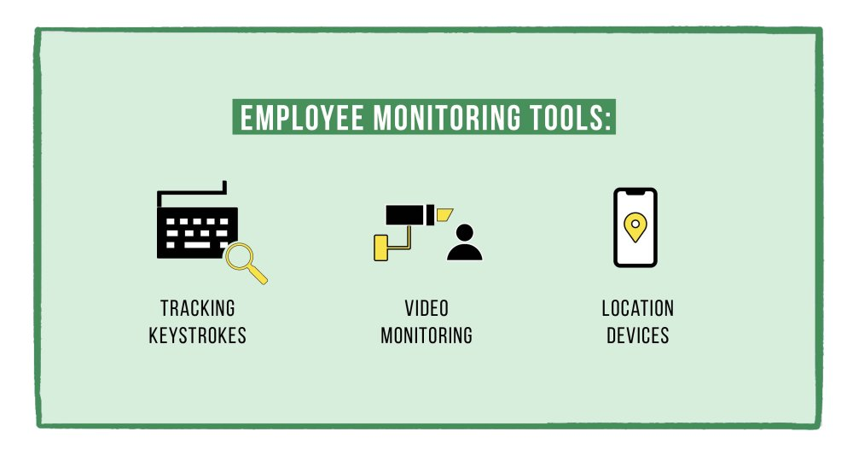
Is this the way we manage performance?

Slide 6
Manager Role – Motivating Staff …

Slide 7
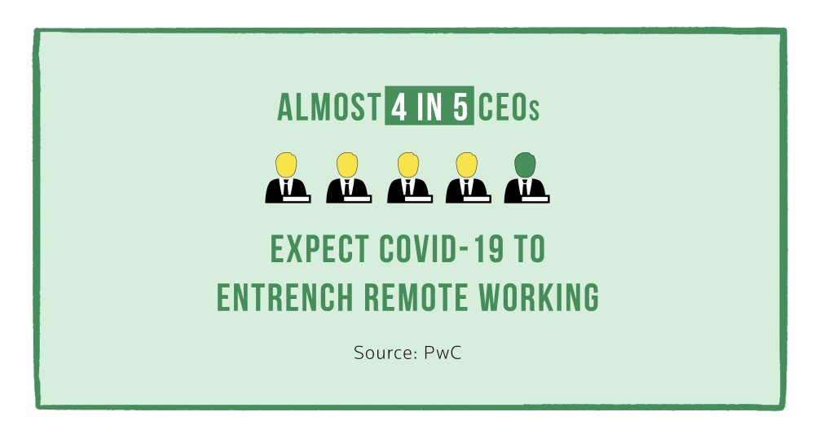
WfH – is this the Future of Work?

Slide 8
Future of Work – Some Considerations for WfH
Remote interviews
Supporting documents for interviewee
Bandwidth availability
Psychometric Tests - one venue/many venues
Onboarding new staff
“In office”
Sharing corporate culture
Handing over computers / tools
Training on tools used – online computer training?
Management of Cyber Security
Password protection
Virtual Private Network
POPIA
Management
Outputs and outcomes, milestone management
Time management
New Opportunities
Gig Economy
Overseas training (time differences)
Reduce/reconfigure workplaces to “hot desks”
Reduction in sick leave
New Challenges
Distance from work (for F2F meetings)
“Home office provision”
Different Abilities

Slide 9
Thank You
For Queries contact: Louise.Muller@capetown.gov.za

