Slide 1

Why have we failed to do what the Constitution and MFMA expected us to do?
CIGFARO Conference 2021
Ismail Momoniat, National Treasury

Slide 2
STATE OF LOCAL GOVT TODAY according to TREASURY
I have been away from LG for 16 years, and feel like Rip van Winkel – except that things have gotten WORSE!
  This despite all our idealistic planning 1994-2003
Corruption and lack of delivery in most municipalities
National Treasury colleagues say at least 163 municipalities were in financial distress before covid
  43 municipalities were facing a financial crisis
151 municipalities may be regarded as insolvent, unable to pay creditors, 3rd party payments – SARS, medical aid and pensions
Only 116 municipalities were not qualified in 2019/20, so over 150 municipalities were qualified or not audited!
Which are the successful municipalities and why are they successful?

Slide 3
Was our constitution too empowering to all municipalities?
Is your municipality regarded as a success today?
We have 278 municipalities (8 Metros, 226 local, 44 district)
  How many municipalities can be regarded as a success today?
  How many municipalities have progressively improved on their performance since 1994? Or since 2000 elections?
How many of our metros can be regarded as a success today?
Why should residents of a municipality trust it to deliver even very basic services?
Why should residents trust how a municipality spends its revenue?

Slide 4
How WIDESPreAD is corruption at local govt sphere?
We have seen massive corruption in national and provincial govt and our major SOEs
  SOEs: Eskom, Transnet, Denel, SAA, PRASA (state capture)
  National/provincial govt: BOSASA, ESTINA and many others
What is the extent of corruption at local govt?
Which metros are not regarded as corrupt?
Which local municipalities are not regarded as corrupt?
Which municipalities have procurement processes that have not been corrupted?
Why is the audit process not recording all corrupt or suspicious transactions?

Slide 5
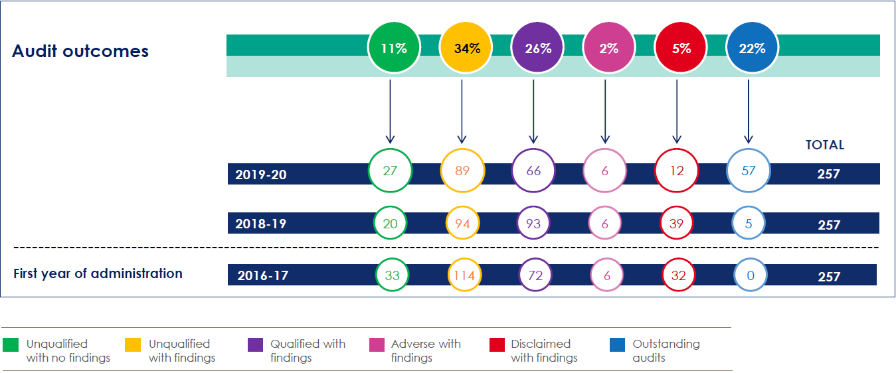
Slide from Treasury colleagues:
MFMA 2019/20 Local Government Audit Outcomes confirms position…

Slide 6
slide from TREASURY COLLEAGUES: WHAT FAILURES ARE THERE AT LG
Prior to COVID-19, a number of municipalities were already:
  Failing to deliver services and take care of their assets
  Failing to prudently manage fiscal resources, bill and collect revenue
  Failing in their leadership functions
  Failing in their governance functions
  And hence failing in meeting the agenda for a developmental local government
These failures manifested in:
  An unprecedented growth in municipal debtors
  An unprecedented growth in outstanding creditors
  Dismal year-on-year audit outcomes
  An inability to meet basic salary commitments in some municipalities

Slide 7

SLIDE From TREASURY COLLEAGUES:
The Quarterly s71 publication 2020/21 FY reaffirms this performance trend:
2020/21 Financial year
R494.5 billion
(total adjusted expenditure budget)
R423.8 billion
(operating expenditure)
R70.8 billion
(capital expenditure)
>30% to salaries and wages
Some cases 45 – 50%
Consumer debts R230.7 billion (R230.5 billion - 31 Dec 2021)
Outstanding creditors R65.5 billion (R67.2 billion – 31 Dec 2021)
As at 31 March 2021, 3rd Q
R323 billion (65.3%)
(expended)
R68.4 billion
total balance on borrowing
R44 billion is owed to Eskom -
R35 billion in arrears (top 20 defaulters owing 85 per cent of the debt)
R288.3 billion (68%)
(operating expenditure)
R34.6 billion (48.9%)
(capital expenditure)
R43.4 billion
total investments
Total allocation of direct grants R29.4 billion -
R29 billion was transferred expenditure reported 62.9 %
R10 billion is owed to Water Boards and another R7.5 billion to the WTE of the department
R95.3 billion
(salaries and wages expenditure)
(Source: MFMA S71 reports)

Slide 8
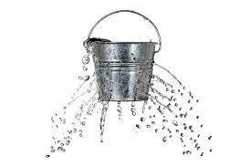
SLIDE FROM TREASURY COLLEAGUES:
The approach to address the challenge…
National / Provincial Government
Constitutional role
in averting financial crises and municipal dysfunctionality
Throwing money to the problem will not solve it
  Correct application of the S139 intervention process
fix the holes first
Instil fiscal discipline
Restore effective governance and well functioning Troika’s
Invoke consequence management, councils must be decisive
Government failure will continue to be directed by the courts, weaken confidence of civil society
Administrative capacity must be addressed, MMs and CFOs
Remedies must respond to the problem – Cabinet decision to dissolve Lekwa council demonstrate decisiveness
Address asset management failures, poor asset management translates to no revenue, this translates to service delivery failures and visa versa
Address Municipal staff remuneration challenges: Bloated org structures and skills gaps
Address poor budgeting, over expenditure and revenue management (closer to norm) practices,
enforce funded budgets
Municipal Council, Mayor and Municipal Manager must be held accountable
Coordinated and Integrated S154 support

Slide 9
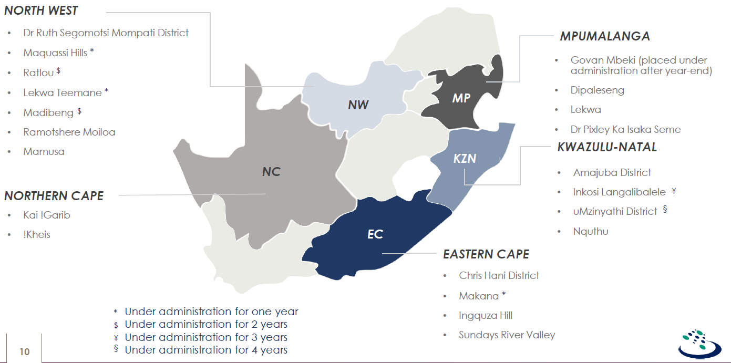
SLIDE FROM TREASURY COLLEAGUES:
MFMA 2019/20 Local Government Audit Outcomes
Overall trends and observations
Local government finances continue to worsen
Over a quarter (26%) significant doubt on ability to continue as going concern
Municipal debtors not recoverable (average 63%) resulting in creditors greater than available cash at year end for almost half of municipalities (49%) and average creditor payment period of 209 days
Large portion (36%) of estimated recoverable revenue and equitable share used for salaries and council remuneration only 2% of expenditure towards maintenance
High unauthorised expenditure (R14 billion) and 30% ended year with a deficit
Key messages from AG
Improvement in outcomes, but they might not be sustainable due to poor control environments
The state of internal controls, coupled with lack of consequences for transgressions and weakened oversight is at the centre of the deteriorating accountability in our local government and increasing levels of UIFW expenditure
Lack of accountability creates a perpetual disrespect for regulations, resulting in mismanagement of resources and lack of service delivery
Total neglect of internal control disciplines resulting in financial and operational collapse, weakened governance and lack of accountability
Leadership concerns
Consequence management not consistently enforced
Lack of active leadership supervision for a sustainable control environment
A need for leadership to bring about accountability
Leadership must be aligned and actively lead
Sustainable change starts with leadership to drive it

Slide 10
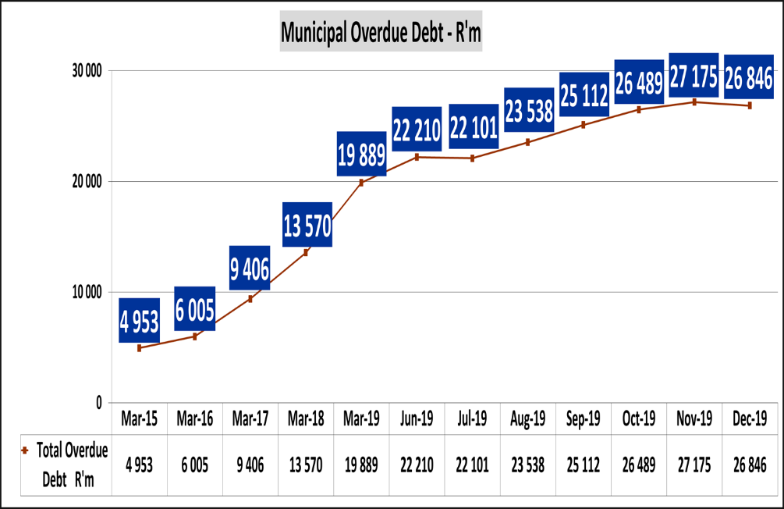
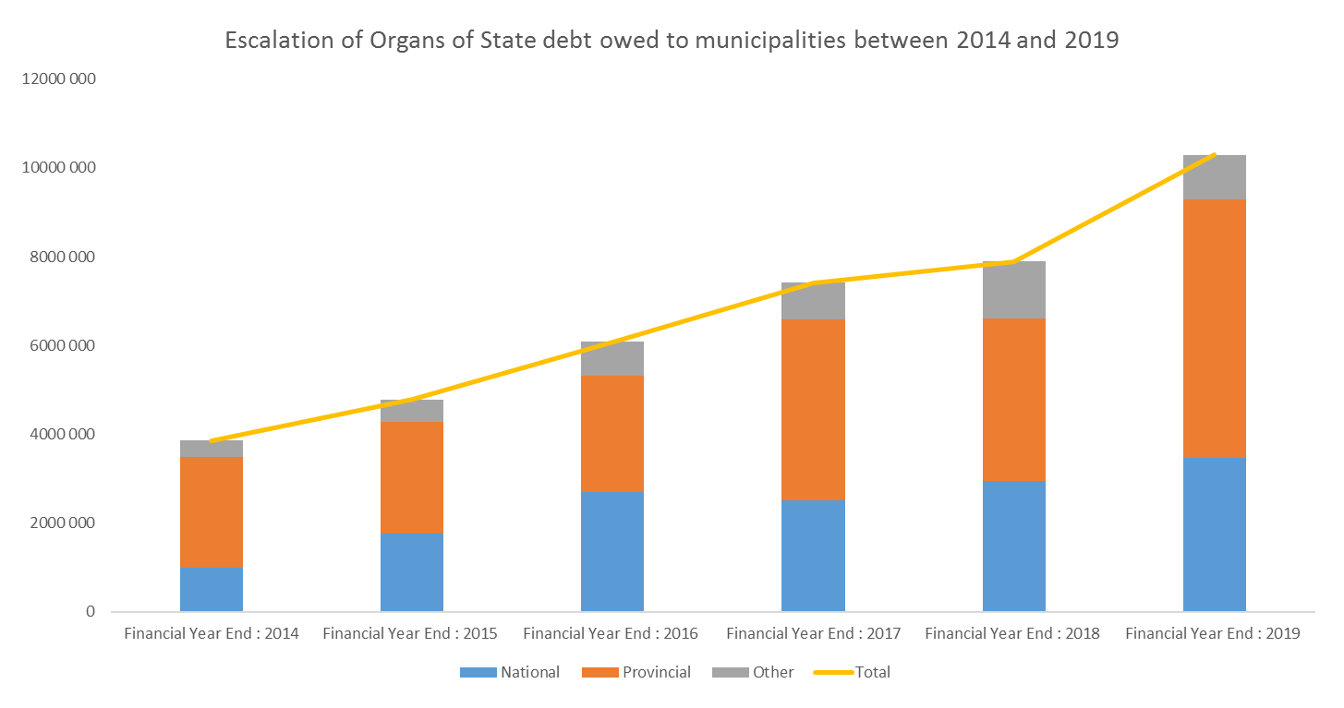
SLIDE FROM TREASURY COLLEAGUES:
Electricity (ESKOM) and Water (Water Boards & WTE) Outstanding Debt
Eskom
S71 report, March 2020 - Organs of State debt – R14.8bn
S41 report, March 2020 - Eskom debt owed by municipalities – R26.8bn, S71 report, March 2020 – R21.6bn
S71 report, March 2020 – Water debt R9.4bn

Slide 11
previous 6 NT SLIDES ALL SAY WE AS FINANCIAL OFFICIALS ARE FAILING
All the measures in previous slides from Treasury colleagues suggest that we as finance officials are the big problem
Is it because we cannot deal with political pressure?
How PROACTIVE are we with our political principals to take PREVENTIVE action?
Whose fault is it if the municipality fails to collect ALL of its revenue?
Whose fault is it if the municipality is making UNREALISTIC revenue projects and actually concealing DEFICITS that will CERTAINLY materialize?

Slide 12
Did we MAKE TOO MANY heroic assumptions for lG SYSTEM in 1997-2003?
Constitution 1997, Str Act 1998, Systems Act 2000,MFMA 2003
We made LG one of the three autonomous spheres of govt
We assumed ALL our municipalities would be capable and would perform – and that the CFO and finance officials would be professional and effective in doing their work
We assumed that all key players in LG will always act in the public interest?
  Mayors, mayoral/executive committees, councillors?
  Municipal manager(MM) and officials?
  CFO and financial officials
We assumed all would be honest, except for a few rogue elements
We assumed that our system would quickly identify, and remove, those that are corrupt

Slide 13
We ASSUMED CORRUPTION WOULD NEVER BE SO DEEP AND WIDeSPreAD
We thought corruption would be in isolated cases only, and when we found one player doing wrong, that player would be sanctioned and removed from office
We NEVER thought corruption would be so DEEP, SYSTEMIC and WIDESPREAD
We NEVER thought all players would be doing wrong at the same time, and even colluding in many cases
We never thought that our criminal prosecution authorities would hardly ever successfully investigate and prosecute those doing wrong!
WHAT FORMS OF CORRUPTION DO WE SEE?

Slide 14
WE ASSUMED ALL WOULD BE ACCOUNTABLE!
We assumed that the Council would hold the mayor/exco and MM/officials to account? And ACT DECISIVELY when they saw any problems!
We assumed that if the mayor was doing wrong, the Council would stop and act against the mayor
We assumed if the MM was doing wrong, the mayor would act against the MM
We assumed if other officials were doing wrong, the MM would act against such officials
We thought whilst political parties may differ on policy and budget issues, they would be more united on performance issues (as this was a technical outcome)

Slide 15
WE HAVE CLEARLY FAILED – WHAT DO WE DO NOW to FIX the system?
Can we as officials fix up the system in spite of the politics? Or reduce the scope for corruption
YES, to a large extent, if
  MM and CFO have BACKBONES and can say NO to all inappropriate requests, even if it is from the mayor or influential councilors
  MM as Accounting Officer and CFO refuse to do approve or allow any wrongful or illegitimate expenditure
  MM and CFO focus on ensuring that the administration will deliver on basic services, and prioritises doing the basics well
YES, if we implement Chapter 13 of NDP on the POLITICAL-ADMIN INTERFACE is CLARIFIED, and a professional public service established
It will be difficult, and we will be persecuted, but we must NEVER yield to corruption

Slide 16
YES WE CAN DO BETTER IF OFFICIALS INSIST ON DOING THEIR JOBS
MM is responsible for dealing with the weaknesses identified in the audit process
MM MUST ensure that the council has an effective internal control system, and a competent AUDIT COMMITTEE
MM MUST regard PROCUREMENT as HIGH RISK, and ensure procurement processes have INTEGRITY and there is NO INTERFERENCE from the mayor and any other councilors
MM must ensure officials who run key engineering and technical services (water, electricity) have the skills and expertise to do so
MM must ensure that ALL REVENUE is collected, and have REASLISTIC BUDGETS (and projections)
HOW DO WE AVOID ANOTHER VBS TYPE SCANDAL?
MM must ensure that all bills are paid, inc Eskom and water boards. And check who is not paying to the municipality!!!
BEING an MM or CFO is a TOUGH JOB!

Slide 17
OLD REFORMS THAT MUST STILL BE IMPLEMENTED
How do we improve the revenue collection system in local government?
What is the fiscal capacity of municipalities (rates, user charges) and how do we take this into account when determining the equitable share?
How do make users pay for electricity, water and other services?
How do we ensure that we get VFM for each and every tender?
How do we ensure that transformation and localization objectives are not abused to weaken primary objectives?

Slide 18
HOW DO we use our preventive AND EARLY WARNING TOOLS?
How do we make our INTERNAL CONTROL systems work better?
  MUST NOT BE RESTRICTED TO FINANCE
  Non-financial measures on delivery of water, electricity, fixing up leakages and portholes
  How do we ensure our traffic police do not take bribes?
How do we improve our EARLY WARNING SYSTEMS?
How can our AUDIT COMMITTEES work BETTER?
WHAT OTHER PREVENTIVE TOOLS CAN WE USE?

Slide 19
The following boring reforms must be properly implemented
  Ensure that budgets adopted by the municipal councils are funded i.t.o. Section 18 of the MFMA;
  An improved revenue management framework for municipalities;
  The Municipal Standard Chart of Accounts (mSCOA) is being implemented;
  Improved asset management;
  An improved supply chain management system; and
  Addressing poor audit outcomes

Slide 20
MUNICIPAL RETIREMENT FUNDS: How to do better?
What is happening with municipal employee pension/provident funds?
Why are there so many and are the trustees and administrators appointed for life?
What are the charges and benefits for members?
  Can we not consolidate these into one or two or three funds and lower charges?
How do we ensure portability btw pension funds in the entire public service, including with GEPF and SoE pensions?
And what is happening with the municipal councillor pension fund?
  How does the pension fund factor in that councilor are elected for 5 years at a time?

Slide 21
New CHALLENGES and OPPORTUNITIES
CLIMATE CHANGE – the biggest risk to human kind
  Renewables, public transport and other challenges
RECYCLING ECONOMY – how do we deal with waste? How do we deal with plastic waste? How do we deal with landfill sites?
URBANISATION and SPATIAL CHALLENGES
RURAL DEVELOPMENT
REDUCING the COST of DOING BUSINESS

Slide 22
CONCLUSION
LET US FOCUS ON IMPLEMENTING OLD REFORMS, and take note of NEW CHALLENGES (eg climate change)
  Can we check why we are not getting the BASICS right?
HOW DO WE BECOME MORE ACCOUNTABLE TO THE PEOPLE?
Government is a complex organism, and many factors can cause us to fail – but we must still succeed!
  Times to say YES and times to say NO, and not be fired!
We need to be open to deal with the mistakes of the past, whatever they are – we clearly did not plan well
  Should we REVIEW HEROIC ASSUMPTIONS and make the system more able to deal with FAILURES?
  Are the PLANNING and BUDGETING SYSTEM worth the paper they are written on?
How do we improve GOVERNANCE and reduce the scope for DISCRETION and CORRUPTION?
How do we as FINANCE officials make the system work better and more effectively?

