Slide 1
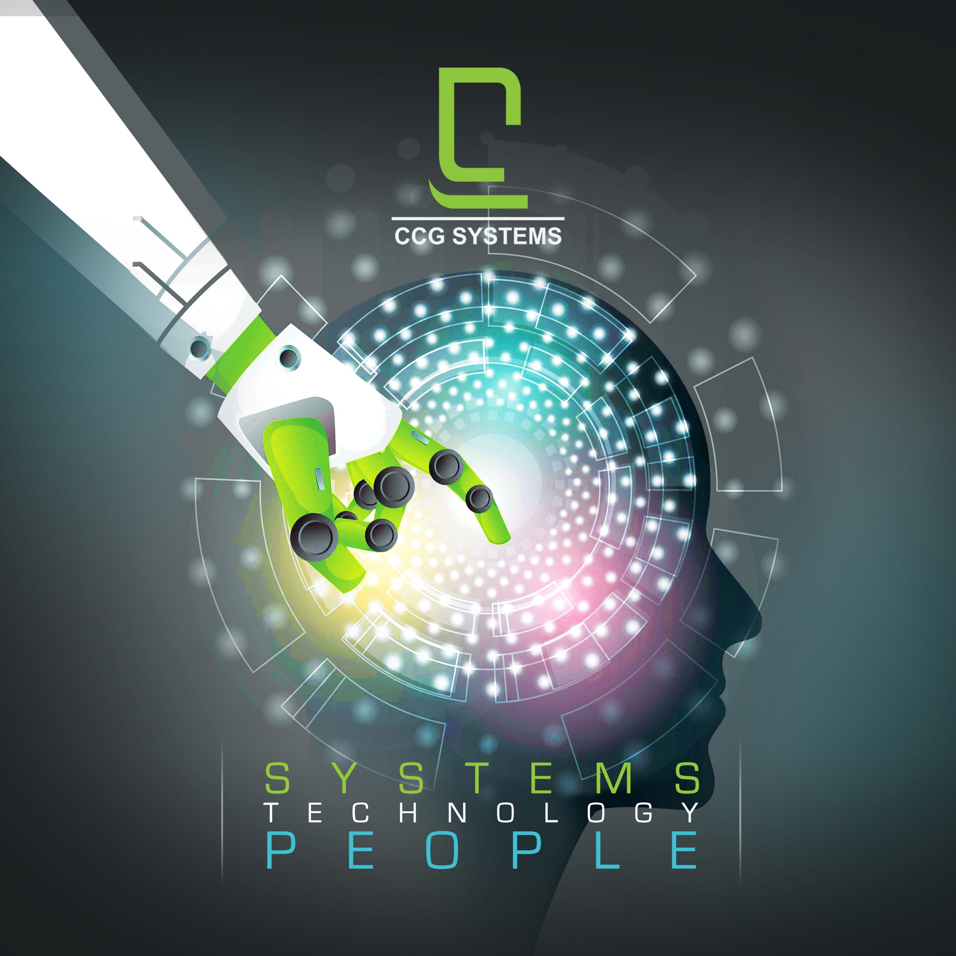
Notes:
Good morning everyone and thank you to the event organizers, sponsors and esteemed dignitaries for this opportunity.
My subject matter is not the most appreciated. Its often scorned at as the general preconceived idea is that of annoyance bordering on hatred.

Slide 2
POPIA issues when working from home
Notes:
POPIA, and the potential issues when working from home.
Before I can address that specific statement, I need to first explain POPIA. In all its glory.
This is a practical explanation and I try to avoid legal terminology as far as possible.
Its created for humans, so humans need to be to understand it.

Slide 3
The roadmap
Why POPIA?
Who does this affect?
Impact on business
Impact on Employees
The ideal setup
Notes:
What do I want to cover today?
Why and what is POPIA?
Who does this affect?
Impact on business – the underlying benefits to popia
Impact on Employees –
What do we need to have in order protect ourselves and our data subjects, and work safely remotely
The ideal setup
What tools do we need to ensure compliance and improved data security

Slide 4
What is POPIA?
Protection of personal information ACT
New ACT that exists to protect individuals from harm by protecting their personal information.
Organisations in SA are the responsible parties, they are tasked at upholding specific conditions in order to protect personal information
If the organisation is located in SA
If the organisation process personal information in SA
Notes:
What is POPIA?
It’s the Protection of personal information ACT.
It exists to protect individuals from harm by protecting their personal information. It prevents companies from abusing and misusing our personal information.
Organisations and government departments in SA are the responsible parties, they are tasked at upholding specific conditions in order to protect personal information and ensure data are handled responsibly
When do you need to comply with POPIA?
If the organisation is located in SA
If the organization process personal information in SA
The roll out might not have been perfect. It caused great confusion and some element of chaos.
However I do believe the ACT is well intentioned. It exists the protect the individual, the man or woman on the ground.
It will add structure to an organization, a new layer of security and enhance reputations of organisations if done correctly.

Slide 5
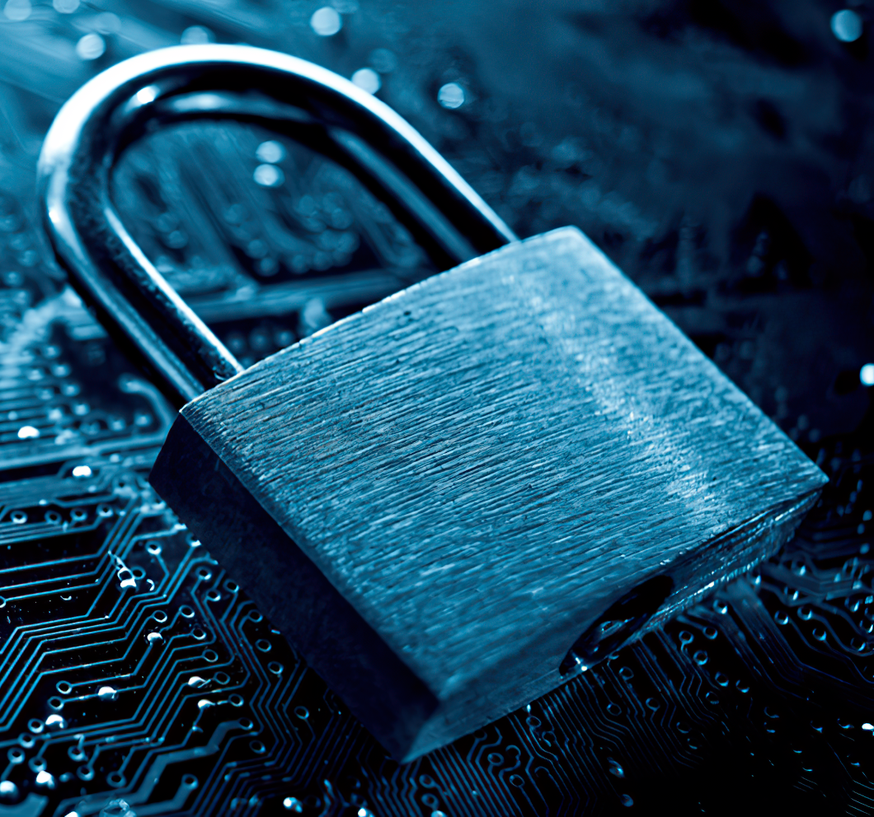
Why does it exist?
The Universal Declaration of Human Rights in 1948 declared the right to privacy.
Personal data belongs to the individual.
Individuals must give consent for their personal information to be used by organisations.
Organisations using personal information must respect it.
The information must be used purely for the purpose it was intended.
The information must be protected from the risk of theft and abuse.
Notes:
Why does POPIA exist?
we have a huma right to privacy.
Personal data belongs to the individual.
Individuals must give consent and be in charge of deciding what happens to their personal information when it comes to dealing with orgnisations
The information must be used purely for the purpose it was intended.
The information must be protected from the risk of theft and abuse.
Personal information is Data.
Data is an extremely valuable commodity and the frequent trade of data is common business practice in todays age.
There must be some sort of governance in terms of respecting the personal information of individuals as well as protecting the rights of consumers and employees.
Data is the new OIL.

Slide 6
The current environment
Sep 2021 – SA Justice Department "As a result, all electronic services provided by the department are affected, including issuing of letters of authority, bail services, email, and the departmental website."
July 2021 – SA Transnet “Gateway to Africa” closed for business.
May 2021 – US Colonial Pipeline Co. $4.4 million ransom.
Koeberg – When, not if.
Notes:
The current landscape are rife with cyber security attacks.
Sep 2021 – SA Justice Department - "As a result, all electronic services provided by the department are affected, including issuing of letters of authority, bail services, email, and the departmental website.” – the latest update on this attack is that a Ransom of 50 Bitcoin (approx. (R33m) has been requested. The hackers even included a security suggestion – use Cloud hosted Backup.
July 2021 – SA Transnet “Gateway to Africa” closed for business. - The hack disrupted normal processes and damaged equipment and information, culminating in the declaration of a force majeure at the ports' container terminals
May 2021 – US Colonial Pipeline Co. $4.4 million ransom. – The largest pipeline in the US, was brought to a halt due to the usage of a legacy system, that did not have a second level password protection safeguard.
Koeberg - not just yet. – When, not if.
Frequent cyber attacks sped up and forces the requirement of data regulations. These are some of the most recent local and global events that have made headlines. The Information regulator as announced that 38 Data breaches were reported only in the month of august.
Criminal org are targeting utilities and other gov departments. These could be seen as most vulnerable.
All the more critical to firm up data management, data security and data compliance.
In this new era that we find ourselves in, what are the risks?

Slide 7
Compliance risk Policies, processes & training!
Reputational risk Employees & organisation
Cyber risk Hand-in-hand with POPIA, business continuity & disaster recovery
Human resources risk Employee data risks
Legal risk Fines and ultimately imprisonment
Notes:
And there are plenty to consider. Org need to be cognizant of these risks and how to mitigate them.
Compliance Risk – you need to spend time on understanding what compliance risks are in your orgnisation. Ensure you have the right policies and processes in place.
Reputational Risks
There will always be a risk of reputational damage once a business has been through a data breach or a cyber attack. This will have a financial ripple affect. The bigger they are the harder they fall.
Cyber Risk
POPIA encourages data security. And we need to do what we can to ensure we have the right mechanisms in place. Ignorance will not hold up as viable excuse anymore.
Human Resource risk
As employees, who trust organisations with our personal data, our personal identiies are at risk.
Legal Risk and the legal ramifications
If not considered and mitigated carefully, orgnisations leave themselves open to lawsuits, (both criminal as well as civil)

Slide 8
Impact on Business
Notes:
Lets now zoom into the micro-environment. What must businesses do and what can it mean for them?

Slide 9
Impact on business
The new regulation as outlined by the Regulator has made all organisations in SA the responsible parties.
They have to within the best of their abilities and within reason adhere to the outlined requirements of the ACT.
They need to create an environment of security & responsible behaviour.
Leadership.
Understand the requirements of POPIA, especially for areas under their influence
Drive the adoption of the appropriate behaviours throughout the organization.
Understand and regularly assess and respond to any privacy risk to their areas of operation.
If the organisation complies, they reduce the risk of exposure to data subjects
Notes:
The new regulation as outlined by the Regulator has made all organisations in SA the responsible parties. This means that they are the keepers and protectors of individual's personal information.
They have to within the best of their abilities and within reason adhere to the outlined requirements of the ACT.
They must create an environment of security & responsible behaviour.
Organisational Leadership need to:
Understand the requirements of POPIA, especially for areas under their influence and especially where they have responsibilities as information owners.
Leadership must drive the adoption of the appropriate behaviours throughout the organization. Through policies, education and culture shifts
Understand and regularly assess and respond to any privacy risk in their areas of operation. React quickly yet cautiously if an incident has been identified.
If the organisation complies, they reduce the risk of exposure to data subjects and thereby reduce the potential financial and reputational exposure.
Amidst all the regulatory conditions and structural requirements, Its not all fire and brimstone, there are still a few benefits in complying with regulations.

Slide 10
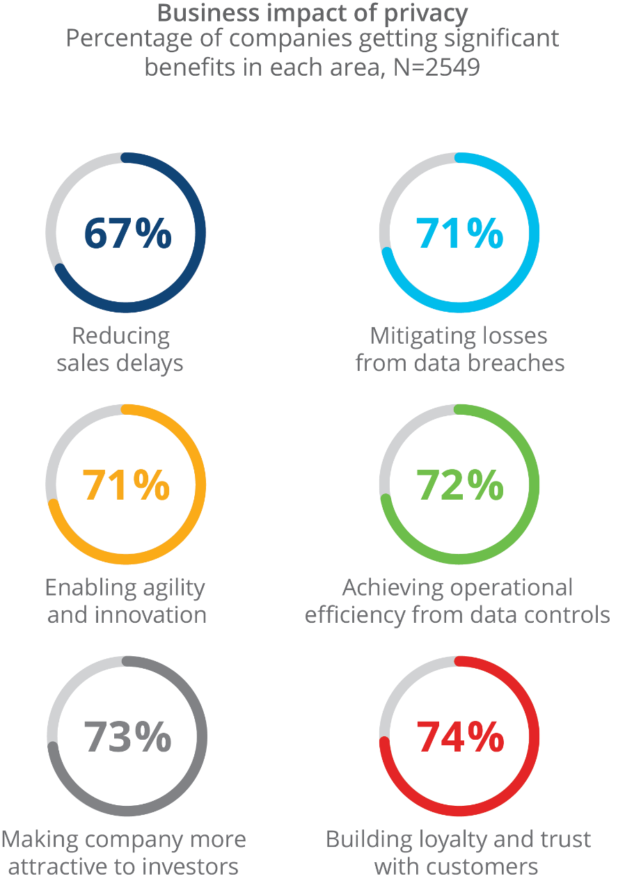
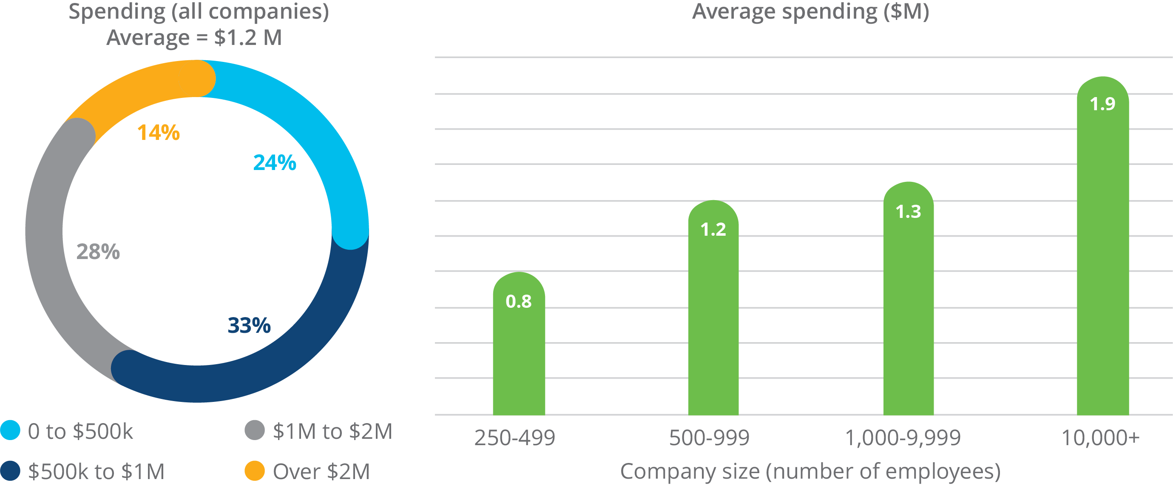
A comprehensive data privacy program will increase your profits and valuation.
“Most organisations are seeing very positive returns on their privacy investments, and more than 40% are seeing benefits at least twice that of their privacy spend.”
— Cisco Data Privacy Benchmark Study 2020
Notes:
1. Improved customer / constituent confidence
POPIA compliance will prove that your organization is a good custodian of data. The proposed security enhancements and practices will bolster your reputation, showing stakeholders that you have a robust data governance system in place
2. Better Data security
POPIA compliance will lay the groundwork for improved data security. Its critical now more than ever.
3. Reduced maintenance costs
Understanding what data is being stored, processed and for what reason would uncover certain redundant items in any organization. You will significantly reduce costs be consolidating information that’s is currently present inside silos or stored in inconsistent formats.
4. Better use of evolving technologies
A thorough evaluation of your existing network will allow you to fully consider the latest technology trends. And migrating towards this future, ie virtualision and cloud computing – resulting in better and more secure ecosystems and improved services to your audience.
5. Greater Decision making
Certain data driven decisions will now be improved merely based on the fact, that we pay closer and more special attention to the data we carry. Gone are the days of shot-gunning or applying a blanketed decision. We need to be more thoughtful as we are carrying specific data types. Which should lead in improved results.

Slide 11
A comprehensive data privacy program will increase your profits and valuation.
Gartner
“By 2023, 65% of the world’s population will have its personal information covered under modern privacy regulations, up from 10% today.”
“By 2023, companies that earn and maintain digital trust with customers will see 30% more digital commerce profits than their competitors.”
“By 2024, more than 80% of organisations worldwide will face modern privacy and data protection requirements.”
Notes:
From a commercial operation’s point of view the benefits of proper compliance can and will lead to more profit and increased positive reputations.
But from a government institution view, the benefits are quite substantial
- More effective public services
- a greater level of trust will be established
- As we move towards a more entrenched digital ecosystem, for a government that leads with secure and established data privacy foundations will sustain that faith over a longer period of time

Slide 12
Impact on Employees
Notes:
Now, the real reason why I am here.
What impact does POPIA have on the employees, especially now in this era of remote work.

Slide 13
Impact on employees
As an employee, you are a data subject and your personal information such as your name, identification, address and banking details' or perhaps sensitive data such as your health status or trade union membership, will be used.
Clients and customers are also data subjects. POPIA states that this personal information must be protected, it must remain fresh and valid and that data subjects must be able to access their personal information.
Notes:
Its critical that employees understand what they are, their specific rights and what they are responsible for.
It’s a a coin with 2 sides
Your rights must be protected and you must protect the rights of others.
In order to fulfill this mandate, there needs to be a controlled environment that focuses on both these aspects.

Slide 14
Remote working
Unprecedented times. New operating protocols. Identify risks and ensure mitigations are in place. Communicated in formalized manner.
Work from Home Policy
Underling the Do’s and Dont's
Highlighting physical and personal security
Acceptable Usage Policy
Protection of information should be emphasised
CCTV and other behavior monitoring policies
Monitoring must be communicated – lawful
Information security compromise policy
Reporting of incidents
Containment and recovery
Investigation and risk assessment
Notification
Evaluation and response
Information Protection and Handling Policy
Best Practices on protection of personal information.
All about awareness and training.
This is habit forming.
Ensure you educate and repeat.
Notes:
What does that controlled environment look like?
- The individuals need to be made aware what they can and cant do.
- A variety of polices need to be implemented and followed meticulously
- Work form Home policy
Underling the Do’s and Dont’s – What can you do with office equipment and what you cant do,
Highlighting physical and personal security – awareness need to be made around how to keep physical equipment safe and more importantly how to keep the personal information safe and secure.
Implementing AUPs (acceptable usage policies)
Protection of information should be emphasized and reiterated. Never leave your laptop open and unattended, Log off before you leave, especially if you have teenagers in your home.
Monitoring policies need to be carefully communicated and explained, be it physical such as CCTV, software based.
monitoring software are now common practice in business today. As employers need to still be to determine how and what their staff is doing.
Information Security Compromise policy
once an incident has become known,
what do you do, how do contain a potential breach,
then asses who is at risk –
what data has been impacted,
notify the correct decision makers and respond correctly as per any legal requirements.
Information Protection and Handling Policy
- Information classification – ensure that your data is classified to the degree that is clear to the users, what information is Confidential, Internal or for Public domain
Best practices on protection of personal information
Only process personal information which is relevant to our organisational needs
Together with our data subjects, keep their personal information up to date
Not keep personal information in the hope that it may become useful later on
Only grant access to the data to people who need to use it for their jobs
Educate, Train, Form habits and reinforce as often as possible.
Human error attributed to 90 percent of ALL breaches in 2019 – according to an analysis done by the UK Information Commissioner’s Office
So what can be done?

Slide 15
Implement the right systems
Technical implementations
Virtual private Networks – access tunnels
Hosted Solutions – cloud hosted data location / storage
Avoid public access areas
Cyber Security must be implemented and kept updated
Practical implementation
Policies
Personal accountabilities and responsibilities – self policing
Inline with Company’s privacy and use of data policies
Training programs
Notes:
There are a multitude of aspects to consider when you truly want to create a safe and secure remote environment for your organisations.
There will be technical implementations to consider such as:
- VPNs
- Hosting your critical applications in the cloud to provide ease of access, securely
- Voice of over IP telephony – to ensure communication channels remain open
- Enhancing cyber security to ensure all end points (meaning the individual machines / laptops) are fully secured
And Practical implementations
- New policy requirements
- Culture and habit forming around accountability and self discipline, personal protection,
Cyber Security awareness and Training must be conducted
Let me go through a specific checklist

Slide 16
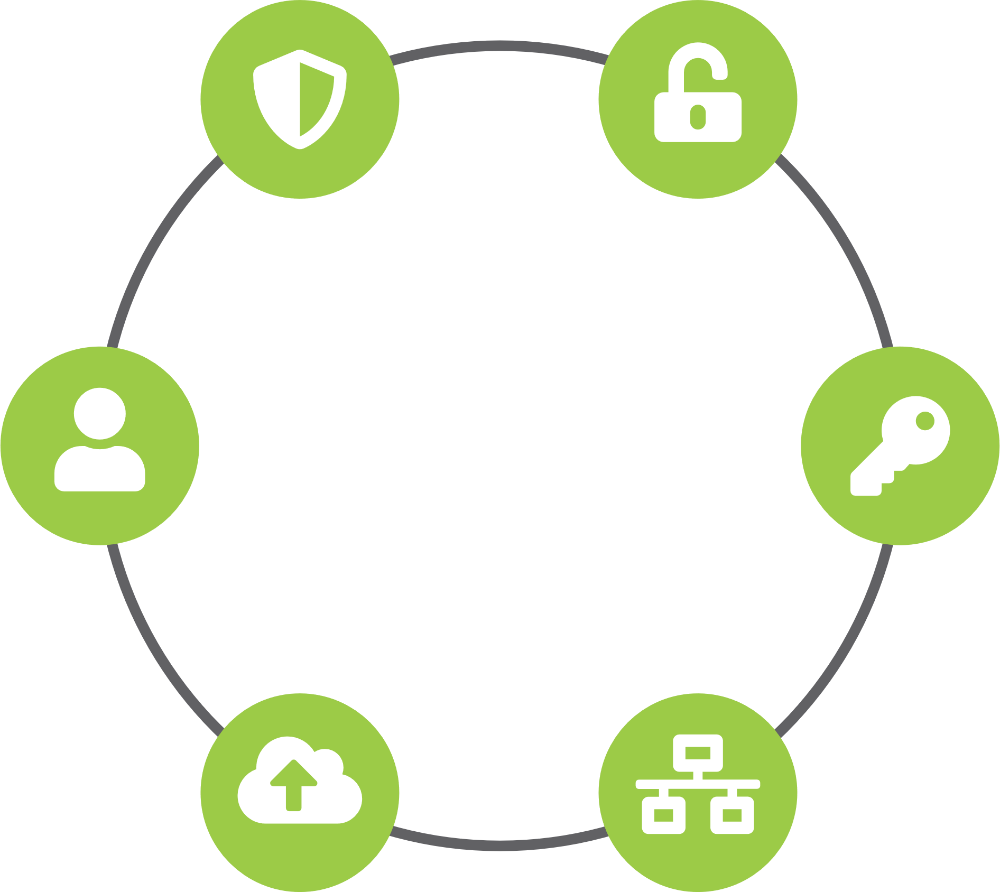
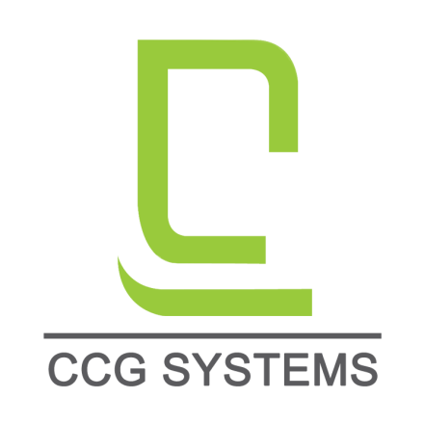
Options
Cyber Security – ransomware prevention
Cloud hosting – offsite, secure, fully managed
Disaster Recovery – restore data when hit by ransomware
Cloud-based compliance management software
Cloud-based secure file storage
Full network device backup and recovery (offsite and secure)
Office365 backup and recovery
Multi-factor authentication
Password management
Services offered by CCG Systems
Notes:
Here are a few options and technical terms to familiarize yourselves with whats needed and what it actually means.
Cyber Security – ransomware prevention, anti virus, cyber attack preventions.
Cloud hosting – offsite, secure, fully managed – take entire business applications away from physical locations.
Disaster Recovery – restore data when hit by ransomware, or any other kind of disaster
Cloud-based compliance management software – software that will assist you giving demonstrable proof of your compliance
Cloud-based secure file storage – store your mission critical files offsite away from physical devices, and fully secured
Full network device backup and recovery (offsite and secure) – backing up not just individual files, but entire networks for fast and easy recoveries.
Office365 backup and recovery – protect your emails and Microsoft documentation
Multi-factor authentication – adding an additional layer of security when accessing applications or accounts
Password management – consider a secure password management system, where users are assisted in creating and remembering secure passwords
And in conclusion….

Slide 17
In conclusion – reasons why full compliance is key
To enable safe remote working
The need to conform internationally has been massively accelerated by worldwide privacy laws.​
To rebuild our economy post-Covid we need to be able to participate in the global economy.​
We must manage our data flows and reduce risks wherever possible.​
We need to ensure we have appropriate risk management, oversight systems and technology measures in place.​
Now more than ever, there’s a great opportunity to be a part of this rebuilding, with positive outcomes for all.​
Next steps​
Compliance software​
Cyber Security​
Easy data recovery
Ensure a secure remote work environment
Notes:
In order to allow employees to continue working from home in a safe and controlled environment, Organisations need to ensure they play their part.
The need to conform internationally has been massively accelerated by worldwide privacy laws.​ Led by Europe, other nations and states are following suite.
To rebuild our economy post-Covid we need and the participation in a global economy.​ As growth of a digitization accelerates, it is critical that we keep up or forever remain behind.
we must manage our data flows and reduce risks wherever possible.​
We need to ensure we have appropriate risk management, oversight systems and technology measures in place.​
For all of us attending here, there’s a great opportunity to be a part of this rebuilding, with positive outcomes for all.​
Finally, I want to leave you a few steps​
Investigate what is available in terms of compliance software. POPIA need not be a manual burden to carry.
Consider if your cyber security, organization is wide is up to par with whats needed. If its not, reach out to experts.
Plan for the worst and hope for the best when it comes to your data. Have the required recovery channels mapped and ready to go.
By implementing specific policies and a robust internal structure you can ensure a secure remote-work environment

Slide 18
Thank You

