Slide 1
TRANSVERSAL CONTRACTING Office of the Chief Procurement Officer National Treasury of South Africa Molefe-Isaac Fani Chief Director
Pre-Conference Presentation - CIGFARO
06 October 2019

Slide 2
TRANSVERSAL CONTRACTING
Public Procurement in Context
Transversal Sourcing – A solution
Candide reflection of ourselves – where are we now?
Where are we going? The road ahead
Journey Evaluation – Are we there yet?
Questions

Slide 3
Public Procurement in Context

Slide 4
Public Service Procurement
The Public sector is the country’s single largest service provider. An incremental improvement in public service delivery positively impacts millions of people. More than R600 Billion Spend per annum.
Beyond advancing social objectives, public procurement in South Africa is also being leveraged towards generating employment, enhancing domestic manufacturing capacity, and supporting inclusive growth priorities.

Slide 5
Public Service Procurement
To support the overall goals of public service procurement, delivery must be clearly understood.
That means, using the public money effectively will enable government to:
Improve service delivery for citizens
Defeat inequality
Create jobs; and
Give value for money for purchases

Slide 6
Leveraging on Public Procurement - wins
Service delivery;
Quality, efficient, cost-effective
On time, right quality and quantity, the right price
Socio-economic objectives;
Address economic imbalances
Women, youth, people with disabilities, SMMEs
Job creation
Value-for-money and return on investment;
Getting the balance between the objectives is important

Slide 7
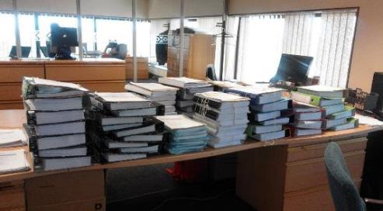
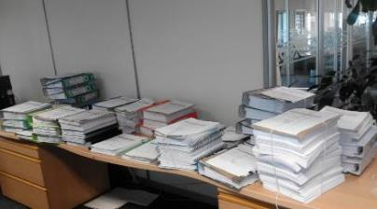
Problem statement
✓
Where does all the money go?

Slide 8
Problem Statement
Some of the challenges identified in the procurement value chain: need for transversal contracts:
A fragmented approach to planning and procurement and/or lack of systematic replenishment and replacement strategy
Inconsistencies in prices between private and public sector and between provinces exist for goods and services
The rapid rate of technological influx and lack of a scientific mechanism to decide on appropriate technologies
Poor maintenance practices with a high percentage of equipment that is not fully functional and high levels of maintenance backlogs coupled with low user training levels
Lesser control and monitoring capability, increased levels of corruption and abuse of the system, not realizing benefits from leveraging on economies of scale, poor inventory management.

Slide 9
Expanded Problem statement
Fragmented procurement system across the State
Lengthy tender processes – 6 months to a year to finalise a tender
Huge price variations between procuring entities
Poor standardisation in procuring same goods/ services/ works
Interference
Tenderpreneurism
Lack of capacity to conduct monitoring and compliance
Shoddy quality/workmanship in products/ services
Lack of focus on core service delivery
Lack Procurement planning
Over-use of RFQ methods
Inadequate Procurement Capacity
Manual Procurement System
Lack of Self-Monitoring Culture
Weak contract management
Unnecessarily appeals and judicial review process
Duplication of effort - RFx’s, Contract creation, Contract management, Supplier management, Supplier queries, Litigation, Cancelled tenders and contracts, Audit queries

Slide 10
Impact: delayed service delivery

Slide 11
Consequences: service delivery collapse

Slide 12
Transversal Sourcing – A solution

Slide 13
Legal Framework on Transversal Term Contracts
Transversal contracts are facilitated by:
National treasury
Provincial Treasuries – other than NT transversal contracts
Applicable to:
All Departments, National and Provincial
Constitutional and public entities as listed in schedule 2 and 3 to the PFMA
SOE may participate
Municipalities may participate (Regulation 32 of MFMA)
Transversal contracts provides for the following:
Voluntary participation in Contracts arranged by relevant Treasuries
Prohibition of facilitation of Transversal Term Contracts by other organs of state but the relevant treasuries

Slide 14
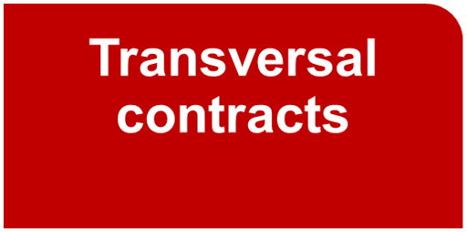
Transversal contracting
Over R25 Billion spend per annum under central management
Currently, the National Treasury manages 65 transversal contracts for the purchase of goods and service

Slide 15
Scope of centrally negotiated contracts
Reduce cost and Increase value
How? Leverage economies of scale
Departments, provinces, municipalities and entities are procuring from central contracts.
These centrally negotiated contracts:
Eliminate unnecessary duplication, reduce leakage and ensure better use of scarce procurement skills
Reduce the administrative burden for suppliers
Provides an opportunity for long-term supplier relationships and certainty in the market place
Better market intelligence across government
Reduce the administrative burden from repetitive quotes which could have been directed towards contracts; and
Allow government to refocus on contract management

Slide 16
Candide reflection of ourselves – where are we now?

Slide 17
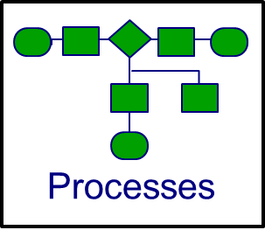
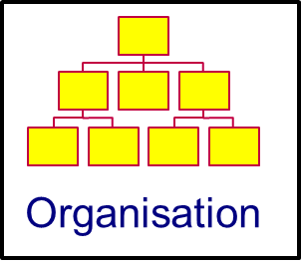
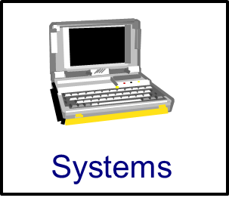
The current TC environment
Notes:
Any transformation must focus on the four levers of change

Slide 18
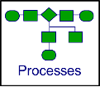
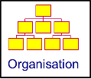
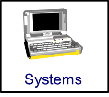
Current SCM challenges
PROCESS | ORGANISATION
Intensive Labour demand management process Paper based submissions leads to long bid management process Limited alignment between people, process and system Paper based process leads to long contracting lead times Lack of visibility on consumption / forecasting leads to incorrect contract values “Red tape” delays contract throughput Multiple extensions on contracts due to slow processes Payments against contract not honoured Weak contract management and supplier relationship processes | Inadequate stakeholder engagement The current organisation structure does not necessarily support the growth path envisaged
PEOPLE | SYSTEMS
Inadequate knowledge of new commodities Inadequate capacity to drive the annual spend Resistance to adoption of new technology / processes Buy-in from client Departments not always there Staff not catching “the dream” (tactical vs strategic) Skills and capacity gaps in current personnel | Current systems not performing optimally Limited utilisation of system functionality Numerous processes not performed in system ie. CPA, contract management, etc Paper based process to be replaced by system functionality

Slide 19
Where are we going?
The road ahead

Slide 20
Sourcing diagnostic and process enhancement
1.
Assess opportunity
2.
Define Internal requirements
3.
Assess External Supply Market
4.
Develop Sourcing Strategy
5.
Execute Sourcing Strategy
6.
Implement Sourcing Decisions

Slide 21
Evaluate Ideas
Cost saving ideas
Idea prioritisation matrix
Competitive Bidding
R100m
Long term high value projects
Star ideas- pursue immediately
1
3
Rationalise current specifications
2
Ideal value
Last priority
Quick-wins
4
3
Implement new corporate requirements
1
2
Reduce procurement, labour and admin costs
R0m
4
Low
(Difficult)
High
(Easy)
Ease of implementation

Slide 22
Negotiation Power
Potential Competitive forces
Level of Impact
Rationale
Many suppliers
Quality of supply is a key factor
High level of disengaging
Bargaining power of Suppliers
Low
High
Threat of New Entrants
Low
High
Low entry requirements
Low to medium capital outlay
Low and medium regulated industry
Bargaining power of Buyer
Low
High
Significant annual spend – largest market buyer
Product/ service for the majority of Departments critical for service delivery
Threat of Substitutes
Low
High
Low, if done, not a threat
Level of manufacturing in SA low
Competitive Rivalry
Low
High
Aggressive price competition
Open trade markets allowing participation by multinationals
Negotiation Power
Balanced

Slide 23
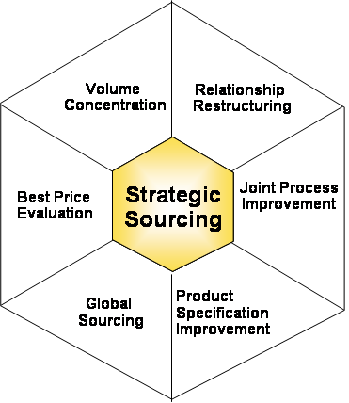
Savings Approaches
Supplier rationalisation
Increase supply base
Reduce Volumes
Volume pooling
Volume redistribution
Category consolidation
Stadardisation
Analyze core competencies
Examine make versus buy decisions
Networking
Once off vs strategic partnerships
Renegotiate contracts
Bundling & Un-bundling
Current Market
Reverse engineering
Reverse Auctions
Internal price benchmarking
Transportation / packaging
Exchange Rate Indexing or Hedging
Formula Pricing
Fixed Pricing
Lowest quoted price or lowest cost
Competitive bidding
Develop long-term contracts
Supply chain integration
Consignee stock and supplier maintenance
Simplified ordering
Joint improvement opportunities
Outsourcing and Insourcing
Optimize communication
Strategic alliance
Rationalise / Standardise
Piece part of assembly
Consulting or engineering standards
Product or part substitution
Concurrent production
Value engineering
Examine life cycle cost
Develop long-term contracts
Identify global suppliers for the Commodity group
Market protection

Slide 24
Ease of Strategy Implementation
Easy
Ease of Implementation
Difficult
Volume
Concentration
Demand
Management
Actions
Best Price
Evaluation
Global
Sourcing
Product Specs
Improvement
Joint Process
Improvement
Relationships
Restructuring
Supplier rationalisation
Increase supply base
Reduce Volumes
Volume pooling
Volume redistribution
Category consolidation
Standardisation
Policy changes that reduce demand for the product/ service or substitute lower price product/ service
Renegotiate contracts
Bundling/Un-bundling
Current Market
Reverse engineering
Reverse Auctions
Internal price benchmarking
Transportation / packaging
Exchange Rate Indexing or Hedging
Formula Pricing
Fixed Pricing
Lowest quoted price or lowest cost
Competitive bidding
Develop long-term contracts
Identify global suppliers for the Commodity group
Market protection
Rationalise / Standardise
Piece part of assembly
Consulting or engineering standards
Product or part substitution
Concurrent production
Value engineering
Examine life cycle cost
Develop long-term contracts
Supply chain integration
Consignee stock and supplier maintenance
Simplified ordering
Joint improvement opportunities
Outsourcing and Insourcing
Optimize communication
Strategic alliance
Analyze core competencies
Examine make versus buy decisions
Typical Focus for Initial Efforts

Slide 25
Quantify benefits at three relationship levels
NATIONAL TREASURY
Consistency in policy application and effective contract management
Negotiate better prices based on bulk buying
INDUSTRY
Less administration burden
Enable suppliers to negotiate better prices for the materials/products manufactures
END-USERS
Access to products and availability (Right products delivered in full and on-time)
Quality products and service delivery
Scarce procurement skills are better utilized
Market intelligence can be shared across public sector and maintaining sustainable competition
Opportunity for improved distribution planning
Managing business risk i.e. forex exchange fluctuations
Less administration burden
Close monitoring and reporting on supplier performance

Slide 26
Journey Evaluation - Are we there yet?

Slide 27
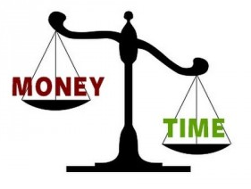
Key Results
Key Results
Efficient Procurement Management
Low internal administrative cost for institutional-level services
Lowered cost for suppliers
Leverage category spend across all departments
Realisation of targeted saving based on current spend portfolio
Improve quality of services

Slide 28
Performance Measures (have we arrived yet?
Significant reductions in prices of goods and services due to
economies of scale;
Better services at lower cost;
Increased purchasing power for Government;
Technical standardisation for government procurement;
Better performance management of staff; and
Effective contract management and controls, clean audit trail
Increased capacity by line Departments to focus on core
Achieve savings as a result of participation by organs of state
Increase participation by Local Government and State Owned Entities
Increase in Local, Black and Small Business Spend
Respond to empowerment of women
Respond to local economic development initiatives at provincial and municipal levels

Slide 29
The end – Thank you
Any questions?

