Slide 2
INTERNAL AUDITING
&
Risk Management

Slide 3


1. KEY CONCEPTS
1.1 WHAT IS RISK?
“uncertainty of events; including the likelihood of such events occurring and their effect, both positive & negative, on the achievement of the organisation’s objectives. Risk includes uncertain events with a potential positive effect on the organisation (i.e. opportunities) not being captured or not materialising” King IV
“The possibility of an event occurring that will have an impact on the achievement of objectives. Risk is measured in terms of impact and likelihood” IIA
Key Characteristics of Risk
Uncertainty = uncertain future events
Opportunity = positive outcomes
Hazards = negative outcomes
Risk Measure = impact and likelihood
“A possibility that an event will occur and adversely affect the achievement of objectives” COSO.
“effect of uncertainty on objectives” ISO 31000

Slide 4
1. KEY CONCEPTS
1.2 WHAT IS ENTERPRISE-WIDE RISK MANAGEMENT (ERM)?
“A process, effected by the Board, management and other personnel, applied in strategy setting and across the enterprise, designed to identify potential events that may affect the entity, and manage risk to be within its risk appetite, to provide reasonable assurance regarding the achievement of entity objectives” COSO
“An approach that enables an organisation to consider the potential impact of all types of risks on all processes, activities, stakeholders, products and services”
ISO 31000

Slide 5
ERM FRAMEWORK – IN PRACTRICE
Risk Oversight
Board
AC
ERM Process
Risk Drivers
Financial risks
Infrastructure risks
Market Place risks
Reputational risks
Establish the Context
Communicate, Report & Improve
Monitor and Review
Assurance
Internal Audit
External Audit
Assess Risk
Identify Risk
Analyse Risk
Enablers
RM Strategy
RM Policy
Implementers
Risk Committee
CEO
Management
Evaluate Risk
Risk Protocols
Tools & Techniques
Guidelines
Methodology
Treat Risk
Support
CRO
Risk SteeCom
Control Risk

Slide 6
1. KEY CONCEPTS
1.4 RISK MANAGEMENT (RM)
“A process to identify, assess, manage, and control potential events to provide reasonable assurance regarding the achievement of the organization’s objectives” IIA
Inherent Risk
Controls
Impact
Tolerance level
Residual Risk
RM is a systematic and structured framework used by an organisations to counter risks and exploit opportunities. It includes the risk management process
Likelihood

Slide 7
2. SOURCES OF RISKS
External
Internal
Changes
Difficult and at times impossible to control
Economic
Financial markets
Regulation
Competition
Come from business activities, processes, products & relationships
Use of technology
Information
Employee engagement and satisfaction
Changes in the business environment. This includes:
New technology
Changes in legislation
New personnel
New products & activities
Business expansions

Slide 8
3. INTERNAL AUDIT AND RISK MANAGEMENT
ENTERPRISE RISK MANAGEMENT FRAMEWORK
INTEGRATED ASSURANCE FRAMEWORK
Map key risks to processes (Heat map) Map key controls to key risks Identify sources of assurance and management rating of key controls
Control Self-Assessment Data analytics | Policy Management Fraud Risk Management Continuous monitoring Compliance Management Ethics Management | Risk based IA plans Internal/ external audits Other independent audits Quality Assurance Reviews
Strategy and Structure
Assurance Process
Risk strategy Risk culture Risk tools/ systems | Risk governance (structure & policy) Risk appetite | Risk change management
Risk parameters Risk assessment: Identify analyse Risk quantification Risk profile | Risk mitigation strategies risk action plans scenario analysis Risk registers | Key risk indicators (KRIs) Risk dashboard reporting on: emerging risks changes to risk profiles due to: KRIs Incidents Audit findings CSA result
Measure
Manage
Monitor
1st Level
2nd Level
3rd Level

Slide 9
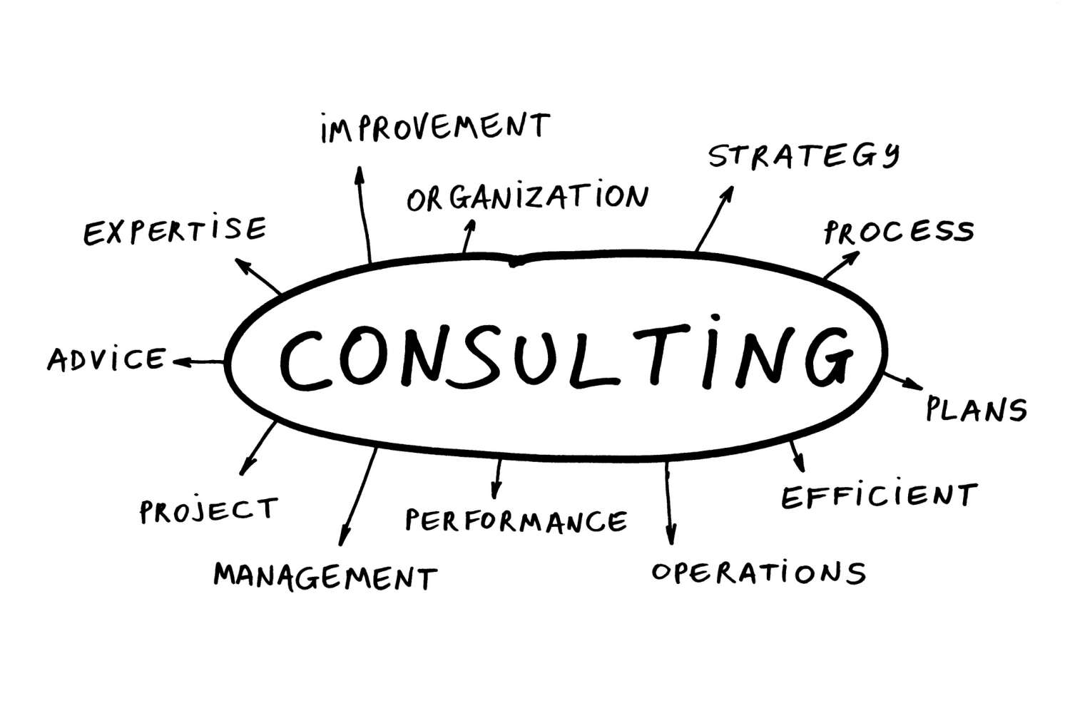

3rd LINE - THE ROLE INTERNAL AUDIT IN THE ERM
3. INTERNAL AUDIT AND RISK MANAGEMENT
ASSURANCE SERVICE
Diagnosis: Risk Register
Scope determined by the IAF based on risk exposure
Evaluate risk mitigation - Adequacy and effectiveness of controls
Recommend improvement
CONSULTING SERVICE
Diagnosis: Management & Risk Register
Scope determined by client
IA proactive
improvement initiatives

Slide 10
3. INTERNAL AUDIT AND RISK MANAGEMENT
ASSURANCE VS CONSULTING
Weak ERM process or controls = Consulting
Strong ERM processes or controls = Assurance

Slide 11
4. RISK BASED INTERNAL AUDIT PLAN
WHY RBIA?
IPPF – Definition
Internal auditors help an organization accomplish its objectives by bringing a systematic, disciplined approach to evaluate and improve the effectiveness of risk management, control, and governance processes.
IPPF – Core Principles
Internal audit MUST:
Be aligned with institutional strategies, objectives and risks.
Provide risk based assurance.

Slide 12
4. RISK BASED INTERNAL AUDIT PLAN
WHAT IS RISK BASED INTERNAL AUDITNG (RBIA)?
RBIA is the methodology that:
Assesses that risks are being managed within the organisation’s risk appetite.
Reviews the management of key risks to ensure that controls have been put in place and are being monitored.
Provides assurance that controls are adequately designed and operating effectively.

Slide 13
Audit focus areas
New Regulations
Covid-19 relief funding and assistance
Remote working
Cyber security
OHS protocols
Cost saving/reduction measures
Service delivery

Slide 14
Audit Objectives
Improve organisational resilience
Enhance Controls
Ensure compliance
Support achievement of objectives
Ensure safeguarding of assets
Provide Assurance to executive management

Slide 15
4. RISK BASED INTERNAL AUDIT PLAN
Develop a 3-year based plan
YR1- Audit Plan
YR 2
YR 3
Audit Universe
Select significant audit engagements
Group universe into auditable manageable units
Risk assessment of auditable manageable units

Slide 16
Key Covid-19 Risks
Internal
Back to work readiness
BCM strategy
Resource Management (Asset Management)
International event impact (second wave impact)
External
Management of infections
Market movements
Impact of Lockdown
Social Issues

Slide 17
Internal Audit Considerations
Staff
Information access
Audit execution
Remote meetings
Onsite audit execution

