Slide 1
KEYNOTE BY PRESIDENT

Slide 2
THEME: New World – New Thinking

Slide 3
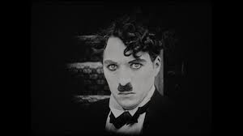
CHARLIE CHAPLIN

Slide 4
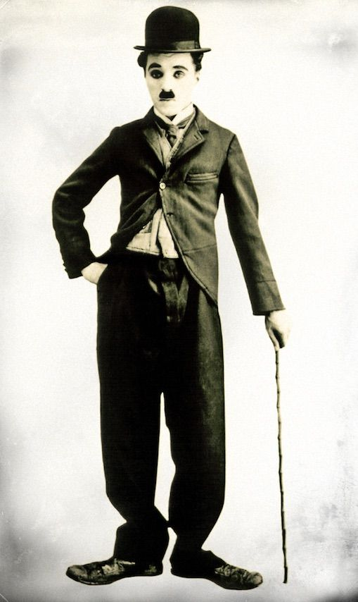
HE WAS 88 YEARS
Nothing is forever in this world, not even our problems.
I love walking in the rain because no one can see my tears.
The most lost day in our life is the day we don't laugh.
Stick to the following 6 best doctors at all stages of your existence and you will enjoy a healthy life:
The sun
Rest
Exercise
Diet
Self-respect
Friends.
By looking at the moon, you’ll see the beauty of God;
By looking at the sun, you’ll see the power of God.
And when looking in a mirror, you’ll see God's best creation. So believe it.
We are all tourists and God is our travel agent who has already identified our routes, bookings and destinations. Just trust him.

Slide 5
Lastly:
Life is just a journey; enjoy it and live it because tomorrow may not be...

Slide 6
Thank You!

