Slide 2
CIGFARO Workshop By Lourens Nel (Pr.Val)
The Municipal Valuer
Municipal Valuations (Grey Areas) Educational Workshop

Slide 3
introduction
Welcome back
the discourses?
Session1: Important legislations, application and why?
Session2: The Valuer procurement & appointment. Property Register vs Masterfile.
Session3: Deeds office, Surveyor General Offices and Data collection.
Session4: GVR Maintenance, Supplementary Valuations & Rolls.

Slide 4
Session3: Deeds office, Surveyor General Offices and Data collection.
is about the…
status and importance of the deeds-, and cadastral data
effect to outcome, if good or poor deeds-, and cadastral data available, and the experience of the audience
and perhaps the maintenance tools, application and growth towards improving both ways

Slide 5
basic overview points
surveyor general office errors;
registered property;
registration dates;
surveyed and proclaimed areas (towns/erven);
subdivisions/consolidations/surveyed lands (erven and farms);
renumbering of towns;
demarcation errors;
registration divisions and authorities;
Deeds office regional divisions;
Etc

Slide 6
Pros and Cons of miscommunication between the Deeds Office and the Surveyor General Offices?
which is…
the heart and veins network of data providing for sufficient and accurate land audit verification and identifications…
Before the rest can be done or maintained…

Slide 7
and is subject to…
start-up costs and total costs?
and professional services and fees?
which requires for the Municipality and Valuer to budget for…

Slide 8
Out of 257 municipalities…
CRISIS:
43 collapsed (bankrupt);
151 on the brink of collapse;
Estimated R250b plus owned in rates/taxes, etc.
W/L owes in estimation of R90b….

Slide 9
TEAMWORK is important…
And EDUCATION is crucial…

Slide 10
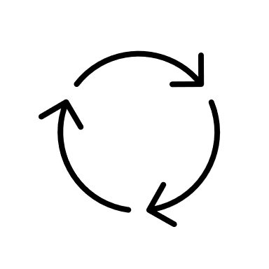
deeds & data error timeline for maintenance?
Jan/Mar
2020
GVR
Jan/Mar
2024
Repeat
Repeat
1Jul
2020
Jan
2021
1Jul
2021
1Jul
2024
31Dec
2025
1Jul
2025
30Jun
2021
1Jul
2021
30Jun
2022
1Jul
2022
30Jun
2023
1Jul
2023
30Jun
2024
1Jul
2024
30Jun
2025
30Jun
2025
1Jul
2025
30Jun
2026
EndY4
EndY5
BegY1
Y2
Y3
Y4
End Y5
BegY1
Repeat
SVR1
SVR2
SVR3
SVR4
Appoint a Valuer
Appoint a Valuer
bulk deeds prior “certified roll”. And which must be cleaned and linked with cadastral data…..
Then update deeds between submission period and end May (1-month prior implementation) for interim supplementary valuations.
From implementation date to new appointment of Valuer for the next term, there are the general Section 77 – 79 maintenance structure.
And ALL data nowadays have flaws!!

Slide 11
the Municipal Property Rates Act (cont.)
Section 45 – Valuation of property (it is Mass Appraisal with room for perfection and error and systems for correction allowed within the MPRA). Approach whether physical or not (optional), computerized systems or techniques, etc. GVR vs VRMS vs CAMA?
Section 49 to 53 – Public notice of valuation rolls, Inspection of, and objections to, valuation rolls, processing of objections, Compulsory reviews of decisions of the Municipal Valuer, Outcome notifications of objections and reasons, etc. (Covered in sessions 4)
Section 54 to 55 – Deals with Rights to appeal, and Adjustments or Additions made to the Valuation Rolls. The task of the Municipality and COGTA, etc.
Section 77 to 79 – Deals with General Update of GVR i.t.o Sec78 and 79 pertaining Supplementary Valuations and Notifications, etc. This is a concerning section, as there are certain responsibility towards the Municipality, not always followed, which delay processes and compliancy. Such as? Why?

Slide 12
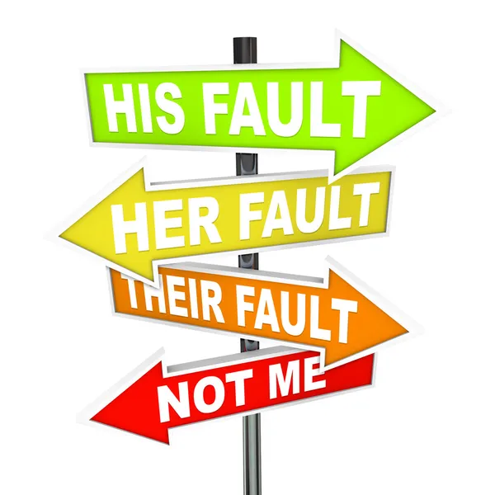
maintenance toolbox sec.78
incorrectly omitted from the valuation roll;
included in a municipality after the last general (implementation) valuation;
subdivided or consolidated after the last general valuation;
of which the market value has substantially increased or decreased for any reason after the last general valuation;
substantially incorrectly valued during the last general valuation;
that must be revalued for any other exceptional reason;
of which the category has changed; or
the value of which was incorrectly recorded in the valuation roll as a result of a clerical or typing error.

Slide 13
the GVR (masterfile) breakdown
Status – deed status (Registered/Surveyed/History) (Why?)
RegDiv – registration division (Welkom / Welkom RD) (Why?)
TownFarm – township/suburb/farm name
Scheme – name of Sectional Title Scheme
erf-, portion-, unit no
Extent (sqm/ha) (dummy) (Why?)
Physical Address

Slide 14
the GVR (masterfile) breakdown (cont.)
Registered owner (entity/unknown) (Why?)
Owner Status – (Private, State-Owned (SO), State-Owned Enterprise (SOE), Mining, Religious, Municipal, Unknown)
Category (Use, Rates Policy, MPRA, PSI, etc)
Value
Remark (School, Hospital, Police Station, etc) (Why?)

Slide 15
a typical GVR example
…and for the electronic copy / “Property Register” (Because there is one for the Municipality and one for the Public)
LISKey alias GisKey alias SGKey, etc. (21-digit/26-digit/ other) (Why?)
Status – deed status (Registered/Surveyed/History) (Why?)
And other such as the Wards, Municipal Account Numbers, Zoning, Etc.

Slide 16
spatial and property information verification
A shapefile of all properties contained in the Property should contain polygon shapes (property boundaries).
LIS / SG Key; (21-digit/26-digit and other)
Boundary Key;
Erf Number;
Portion Number;
Township / Farm (name and number);
Registered owner;
Registered property extent;
Scheme (name and number);
Asset Number;

Slide 17
property type and value information
Current land use;
Current Zoning;
GRAP Category (If applicable for Investment Property Portfolio & Insurance);
Development Status (improved/unimproved)
Municipal market value (Actual market value)
Actual market value
Improvement Value (GRAP)
Land Value (GRAP)

Slide 18
additional data
Registration division;
Unit number;
Longitude/Latitude Coordinates;
Title deed number;
Registered owner;
Clearance area;
Size;
Old classification on LAR;
Street name;
Street number;
Newly allocated classification and or status;

Slide 19
additional data (cont.)
Asset sub-categories;
Asset actual status;
Asset group name;
Description type;
Property classifications, categories;
Actions;
Etc.

Slide 20
resources, pros and cons?
Deeds Office;
Windeed;
Lightstone;
eKaya;
Etc.

Slide 21
common FAQ’s?
The property is not in new general valuation roll, but was in old?
- Farms (demarcation areas)(Why do they change?)
- Towns (Error (omitted), History, Surveyed, other)
- Renumbering? What is this?

Slide 22
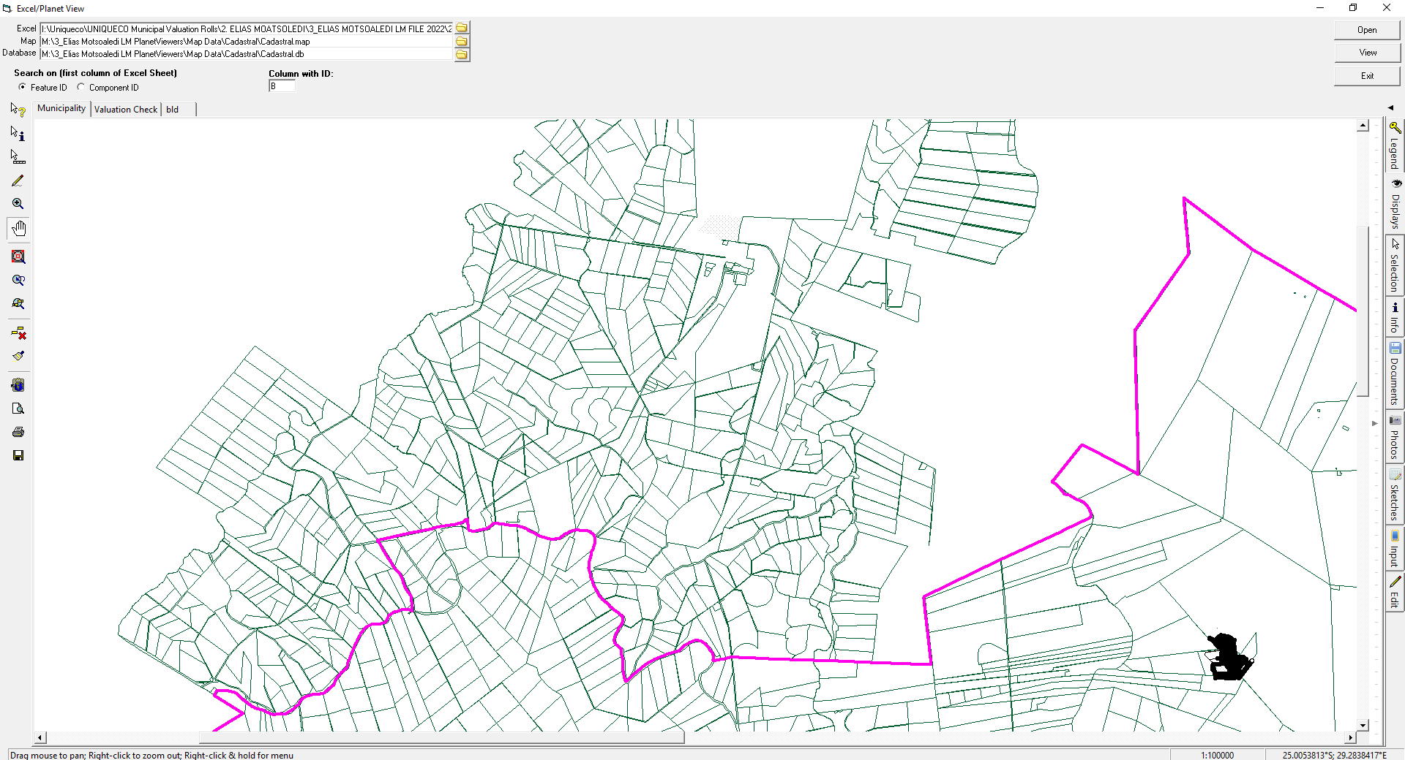

Slide 23
common FAQ’s? (cont.)
The deed indicate the local authority as our municipality, but the property is not in roll? Or the property is in our roll, but state another local authority?
- Demarcations (AGAIN)
- Deeds Office Rename, etc.
- Existing farms names replaced with new names

Slide 24
Same farm
Same farm

Slide 25
common FAQ’s? (cont.)
The property is not in the roll, but there is a deed, and it was registered 10 years ago? Why is in not in the roll?
- Error (omitted), deeds office (mistake/delay), No cadastral data, etc.
- Extents (sqm/ha/dummy/etc.)
- Registered/Unknown or No Owner and then later Registered.

Slide 26
deeds – extents (Sqm/Ha vs Dummy/M)

Slide 27
deeds – extents (Sqm/Ha vs Dummy/M)

Slide 28
common FAQ’s? (cont.)
Another “The property is not in the roll”. Why is in not in the roll? But it is in the roll, just not where you know it is….
- surveyed and subdivided, but not registered yet. (Why?)
- surveyed towns (residential) on state owned land.
- sectional title schemes (communal lands)

Slide 29
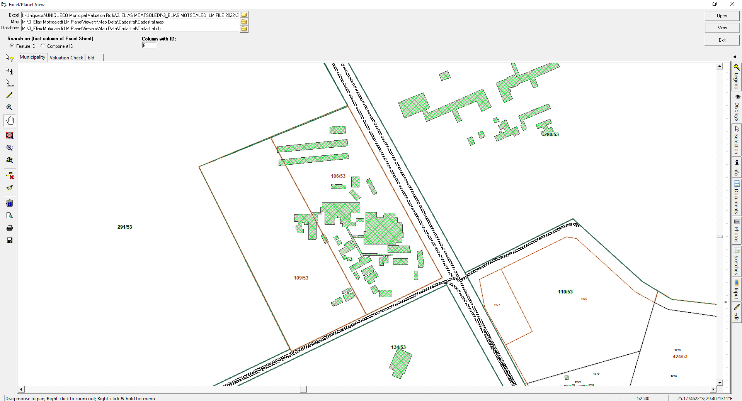

Slide 30
common FAQ’s? (cont.)
The property is not in the roll, but there is a deed, and it was registered 10 years ago? Why is in not in the roll?
- Error (omitted), deeds office (mistake/delay), No cadastral data, etc.

Slide 31
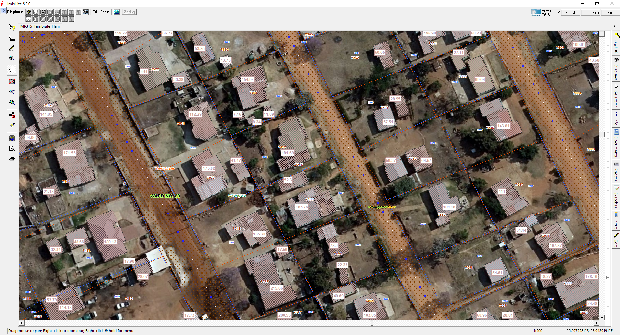

Slide 32
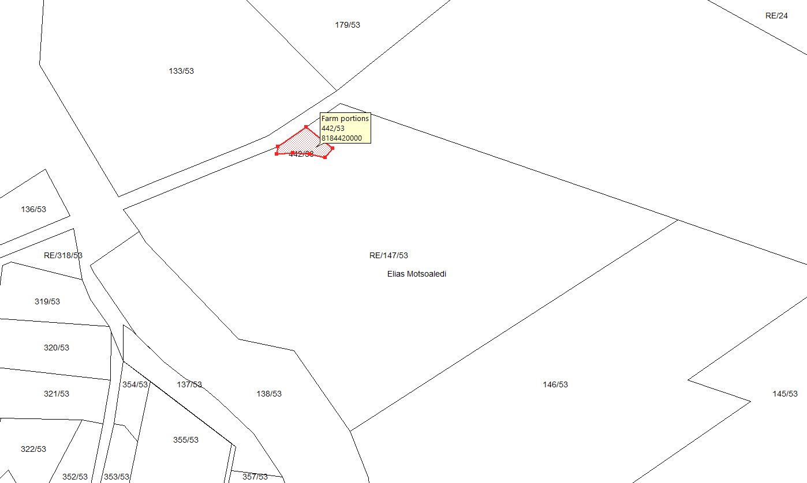

Slide 33
End
Session day2of 4
LOURENS NEL (Pr.Val)(Managing Director)(Partner)(49%)
and partner RUTH MOKONYANE (Finance Director)(Partner)(51%)
Pretoria National Group Head Office – (0861 99 0003)
info@uniqueco.co.za

