Slide 1
Annual performance plans - how to go about developing your SDBIP

Slide 2
Disclaimer: the views are personal and are based on my experience working in municipal finance space

Slide 3
THE LOGIC MODEL APPROACH

Slide 4
SDBIP DEFINITION AS PER MFMA

Slide 5
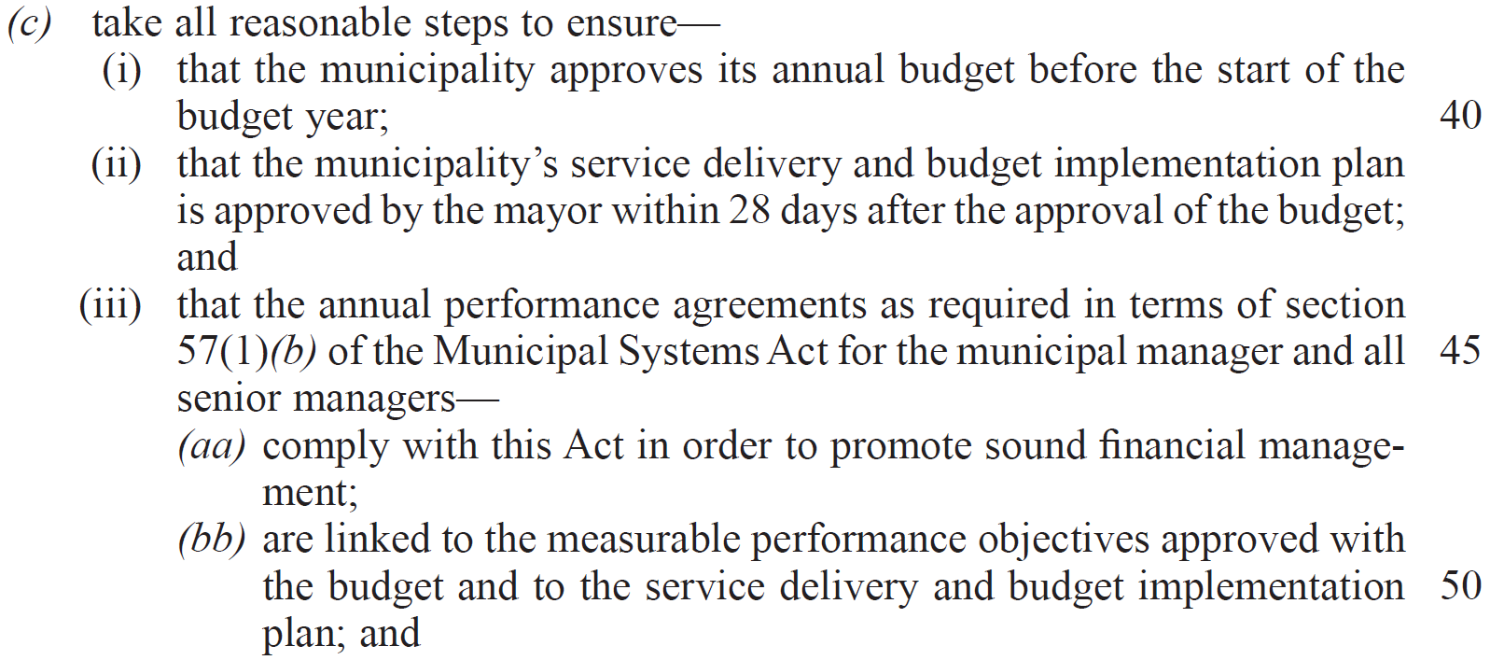
MFMA ROLES & RESPONSIBILITIES OF MAYORS

Slide 6
MFMA ROLES & RESPONSIBILITIES OF MAYORS (S53)

Slide 7
MFMA ROLES & RESPONSIBILITIES OF MAYORS

Slide 8
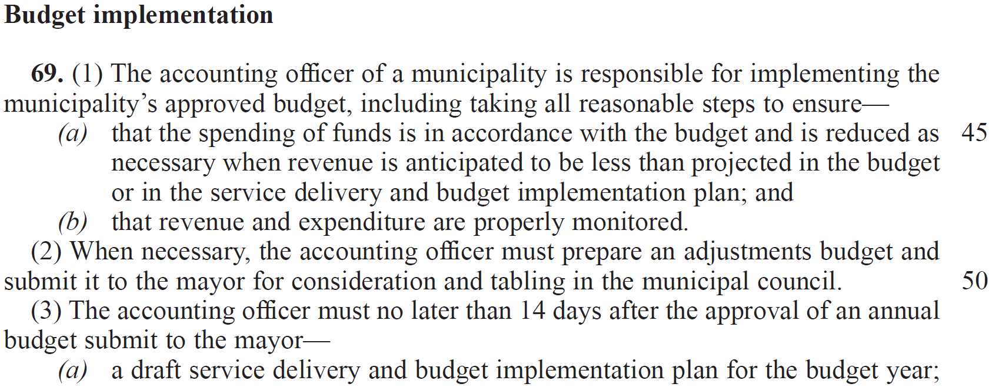
MFMA ROLES & RESPONSIBILITIES OF ACCOUNTING OFFICERS

Slide 9
MFMA ROLES & RESPONSIBILITIES OF ACCOUNTING OFFICERS

Slide 10
MFMA ROLES & RESPONSIBILITIES OF ACCOUNTING OFFICERS

Slide 11
LONG-TERM PLANNING CONSIDERATIONS
Conduct strategic planning
Identification of needs, then prioritise
Assess state of infrastructure and assets
Identify risks and develop management strategies
Forecast multi-year economic and financial trends
Cost estimations for long-term plans
Develop property tax, service charges and borrowing strategies
Long-term strategic plan (15 - 20-year plans then 5-year IDPs)
Detailed 3-year MTREF budgets
Develop SDBIP
Continuous Monitoring & Evaluation

Slide 12
SDBIP A PRODUCT OF LONG-TERM PLANS
1-year SDBIP
3-year MTREF
5-year IDP
15 to 20-year Plan
Inputs from stakeholders (internal & external) & buy-in
Leadership & Governance stability
Financial modelling, forecast & financing

Slide 13
MFMA CIRCULAR NO 13 - 31 January 2005
The table in the following slide shows an extract from a 2021/22 IDP of a municipality where there is a misalignment between planning and budgeting, it will be a costly Design if it requires R110 million over 2 years. A direct implication to the development of a credible SDBIP.

Slide 14
CONTRAST TO THE BASIC REQUIREMENTS

Slide 15
PERFORMANCE INFORMATION
Financial performance
Financial reports (S71 & AFS)
Operating revenue & expenditure
Capital sources & expenditure
Financial ratios
Non-financial performance
Service delivery targets or measures (number of houses built, number of kilometers tarred, increase in number of HHs that has access to water & electricity and other basic services)
Annual reports (includes AFS)

