Slide 1
ETHEKWINI WATER & SANITATION
Presentation to CIGFARO
on
The Setting of Tariffs
Simon Scruton, Pr Eng, MSc. Eng
eThekwini Water and Sanitation

Slide 2
CIGFARO 2021 Tariff Setting
Introduction
EWS Quick Statistics
Determining the cost of the service
Cross-subsidization
Tariff determination
Water Business Perspectives
Concluding Remarks
References

Slide 3
EWS Quick Statistics
3,6 million people in the Municipal area ​
Extent of Municipal area – 2559 km2​
±3732 Full time employees​
Supply ±1020 Ml/day of water ​
Treat ±500 Ml/d of wastewater ​
27 Waste Water Treatment Works and 6 WTW​
30 water and 247 wastewater pump stations​
8 500 km of sewer mains​
349 water storage tanks and 53 elevated tanks​
12 684 km of water mains​
526 000 water connections ​
Value of Infrastructure Assets – R109,6 bn

Slide 4
Water Business Perspectives
A Good Water Utility should:
Be efficient and effective
Provide affordable services
Have a good cash collection rate
Have low non-revenue water
Have a positive cash flow
Be paying creditors on time

Slide 5
Water Business Perspectives
What is needed:
• Sound governance (leadership that does the right thing)
• Professional management (who know what to do and can do it)
• Technical know-how (readily available)
• Suitable skilled workforce (engineering & technical, commercial, customer)
• Transparent, corruption-free, efficient and effective procurement
• Effective regulation (but not over regulation)
• Access to finance.

Slide 6
Water Business Perspectives
The process for setting tariffs is typically done as part of the annual budgeting process (consultation and approval)
The electricity body has NERSA as a regulator but there is no water regulator (yet)
The water business must be self-sustaining
Tariffs must be equitable and cost reflective

Slide 7
Tariff Setting Timetable

Slide 8
Water Business Perspectives
The process for setting tariffs can be fairly complex and the outcome is not 100% predictable as it is influenced by external factors such as social behavior and the economy
It is advised to document the objectives when adjustment is made to the tariff structure as well as the tariff amounts.
The outcome of these changes should be monitored over time

Slide 9
Water Business Perspectives
Examples of changes
Changing the block tariff bands (30kl to 25kl)
Printing the tariff band information on the bill
Printing the neighbourhood comparative consumption on the bill
Introducing and then removing a drought levy
Moving the sanitation charge from the rates to a stand alone charge

Slide 11
Determination of the cost of the service

Slide 12
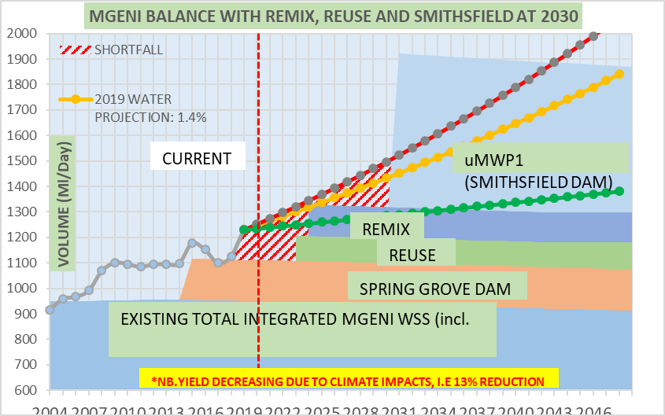
EWS Water Balance

Slide 13
EWS Future Water Supply
EWS require major water infrastructure projects in order to be able to supply water to meet the growing requirements:
The provision of 3 New Water schemes (150Ml/day)
Northern Works (Water Re-use)
KwaMashu Works (Water Re-use)
Central Works (Remix – blend of desalination and Re-use)
The continuation of the Durban Water Recycling Plant (46Ml/day)
The commissioning of the Upper UMkhomazi scheme (400 Ml/day)
This is anticipated in 2030 at a cost of R24bn
50% funding is being sought by TCTA from NT (25% upfront and balance over 20 years)
This charge could increase the water tariffs between 10 and 30%!

Slide 14
Water Business Perspectives
Income is derived from grants and charges
All properties should be metered for accurate charges as well as WC/WDM
Domestic sanitation disposal charges are typically based on the volume of water consumed x by pre-determined factors
Commercial and Industrial sewerage disposal charges are based on the characteristics of the effluent x the volume and are typically not metered

Slide 15
Water Business Perspectives
Many of the cost drivers are fixed (staff, maintenance) and some are linked to the water sold
There are varying models of tariffs from flat rate to volume based charge to stepped tariffs
There is a move towards recovering more operating costs from fixed charges as opposed to volume based charges to be more resilient to changes in demand (drought / boreholes etc)

Slide 16
Water Business Perspectives
There are 4 main components to the water tariff:
Developmental charges
Connection charges
Fixed fees
Consumption charges
There are also sundry charges
There is considerable flexibility in the way each of the these are used to recover costs and each can be justified based on economic principles and tariff goals
Levies or Surcharges may be raised when reqd

Slide 17
Cross-subsidisation
The municipal stance is that the costs of the services are cross-subsidized and policies are pro-poor
This provides for free basic water to indigent households
It also provides for water to be provided at a basic cost to properties <R250 000 (6 to 25kl)
The rising block tariff structure charges a higher tariff to the middle and high income value properties and this is also based on consumption

Slide 18
Cross-subsidisation

Slide 19
Cross-subsidisation

Slide 20
Cross-subsidisation

Slide 21
Water Business Perspectives
There is an elasticity in the demand which will vary according to internal and external factors (economy, pricing, tariff structure, total costs)
The willingness to pay is influenced by affordability and also the effectiveness of the credit control mechanisms
Example of Philippeans draconian policy (approx 110m people)

Slide 22
Water Business Perspectives
The municipality needs to recover all the costs of service delivery. In a consolidated billing environment, rates are allocated first, then water, then electricity.
This allows the credit control procedures to first disconnect electricity, then restrict water
This results in a higher collection rate being declared for rates as opposed to water and sanitation

Slide 23
Water Business Perspectives
Evaluation of impacts before making tariff changes
Likely changes in water use
Likely changes in revenue
Likely changes in monthly bills for a range of consumers

Slide 24
Water Business Perspectives
Things to watch out for:
The dangers of radical tariff changes
Lack of consultation leading to a reduction in proposed increases
Dealing with “special cases”
Cross subsidies and their pitfalls
Increasing complexities

Slide 25
Concluding remarks
Tariff change is a process not an event
Understand the status quo
Understand the short and long run marginal costs
Incremental reform is more likely to succeed
Follow an iterative process
Improve input data
Use spreadsheet models for scenario and sensitivity analysis
Link tariff reforms to other measures

Slide 26
Reference documents
National Water Act 36 of 1998
Water Services Act 108 of 1997
Water Policy White paper (DWAF 1997)
WRC – Management guidelines for water service providers
American Water Works Association (AWWA) – Water rates manual
Ofwat - Charges Scheme Rules issued by the Water Services Regulation Authority
Palmer Development Group publications

Slide 27
Reference documents
MFMA
National Water Resource Strategy II
Raw Water Pricing Strategy
Municipal Systems Act
Strategic framework on water services
National Treasury – Expenditure and performance Review of the Water Services Delivery Chain
National Norms and Standards for Domestic Water and Sanitation Services
Credit Control and Debt Collection Policy

Slide 28
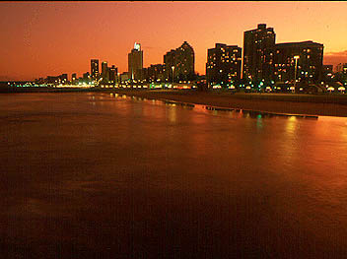
Thank you / Siyabonga

