Slide 1
CIGFARO Standard Presentation

Slide 2
Introduction
Assets - tools for efficient + effective service delivery;
Decisions making - acquisition, safeguarding, maintenance, disposal.
Legislative responsibilities regarding asset management
Audit outcomes – to confirm the result of our stewardship during the year

Slide 3
Common deficiencies in asset mgt/ accounting
Asset registers not being updated regularly;
Asset registers not being reconciled to the accounting records.
Assets that are under the control of the institution not being included in the asset register.
Asset registers not containing sufficient detail to enable the identification of the physical assets recorded in these registers.

Slide 4
Proposed controls
Keep proper records of assets and perform conditional assessments;
Implement controls to safeguard and maintain assets.
Ensure segregation of duties in management of assets

Slide 5
Keep proper records of assets and perform conditional assessments
List of assets;
Locations;
Bar code/ Serial numbers;
Proper descriptions;
Custodians, etc

Slide 6
Conditional assessments
Physical verification/ confirmation
Sheet to ground – existence
Ground to sheet – completeness
Assess condition
Extent of physical damage
Service potential/ productive capacity

Slide 7
How to perform physical verification
Print a list of assets by location and custodian with bar codes/ serial number;
Assemble teams for verification (at least 2);
Document procedures to follow during verification;
Train / refresh teams on verification procedures;
Prepare a verification plan (by route/location);

Slide 8
How to perform physical verification
Pick an asset from your list, match to the asset on the ground. The best match is with reference to serial number, barcode, asset id (unique identifier)
Note assets in a location other than on the register by picking an asset on the flow and confirming against the register

Slide 9
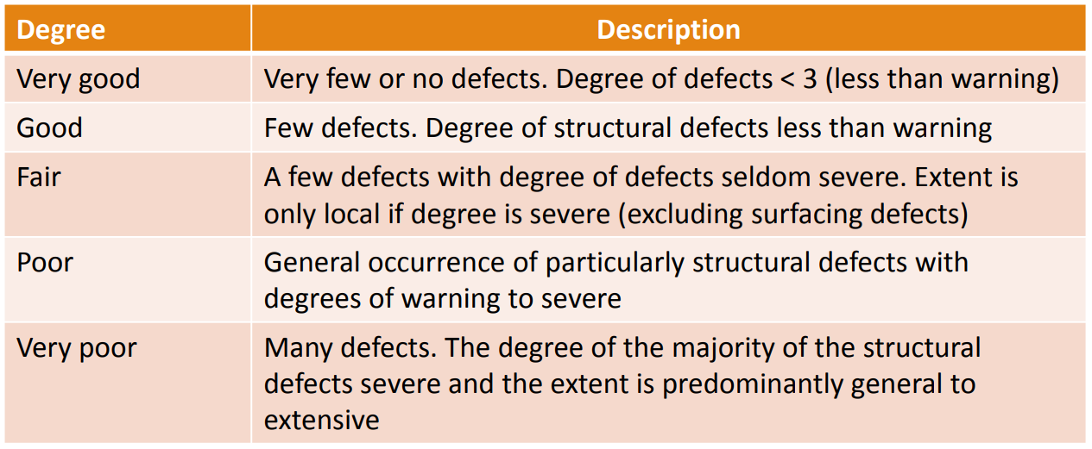
How to perform physical verification
Note the condition and highlight on your verification sheet

Slide 10
How to perform physical verification
Involve technical dept for WIP and infrastructure assets
Involve engineers for specialized assets
Take dated pictures

Slide 11
Why physical verification
Existence – do assets exists at the reporting date (overstatement)
Completeness – have all assets owned and controlled by the organization been recorded (Understatement);
Valuation – are we carrying the assets at the values commensurate with their condition/ productive capacity/ service potential;
Have we captured sufficient detail to enable identification of each and every asset (this also aids classification, presentation and disclosure)

Slide 12
Why physical verification
Service delivery and other objectives are likely to be compromised if an institution is unaware of which enabling assets belong to them.
Without a complete record of all the assets and their location, assets will be left unattended and unmaintained without any accountability being taken for them.
The identification of assets will, however, inform the institution which assets they have available to enable service delivery.
A lack of conditional assessments will result in assets not being adequately maintained.

Slide 13
Questions

Slide 14
Thank You!

