Slide 1
CIGFARO CONFERENCE
23 October 2020
COVID-19 “QUO VADIS”
“Where are we going” ?
Revenue - Additional Revenue Sources
Ms. N. S. Mhlanga

Slide 2
Outlining the journey
Introduction
COVID -19 SWOT Analysis
Fixing The Wheels- Revenue Management Chain
Spare Wheel – Integrated Revenue Management
Traditional Mode – Existing Sources Of Revenue
Manual Transmission (4 Gears )
Gear 5
Gear 6
Gear 7
Gear 8
Conclusion
References

Slide 3
Introduction
Covid-19 outbreak was declared a global pandemic by WHO in March 2020.
President Cyril Ramaphosa declared a National State of Disaster and effected a nation-wide lockdown from 27th March 2020.
The impact of the lockdown and global restrictions has negatively impacted the economy.
National Treasury has projected that the economy may contract by16% Economist have predicted unemployment to grow to 39%.
Grant funding from national allocations is likely going to decrease
Notes:
Loss of revenue
Slow down in the delivery of infrastructure projects
Increase in the number of Indigents and unemployed
Land invasion
Non-compliance with Municipal By-laws and regulations
Effect on Midvaal Long Term Financial Plan
GVA Decline
Affected Households in a negative way
Payment Levels (Ratio) is under stress
Consumption of Services that people can no longer afford
Additional Expenditure to prevent the spread

Slide 4
COVID -19 SWOT Analysis
Strengths
Weaknesses
Opportunities
Threats
Functioning systems in LG
Business continuity plans
Resilient workforce
Delays in development of effective communication channels
Opportunism as result of DMA regulations
Rethink service delivery offering modes
Competitive market prices (goods, services and skills)
The use of technology to enable municipalities to deliver services
A rapid rate of urbanisation and semigration
Demand for improved services and infrastructure
Increased cyber crime
Generic: N.S. Mhlanga

Slide 5
Fixing The Wheels
Revenue Value Chain
Customer Care
Customer Registration
Debt collection
Data management
Meter Reading
Timely billing and distribution of account
Receipting and allocations
Indigent Management
Credit Control
Source: Adopted from National Treasury (2013)

Slide 6
Spare Wheels
Revenue Value Chain
Infrastructure department
Development and Planning
Valuation / SG
Source: Adopted from National Treasury (2013)

Slide 7
Traditional Mode of Revenue
Category | Description and Limitations
 | MPRA Property Rates (Residential, Business, Agricultural, industrial, vacant) Limitations in terms of ratios Service Charges – Electricity Eskom inefficiencies
Service Charges – Water Water losses Conventional meters relevance

Slide 8
Traditional Mode of Revenue
Category | Description and Limitations
 | Service Charges – Sanitation (regulated WSA) Waste Water treatment
 | Service charges – Refuse removal Downstream strategies of waste recycling and reuse.
 | Fines and Penalties Effective court system vs functional municipal courts

Slide 9
Revenue 4 Gear Manual Transmission
G1 Service fees | G2 Fines & Penalties | G3 Charges &Taxes | G4 Assets monetization
Utilities (Water & Electricity) | Traffic violations | Advertising billboards | Public markets
Municipal services (waste collection) | Illegal buildings and land use | Property rates | Parks
Public parking |  | Rental charges (Municipal Properties) | Resorts and Tourism
Developer contributions
Toll roads | Unmaintained properties |  | Naming rights
Telcon towers | Municipal by-laws violations |  | Land value appreciation
Public toilets |  |  | Municipal data (POPI)
Business license |  |  | Beaches
Land registration
Level 1
Level 2

Slide 10
Revenue Gear 5 - Vacant Land Monetization
Public Infrastructure development
5 – 7 Years
2-5 Years
Immediate
Joint development Agreements
Lease vacant Land
Source: AlMujadidi, Azuory, Schmautzer & Woetzel (2019:6)
Notes:
Vacant land brings unnecessary issues for the municipality
Private Public Partnership
Opportunity to determine own development trajectory
Increased revenue baseline

Slide 11
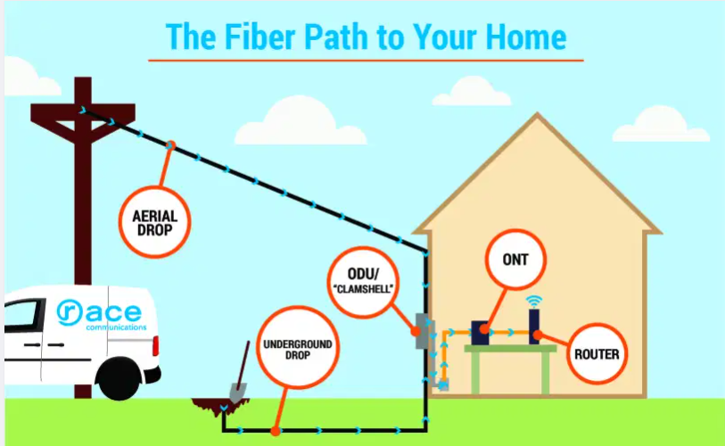
Revenue Gear 6 – The New Gold “Data”
How many wayleaves were granted in the past 12 months ? How many relate to fibre-installation ? How can municipalities use this as a competitive advantage to maximise revenue collection ? How can municipalities use this to connect homes to public Wi-Fi and integrate the same to municipal accounts ? Using Wi-Fi for credit control ?
Notes:
Vacant land brings unnecessary issues for the municipality
Private Public Partnership
Opportunity to determine own development trajectory
Increased revenue baseline

Slide 12
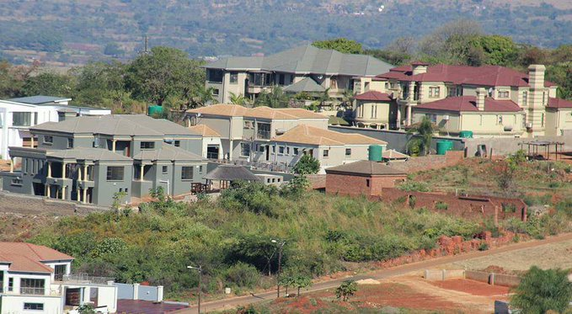
Revenue Gear 7 – Site And Service Vs Social Housing
Identify development nodes Consider mix housing Partner with Private Developers and Department of Human Settlement and Water. Sale of stands , determine building periods. Rethink the concept of private town?
Notes:
Vacant land brings unnecessary issues for the municipality
Private Public Partnership
Opportunity to determine own development trajectory
Increased revenue baseline

Slide 13
REVENUE GEAR 8 – ATTRACTIVE BUSINESS CLIMATE
Provide a business friendly environment Reduce the cost of doing business Invest in water reclamation projects to reduce water costs Ignite economic growth and development by offering development rebates and incentives Facilitate investment opportunities Reduce turnaround times for evaluation of building plans and town planning processes Leverage partnerships to realise economic development Identify areas for short, medium and long term development and investment
Notes:
Vacant land brings unnecessary issues for the municipality
Private Public Partnership
Opportunity to determine own development trajectory
Increased revenue baseline

Slide 14
Conclusion
Unlock and maximize the potential of existing revenue sources
Introduce VIP services, where increased fee guarantees quicker turnaround times and higher quality.
Ensure that the fees charged cover the cost of service (Cost reflective tariffs)
Consider renegotiating Homeowners bulk readings vs individual units within the gated communities.
Establishment of revenue optimization steering committees, reduce these to Performance Indicators to all officials

Slide 15
A successful economic development strategy must focus on improving the skills of the area's workforce, reducing the cost of doing business and making available the resources business needs to compete and thrive in today's global economy.
(Rod Blagojevich)

Slide 16
References
AlMujadidi, A., Azoury, C., Schmautzer, D & Woetzel, J. (2019). Unlocking the full potential of city revenues. Public and Social Sector proactive. McKinsey and Company.
National Treasury.2005. Revenue Guide. National Treasury: Pretoria.
Du Plessis,P. 2017. Revenue Management workshop. Ethekwini Municipality: Durban.

Slide 17
End of Presentation
Thank you

